Slide 1
Analisis dan Perancangan Sistem (System Analysis and Design)
Introduction

Slide 2
System Concept
System ????

Slide 3
Definition
Murick
System is a set of elements / combination of several components that interact with each other to achieve goals
Jeri Ferd Jeral
System is a set of elements that do some action to procedure then interact between procedures in realizing the objectives in the system

Slide 4
Definition
System → a set of interacting or interdependent components forming an integrated whole or a set of elements (often called 'components' ) and relationships which are different from relationships of the set or its elements to other elements or sets

Slide 5
System Characteristics
System Characteristics :
Components
Boundary
Environments
Interface
Input
Process
Output
Objectives/ goals

Slide 6
System Classification
System Classification :
Abstract System and Physical System
Natural system and human made system
Deterministic System and Probabilistic System
Closed System and Open System

Slide 7
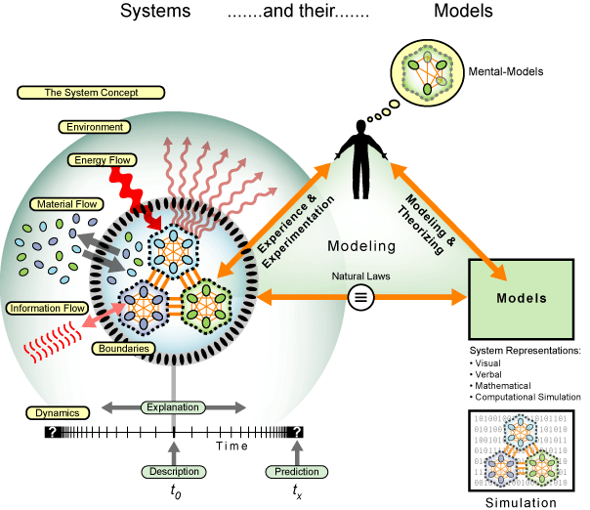
SYSTEM

Slide 8
Data Definition
Data :
“Datum” → Fact/Description
Business View → Organization description about something (resources) and events (transactions) that occur
Gordon B. Davis : Raw material of the information given by a group of organized symbols or action or other things.

Slide 9
Data (2)
Data is:
Raw Facts representing values, quantities, concepts and events pertaining to business activities

Slide 10
Data Types
Static Data: non changing data or rarely change ,ex : name of employee.
Dynamic Data : changing Data in short or for long time, ex : data of employee salary

Slide 11
Data Characteristic
Quantitative : Data are anything that can be expressed as a number. Ex : number of hours of study, Weight of suject
Qualitative : Descriptive Data. Ex : Beautiful

Slide 12
Data from its source
Internal Data : Data comes from inside organization. Ex : Sales Data
External Data : Data comes from outside organization. Ex : Research results from government

Slide 13
Data Content(1)
Event Data : Data needs by organization for organization activities or data comes from organization activities.
Subtantive : Data as result of organization primary activities
Facilitative : Data as result of organization secondary activities

Slide 14
Data Content(2)
Research Data
Internal : Results of research on issues in their own organizations / external research organizations designated. ex: Market Research Data
External : Results of research on issues outside their own organization. Every organization requires data and information on various issues / activities that are sourced from outside the organization. ex: The results of research of non-governmental organizations

Slide 15
Data Content(3)
Environment Data : Regarding all matters relating to the activities of the organization and can affect organizational activities. The data is widely available in printed media such as books, reference books, magazines, newspapers etc.
Source :
Printed Media
Electronic Media

Slide 16
Data Content(4)
Regulatory Data: Data relating to the rules related with the activities of the organization.

Slide 17
Data Processing
Period / time that is used to describe the transformation of data into information that has usefulness

Slide 18
Data Processing Operations
Data Input
Recording Transaction : Recording the transaction data to a data processing media. For example: enter a number into a calculator
Coding Transaction : Transform the data into another form. Ex: change sexes - male to M
Storing Data : store data for decision-making.

Slide 19
Data Processing Operations(2)
Data Transformation
Calculating : aritmatic operations on data
Summarizing : data accumulation process
Classifying : Classifies data based on certain group
Categorizing : Categorizing data base on certain criteria
Sorting : sorting data
Merging : Merging 2 or more data sets base on certain criteria
Matching : Selecting data based on the user wishes to group the data

Slide 20
Data Processing Operations(3)
Information Output
Displaying Result : The necessary information through the user's monitor / printer
Reproducing : Data storage for other users who need it
Telecommunicating : Electronic data storage via a communication channel

Slide 21
Information ???

Slide 22
INFORMATION
Information :
Gordon B. Davis : Information as the result of data processing into useful form for the recipient, a value which can be understood in the present and future decisions.
Barry E. Cushing : Is something that shows the results of data processing are organized and useful to those who receive it.

Slide 23
INFORMATION (2)
Robert E. Anthony & John Dearden : Information as fact, data, item to give knowledge for its user
Stephen A. Moscove & Mark G. Simkin : Information as a fact/ reality or useful form to take decision

Slide 24
Information
Information → the result of processing, manipulating and organizing data in a way that adds to the knowledge of the person receiving it.

Slide 25
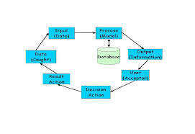
Information Life Cycle

Slide 26
Information Quality
Accurate
Timeliness
Relevance
Trusted
Economical
Information value determine by :
Advantage
Cost

Slide 27
Component of Accurate :
Completeness
Correctness
Security

Slide 28
Information System ??

Slide 29
Information System Components
Information System Components (Building Block) :
Input Block : Method or media to capture data
Model Block : this block consist of Combination of procedures, logic and mathematical methods to manipulate data input and data stored in database with certain rules and to produce certain output
Output Block : Product of information system is qualified information and useful documentation for all levels of management and all users on the system.

Slide 30
Information System Components (2)
Technology Block : Technology used to receive inputs, run the model, store and access data, generate and transmit output and helping in overall self-control
Main Components of Technology :
Brainware
Software
Hardware
Database Block : Data Collection linked each other , stored in computer and using software to manipulate it

Slide 31
Information System Components (3)
Control Block : Some controls need to be designed and implemented to ensure that the things that can damage the system can be prevented or if already occurred error can be directly addressed.

Slide 32
Information System Activity
Information System Activity :
Input
Process
Output
Storage
Control

Slide 33
Question
Find and describe every steps in System Life Cycle
Explain The main difference between Structured Analysis and Object Oriented Analysis?

Slide 34
To Be Continue …

