Slide 1
Chap 2
Alignment IT with Business Design
Dr. Yeffry Handoko Putra
Magister Desain
Universitas Komputer Indonesia

Slide 2
Chap 2
IT Alignment IT with Business Design
Dr. Yeffry Handoko Putra

Slide 3
Role of IT in (Business) Design
IT – Assisted Business
IT – facilitated Business
IT
IT
Stack Holder
Design
Stack Holder
Design
IT – Mediated Business
IT – generated Business
IT
IT
Stack Holder
Design
Stack Holder
Design
Notes:
1 tracing, digitizer
2 3d Modeling, Image Processing, promotion, procurement, photo editing
3 Laser Art
4 avatar

Slide 4
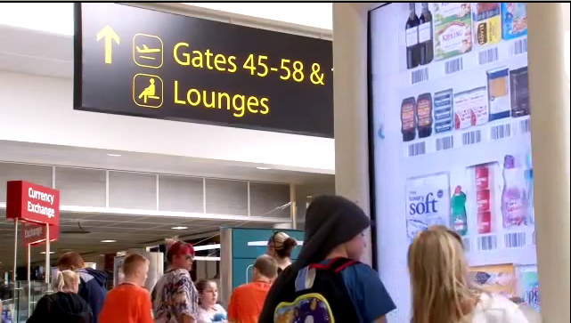
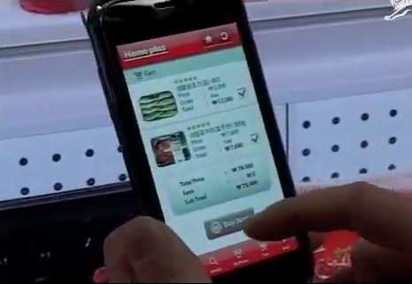
Virtual Shop by TESCO.COM
Gatwick, Airport, UK. November 2011
TESCO Homeplus, Virtual Subway Shop South Korea, 2010

Slide 5
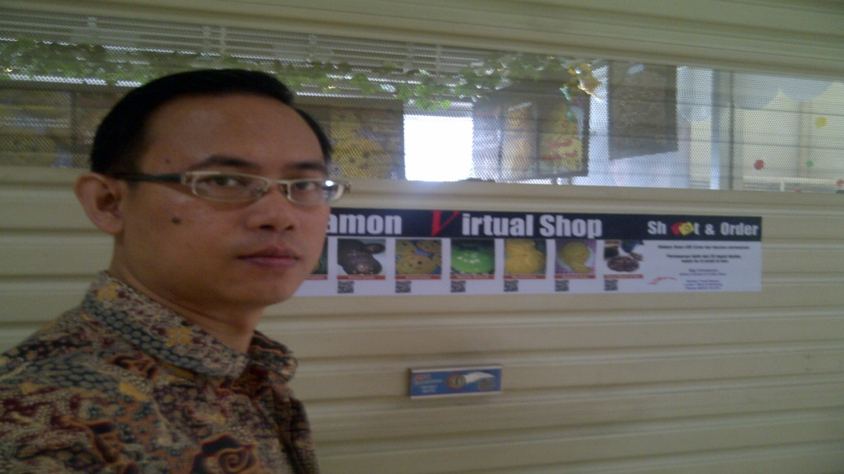
Virtual Shop by Me

Slide 6
Virtual Shop : Social Behavior

Slide 7
Three major drivers of IT-Design Production
The need to align technology Design projects with strategic organizational goals, ensuring they deliver planned value (project governance)
The search for competitive advantage in the dynamically changing information economy through intellectual assets, information, and IT
The proliferation of threats to intellectual assets, information, and IT. E.g. Watermarking
Notes:
Major drivers= motivasi utama
Proliferation = berjamurnya

Slide 8
Business Promotion iconing Beautiful Celebrity

Slide 9
Need famous celeb in appropriate event

Slide 10
Need running text for new update or promo Information
Need interactive web with flash player

Slide 11
What’re strategy to make IT-Design Project alignment with Business Goal ?
Understandability (clear goal, focus, scope)
Realizable (phase/timing bound, effective )
Robustness (standard, policy)
Completeness (still efficient, Portfolio, Project Management)
Consistency
Stability in skill and quality (enduring, amendment)
Repeatable and measureable ,(Strategy as pattern)
Observable
Notes:
Understandability The underlying tenets of a principle can be quickly grasped and
understood by individuals throughout the organization. The
intention of the principle is clear and unambiguous, so that
violations, whether intentional or not, are minimized.
Robustness :Principles should enable good quality decisions about
architectures and plans to be made, and enforceable policies and
standards to be created. Each principle should be sufficiently
definitive and precise to support consistent decision-making in
complex, potentially controversial situations.
Completeness :Every potentially important principle governing the management
of information and technology for the organization is defined. The
principles cover every situation perceived.
Consistency :Strict adherence to one principle may require a loose
interpretation of another principle. The set of principles must
be expressed in a way that allows a balance of interpretations.
Principles should not be contradictory to the point where
adhering to one principle would violate the spirit of another.
Every word in a principle statement should be carefully chosen to
allow consistent yet flexible interpretation.
Stability : Principles should be enduring, yet able to accommodate
changes. An amendment process should be established for
adding, removing, or altering principles after they are ratified
initially.

Slide 12
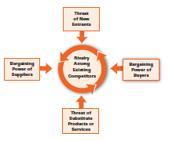
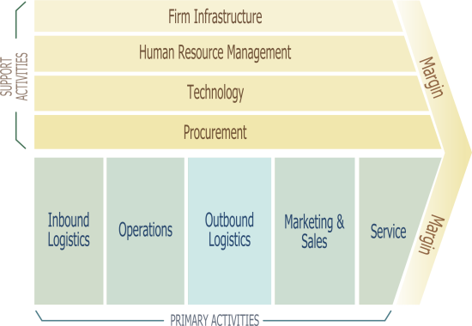
Alignment Strategy for IT Design Project
Design Industry
(5 Competing Forces)
Competitive
Strategy
Business Process
Design / Reengineering
Value Chain
Analysis
New Alignment Method

Slide 13
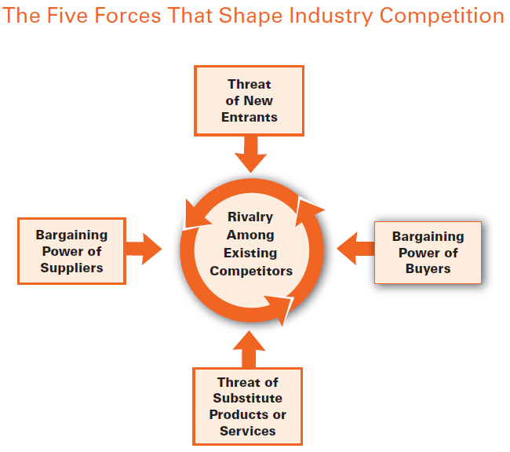
Michael Porter Strategic Theorema
Entry threat/
Entry barriers
Emerging technologies
Notes:
http://www.quickmba.com/strategy/porter.shtml
I am a big fan of Michael E Porter and his 5 forces model and if I look at the standard computer market through the five forces, I would say that it is a zero or one star industry due to following reasons: (a) Power of supplier is moderate/high. It could be easy to buy standard products but technologically advanced products are only sold to people who invest considerable amount of money and time with the suppliers. Where as standard chip manufacturers will always sell it at a higher price. (b) Power of buyer is high. People can buy a different computer if you give a $10 webcam for free. (c) Threat of new entrant is high: Any guy with some computer skills can learn to assemble a computer in 1-2 days. (d) Substitutes: High: Ipads, mobile devices and tablets (e) Rivalry: Very high. Fierce competion in the market, So if HP would have done better with the suppliers it could have got better products and new technologies to roll out. The Blue Ocean strategy would then kick in and say "I would make a product that is highly innovative and would change the market" and that was what apple did. I think, by writing this, I just attempted to see things in a different way but probably ended with the same solution.

Slide 14
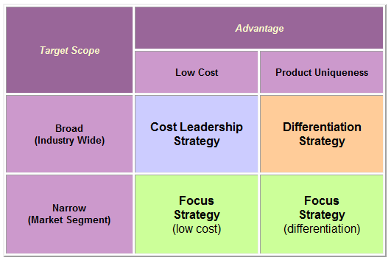
Porter Generic Strategies
Cost Leadership: High volume and low profit margin
Differentiation strategy: High margin/price, low volume
Focus
Source: http://blogs.hbr.org/cs/2011/08/why_hps_departure_from_the_pc.html
read the comments

Slide 15
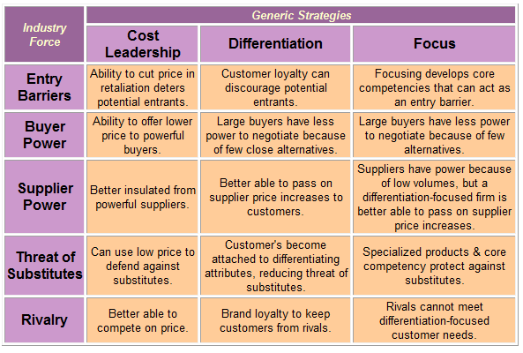
Generic Strategies and Industry Forces

Slide 16
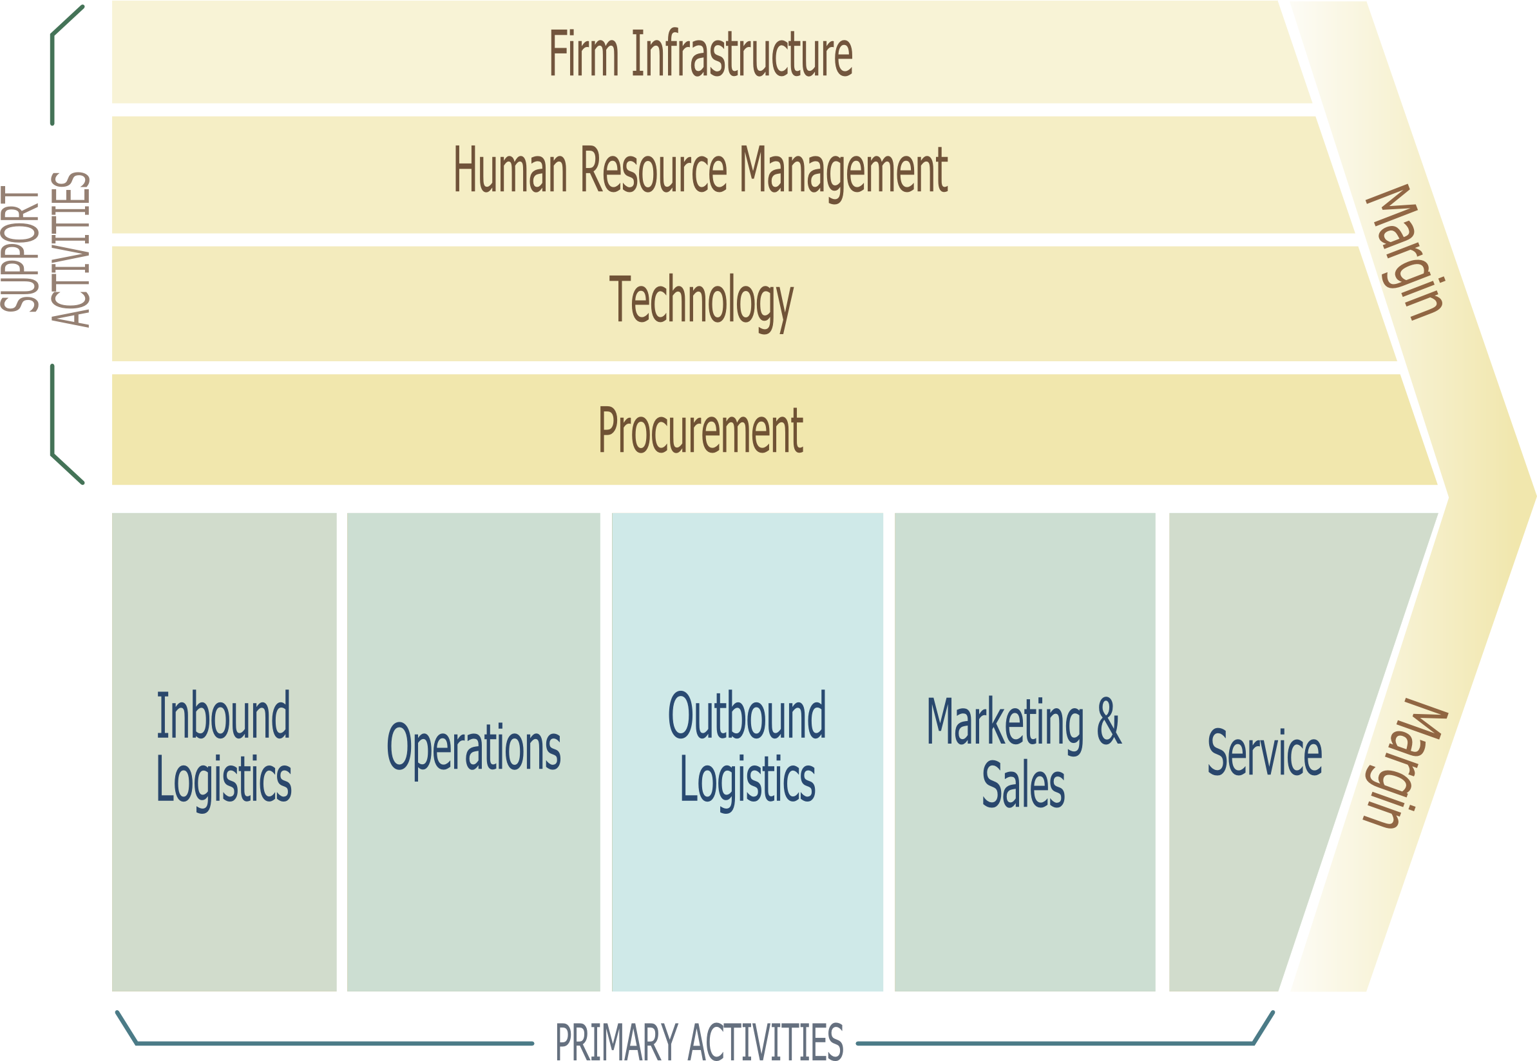
Value Chain
Notes:
http://upload.wikimedia.org/wikipedia/commons/7/70/Porter_Value_Chain.png
http://en.wikipedia.org/wiki/Value_chain

