Slide 1
Secure the System
Girindro Pringgo Digdo

Slide 2
Whoami
Seven years in Information Security
Lecturer
Author

Slide 3
Agenda
Some things to secure the system

Slide 4
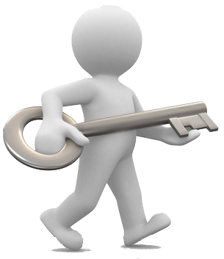
Some things to secure the system
Password
Use strong password
Thisispassword
Th!5Isp45sw0Rd
%4+TEP*F^!Hg3KS!6g!HDGx&bkR==L
Close the Service
service [servicename] stop|start|restart
/etc/init.d/[servicename] stop|start|restart
kill pid

Slide 5
Some things to secure the system
Audit
Log
?
Backup
Data
System
Confidential documents
?

Slide 6
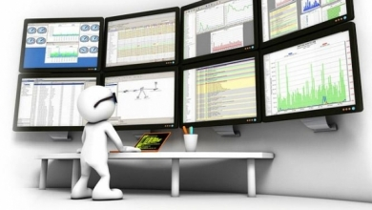
Some things to secure the system
Firewall
Monitoring System
Intrusion Detection System (IDS)
Intrusion Prevention System (IPS)
Monitoring Access
Tripwire
?

