Slide 1
FUNCTION

Slide 2
Definition
Let A and B be sets, a function f from A to B is an assignment of exactly one element of B to each element of A.
We write :
f(a) = b
if b is the unique element of B assigned by the function f to the element a of A.
If f is a function from A to B , we write f : A→ B

Slide 3
Definition
If f is a function from A to B, we say that A is the domain of f, and B is the codomain of f.
If f(a) = b, we say that b is the image of a and a is a pre-image of b.
The range of f is the set of all images of elements of A.
If f is a function from A to B, we say that f maps A to B.

Slide 4
Ilustration

Slide 5
Contoh :
Lets f(x) = x³ – 4 , find each value :
f(2) = 2³ – 4 = 4
f(-1) = (-1)³ – 4 = -5
f(a) = a³ – 4
f(a+h) = (a+h)³ – 4 = a³ + 3a²h + 3ah² + h³ – 4

Slide 6
Operations
( f + g)(x) = f(x) + g(x)
( f – g )(x) = f(x) – g(x)
( f.g )(x) = f(x) . g(x)
( f/g )(x) =

Slide 7
Contoh : if we knew dan . Find the new function
( f + g)(x) = f(x) + g(x)
( f – g )(x) = f(x) – g(x)
( f.g )(x) = f(x) . g(x)
( f/g )(x) =

Slide 8
Jika f(x) = dan g(x) = 4x² – 5 maka(g o f) (2) = …
(g o f) (x) = g (f (x))
= 4 (f(x))² – 5
= 4 - 5
= 4 (2x + 1) – 5 = 8x + 4 – 5 = 8x – 1
Maka (g o f) (2) = 8(2) – 1 = 15
Jika f(x) = x + 1 dan (f o g) (x) = 3x² + 4 maka g(x) = …
(f o g) (x) = f (g (x)) = 3x² + 4
g(x) + 1 = 3x² + 4
g(x) = 3x² + 4 – 1
g(x) = 3x² + 3

Slide 9
Komposisi Fungsi
(f o g) (x) = f (g (x))
(g o f) (x) = g (f (x))
Contoh :
Jika f(x) = x² – 2 dan g(x) = 2x + 1 maka (f o g) (x)= …
(f o g) (x) = f (g (x))
= (g(x))² – 2
= (2x + 1)² – 2
= 4x² + 2x +1 – 2
= 4x² + 2x – 1

Slide 10
Jika f(x) = dan g(x) = 4x² – 5 maka(g o f) (2) = …
(g o f) (x) = g (f (x))
= 4 (f(x))² – 5
= 4 - 5
= 4 (2x + 1) – 5 = 8x + 4 – 5 = 8x – 1
Maka (g o f) (2) = 8(2) – 1 = 15
Jika f(x) = x + 1 dan (f o g) (x) = 3x² + 4 maka g(x) = …
(f o g) (x) = f (g (x)) = 3x² + 4
g(x) + 1 = 3x² + 4
g(x) = 3x² + 4 – 1
g(x) = 3x² + 3

Slide 11
$f\left(x\right)=\frac{x+4}{x}$
$g\left(x\right)=2x−4$
Find :
$f\left(g\left(x\right)\right)=$ ...
$g\left(f\left(x\right)\right)=…..$

Slide 12
Inverse Function
(f o g)⁻¹ (x) = g⁻¹(x) o f⁻¹(x)
(g o f)⁻¹ (x) = f⁻¹(x) o g⁻¹(x)
f (g (x)) = x for all x in the domain g
g (f (x)) = x for all x in the domain f
Every point (a,b) on the graph of f correspondence to a point (b, a) of the graphs of g

Slide 13
$f\left(x\right)=x^{3}−1$
Find $f^{−1}\left(x\right)=$....
Step by step :
Draw f(x) to determine whether f has an invers
f(x) is a function not just a relation.
If so, graph $f^{−1}\left(x\right)$ will reflecting f(x) accros the line y=x

Slide 14
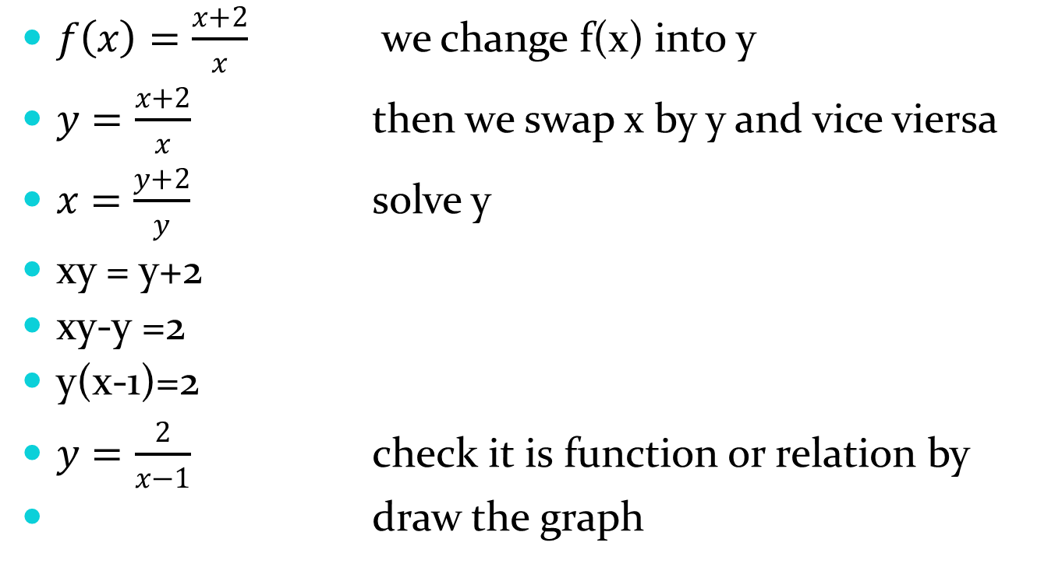
Example
$f\left(x\right)=\frac{x+2}{x}$ we change f(x) into y
$y=\frac{x+2}{x}$ then we swap x by y and vice viersa
$x=\frac{y+2}{y}$ solve y
xy = y+2
xy-y =2
y(x-1)=2
$y=\frac{2}{x−1}$ check it is function or relation by
draw the graph

Slide 15
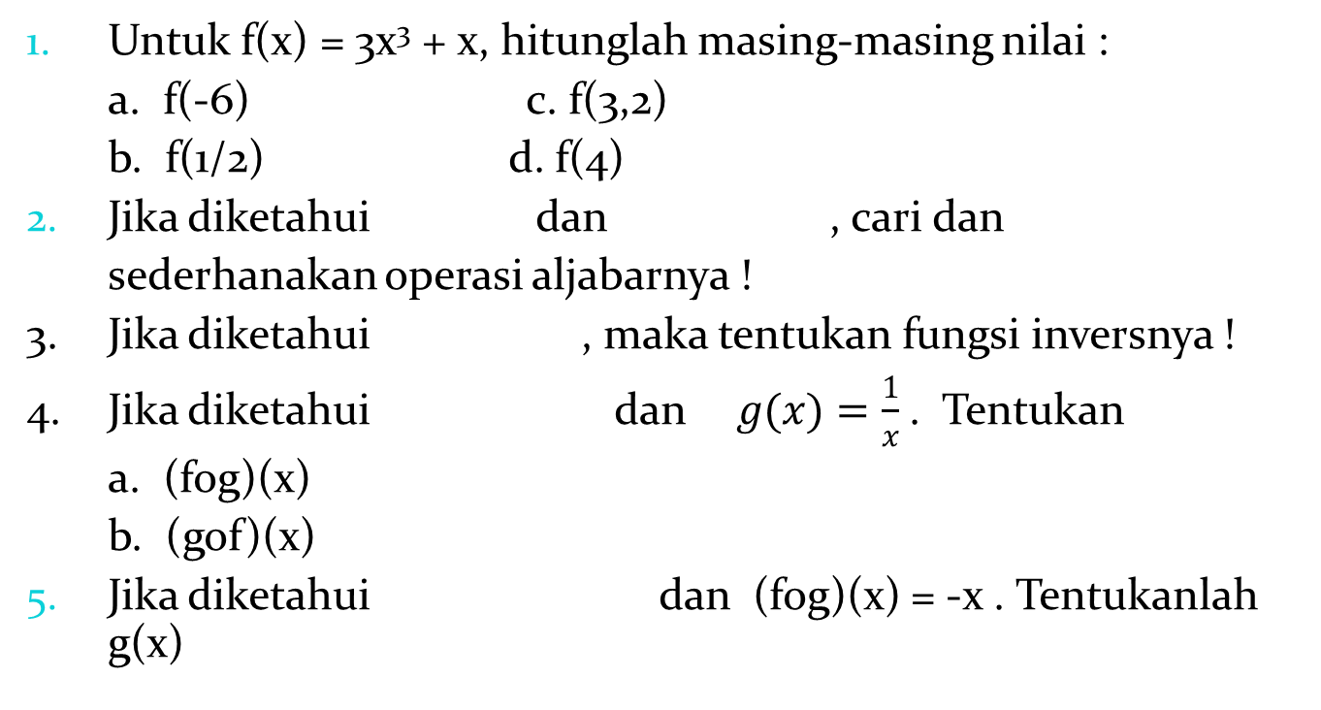
Latihan
Untuk f(x) = 3x³ + x, hitunglah masing-masing nilai :
a. f(-6) c. f(3,2)
b. f(1/2) d. f(4)
Jika diketahui dan , cari dan
sederhanakan operasi aljabarnya !
3. Jika diketahui , maka tentukan fungsi inversnya !
4. Jika diketahui dan$g(x)=\frac{1}{x}$ . Tentukan
a. (fog)(x)
b. (gof)(x)
Jika diketahui dan (fog)(x) = -x . Tentukanlah g(x)

