Slide 1
SW ENGINEERING
Ian Sommerville

Slide 2
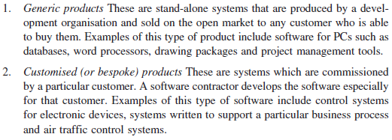
Two types of SW Products

Slide 3
SW Processes

Slide 4
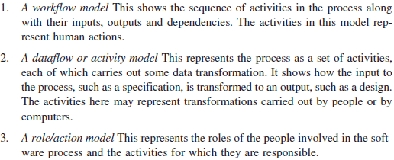
Types of SW Process Model

Slide 5
SW development paradigms

Slide 6
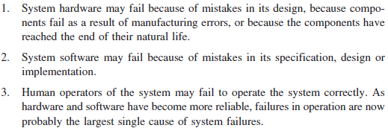
Critical systems failures

Slide 7
Requirements

Slide 8
Functional and Nonfunctional Requirements

Slide 9
Problems that arise in requirement

Slide 10
Minimize misunderstanding

Slide 11
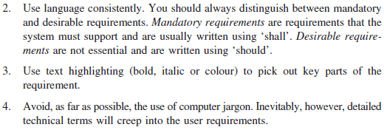
Minimize misunderstanding

Slide 12
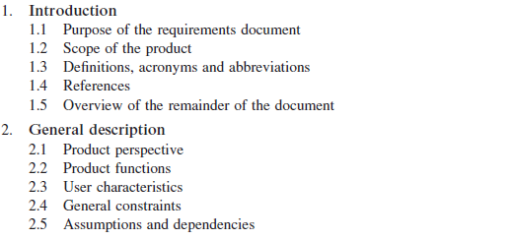
Requirements documents

Slide 14
Perspective of building SW

Slide 15
Tools

Slide 16
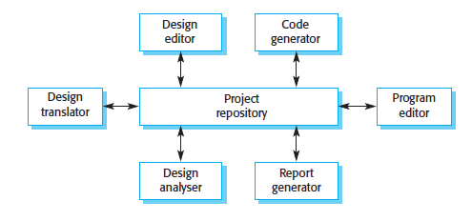
The Repository models

Slide 17
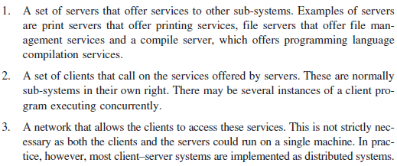
The Client Server Model

Slide 19
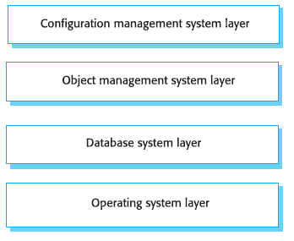
The Layered Model

Slide 20
S/W ENGINEERING
Roger S. Pressmann

Slide 21
Layered Technology

Slide 24
SW Scope

Slide 25
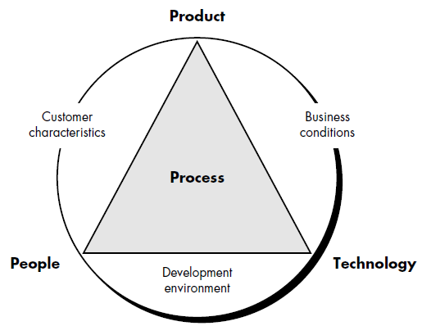

Slide 26
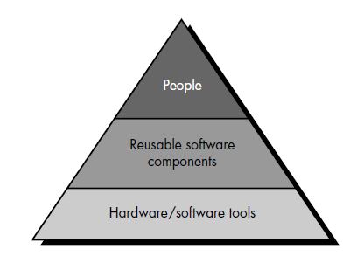
Project Resources

Slide 27
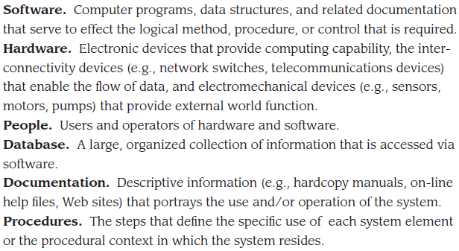
Elements of IS

Slide 28
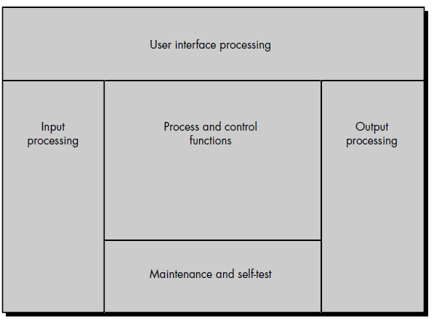

Slide 29
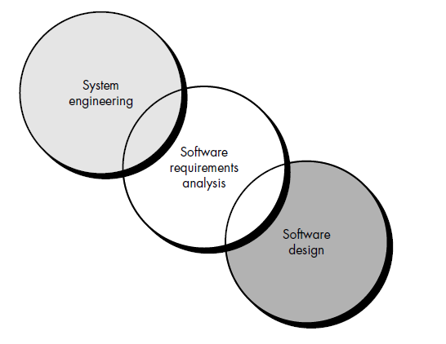

Slide 30
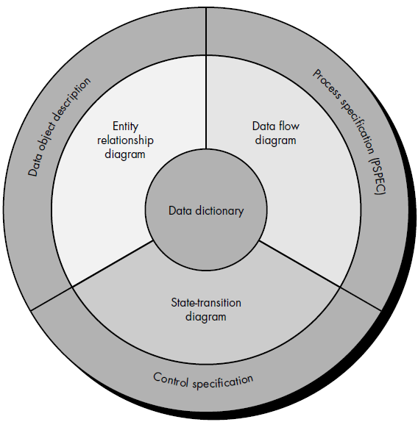

Slide 31
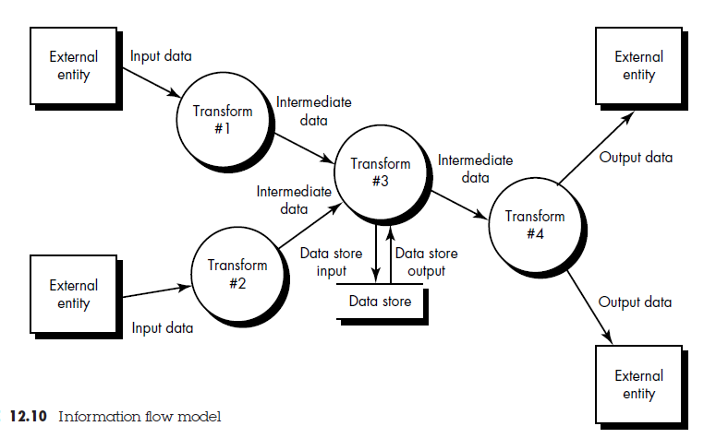

Slide 32
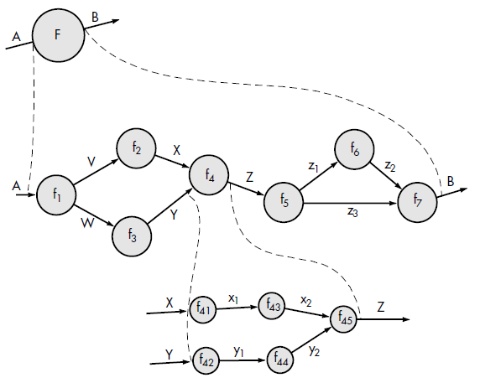

Slide 33
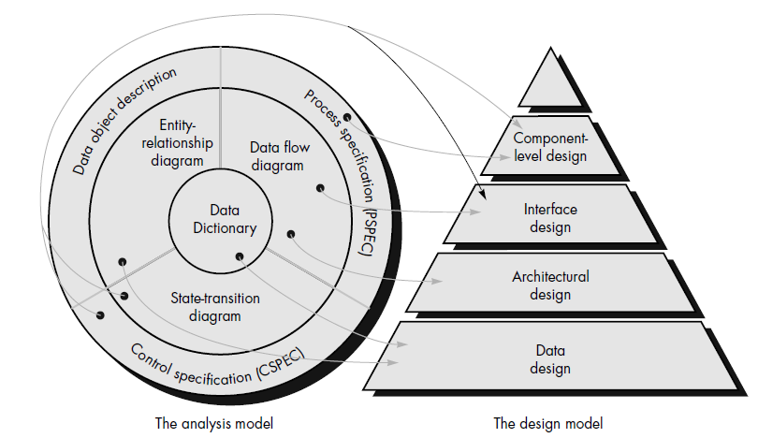

Slide 34
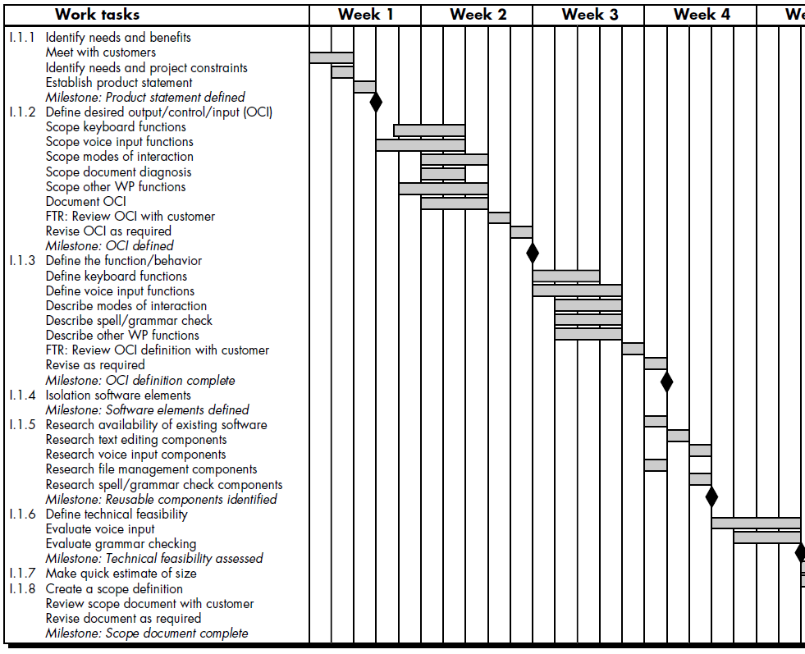

Slide 35
Golden Rule of UID

