Slide 1
White Box Testing

Slide 2
White box (glass box)
White box testing of S/W is predicated on close examination of procedural detail. Logical paths through the S/W are tested by providing test case that exercise specific sets of conditions and/or loops.
The status of the program may be examined at various points to determine if the expected or asserted status corresponds to the actual status.
White box is a test case design methode that uses the control structure of the procedural design to derive test case

Slide 3
Goals
Guarantee that all independent paths within a module have been exercised at least once
Exercise all logical decisions on their true and false sides
Execute all loops at their boundaries and within their operational bounds
Exercise internal data structures to ensure their validity

Slide 4
Basic path testing (Tom McCabe)
The basis path methode enables the test case designer to derive a logical complexity measure of a procedural design and use this measure as a guide for defining a basis set of execution paths. Test cases derived to exercise the basis set are guaranteed to execute every statement in the program at least one time during testing

Slide 5
Flow graph Notation

Slide 6
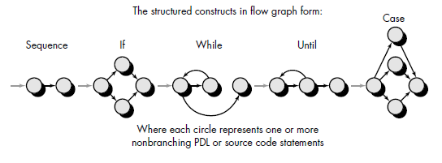

Slide 7
Example
Var
A, B, C : integer
Begin
A := 10; (1)
B :=5; (2)
C:= 6; (3)
If A>B (4)
then C:=A+B (5)
Else if A>C (6)
then C:=A (7)
Else C:=B; (8)
Endif (9)
Endif (10)
Writeln(‘Nilai C = ‘,C); (11)
End. (12)

Slide 8
Draw a flow chart

Slide 9
Change into a flow graph

Slide 10
Cyclomatic Complexity
Cyclomatic complexity is a S/W metric that provides a quantitative measure of the logical complexity of a program.
The vallue defines the number of independent paths in the basis set of a program and provides us with an upper bound for number of tests that must be conducted to ensure that all statements have been executed at least once.

Slide 11
Computation of cyclomatic complexity
The number of regions of the flow graph correspond to the cyclomatic complexity
Cyclomatic complexity, V(G) for flow graph, G is defined as : V(G) = E – N + 2
E is number of flow graph edges
N is number of flow graph nodes
Number of predicate nodes (P), defined as : V(G) = P + 1

Slide 12
Determine a basis set of linearly independent path
An independent path is any path through the program that introduces at least one new set of processing statements or a new condition.

Slide 13
Graph Matrices
To develop a software tool that assists in basis path testing, a data structure.
A graph matrix is a square matrix whose size is equal to the number of nodes on the flow graph. Each row and collumn corresponds to an identified node, and matrix entries correspond to connections between nodes.

Slide 14
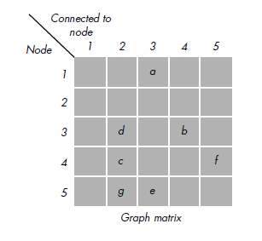
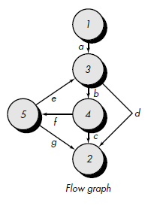
Example

Slide 15
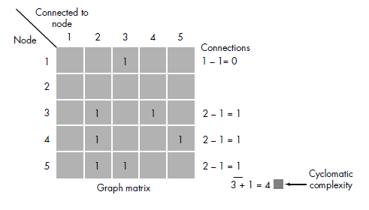

Slide 16
Draw the flow graph, compute the cyclomatic complexity and define the independent paths
Procedure seleksi(Var A:larik; N:integer); Var I, J, Lok, temp : integer; Begin .............................................. (1) For i:= 1 to N-1 do ........................... (2) Begin ............................................ (3) Lok := I; .................................... (4) For J:=I=1 to N do ........................ (5) If (A[lok]>A[J]) then Lok := J; ........ (6) Temp := A[I]; ................................... (7) A[I] := A[Lok]; .................................. (8) A[Lok} := temp; ................................ (9) End; ................................................. (10) End. ..................................................... (11)

Slide 17
CONTROL STRUCTURE TESTING

Slide 18
Condition testing is a test case design method that exercises the logical conditions contained in a program module.
Simple condition is a boolean variable or a relational expression

Slide 19
Types of errors
Boolean operator error (incorrect/missing/extra boolean ooperators)
Boolean variable error
Boolean parenthesis error
Relational operator error
Arithmetic expression error

Slide 20
Data Flow Testing
The data flow testing method selects test paths of a program according to the locations of definitions and uses of variables in the program.

Slide 21
Loop testing
Loops are the cornerstone for the vast majority of all algorithms implemented in software.
Loop testing is white box testing that focuses exclusively on the validity of loop constructs.

Slide 22
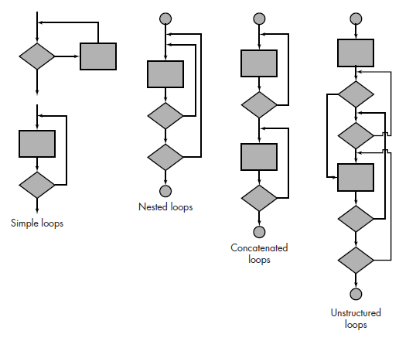
4 Different loop

