Slide 1
BLACK BOX

Slide 2
Black box focuses on the functional requirements of s/w.
Black box testing enables to derive sets of input conditions that will fully exercise all functional requirements for a program.
Black box is not an alternative to white box, but it is a complementary approach to uncover different class errors.

Slide 3
Testing focuses
Incorrect or missing functions
Interface errors
Errors in data structures or external database acces
Behaviour or performance errors
Initiialization and termination errors

Slide 4
Black box testing tends to be applied during later stages of testing. Test are designed to answer the following question :
How is functional validity tested?
How is system behavior and performance tested?
What classes of input will make good test cases?
Is the system particularly sensitive to certain input values?
How are the boundaries of a data class isolated?
What data rates and data volume can the system tolerate?
What effect will spesific combination of data have on system operation?

Slide 5
Graph-based testing methods
S/w testing begins by creating a graph of important object and their relationships and then devising a series of tests that will cover the graph so that each object and relationship is exercised and errors are uncovered.

Slide 6
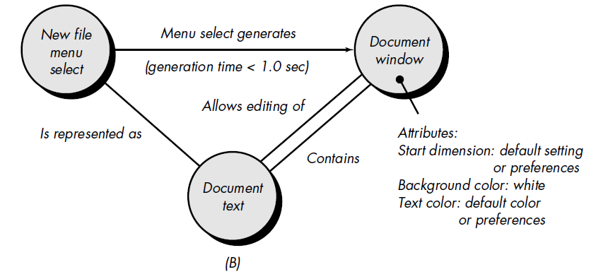
sample

Slide 7
Equivalence partitioning
This method divides input domain into classes data from which test cases can be derived.
EP strives to define test case that uncovers classes of errors, thereby reducinf the total number of test cases that must be developed.

Slide 8
Guidelines
If an input condition specifies a range, one valid and two invalid equivalence classes are defined
If an input condition requires spesific value, one valid and two invallid equivalence classes are defined
If an input condition specifies a member of a set, one valid and one invalid equivalence class are defined
If an input condition is boolean, one valid and one invalid classes are defined.

Slide 9
Sample → phone number 0022 251-4119
Area code – blank or four digit number
Prefix – three digit number begin with 2..
Suffix – four digit number
Input conditions :
Area – input condition, boolean (may not be present)
Input condition, value >0020
Prefix – input condition, range – specified >1999
Input condition, value – 4 digit number
Suffix – input condition, from zero
Input condition – 4 digit number

Slide 10
Boundary Value Analysis
BVA is a test case design technique that complements EP.
BVA leads to selection of test case at the edges of class.
BVA derived test case form output domain as well.

Slide 11
Guidelines
If an input condition specifies a range bounded by values a and b, test cases should be designed with values a and b just above and just below a and b
If and input condition specifies a number of values, test case should be developed that exercise the minimum and maximum numbers. Values just above and below minimum and maximum are also tested.

Slide 12
Apply guidelines 1 and 2 to output conditions. Test case should be designed to create an output report that produces the maximum (and minimum) allowable number of table entries
If internal program data structures have prescribed boundaries, be certain to design a test case to exercise the data structure at its boundary

Slide 13
Comparison testing
There are some situation where reliability of s/w is critical. Redudant H/w and S/w are often used to minimize possibility error.
Each S/w version can be tested with the same test data to ensure that all provide identical output.

