Slide 1
IT Audit and Control
Dr. Yeffry Handoko Putra, M.T
MAGISTER SISTEM INFORMASI

Slide 2
Sylabus
Chap 1 – IT Audit Fundamental
Chap 2 - Audit in Context
Chap 3 – Internal Audit
Chap 4 – External Audit
Chap 5 – Audit Type and IT Audit Component
Chap 6 - IT Audit Driver
Chap 7 – IT Audit with COBIT 5
Chap 8 – CISA Certification Review

Slide 3
Reference
[Gantz] Gants, S.,(2014), The Basic of IT Audit, Elsevier
[ISACA] ISACA (2013), CISA Review Manual 2013

Slide 4
The Evolution of COBIT 5
Governance of Enterprise IT
IT Governance
BMIS
(2010)
Evolution
Management
Val IT 2.0
(2008)
Control
Audit
Risk IT
(2009)
COBIT1
COBIT2
COBIT3
COBIT4.0/4.1
COBIT 5
1996
1998
2000
2005/7
2012
Notes:
Reference section 4

Slide 5
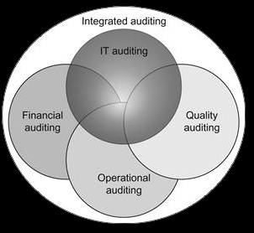
Audit in many area

Slide 6
What is IT Auditing?
Evaluating criteria conformity: ITIL
Assessment :
Quantitative : Balanced Score Card: maturity model (cobit 4.1)
Qualitative : PAM Cobit 5 (e.g. Partially, Not available, Fulfilled )
Inspection : CMMI model
Comparing to standard, framework, requirement

Slide 7
What to audit
entire organizations
individual business units
mission functions and business processes
Services
Systems
Infrastructure
or technology components
Focused on : controlling, finding bias (differentiation to standard), method

Slide 8
Who make IT audit?
Internal Audit
External Audit

Slide 9
Why should do IT Auditing?
Preventive
Correcting
Detective

Slide 10
Some reason to do IT Auditing
complying with securities exchange rules that companies have an internal audit function;
valuating the effectiveness of implemented controls;
confirming adherence to internal policies, processes, and procedures;
checking conformity to IT governance or control frameworks and standards;

Slide 11
Some reason to do IT Auditing (2)
analyzing vulnerabilities and configuration settings to support continuous monitoring;
identifying weaknesses and deficiencies as part of initial or ongoing risk management;
measuring performance against quality benchmarks or service level agreements;
verifying and validating systems engineering or IT project management practices;

Slide 12
Who perform IT Auditing (The Actor)
Internal auditors : employee
External IT Auditor:
consultant
Auditing firm
Certification Organization (ISACA with CISA )
International Organization

Slide 13
External Auditor from ISACA
Certified Information System Auditor (CISA)
Certified in Risk and Information System Control (CRISC)
Certified Information System Manager (CISM)

Slide 14
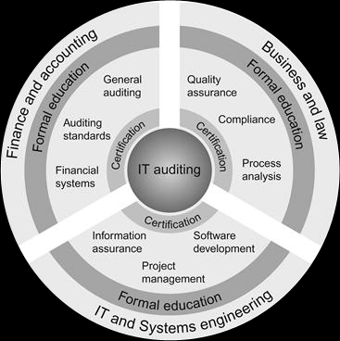
How to become IT Auditor

Slide 15
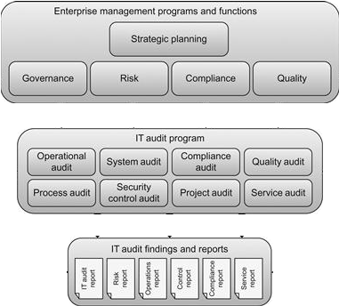
The good thing of IT Auditing (Auditing Context)

Slide 16
Categories of Performance Measures
Performance Measurement: What are indicators of good IT performance?
IT Control Profile: How can we measure the effectiveness of our controls?
Risk Awareness: What are the risks of not achieving our objectives?
Benchmarking: How do we perform relative to others and standards?
Notes:
Measures are effectively statistics. This provides some categories for performance metrics.

Slide 17
IS Auditor & IT Governance
Are IS functions aligned with organization’s mission, vision, values, objectives and strategies?
Does IS achieve performance objectives established by the business?
Does IS comply with legal, fiduciary, environmental, privacy, security, and quality requirements?
Are IS risks managed efficiently and effectively?
Are IS controls effective and efficient?
Notes:
These are functions that an IS Auditor would we concerned with relative to IT governance.
Fiduciary = Financial

Slide 18
Audit: Recognizing Problems
End-user complaints
Excessive costs or budget overruns
Late projects
Poor motivation - high staff turnover
High volume of H/W or S/W defects
Inexperienced staff – lack of training
Unsupported or unauthorized H/W S/W purchases
Numerous aborted or suspended development projects
Reliance on one or two key personnel
Poor computer response time
Extensive exception reports, many not tracked to completion
Notes:
These are things that an auditor would look for.

Slide 19
Audit: Review Documentation
IT Strategies, Plans, Budgets
Security Policy Documentation
Organization charts & Job Descriptions
Steering Committee Reports
System Development and Program Change Procedures
Operations Procedures
HR Manuals
QA Procedures
Contract Standards and Commitments
Bidding, selection, acceptance, maintenance, compliance
Notes:
Auditors would review this documentation. Do they follow best practices? Do they document processes well?

Slide 20
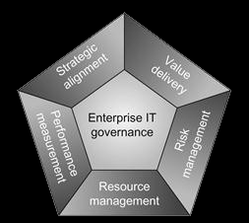
IT Governance
The main idea from COBIT with five key area:

Slide 21
IT Governance
Also supported by
The Information Technology Infrastructure Library (ITIL) and ISO/IEC 20000 for service management;
The Project Management Body of Knowledge (PMBOK) and Projects in Controlled Environments version 2 (PRINCE2) for project management;
Capability Maturity Model Integration (CMMI) and ISO/IEC 15504 for software development processes; and
The ISO/IEC 27000 series and National Institute of Standards and Technology (NIST) risk management framework for information security management.

Slide 22
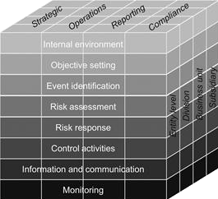
Risk Management
COSO’s enterprise risk management framework

Slide 23
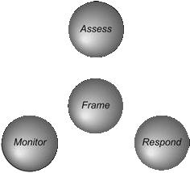
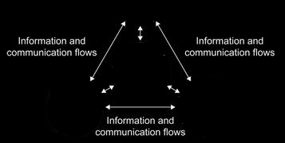
Risk Management
NIST’s risk management framework

Slide 24
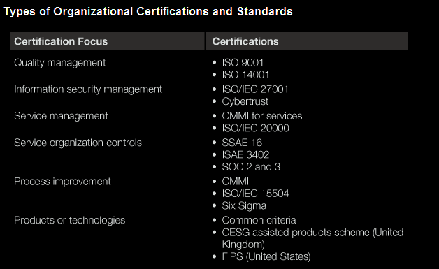
Compliance and certification

Slide 25
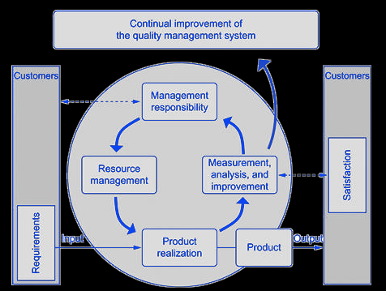
Quality management and quality assurance
ISO 9001

Slide 26
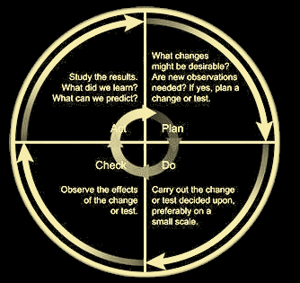
The PDCA cycle popularized by W. Edwards Deming

Slide 27
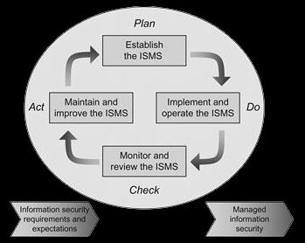
Information Security Management System
The ISMS process defined in ISO/IEC 27001 applies the familiar PDCA model

