Slide 1
Chap IT Audit and Control
Dr. Ir. Yeffry Handoko Putra
MAGISTER SISTEM INFORMASI

Slide 2
Audit Results Indicate the Truth
Management
claim
Plan audit to
Test claim
Gather
evidence
Test
evidence
Report
findings
Management
Auditor

Slide 3
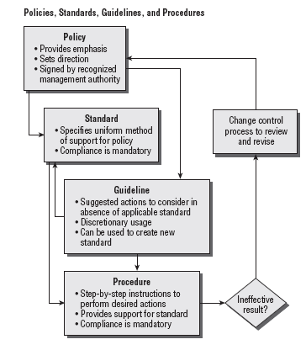
Understanding Professional Ethics

Slide 4
Implementing Audit Standards

Slide 5
Stakeholders: Identifying Who You Need to Interview
Role | Example | Basic Responsibilities
Data owner | Vice president | Determine classification Specify controls Appoint custodian
Data user | Internal business user Business partner Business client (web) | Follow acceptable usage requirement Maintain security Report violation
Data custodian | Database administrator Production programmer System administrator | Protect information Ensure availability Implement and maintain controls Provide provision for independent audit Support data users

Slide 6
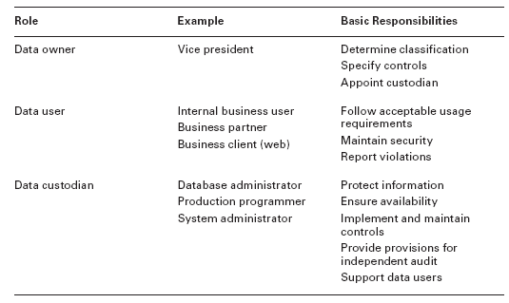
Stakeholders: Identifying Who You Need to Interview

Slide 7
Stakeholders: Identifying Who You Need to Interview
Typical Corporate Organizational Chart
Audit Committee
Board of directors
(investors and advisors)
CEO
(Revenue risk/gain)
CFO
(controls, liability)
Corporate CIO (in corporate HQ)
Divisions
Division CIO
(Division officer of nonofficer)
Division president
(aka GM, revenue resp.)
Division CFO
(VP, int. control resp)
Company or division officer
Vice pres
Management (non officer)
Sales
Mfg
R&D
Marketing
Int.
audit
IT
Finance
Whse
HR
Purchasing
Multiple persons
Directors
Staff worker
Dept.
managers

Slide 8
Stakeholders: Identifying Who You Need to Interview

