Slide 1
Chap 5 – Type of Audit
Dr. Ir. Yeffry Handoko Putra
MAGISTER SISTEM INFORMASI

Slide 2
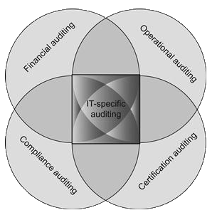
Type of Audit

Slide 3
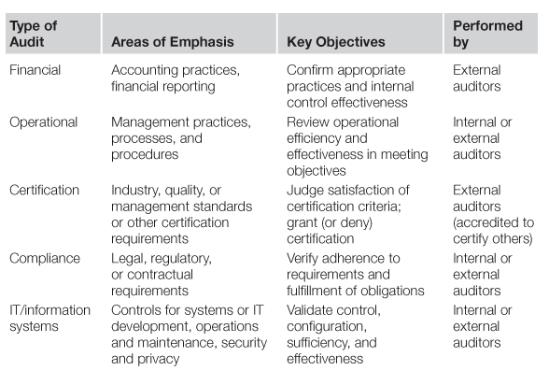
Area of Auditor

Slide 4
Contributed Financial Audit
Cost Accounting
Programmatic audits
comparing proposed or budgeted
program management approaches : Project Management Body of Knowledge (PMBOK),

Slide 5
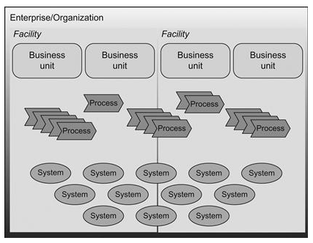
Contributed Operational audits

Slide 6
Contributed Operational audits
adherence to standard processes for software development, implementation, operations and maintenance, and other system development life cycle (SDLC) phases.
Include process or service frameworks : COBIT, ITIL, ISO, IEEE, SEI

Slide 7
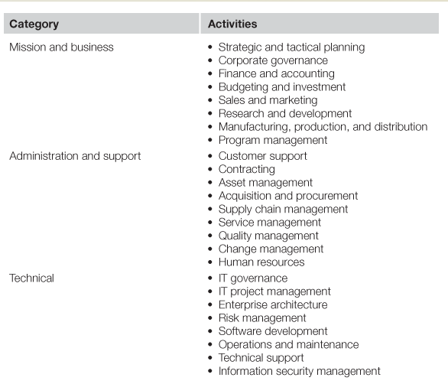
Categorization of Organizational Activities for Operational Audits

Slide 8
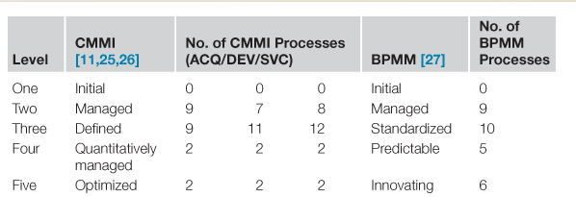
IT-specific audits

Slide 9
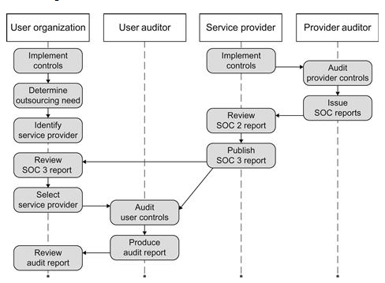
outsourced IT services are subject to specialized IT control audits

Slide 10
Performing IS Audit (Source: CISA Review)
Classification of Audit
Audit Program
Audit Methodology
Fraud Detection
Risk-based Auditing
Audit Risk and Materiality
Risk Assessment and treatment
Risk Assessment Technique
Audit Objectives
Compliance vs substantive testing
Evidence
Notes:
Sumber CISA Review manual

Slide 11
Performing IS Audit (Source: CISA Review)
Interviewing and Observing Personal in perform their duties
Sampling
Using the other services of auditors and Experts
Computer-assisted audit Techniques(CAAT)
Evaluation of strength and weakness
Communication audit result
Management Implementation and recommendation
Audit documentation
Notes:
Sumber CISA Review manual

