Slide 1
Software
Introduction to Computer Science

Slide 2
Computer Software
The HW needs SW to be useful; the SW needs HW to be useful
When the user needs something done by the computer, he/she gives instructions in the form of SW to computer HW
These instructions need to be written in a language that is readily understood by computer uP

Slide 3
Software
Collection of programs and data that tell the computer what to do
Made up of instructions
Allows users to interact with the computer
Two types of software
Application
System
3

Slide 4
Systems Software
System software manages computer resources and makes computers easier to use
Systems software can be divided into three categories:
1. Operating System (OS)
Examples: Windows, UNIX and Macintosh
2. System support software
Examples: disk-formatting and anti-virus programs.
3. System development software.
Example: Language translators.

Slide 5
Applications Software
An applications software enables a computer user to do a particular task
Example applications software include:
Word processors
Game programs
Spreadsheets (or Excel sheets)
Database systems
Graphics programs
Multimedia applications

Slide 6
Tow Major Types of SW
System SW
Programs that generally perform the background tasks in a computer. These programs, many times, talk directly to the HW
Application SW
Programs that generally interact with the user to perform work that is useful to the user. These programs generally talk to the HW through the assistance of system SW
The diagram on the screen shows the relationship between HW and these two types of SW

Slide 7
Hardware
Operating System
Device Driver
Utility
Language
Translator
Scientific
Apps.
Business
Apps.
Productivity
Apps.
Entertainment
Apps.
System software
Application software

Slide 8
System SW are programs that …
Control the overall operation of the computer
OS
Interact directly with HW
Device drivers
Perform system management & maintenance
Utilities
Are used to develop or maintain other programs
Language translators

Slide 9
Operating System
Performs its work invisibly to control the internal functions of a computer, e.g. maintaining files on the disk drive, managing the screen, controlling which tasks the uP performs and in what order
It interacts directly with the computer HW
Other SW normally does not directly interact with the HW, but through the OS
Examples:
Windows Mac OS Linux
Unix Solaris DOS
CP/M VMS

Slide 10
Firmware
OS components that are stored permanently on chip (ROM) and not on the disk drive
When a computer is powered-on, firmware is the first program that it always executes
Firmware consists of startup and a few low-level I/O routines that assist the computer in finding out and executing the rest of the OS
On IBM-compatible PC’s, it is called BIOS

Slide 11
Utilities
Computer programs that perform a particular function related to computer system management and maintenance
Examples:
1. Anti-virus SW
2. Data compression SW
Disk optimization SW
Disk backup SW

Slide 12
Language Translators
Programs that take code written in a HLL and translate it into a low-level language that is easily understood by the uP
1. Compiler translates the program written in a HLL in one go. The translated code is then used by the uP whenever the program needs to be run
2. Interpreter translates the HLL program one statement at time. It reads a single statement, translates it into machine language and passes that machine language code to the uP and then translates the next statement, and so on …

Slide 13
Device Drivers
A computer program that facilitates the communication between the computer and a peripheral device (e.g. printer, mouse, etc.)
It takes the instructions and/or data from the computer and converts them into a form that is readily understood by a peripheral device, and vice versa

Slide 14
Application SW
Application SW are programs that interact directly with the user for the performance of a certain type of work
Scientific/engineering/graphics SW
Mathematica; AutoCad; Corel Draw
Business SW
The billing system for the mobile phone company
Productivity SW
Word processors; Spreadsheets
Entertainment SW
Games
Educational SW
Electronic encyclopedias; The VU Web site

Slide 15
Applications Software
Apply to real-world tasks
Solves user problems
vs. OS
controls the hardware

Slide 16
PC Software Characteristics
User-friendly
Easy
Intuitive
Minimum training and documentation needed to use

Slide 17
Software Types Custom Software
Written by programmers
Takes a lot of time to write and test
When specifications are unique

Slide 18
Software Types Packaged or Commercial
Sold in stores, catalogs, or downloadable from the WWW
Purchased from software publishers
Must be installed
Standard or custom installation
The setup process copies some of all of the software to the hard disk
May require the CD-ROM to be in the drive to run

Slide 19
Acquiring Software
Freeware
Free to all
Copyrighted
Distributed in machine-readable format
Shareware
Freely distributed for a trial period
Pay a nominal fee to register with the author

Slide 20
Acquiring Software
Public-domain software
Un-copyrighted
May be used or altered without restriction
Generally developed under government grants
Open-source
Free to all
Source code is distributed
May be used or altered
Popular under the LINUX OS

Slide 21
Acquiring Software
Commercial software (Proprietary Software)
Used most often
Copyrighted
Generally costly
May not be copied without permission of the manufacturer

Slide 22
Types of Proprietary Licenses
Single-user license
Multi-user license
Concurrent-user license
Site license

Slide 23
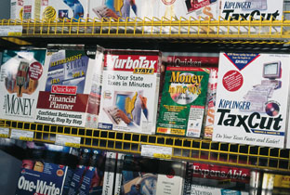
Purchasing Commercial Software Individuals
Software warehouse store
Mail order
Electronic software distribution

Slide 24
Purchasing Commercial Software Businesses
Volume discount
Site license
Network versions
Application Service Provide (ASP)
Software is setup and maintained by ASP
Access the software over the Internet
Pay per use
Saves the expense of installing and maintaining the software

Slide 25
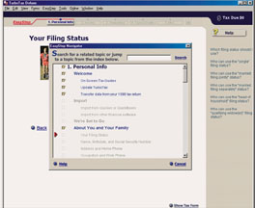
Task-Oriented Software Productivity Software
Makes work faster
Makes our lives easier

Slide 26
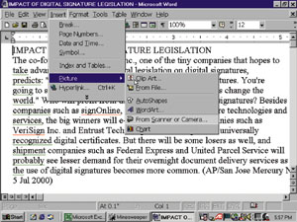
Word Processing
Uses
Memos
Reports
Correspondence
Minutes of meetings
Anything to be typed
Functions
Create
Edit
Format
Store
Print text and graphics

Slide 27
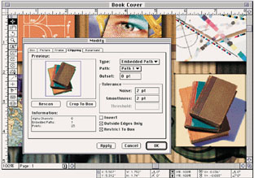
Desktop Publishing
Uses
Newsletters
Reports
Brochures
Functions
Handles high-level publishing needs

Slide 28
Electronic Spreadsheets
Uses
Comparing mortgage interest rates
Preparing budgets
Tracking weight loss
Functions
Manipulates numbers in rows and columns
Recalculates the results when a number is changed
What if?

Slide 29
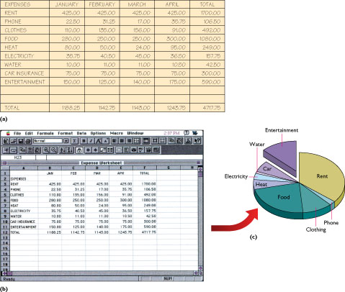
Electronic Spreadsheets

Slide 30
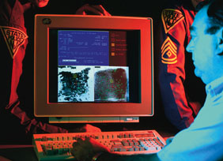
Database Management
Uses
Keep track of a large number of related facts
Query the data for specific information
Retrieve information in a variety of ways
Functions
Store data
Update data
Manipulate data
Retrieve data
Print data in many forms
Report on data in a variety of ways

Slide 31
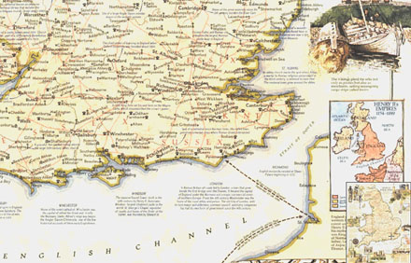
Graphics
Uses
Maps
Graphs
Charts
Helps to
Compare data
Spot trends
Make decisions
Visual information is more compelling

Slide 32
Presentation Graphics
Uses
Sales tool
Demonstrate a product
Show cost/benefit projections on charts
Present audio/video testimonials from satisfied customers
May contain
Text
Graphics
Audio
Video

Slide 33
Computer Art
Use software to
Produce art
Express ideas
Graphic artist
Artistic ability
Computer skills
Produces computer art

Slide 34
Communications
Communicate from home with computer at office
Access data stored in another computer in another location
Stock exchange updates
Weather information

Slide 35
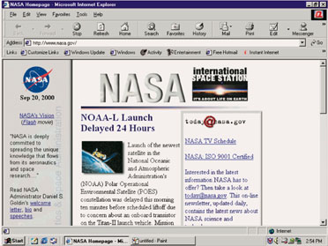
Communications
Provides method for communicating between computers
Most likely way to connect is via the Internet
Use a browser to access the Internet

Slide 36
Office Suites
Group of basic software applications designed to work together
Data is portable between basic applications of the suite
Various applications in the suite have the same “look and feel”
Cost of suite is less than purchasing individual applications

Slide 37
Integrated Applications
Combine basic word processing, spreadsheet, and graphics capabilities
More limited than a suite
Easier to learn and use

Slide 38
Software Development Focus
Ease of use
Personal use programs
Personal time organizers
To-do list makers
E-mail programs
Internet access

Slide 39
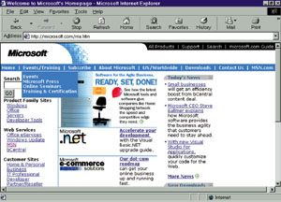
Business Software
Custom-written to meet special business needs
Standard packages
Combination of custom-written and off-the-shelf

Slide 40
Vertical Market Software
Written for a particular type of business
Dentist’s office
Drugstore
Auto shop
Software may be part of complete package
Hardware
Installation
Training
Support

Slide 41
Software for Workgroups
Groupware / collaborative software
Lets a group of people share information or track information together
Data being used is located in central database
Data can be accessed and updated by anyone in the project group

Slide 42
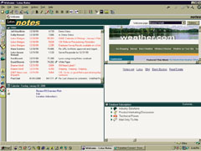
Software for Workgroups
Examples
Scheduling
Preparation of proposals by several individuals

Slide 43
The Information Center Help Desk
Software selection
Software training
Software and hardware installations
Software and hardware updates
Troubleshooting

Slide 44
Software for Small Business
Accounting
Spreadsheet software
Accounting package – Basic accounting, financial statements, tax summaries, payroll
Writing and Advertising
Word processing
Desktop publishing
Customer Service
Database management

Slide 45
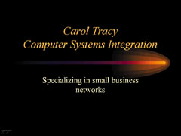
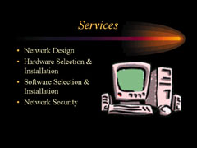
Software for Small Business
Keeping Up and Making Contacts
Networking over the Internet
Making Sales Pitches
Graphical presentation software

Slide 46
Small Office, Home Office SOHO
Moderately priced to solve typical needs
All-in-one software package

Slide 47
Small Office, Home Office SOHO
What is needed
Organizational skills of a secretary
Research skills of a librarian
Accounting skills of a bookkeeper
Experience of someone who has done it before
What is has
Searchable library of resources
Legal guide
Tax guide
Collections of business documents
Links to useful business and government sites on the Internet

Slide 48
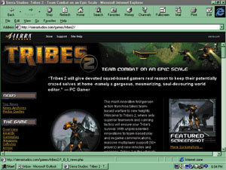
Application Software Ethics
What is legal?

Slide 49
Software Piracy
Making illegal copies of copyrighted software
Why the fuss?
Very easy to duplicate software vs. a text book
Software company may lose hundreds of dollars per pirated copy
Prosecution
Yes: Small-medium sized business who purchase a few copies and distribute to many users
No: Individual users who probably would not have purchased software on their own anyway

Slide 50
Counterfeiting
Software is copied onto CD-ROMS / DVD-ROMS
Package duplicates the original
Sold in flea markets or small stores
Cheaper price
Occurs more overseas

Slide 51
Copying Software
Legitimate reasons
Backup copy
Copy to hard disk
Illegitimate reasons
Obtain software without paying for it

Slide 52
Computers and People
Users
Any individual who operates a computer to accomplish a task
Home
Business

Slide 53
Computer Professionals
Management Information Systems (MIS)
Computer Information Systems (CIS)
Computing Services
Information Services
Information Technology (IT)

Slide 54
Computer Professionals
Data entry operators – key data into a machine-readable format
Computer operators – monitor the computer
Librarians – catalog and keep secure the disks
Computer programmers – write, test, implement, and maintain programs
Systems analysts – plan and design computer systems
Network manager – oversees the network
Chief information officer (CIO) – department manager; makes strategic decisions relating to the flow of information in the organization

