Slide 1
Chap 6 Signal Encoding Technique
Wireless and Mobile Communication
Dr. Yeffry Handoko Putra, M.T
Department of Computer Engineering

Slide 2
Wireless Communication System
Channel code word
Message Signal
Source
Encoder
Channel
Encoder
Mod-
ulator
Modulated
Transmitted Signal
Source
Wireless Channel
User
Source
Decoder
Channel
Decoder
Demod-
ulator
Received
Signal
Estimate of
Message signal
Estimate of
channel code word

Slide 3
Signal Encoding Techniques

Slide 4
Reasons for Choosing Encoding Techniques
Digital data, digital signal
Equipment less complex and expensive than digital-to-analog modulation equipment
Analog data, digital signal
Permits use of modern digital transmission and switching equipment

Slide 5
Reasons for Choosing Encoding Techniques
Digital data, analog signal
Some transmission media will only propagate analog signals
E.g., unguided media
Analog data, analog signal
Analog data in electrical form can be transmitted easily and cheaply
Done with voice transmission over voice-grade lines

Slide 6
Signal Encoding Criteria
What determines how successful a receiver will be in interpreting an incoming signal?
Signal-to-noise ratio
Data rate
Bandwidth
An increase in data rate increases bit error rate
An increase in SNR decreases bit error rate
An increase in bandwidth allows an increase in data rate

Slide 7
Comparing Encoding Schemes
Signal spectrum
With lack of high-frequency components, less bandwidth required
With no dc component, ac coupling via transformer possible
Transfer function of a channel is worse near band edges
Clocking
Ease of determining beginning and end of each bit position

Slide 8
Comparing Encoding Schemes
Signal interference and noise immunity
Performance in the presence of noise
Cost and complexity
The higher the signal rate to achieve a given data rate, the greater the cost

Slide 9
Digital Data to Analog Signals
Amplitude-shift keying (ASK)
Amplitude difference of carrier frequency
Frequency-shift keying (FSK)
Frequency difference near carrier frequency
Phase-shift keying (PSK)
Phase of carrier signal shifted

Slide 10
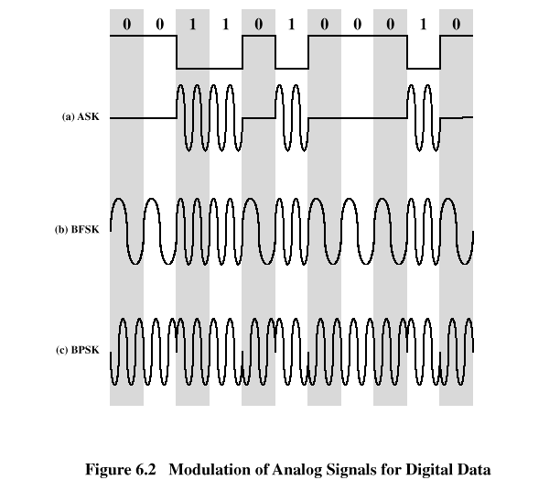

Slide 11
Amplitude-Shift Keying
One binary digit represented by presence of carrier, at constant amplitude
Other binary digit represented by absence of carrier
where the carrier signal is Acos(2πf_{c}t)

Slide 12
Amplitude-Shift Keying
Susceptible to sudden gain changes
Inefficient modulation technique
On voice-grade lines, used up to 1200 bps
Used to transmit digital data over optical fiber

Slide 13
Binary Frequency-Shift Keying (BFSK)
Two binary digits represented by two different frequencies near the carrier frequency
where f₁ and f₂ are offset from carrier frequency f_{c} by equal but opposite amounts

Slide 14
Binary Frequency-Shift Keying (BFSK)
Less susceptible to error than ASK
On voice-grade lines, used up to 1200bps
Used for high-frequency (3 to 30 MHz) radio transmission
Can be used at higher frequencies on LANs that use coaxial cable

Slide 15
Multiple Frequency-Shift Keying (MFSK)
More than two frequencies are used
More bandwidth efficient but more susceptible to error
f _{i} = f _{c} + (2i – 1 – M)f _{d}
f _{c} = the carrier frequency
f _{d} = the difference frequency
M = number of different signal elements = 2 ^{L}
L = number of bits per signal element

Slide 16
Multiple Frequency-Shift Keying (MFSK)
To match data rate of input bit stream, each output signal element is held for:
T_{s}=LT seconds
where T is the bit period (data rate = 1/T)
So, one signal element encodes L bits

Slide 17
Multiple Frequency-Shift Keying (MFSK)
Total bandwidth required
2Mf_{d}
Minimum frequency separation required 2f_{d}=1/T_{s}
Therefore, modulator requires a bandwidth of
W_{d}=2^{L}/LT=M/T_{s}

Slide 18
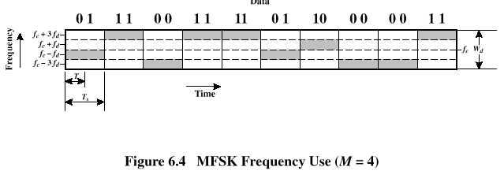
Multiple Frequency-Shift Keying (MFSK)

Slide 19
Phase-Shift Keying (PSK)
Two-level PSK (BPSK)
Uses two phases to represent binary digits

Slide 20
Phase-Shift Keying (PSK)
Differential PSK (DPSK)
Phase shift with reference to previous bit
Binary 0 – signal burst of same phase as previous signal burst
Binary 1 – signal burst of opposite phase to previous signal burst

Slide 21
Phase-Shift Keying (PSK)
Four-level PSK (QPSK)
Each element represents more than one bit

Slide 22
Phase-Shift Keying (PSK)
Multilevel PSK
Using multiple phase angles with each angle having more than one amplitude, multiple signals elements can be achieved
D = modulation rate, baud
R = data rate, bps
M = number of different signal elements = 2^{L}
L = number of bits per signal element

Slide 23
Performance
Bandwidth of modulated signal (B_{T})
ASK, PSK B_{T}=(1+r)R
FSK B_{T}=2DF+(1+r)R
R = bit rate
0 < r < 1; related to how signal is filtered
DF = f₂-f_{c}=f_{c}-f₁

Slide 24
Performance
Bandwidth of modulated signal (B_{T})
MPSK
MFSK
L = number of bits encoded per signal element
M = number of different signal elements

Slide 25
Quadrature Amplitude Modulation
QAM is a combination of ASK and PSK
Two different signals sent simultaneously on the same carrier frequency

Slide 26
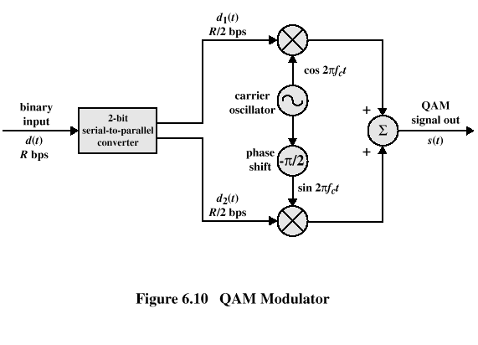
Quadrature Amplitude Modulation

Slide 27
Analog Data to Analog Signal
Modulation of digital signals
When only analog transmission facilities are available, digital to analog conversion required
Modulation of analog signals
A higher frequency may be needed for effective transmission
Modulation permits frequency division multiplexing

Slide 28
Modulation Techniques
Amplitude modulation (AM)
Angle modulation
Frequency modulation (FM)
Phase modulation (PM)

Slide 29
Amplitude Modulation
Amplitude Modulation
cos2πf_{c}t = carrier
x(t) = input signal
n_{a} = modulation index (< 1)
Ratio of amplitude of input signal to carrier
a.k.a double sideband transmitted carrier (DSBTC)

Slide 30
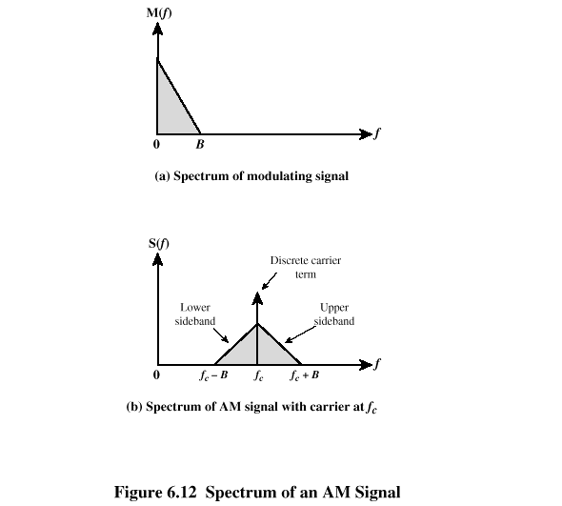

Slide 31
Amplitude Modulation
Transmitted power
P_{t} = total transmitted power in s(t)
P_{c} = transmitted power in carrier

Slide 32
Single Sideband (SSB)
Variant of AM is single sideband (SSB)
Sends only one sideband
Eliminates other sideband and carrier
Advantages
Only half the bandwidth is required
Less power is required
Disadvantages
Suppressed carrier can’t be used for synchronization purposes

Slide 33
Angle Modulation
Angle modulation
Phase modulation
Phase is proportional to modulating signal
n_{p} = phase modulation index

Slide 34
Angle Modulation
Frequency modulation
Derivative of the phase is proportional to modulating signal
n_{f} = frequency modulation index

Slide 35
Angle Modulation
Compared to AM, FM and PM result in a signal whose bandwidth:
is also centered at f_{c}
but has a magnitude that is much different
Thus, FM and PM require greater bandwidth than AM

Slide 36
Angle Modulation
Carson’s rule
where
The formula for FM becomes

Slide 37
Analog Data to Digital Signal
Digitization: Often analog data are converted to digital form
Once analog data have been converted to digital signals, the digital data:
can be transmitted using NRZ-L
can be encoded as a digital signal using a code other than NRZ-L
can be converted to an analog signal, using previously discussed techniques

Slide 38
Analog data to digital signal
Pulse code modulation (PCM)
Delta modulation (DM)

Slide 39
Pulse Code Modulation
Based on the sampling theorem
Each analog sample is assigned a binary code
Analog samples are referred to as pulse amplitude modulation (PAM) samples
The digital signal consists of block of n bits, where each n-bit number is the amplitude of a PCM pulse

Slide 40
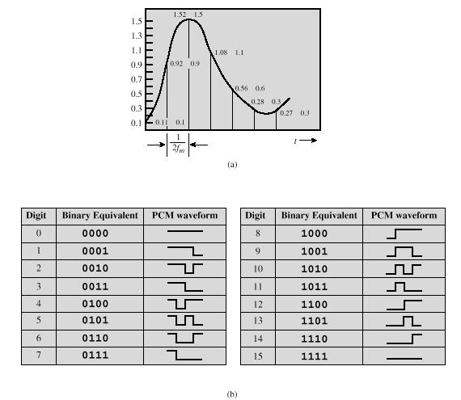

Slide 41
Pulse Code Modulation
By quantizing the PAM pulse, original signal is only approximated
Leads to quantizing noise
Signal-to-noise ratio for quantizing noise
Thus, each additional bit increases SNR by 6 dB, or a factor of 4

Slide 42
Delta Modulation
Analog input is approximated by staircase function
Moves up or down by one quantization level (δ) at each sampling interval
The bit stream approximates derivative of analog signal (rather than amplitude)
1 is generated if function goes up
0 otherwise

Slide 43
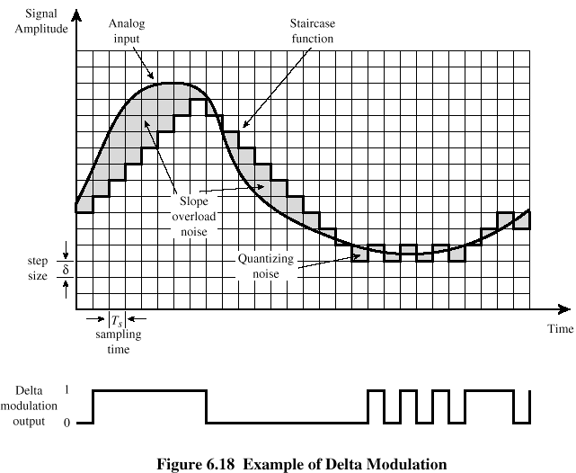
Delta Modulation

Slide 44
Delta Modulation
Two important parameters
Size of step assigned to each binary digit (δ)
Sampling rate
Accuracy improved by increasing sampling rate
However, this increases the data rate
Advantage of DM over PCM is the simplicity of its implementation

Slide 45
1-Mbps Data Rate

Slide 46
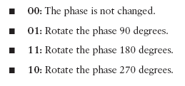
2-Mbps Data Rate
Because DQPSK can modulate data bits in pairs, it is able to transmit twice the data rate
of DBPSK, or 2 Mbps.

Slide 47
Example Phase Changes During DBPSK and DQPSK Modulation.

Slide 48
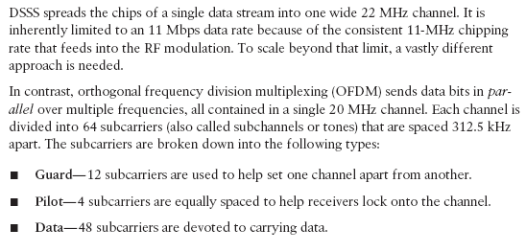
OFDM

Slide 49
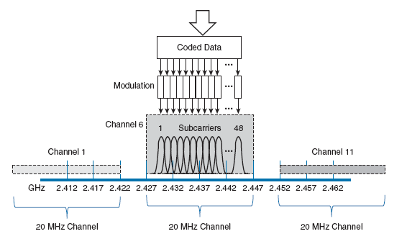
OFDM Operation with 48 Parallel Subcarriers

Slide 50
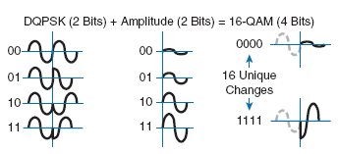
Examples of Phase and Amplitude Changes with 16-QAM.

