Slide 1
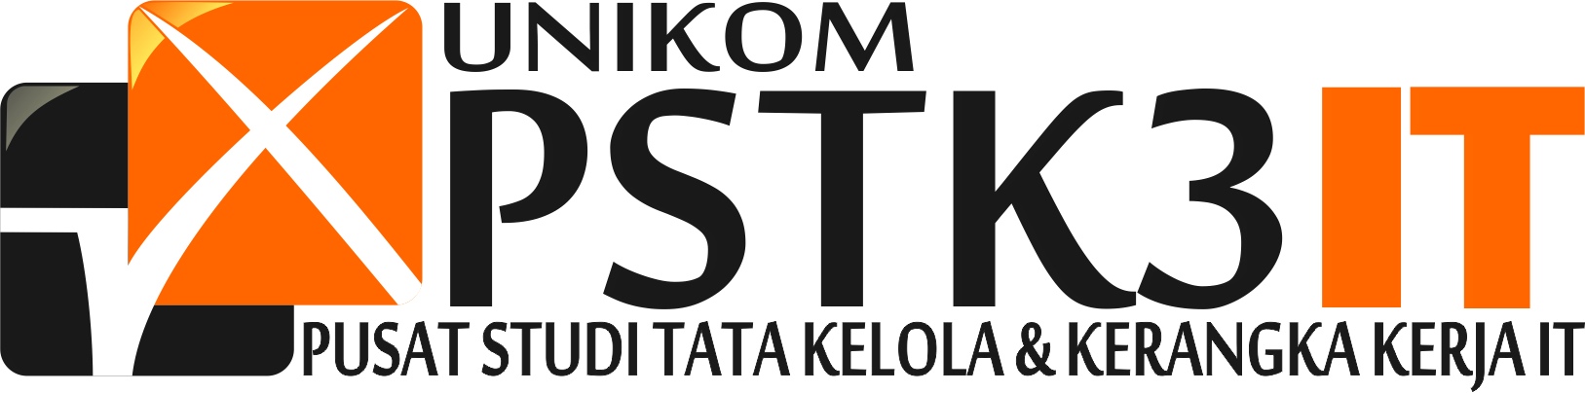
Information Security Management System
ISO/IEC 27001:2005
Introduction and Requirements
Dr. Ir. Yeffry Handoko Putra, M.T
Magister Sistem Informasi UNIKOM

Slide 2
INFORMATION SECURITY MANAGEMENT SYSTEM
ISO/IEC 27001:2005

Slide 3
What is ISO/IEC 27001 Standard
Internationally accepted standard for information security management
Auditable specification for information security management system
ISO/IEC 27001 is not only an IT standard.
Process, Technology and People Management standard.
Helps to combat fraud and promote secure operations.
Unified standard for security associated with the information life cycle.

Slide 4
History of ISO/IEC 27001 Standard
1992
The Department of Trade and Industry (DTI), which is part of the UK Government, publish a 'Code of Practice for Information Security Management'.
1995
This document is amended and re-published by the British Standards Institute (BSI) in 1995 as BS7799.
2000
In December, BS7799 is again re-published, this time as a fast tracked ISO standard. It becomes ISO 17799 (or more formally, ISO/IEC 17799).
2005
A new version of ISO 17799 is published. This includes two new sections, and closer alignment with BS7799-2 processes..
2013
The latest version of ISMS is known as ISO/IEC 27001:2013

Slide 5
27000 Series of Standards
Published standards
ISO/IEC 27001 - Certification standard against which organizations' ISMS may certified (published in 2005)
ISO/IEC 27002 - The re-naming of existing standard ISO 17799 (last revised in 2005, and renumbered ISO/IEC 27002:2005 in July 2007)
ISO/IEC 27006 - Guide to the certification/registration process (published in 2007)
In preparation
ISO/IEC 27000 - Vocabulary for the ISMS standards
ISO/IEC 27003 - ISMS implementation guide
ISO/IEC 27004 - Standard for information security management measurements
ISO/IEC 27005 - Standard for risk management
ISO/IEC 27007 - Guideline for auditing information security management systems
ISO/IEC 27011 - Guideline for telecommunications in information security management system
ISO/IEC 27799 - Guidance on implementing ISO/IEC 27002 in the healthcare industry

Slide 6
Applicable Industries
Which ever the Industry or Organisation where Information has a value to that Organisation.
Low
Agriculture, fishing
Chemical products and fibres
Construction
Engineering services
Machinery and equipment
Printing companies
Recycling
Shipbuilding
Medium
Education
Electricity Supply
Food products, beverages and tobacco
Gas Supply
Hotels and restaurants
Publishing companies
Transport, storage and communication
Water Supply
Wholesale and retail trade
High
Aerospace
Financial
Health and social work
Information Technology
Nuclear fuel
Other social services
Pharmaceuticals
Post and Telecommunications
Government, Local Government, Public administration and defence

Slide 7
What is Information
Information Comprises the meanings and interpretations that people place upon the facts and Data. The value of the information springs from the ways it is interpreted and applied to make products, to provide services, and so on.
Services
Information Systems
Paper files
Electronic
Files
Support Customer
Applications
Newsletter
Equipment
Directives

Slide 8

Various types of Information
Financial Information
Design & Development Info
Customer Details
R & D Information
Salaries, Pensions, Health & Safety, Organizational Records,
Business Plans
Financial Forecasts
Intellectual Property
Employee Personal Information

Slide 9
Why Information Security Is Very Important
  Financial Information Such as Accounts, Tax Details, Employee Pay roll Information, Personnel Records if you lost …..?????
  If you lost New product Designs data through Human Error, Fire, Theft ???
  Losing data in a customer database - such as customer names, contact details and information on their buying trend…..????
  Imagine waking up to discover that your IT systems have been hacked. Your company's financial results have been leaked to the media; your confidential business plans have been compromised; your employees' personal files have been posted on the internet

Slide 10
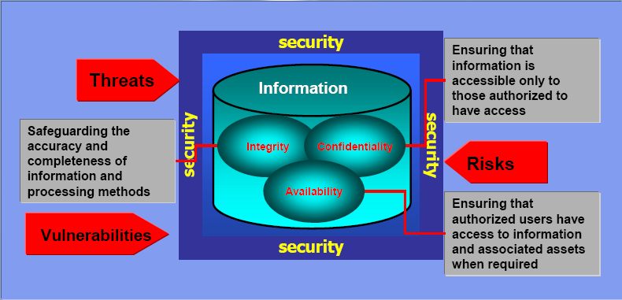
Elements of Information Security
Information Security is the protection of information and information assets to preserve :

Slide 11
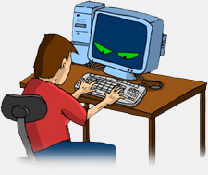

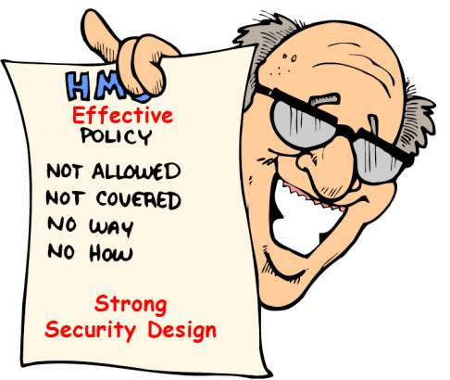
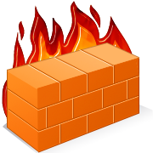
Potential Issues
High User Knowledge of IT Systems
Theft, Sabotage, Misuse
Virus Attacks
Systems & Network Failure
Lack Of Documentation
Lapse in Physical Security
Natural Calamities & Fire

Slide 12
IS IT A PROBLEM ???
YES
How do we overcome
these Problems ?????
We Need a Solution

Slide 13
Solution
ISO/IEC 27001:2005
Information technology — Security techniques — Information security management systems — Requirements
ISO/IEC 27002:2005
Information technology — Security techniques — Code of practice for information security management

Slide 14
What is Information Security Management System
  Information Security Management is a process by which the value of each Organisation information is assessed and, if appropriate, protected on ongoing basis.
  Building a Information Security Management system is achieved through the “systematic assessment of the systems, technologies and media contained information, appraisal of the loss of information, cost of security breaches, and development & deployment of counter measures to threats.”
  If simplify, ISMS provide a platform where organisation recognizes most valuable spots of in an organisation and builds armor-plating to protect them.

Slide 15
What is the ISMS Standard about?
Annex A
133
Controls
Management Clause 4 ~ 8
  Establish ISMS framework
  Set up security policy & objectives
  Risk Assessment & Treatment
PLAN
Establish
ISMS
  Establish ISMS framework
  Set up security policy & objectives
  Risk Assessment & Treatment
  Routine checking
  Self-policing procedures
  Management review
  Audit
  Trend analysis
DO
Implement &
Operate ISMS
ACT
Maintain &
Improve ISMS
  Improvement Plan
  Non-conformity
  Corrective & preventive actions
  Risk Treatment
  Implement measures
  Resources allocation
CHECK
Monitor &
Review ISMS

Slide 16
Structure of ISO/IEC 27001:2005
The information security Management Program should include
Define Scope and Boundaries of the ISMS
Define the Security Policy
Define a Risk Assessment Approach of Organisation
Identify the Information Assets and their Risks
Analyze and Evaluate the Risks
Identify and Evaluate options for Treatment of Risk
Select Control Objectives and Controls for treating Risks ( Annexure A)
Formulate Risk Treatment Plan and Implement RTP Plan
Implement Control to meet Control Objectives
Define how to measure effectiveness of the Controls

Slide 17
Structure of ISO/IEC 27001:2005
Cont…
Implement Training and Awareness Programme
Implement of procedures and other controls capable of detection of
Security Events / Incidents.
Promptly Detect errors in result of Processing
Identify Security Breaches and Incidents
Regular Reviews of Effectiveness of the ISMS
Measure the Effectiveness
Review Risk assessment at planned intervals
Conduct Internal Audits
Implement the identified improvements
Take appropriate corrective and Preventive actions.

Slide 18
Benefits of ISO/IEC 27001
Identify critical assets via the Business Risk Assessment
Improved understanding of business aspects
Provide a structure for continuous improvement
Be a confidence factor internally as well as externally
Systematic approach
Ensure that ”knowledge capital” will be ”stored” in a business management system
Reductions in adverse publicity
Reductions in security breaches and/or claims

Slide 19
Benefits of ISO/IEC 27001
Framework will take account of legal and regulatory requirements
Proves management commitment to the security of information
Helps provide a competitive edge
Independently verifies, Information Security processes, procedures and documentation
Independently verifies that risks to the company are properly identified and managed

Slide 20
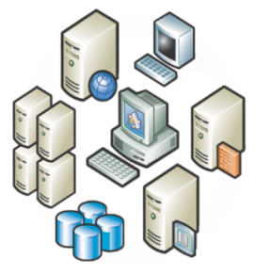
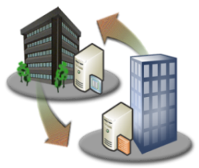

Some of the Controls Recommended by the Standard
- Training
- Awareness
- HR Policies
- Background Checks
- Roles / responsibilities
- Mobile Computing
- Social Engineering
- Social Networking
- Acceptable Use
- Policies
- Performance Mgt
Technology
Process
- System Security
- UTM. Firewalls
- IDS/IPS
- Data Center
- Physical Security
- Vulnerability Assmt
- Penetration Testing
Application Security
- Secure SDLC
- SIM/SIEM
- Managed Services
- Risk Management
- Asset Management
- Data Classification
- Info Rights Mgt
- Data Leak Prevention
- Access Management
- Change Management
- Patch Management
- Configuration Mgmt
- Incident Response
Incident Management
Business Continuity
People

Slide 21
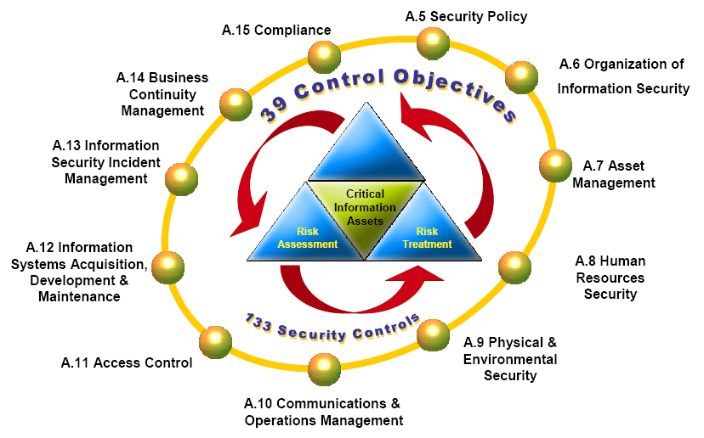
Control Objectives / Controls ( Annexure A)
Overall the standard can be put in : ( Annexure A )
    Domain Areas – 11
    Control Objectives – 39
    Controls – 133

Slide 22
A. 5 Security policy
    Control Objective:
To provide management direction and support for information security in accordance with business requirements and relevant laws and regulations.
    Information security policy document
    Review of the information security policy

Slide 23
A.6 Organisation of Information Security
A.6 Organisation of Information security Internal organisation
    Control Objective:
To Manage Information Security within the Organisation.
    Management commitment to information security
    Information security co-ordination
    Allocation of information security responsibilities
    Authorization process for information processing facilities
    Confidentiality agreements
    Contact with authorities
    Independent review of information security

Slide 24
A.6 Organisation of Information Security
Organisation of Information security External parties
    Control Objective:
To maintain the security of organizational information and information processing facilities that are accessed processed, communicated to, or managed by external parties
    Identification of risks related to external parties
    Addressing security when dealing with customers
    Addressing security in third party agreements

Slide 25
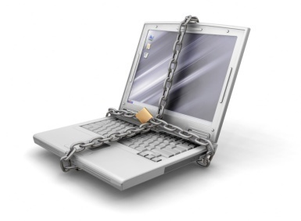
A.7 Asset Management
Responsibility of Assets
    Control Objective:
To achieve and maintain appropriate protection of organizational assets
    Inventory of assets
    Ownership of assets
    Acceptable use of assets

Slide 26
A.7 Asset Management
Information classification
    Control Objective:
To ensure that information receives an appropriate level of protection
    Classification guidelines
    Information labeling and handling
DANGER
Secret

Slide 27
A.8 Human Resource Security
Prior to employment
    Control Objective:
To ensure that employees, contractors and third party users understand their responsibilities, and are the roles they are considered for, and to reduce the risk of theft ,fraud or misuse of facilities
    Roles and responsibilities
    Screening
    Terms and conditions of employment

Slide 28
A.8 Human Resource Security
During employment
    Control Objective:
To ensure that all employees, contractors and third party users are aware of information security threats and concerns, their responsibilities and liabilities and are equipped to support organizational security policy in the course of their normal work and to reduce the risk of human error.
    Management Responsibilities
    Information security awareness, education and training
    Disciplinary process

Slide 29
A.8 Human Resource Security
Termination or change of employment
    Control Objective:
To ensure that employees, contractors and third party users exit an organization or change employment in an orderly manner.
    Termination responsibilities
    Return of assets
    Removal of access rights

Slide 30
A.9 Physical and Environmental Security
Secure areas
    Control Objective:
To prevent unauthorized physical access, damage and interference to the organization's premises and information.
    Physical security perimeter
    Physical entry controls
    Securing offices, rooms and facilities
    Protecting against external and environmental threats
    Working in secure areas
    Public access, delivery and loading areas

Slide 31
A.9 Physical and Environmental Security
Equipment security
    Control Objective:
To prevent loss, damage, theft or compromise of assets and interruption to the organization's activities
    Equipment sitting and protection
    Supporting utilities
    Cabling security
    Equipment maintenance
    Security of equipment off-premises
    Secure disposal or re-use of equipment
    Removal of property

Slide 32
Benefits of ISO/IEC 27001
Focuses on securing company information from being misused by unwanted intruders,
The overall safety of information, personnel and assets are being assured.

Slide 33
A.10 Communications and operations management
Operational procedures and responsibilities
    Control Objective:
To ensure the correct and secure operation of information processing facilities.
    Documented operating procedures
    Change management
    Segregation of duties
    Separation of development, test and operational facilities

Slide 34
A.10 Communications and operations management
Third party service delivery management
    Control Objective:
To implement and maintain the appropriate level of information security and service delivery in line with third party service delivery agreements
    Service delivery
    Monitoring and review of third party services
    Managing changes to third party services
    Capacity management
    System acceptance

Slide 35
A.10 Communications and operations management
Protection against malicious and mobile code
    Control Objective:
To protect the integrity of software and information
    Controls against malicious code
    Controls against mobile code
    Back-up:
To maintain the integrity and availability of information and information processing facilities
    Information Back-up

Slide 36
A.10 Communications and operations management
Network security management
    Control Objective:
To ensure the protection of information in networks and the protection of the supporting infrastructure
    Network controls
    Security of network services

Slide 37
A.10 Communications and operations management
Media handling
    Control Objective:
To protect unauthorized disclosure, modification, removal or destruction of assets, and interruption to business activities
    Management of removable media
    Disposal of media
    Information handling procedures
    Security of system documentation

Slide 38
A.10 Communications and operations management
Electronic commerce services
    Control Objective:
To ensure the security of electronic commerce services and their secure use.
    Electronic commerce
    On-line transactions
    Publicly available information

Slide 39
A.10 Communications and operations management
Monitoring
    Control Objective:
To detect unauthorized information processing activities.
    Audit logging
    Monitoring system use
    Protection of log information
    Administrator and operator logs
    Fault logging
    Clock synchronization

Slide 40
Benefits of ISO/IEC 27001
More assured regarding the reliability of its operations
Any gaps identified and mitigated appropriately by defining suitable policies and procedures and planned actions.

Slide 41
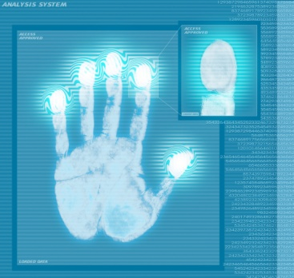
A.11 Access Control
Business requirement for access control
User access management
    Control Objective:
To ensure authorized user access and to prevent unauthorized access to information systems
    Access control policy
    User registration
    Privilege management
    User password management
    Review of user access rights

Slide 42
A.11 Access Control
User responsibilities
    Control Objective:
To prevent unauthorized user access and compromise or theft of information and information processing facilities
    Password use
    Unattended user equipment
    Clear desk and clear screen policy

Slide 43
A.11 Access Control
Network access control
    Control Objective:
To prevent unauthorized access to networked services
    Policy on the use of network services
    User authentication for external connections
    Equipment identification in networks
    Remote diagnostic and configuration port protection
    Segregation in networks
    Network connection control
    Network routing control

Slide 44
A.11 Access Control
Operating system access control
    Control Objective:
To prevent unauthorized access to operating systems
    Secure log-on procedures
    User identification and authentication
    Password management system
    Use of system utilities
    Session time-out
    Limitation of connection time

Slide 45
A.11 Access Control
Application and information access control
    Control Objective:
To prevent unauthorized access to information held in application systems
    Information access restriction
    Sensitive system isolation
Mobile computing and tele working
    Control Objective:
To ensure information security when using mobile computing and
teleworking facilities
    Mobile computing and communications
    Tele working Policy

Slide 46
A.12 Information systems acquisition, development and maintenance
Security requirements of information systems
    Control Objective:
To ensure that security is an integral part of information systems.
    Security requirements analysis and specification
Correct processing in applications
    Control Objective:
To prevent errors, loss, unauthorized modification or misuse of information in applications.
    Input data validation
    Control of internal processing
    Message integrity
    Output data validation

Slide 47
A.12 Information systems acquisition, development and maintenance
Cryptographic controls
    Control Objective:
To protect the confidentiality, authenticity or integrity of information by cryptographic means.
    Policy on the use of cryptographic controls
    Key management
    Security of system files
    Control of operational software
    Protection of system test data
    Access control to program source code

Slide 48
A.12 Information systems acquisition, development and maintenance
Security in development and support processes
    Control Objective:
To maintain the security of application system software and information
    Change control procedures
    Technical review of applications after operating system changes
    Restrictions on changes to software packages
    Outsourced software development
    Technical Vulnerability Management to reduce risks resulting from exploitation of published technical vulnerabilities

Slide 49
A.13 Information security incident management
Reporting information security events and weaknesses
    Control Objective:
To ensure information security events and weakness associated with information systems are communicated in a manner allowing timely action to be taken.
    Reporting information security events
    Reporting security weakness
    Responsibilities and procedures
    Learning from information security incidents
    Collection of evidence

Slide 50
A.14 Business Continuity Management
Information security aspects of business continuity management
    Control Objective:
To counteract interruptions to business activities and to protect critical business process from the effects of major failures of information systems or disasters to ensure their timely resumption.
    Including information security in the BCM process
    Business continuity and risk assessment
    Developing and implementing continuity plans including
    information security
    Business continuity planning framework
    Testing ,maintaining and reassessing business continuity plans

Slide 51
Benefit of ISO/IEC 27001
Organizations will be well prepared for it by the implementation of incident response handling procedures and business continuity management.
Enable organizations to plan ahead of a crisis or disaster and develop appropriate recovery procedures to ensure downtime of operations are minimized.

Slide 52

A.15 Compliance
Compliance with legal requirements
    Control Objective:
To avoid breaches of any law, statutory, regulatory or contractual obligations and of any security requirements
    Identification of applicable legislation
    Intellectual property rights(IPR)
    Protection of organizational records
    Data protection and privacy of personal information
    Prevention of misuse of information processing facilities
    Regulation of cryptographic controls

Slide 53
A.15 Compliance
Compliance with security policies and standards, and technical compliance
    Control Objective:
To ensure compliance of systems with organizational security policies and standards
    Compliance with security policies and standards
    Technical compliance checking
    Information systems audit controls
    Protection of information system audit tools

Slide 54
Benefits of ISO/IEC 27001
Mandates organizations to be compliant to them to improve corporate governance and to avoid being held liable for certain legal issues.

