Slide 1
Information System Project Management
Introduction

Slide 2
References
James Cadle, Donald Yeates; Project Management For Information System; Pearson Prentice Hall
Kathy Schwalbe ; Cengage Learning

Slide 3
What is a Project ?
Work
Difference between operation and project?
Operation
Project

Slide 4
Operation and Project
Operations :
Repetitive
Ongoing
Projects :
Temporary
Unique

Slide 5
Project
A Project is a temporary endeavor undertaken to create a unique product, service, or result.

Slide 6
Project Management
Project Management :
Is the application of knowledge, skills, tools and technique to project activities to meet project requirements.
Or
To describe an organizational approach to the management of ongoing operations.

Slide 7
Project Management
Project management is accomplished through the use of the following 5 processes :
Initiation
Planning
Execution
Controlling
Closure

Slide 8
Project Management
The project team manages the various activities of the project and the activities typically involve :
Competing demands for : scope, time, cost, risk and quality
Managing expectations for stakeholders
Identifying requirements

Slide 9
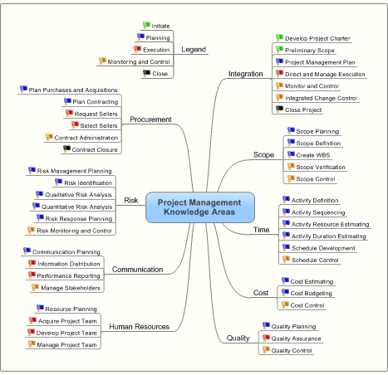
Project Management Knowledge Areas

Slide 10
Project Management Knowledge Areas
Project Integration Management
Describes the process required to ensure that the various elements of the project are properly coordinated. It consist of project plan development, project plan execution and integrated change control
Project Scope Management
Describes the process required to ensure that the project includes all the work required and only the work required to complete the project successfully. It consist of initation, scope planning, scope definition, scope verification and scope change control
Project Time Management
Describes the process required to ensure timely completion of the project. It consist of activity definitions, activity sequencing, activity duration estimating, schedule development and schedule control

Slide 11
Project Management Knowledge Areas
Project Cost Management
Describes the processes required to ensure that the project is completed within the approved budget. It consist of resource planning, cost estimating, cost budgeting, and cost control
Project Quality Management
describes the process required to ensure that the project will satisfy the needs for which it was undertaken. It consists of quality planning, quality assurance, and quality control
Project Human Resource Management
describes the process required to make the most effective use of the people involved with the project. It consist of organizational planning, staff acquisition, and team development

Slide 12
Project Management Knowledge Areas
Project Communication Management
Describes the process required to ensure timely and appropriate generation, collection, dissemination, storage and ultimate disposition of project information. It consist of communications planning, information distribution, performance reporting and administrative closure
Project Risk Management
Describes the process concerned with identifying, analyzing and responding to project risk. It consist of risk management planning, risk identification, qualitative risk analysis, risk response planning, and risk monitoring control
Project Procurement Management
Describes the process required to acquire goods and services from outside the performing organization. It consist of procurement planning, solicitation planning, solicitation, source selection, contract administration and contract closeout.

Slide 13
Project Characterizations
Project Phases
Each project phase is marked by completion of one or more deliverables.
A deliverables is a tangible, verifiable work product such as feasibility study, a detail design, or a working prototype.
The deliverables and hence the phases are part of a generally sequential logic designed to ensure proper definition of the product of the project.

Slide 14
Project Life Cycle
Project Life Cycle
The project life cycle serves to define the beginning and the end of project.

Slide 15
Project Life Cycle
Project life cycle generally define :
What technical work should be done in each phase
Who should be involved in each phase

Slide 16
Project Life Cycle
Most project life cycle descriptions share a number of common characteristics :
Cost and staffing levels are low at the start, higher toward the end and drop rapidly as the project draws to a conclusion
The probability of successfully completing the project is lowest and hence risk and uncertainty are highest, at the start at the project. The probability of successful completion generally gets progressively higher as the project continues
The ability of the stakeholders to influence the final characteristics of the project’s product and the final cost of the project is highest at the start and gets progressively lower as the project continues. A major contributor to this phenomenon is that the cost of changes and error correction generally increases as the project continues

Slide 17
General Management Skills
General management is a broad subject dealing with every aspect of managing an ongoing enterprise. It includes :
Finance and accounting, sales and marketing, research and development, and manufacturing and distribution
Strategic planning, tactical planning and operational planning
Organizational structures, organizational behavior, personnel administration, compensation, benefits and career paths
Managing work relationships through motivation, delegation, supervision, team building, conflict management and other techniques
Managing oneself through personal time management, strss management and other techniques

Slide 18
General Management Skills
Skills needed in general management areas of a project :
Leading : Kotter distinguishes between leading and managing while emphasizing the need for both : one without the other is likely to produce poor results. He says that managing is primarily concerned with consistently producing key results expected by stakeholders, while leading involves :
Establishing direction – developing both a vision of the future and strategies for producing the changes needed to achieve that vision
Aligning people – communicating the vision by words and deeds to all those whose cooperation may needed to achieve the vision
Motivating and inspiring – helping people energize themselves to overcome political, bureaucratic and resource barriers to change
Communicating : 90% of the project managers time goes in carrying out various communications. Communicating involves the exchange of information. The sender is responsible for making the information clear, unambiguous and complete so that the receiver can receive it correctly. The receiver is responsible for making sure that the information is received in its entirely and understood correctly.

Slide 19
General Management Skills
Dimensions of communicating :
Written and oral, listening and speaking
Internal and external
Formal and informal
Vertical and horizontal

Slide 20
General Management Skills
Negotiating : involves conferring with others to come to terms with them or reach an agreement. Agreements may be negotiated directly or with assistance; mediation and arbitration are two types of assisted negotiation
Problem solving : involves a combination of problem definition and decision – making. Problem definition requires distinguishing between causes and symptoms.

Slide 21
General Management Skills
Influencing the organization : influencing the organization involves the ability to get things done. It requires an understanding of both the formal and informal structures of all the organizations involved – the performing organization, customer, partners, contractors and numerous others as appropriate. Influencing the organization also requires an understanding the mechanics of power and politics.

Slide 22
General Management Skills
Due to the presence of multiple delivery locations there are number of cross – cultural factors have to be addressed by a project manager :
Understanding of local culture and language
Techniques and work methods unique to a particular location
Standardization of work practices
Infrastructure replication across locations
Control from remote locations on a more or less real time basis
Offer flexibility in offering products and services

Slide 23
Questions
Find out project types base on the project source
What do you know about Project Management Body Of Knowledge (PMBOK) and what for PMBOK for Project Management
Find out sets of competences needed by a project manager to be a good manager

