Slide 1
Advanced Applied IT for Business
1

Slide 3
Nokia N97

Slide 4
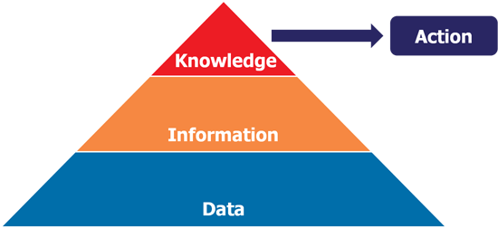

Slide 5
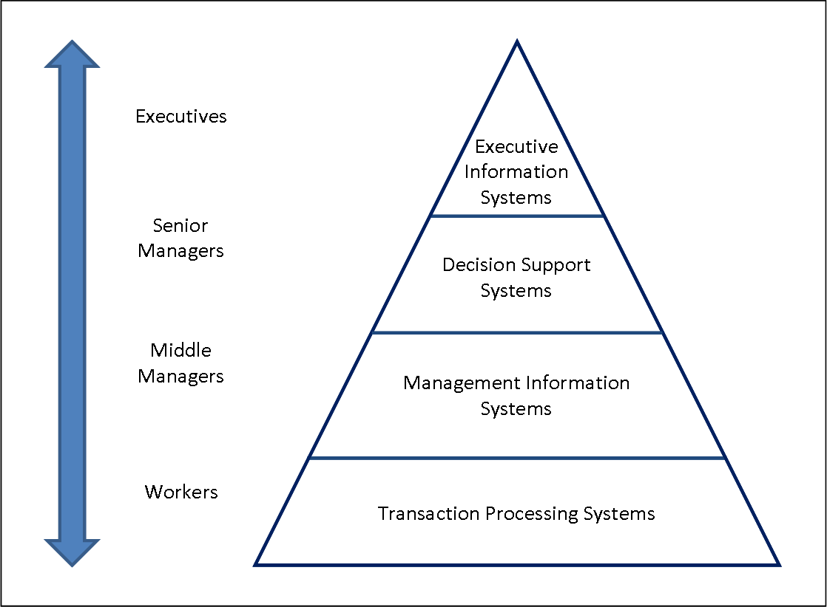

Slide 6
Changing Business Environment & Computerized Decision Support
Companies are moving aggressively to computerized support of their operations => Business Intelligence
Business Pressures–Responses–Support Model
Business pressures result of today's competitive business climate
Responses to counter the pressures
Support to better facilitate the process

Slide 7
The Business Environment
The environment in which organizations operate today is becoming more and more complex, creating:
opportunities, and
problems.
Example: globalization.
Business environment factors:
markets, consumer demands, technology, and societal.

Slide 8
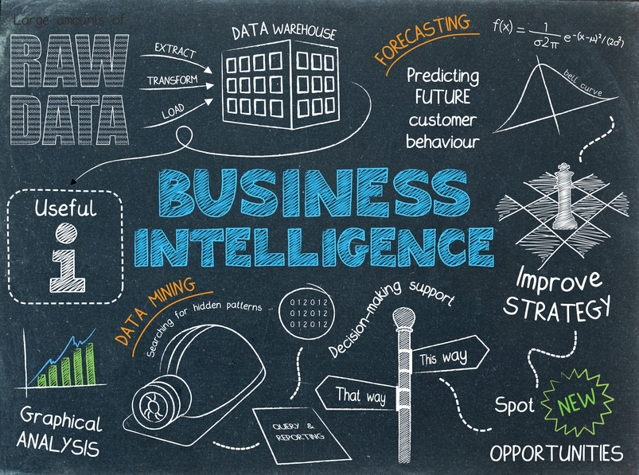
Notes:
Mengapa Anda Perlu BI ??

Slide 9
Business Intelligence (BI)
BI is an evolution of decision support concepts over time.
Meaning of EIS/DSS…
Then: Executive Information System
Now: Everybody’s Information System (BI)
BI systems are enhanced with additional visualizations, alerts, and performance measurement capabilities.
The term BI emerged from industry apps.

Slide 10
A Brief History of BI
The term BI was coined by the Gartner Group in the mid-1990s
However, the concept is much older
1970s — MIS reporting — static/periodic reports
1980s — Executive Information Systems (EIS)
1990s — OLAP, dynamic, multidimensional, ad-hoc reporting -> coining of the term “BI”
2005+ — Inclusion of AI and Data/Text Mining capabilities; Web-based Portals/Dashboards
2010s — Yet to be seen

Slide 11
Definition of BI
BI is an umbrella term that combines architectures, tools, databases, analytical tools, applications, and methodologies.
BI a content-free expression, so it means different things to different people.
BI's major objective is to enable easy access to data (and models) to provide business managers with the ability to conduct analysis.
BI helps transform data, to information (and knowledge), to decisions and finally to action.

Slide 12
The Architecture of BI
4 major components of BI system :
a data warehouse
business analytics
business performance management
a user interface

Slide 13
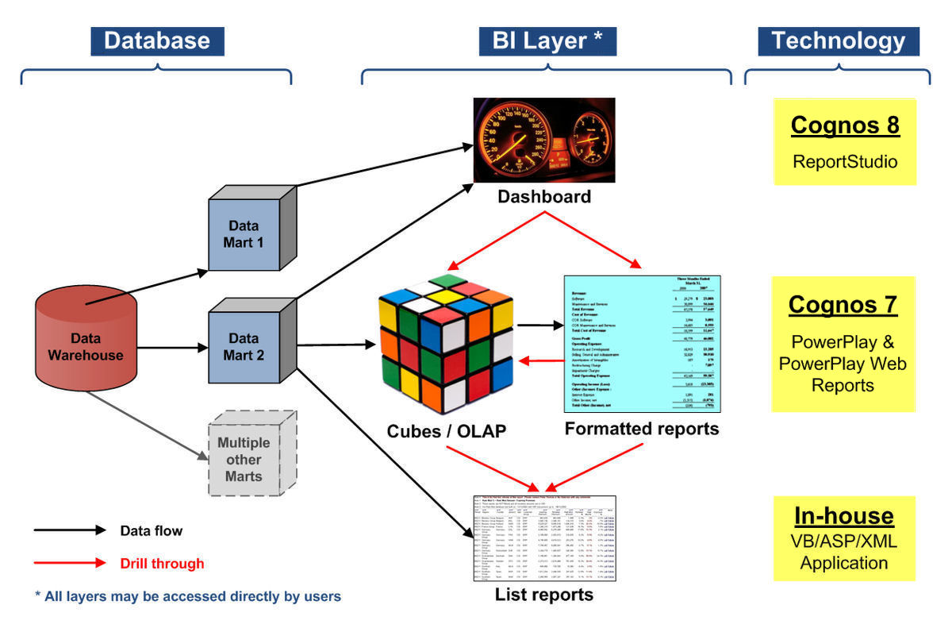

Slide 14
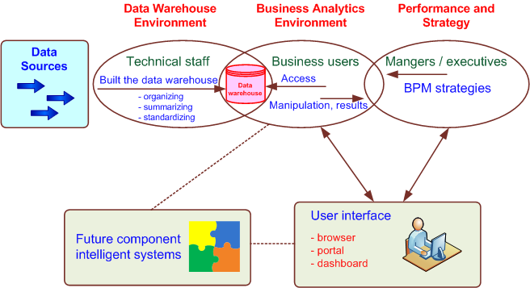
A High-level Architecture of BI

Slide 15
Components in a BI Architecture
The data warehouse is the cornerstone of any medium-to-large BI system.
Originally, the data warehouse included only historical data that was organized and summarized, so end users could easily view or manipulate it.
Today, some data warehouses include access to current data as well, so they can provide real-time decision support (for details see Chapter 2).
Business analytics are the tools that help users transform data into knowledge (e.g., queries, data/text mining tools, etc.).

Slide 16
Components in a BI Architecture
Business Performance Management (BPM), which is also referred to as corporate performance management (CPM), is an emerging portfolio of applications within the BI framework that provides enterprises tools they need to better manage their operations.
User Interface (i.e., dashboards) provides a comprehensive graphical/pictorial view of corporate performance measures, trends, and exceptions.

Slide 17
Styles of BI
MicroStrategy, Corp. distinguishes five styles of BI and offers tools for each:
report delivery and alerting
enterprise reporting (using dashboards and scorecards)
cube analysis (also known as slice-and-dice analysis)
ad-hoc queries
statistics and data mining

Slide 18
The Benefits of BI
The ability to provide accurate information when needed, including a real-time view of the corporate performance and its parts
A survey by Thompson (2004)
Faster, more accurate reporting (81%)
Improved decision making (78%)
Improved customer service (56%)
Increased revenue (49%)

Slide 19
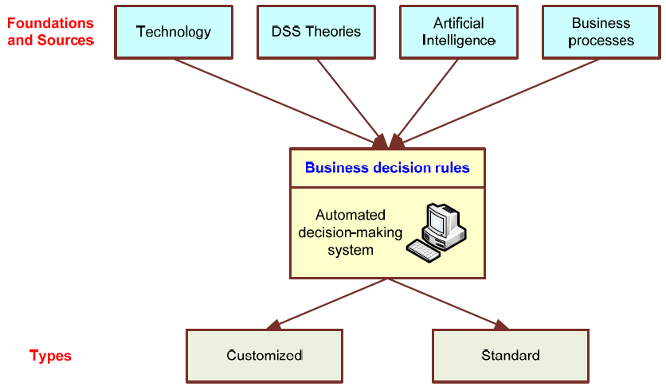
Automated Decision-Making Framework

Slide 20
Automated Decision Making
ADS initially appeared in the airline industry called revenue (or yield) management (or revenue optimization) systems.
dynamically price tickets based on actual demand
Today, many service industries use similar pricing models.
ADS are driven by business rules!

Slide 21
BI Governance Issues/Tasks
Create categories of projects (investment, business opportunity, strategic, mandatory, etc.)
Define criteria for project selection
Determine and set a framework for managing project risk
Manage and leverage project interdependencies
Continuously monitor and adjust the composition of the portfolio

Slide 22
Transaction Processing Versus Analytic Processing
Transaction processing systems are constantly involved in handling updates (add/edit/delete) to what we might call operational databases.
ATM withdrawal transaction, sales order entry via an ecommerce site – updates DBs
Online transaction processing (OLTP) handles routine on-going business
ERP, SCM, CRM systems generate and store data in OLTP systems
The main goal is to have high efficiency

Slide 23
Transaction Processing Versus Analytic Processing
Online analytic processing (OLAP) systems are involved in extracting information from data stored by OLTP systems
Routine sales reports by product, by region, by sales person, etc.
Often built on top of a data warehouse where the data is not transactional
Main goal is effectiveness (and then, efficiency) – provide correct information in a timely manner
More on OLAP will be covered in Chapter 2

Slide 24
Successful BI Implementation
Implementing and deploying a BI initiative is a lengthy, expensive and risky endeavor!
Success of a BI system is measured by its widespread usage for better decision making.
The typical BI user community includes
All levels of the management hierarchy (not just the top executives, as was for EIS)
Provide what is needed to whom he/she needs it
A successful BI system must be of benefit to the enterprise as a whole.

Slide 25
BI and Business Strategy
To be successful, BI must be aligned with the company’s business strategy.
BI cannot/should not be a technical exercise for the information systems department.
BI changes the way a company conducts business by
improving business processes, and
transforming decision making to a more data/fact/information driven activity.
BI should help execute the business strategy and not be an impediment for it!

Slide 26
BI for Business Strategy
Strategy should be aligned with BI/DW – has the capability to execute the initiative by establishing a BI Competency Center (BICC) which can:
Demonstrate linkage – BI to strategy.
Encourage interaction between the potential business users and the IS organization.
Both sides have a lot to learn from each other
Serve as a repository and disseminator of best BI practices among the different lines of business.
Advocate and encourage standards of excellence.
Help stakeholders understand the crucial role of BI.

Slide 27
Issues for Successful BI
Developing vs. Acquiring BI systems
Developing everything from scratch
Buying/leasing a complete system
Using a shell BI system and customizing it
Use of outside consultants?
Justifying via cost-benefit analysis
It is easier to quantify costs
Harder to quantify benefits
Most of them are intangibles

Slide 28
Major BI Tools and Techniques
Tool categories
Data management
Reporting, status tracking
Visualization
Strategy and performance management
Business analytics
Social networking & Web 2.0
New/advanced tools/techniques to handle massive data sets for knowledge discovery

Slide 29
Major BI Vendors
In recent years, the landscape of BI vendors has changed
Cognos acquired by IBM in 2008
IBM also acquired SPSS in 2009
Hyperion acquired by Oracle in 2008
Business Objects acquired by SAP in 2009
Microstrategy
May be the only independent large BI vendor
Others include Microsoft, SAS, Teradata (mostly considered a DW vendor)

Slide 30
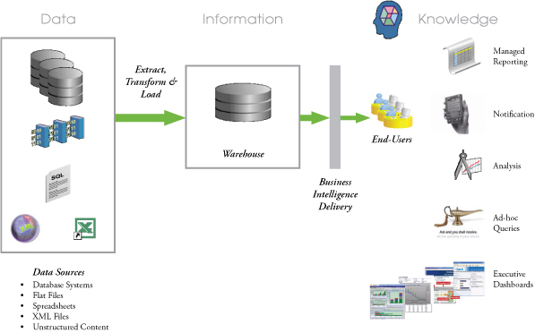

Slide 32
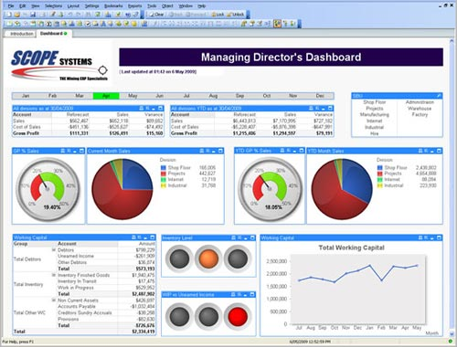
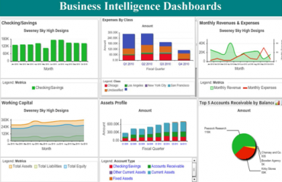

Slide 33
