Slide 1
WEEK 7
MANAGEMENT
Project Management
Magister Desain
Universitas Komputer Indonesia
Source:
Pinto, j.k. 2010, 2ND. ED.

Slide 2
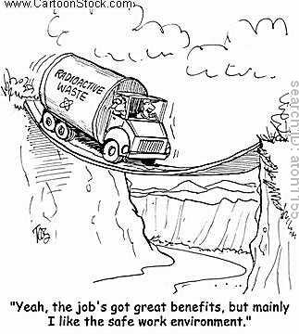
PROJECT
Project Risk, is any possible event that can negatively affect the viability of a project.

Slide 3
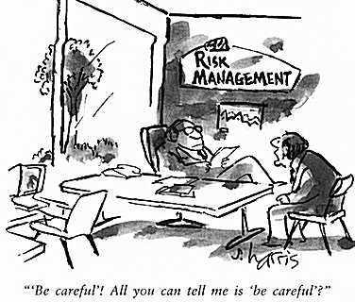
RISK MANAGEMENT
Risk Management is the art and science of identifying, analyzing, and responding to risk factors throughout the life of the project and in the best interests of its objectives.

Slide 4
PROCESS OF RISK MANAGEMENT
Risk Identification – the process of determining the specific risk factors that can reasonably be expected to affect our project.
Analysis of Probability and Consequences – the potential impact of these risk factors, determined by how likely they are to occur and the effect they would have on the project if they did occur.
Risk Mitigation Strategies – steps taken to minimize the potential impact of those risk factors deemed sufficiently threatening to the project.
Control and Documentation – creating a knowledge base for future projects based on lessons learned.

Slide 5
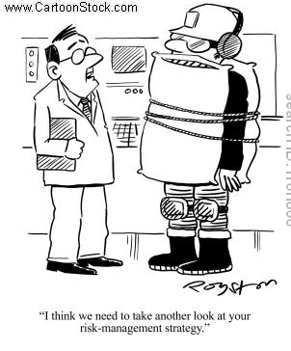
RISK IDENTIFICATION
Financial Risk
Technical Risk
Commercial Risk
Execution Risk
Contractual or Legal Risk
Others: Absenteeism, Resignation, Staff pulled away by management, Additional staff/skills not available, Training not as effective as desired, Initial specifications poorly or incompletely specified, Work or change orders multiply due to various problems, etc.

Slide 6
RISK IDENTIFICATION METHOD
Brainstorming meetings – Bringing the members of the projects team, top management and even clients together for a brainstorming meeting can generate a good list of potential risk factors.
Expert Opinion – The collective “wisdom” of sets of experts is then used as the basis for decision making.
History – In many cases the best source of information on future risk is history.
Multiple (or team based) Assesment – A team based approach to risk factor identification encourages identification of more comprehensive set of potential project risks.

Slide 7
TYPICAL RISK VARIABLES (Jafary, 2001:85, Management of Risks, International Journal of Project Management, 19(2))
Promotion Risk
Market Risk, volume
Market Risk, price
Political Risks
Technical Risks
Financing Risks
Environmental Risks
Cost Estimate Risk (completion risk)
Schedule Risk (delay risk)
Operating Risk
Organizational Risk
Integration Risk
Acts of God

Slide 8
ANALYSIS OF PROBABILITY & CONSEQUENCES
Risk = (Probability of Event)(Consequences of Event).
Risk Impact Matrix:
Consequences
Low High
High
Likelihood
Low

Slide 9
ANALYSIS OF PROBABILITY & CONSEQUENCES Example: DEVELOPING A NEW PRODUCT FOR THE RETAIL MARKET
Risk Factor | Consequences | Likelihood | Impact Potential
A. Loss of lead designer | High | Low | Moderate
B. Technical failure | High | Medium | Serious
C. Budget cut | Medium | Low | Minor
D. Competitor first to market | High | High | Serious
Consequences
Low Medium High
Low Medium high
D
Likelihood
B
C
A

Slide 10
DETERMINING LIKELY RISKS & CONSEQUENCES
Probability of Failure (Pf)
SCORE | MATURITY | COMPLEXITY | DEPENDENCY
Low (0.1) | Existing design | Simple design | Not limited to existing system
Minor (0.3) | Minor redesign | Minor increase in complexity | Schedule or performance depend on existing model
Moderate (0.5) | Major change | Moderate increase | Moderate risk to schedule or performance
Significant (0.7) | Tech. available but complex design | Significant increase | Schedule or performance depend on new system or process. Significant cost or risk
Major (0.9) | State of art, some research complete | Extremely complex | Schedule or performance depend on new system or process. Very high risk.
Consequences of Failure (Cf)
SCORE | COST | SCHEDULE | RELIABILITY | PERFORMANCE
Low (0.1) | Budget estimate not exceeded | Negligible/ no impact | Minimal or no reliability consequences | Minimal or no performance consequences
Minor (0.3) | Cost estimate exceeds budget < 5% | Minor slip in schedule | Small reduction in reliability | Small reduction in system performance
Moderate (0.5) | Cost estimate exceeds budget < 15% | Small slip in schedule | Some reduction in reliability | Some reduction in system performance
Significant (0.7) | Cost estimate exceeds budget < 30% | Slips excess 1 month | Significant degradation in reliability | Significant degradation in system performance
Major (0.9) | Cost estimate exceeds budget < 50% | Large schedule slip | Reliability goals cannot be achieved under current plan | Performance goals cannot be achieved

Slide 11
CALCULATING A PROJECT RISK FACTOR
Use the project team consensus to determine the scores for each Probability of Failure Category: Maturity (Pm), Complexity (Pc), Dependency (Pd).
Calculate Pf by adding the three categories and dividing by 3: Pf=(Pm+Pc+Pd)/3.
Determine the scores for each Consequences of Failure Category: Cost (Cc), Schedule (Cs), Reliability (Cr), Performance (Cp).
Calculate Cf by adding the three categories and dividing by 4: Cf=(Cc+Cs+Cr+Cp)/4.
Calculate Overall Risk Factor for the project by using the formula: RF=Pf+Cf-(Pf)(Cf)
Rule of Thumb: Low risk Rf < 0.3
Medium risk Rf = 0.3 to 0.7
High risk Rf > 0.7

Slide 12
QUANTITATIVE RISK ASESSMENT
Assume your project team has decided upon the following risk values:
Pm = .1, Pc = .5, Pd = .9
Cc = .7, Cs = .5, Cr = .3, Cp = .1
Determine the overall Project Risk using qualitative method

Slide 13
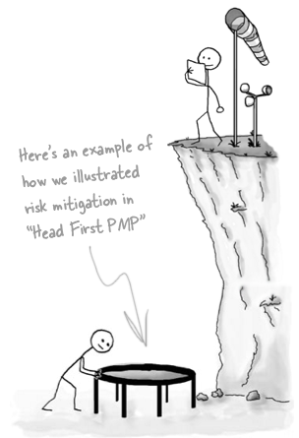
RISK MITIGATION STRATEGIES
Accept Risk
Minimize Risk
Share Risk
Transfer Risk
Use of Contingency Reserves

Slide 14
CONTROL AND DOCUMENTATION
Control and documentation methods help manager classify and codify the various risks the firm faces, its responses to these risks, and the outcome of its response strategies.
Control document has to coherently identify the key information: what, who, when, why, how.

Slide 15
PROJECT RISK ANALISYS & MANAGEMENT (The European Association for Project Management)
Define
Focus
Identify
Structure
Clarify Ownership of Risk
Estimate
Evaluate
Plan
Manage

Slide 16
TERIMA KASIH

