Slide 1
Chap V : Stakeholder Management in Project
Dr. Ir. Yeffry Handoko Putra, M.T
(yeffry@unikom.ac.id)
Magister Sistem Informasi Universitas Komputer Indonesia

Slide 3
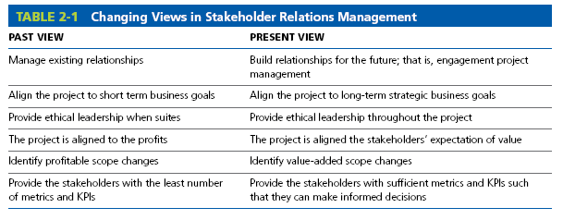

Slide 4
stakeholder relations management

Slide 5
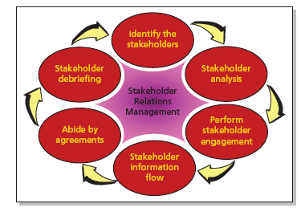

Slide 6
Effective Stakeholder Communication
Communicating with stakeholders on a regular basis is a necessity.
Knowing the stakeholders may allow you to anticipate their actions.
Effective stakeholder communications builds trust.
Virtual teams thrive on effective stakeholder communications.
Although we classify stakeholders by groups or organizations, we still communicate with people.
Ineffective stakeholder communications can cause a supporter to become a blocker.

Slide 7
Agreement in Stakeholder Engagement
Part of the process of stakeholder engagement involves the establishment of agreements between the individual stakeholders and the project manage
Identify any and all agreements among stakeholders (i.e., funding limitations, sharing of information, approval cycle for changes, etc.)
Identify how politics may change stakeholder agreements
Identify which stakeholders may be replaced during the project (i.e., retirement, promotion, change of assignment, politics, etc.)

Slide 9
Project Audit

Slide 10
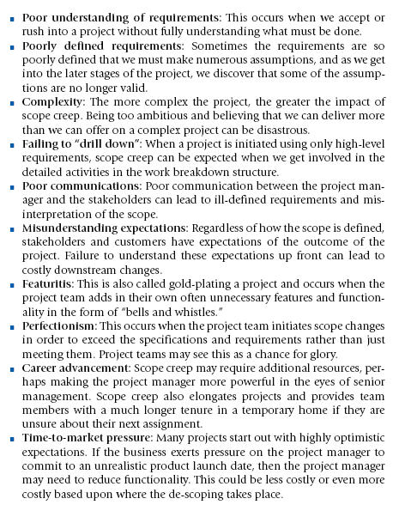
Without Good Communication

Slide 11
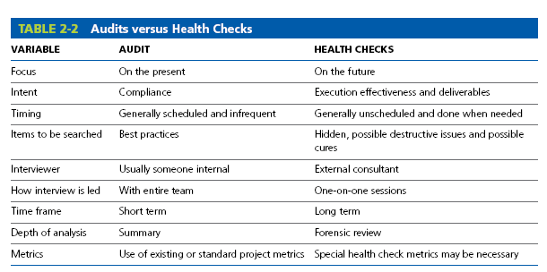

Slide 12
Common Cause of Project Failure, relating to Stakeholder Management
End user stakeholders not involved throughout the project.
Minimal or no stakeholder backing; lack of ownership.
Corporate goals not understood at the lower organizational levels.
Plan asks for too much in too little time.
Poor estimates, especially financial.
Unclear stakeholder requirements.
Passive user stakeholder involvement after handoff.
Unclear expectations.
Assumptions, if they exist at all, are unrealistic.
Plans are based upon insufficient data.
No systemization of the planning process.
Planning is performed by a planning group.

Slide 13
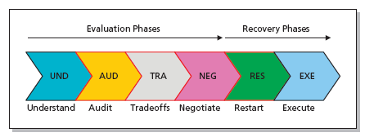
Recovery Life Cycle Phases

