Slide 1
Introduction to Enterprise Information System
SISTEM INFORMASI ENTERPRISE
Riani Lubis
Program Studi Teknik Informatika
Universitas Komputer Indonesia

Slide 2
Information System
An Information System is a work systems whose business process is devoted to capturing , transmitting, storing, retrieving, manipulating, and displaying information, thereby supporting other work systems (Alter, 2002).
An Information System can be defined technically as a set of interrelated components that collect (or retrieve), process, store, and distribute information to support decision making, coordination, and control in an organization (Laundon, 2001).
A Management Information System is an integrated user-machine system for providing information to support the operations, management, analysis, and decision-making functions in an organization (Davis, 1985).
RNL - 2014

Slide 3
Organization & Information Systems
An organization is a stable, formal, social structure that takes resouces from the environment and processes them to produce outputs.
Information Systems must be aligned with the organization to provide information that important groups within the organization need.
RNL - 2014

Slide 4
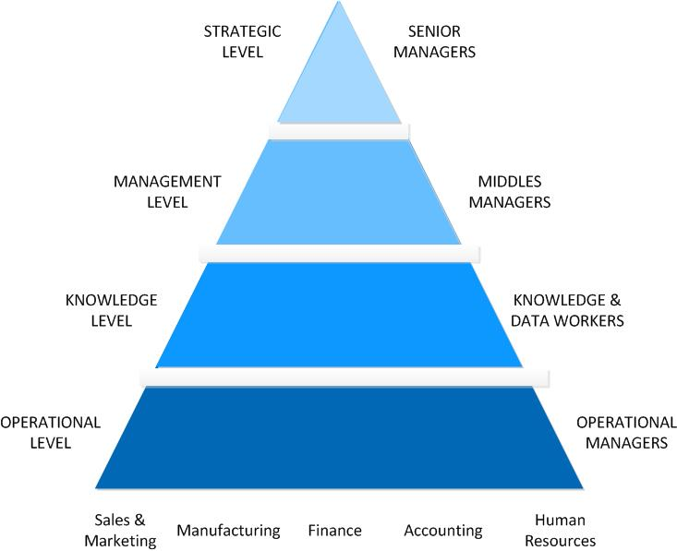
Kind of Information System
RNL - 2014

Slide 5
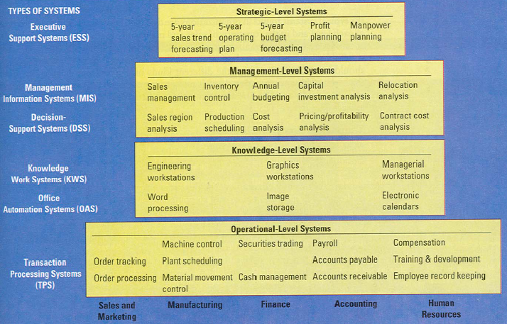
Types of System in Enterprise
RNL - 2014

Slide 6
Characteristics of Information Processing Systems
Type of System | Information Inputs | Processing | Information Outputs | Users
ESS | Aggregate data; external; internal | Graphics; simulations; interactive | Projections; responses to queries | Senior managers
DSS | Low-volume data or massive databases optimized for data analysis; analytic models & data analysis tools | Interactive; simulations; analysis | Special reports; decision analysis; responses to queries | Professionals; staff managers
MIS | Summary transaction data; high-volume data; simple models | Routine reports; simple models; low-level analysis | Summary & exeptions reports | Middle managers
KWS | Design specifications; knowledge base | Modeling; simulations | Models; graphics | Professionals; technical staff
Office Systems | Documents; schedules | Document management; scheduling; communication | Documents; schedules; mail | Clerical workers
TPS | Transactions; events | Sorting; listing; merging; updating | Detailed reports; lists; summaries | Operations personel; supervisors
RNL - 2014

Slide 7
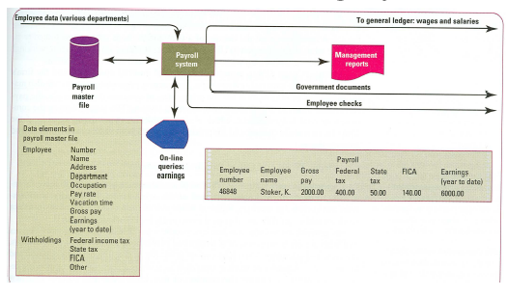
Transaction Processing Systems (Ex : A Payroll TPS)
RNL - 2014

Slide 8
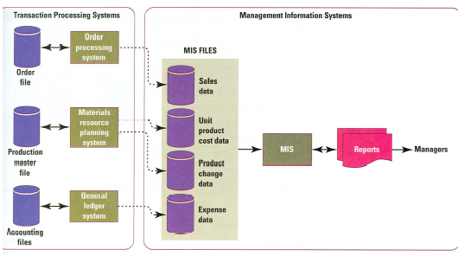
TPS Data for MIS Application
RNL - 2014

Slide 9
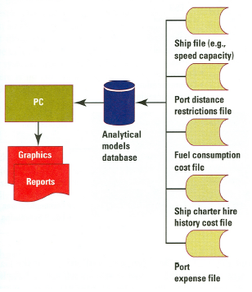
A Sample of Decision Support System
RNL - 2014

Slide 10
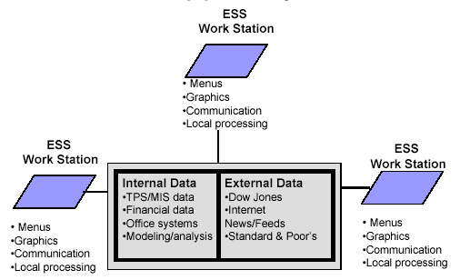
Model of a Typical Executive Support System
RNL - 2014

Slide 11
Interrelationships Among Systems
ESS
MIS
DSS
KWS
OAS
TPS
RNL - 2014

Slide 12
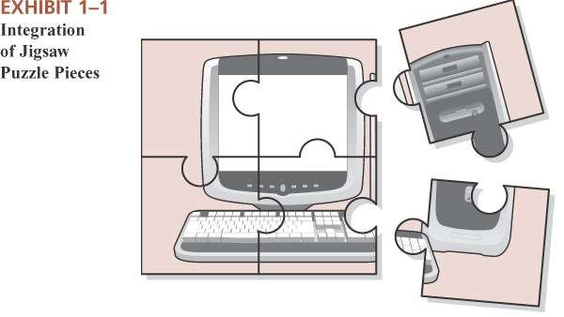
Enterprise Integration
Enterprise
A business, an industrious effort, especially one directed toward making money
Integrated
Joined together, united, made into a whole by having brought all parts together
RNL - 2014

Slide 13
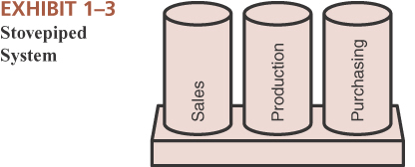
Aren’t all enterprise systems integrated ?
NO!
Why Not?
Enterprise “stove pipes” or “silos”
As enterprises grow, they typically become divided based on functional areas
Each functional area typically has its own system
Even within functional areas, enterprises often develop different systems for different information needs
If existing systems lack functionality, additional systems are built to satisfy new needs
RNL - 2014

Slide 14
Common Integration Attempts
Integrate the end results
Let each functional area have its own system and require them to submit end results in a standardized format that can be merged with results from other areas
Integrate similar types of systems
All financial areas use same system
All manufacturing areas use same system
All areas associated with human resources use same system
Etc……
However, each of those systems are different from each other
Enterprise Systems
May be created from scratch
May be based on packaged software (e.g. OracleApps, PeopleSoft, SAP)
RNL - 2014

Slide 15
Enterprise System
Manufacturing
Accounting
Business Processes
Enterprise-wide Business Processes
Vendors
Customers
Human Resources
Finance
Sales & Marketing
RNL - 2014

Slide 16
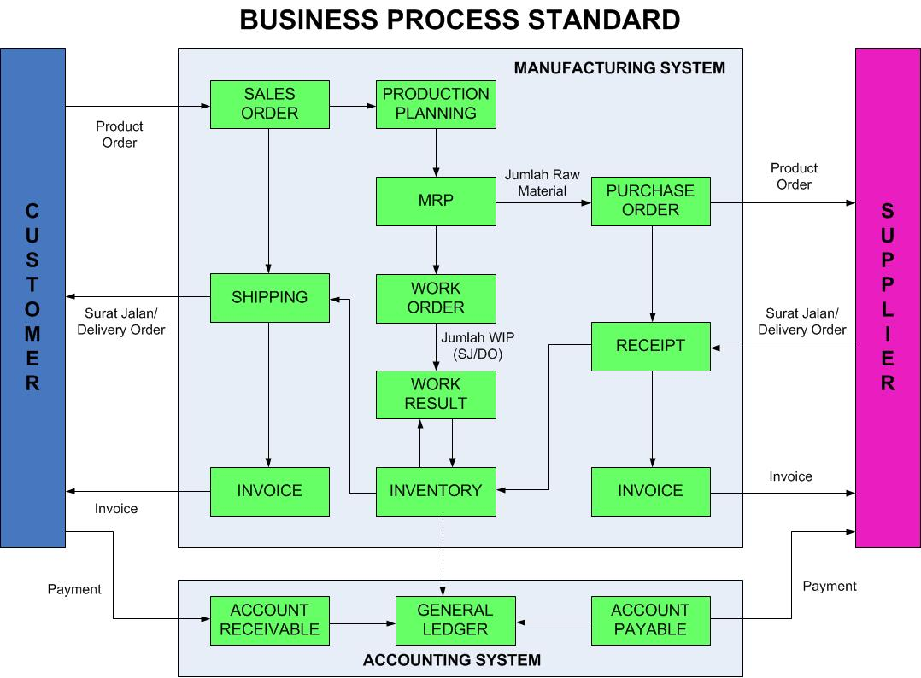
Common Integration Attempts
RNL - 2014

