Slide 1
Classes, Objects and Their Relationship (simple version)
Arry Akhmad Arman
School of Electrical Engineering and Informatics
Institut Teknologi Bandung, Indonesia
Email: arman@kupalima.com
Website: http://www.kupalima.com
Blog: http://kupalima.wordpress.com
Download Center: http://slideshare.net/kupalima
Course milist: arman_course_se@yahoogroups.com
Last update: March 30, 2010

Slide 2
Purposes
Object-oriented modelers use classes, objects, and their relationships to describe things and how they work.
Classes and objects describe the elements in the system, while the relationships reveal communication and interaction.

Slide 3
Class Diagram
A class diagram describes the static view of a system in terms of classes and relationships among the classes.
Although it might look like a data model filled with entities and attributes, remember that classes not only show the structure of your information but also describe behavior.
The class diagram can define a foundation for diagrams showing other aspects of the system, such as the states of the objects and the collaboration between objects shown in the dynamic diagrams.

Slide 4
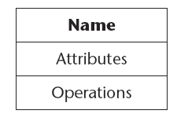
Sample

Slide 5
Class and Object
A class diagram shows only classes, not objects.
The object diagram shows that actual object instances of the classes.

Slide 6
Class and Object Diagram

Slide 7
How to Find Class???

Slide 8
How to Find Class
Do I have information that should be stored or analyzed?
If there is any information that has to be stored, transformed, analyzed, or handled in some other way, then it is a possible candidate for a class. The information might include concepts that must always be registered in the system or events or transactions that occur at a specific moment.
Do I have external systems?
If so, they are normally of interest when you model. The external system might be seen as classes that your system contains or should interact with.
Do I have any reusable patterns, class libraries, or components?
If you have patterns, class libraries, or components from earlier projects, colleagues, or manufacturers, they normally contain class candidates.
Are there devices that the system must handle?
Any technical devices connected to the system turn into class candidates that handle these devices.
Do I have organizational parts?
Representing an organization can be done with classes, especially in business models.
Which roles do the actors in the business play?
These roles can be seen as classes, such as user, system operator, customer, and so on.

Slide 9
Class: Name
the top compartment of the class rectangle contains the name of the class;
it is capitalized and centered in boldface.
the name should be derived from the problem domain and should be as unambiguous as possible.
it should be a noun, for example, Invoice or Debt.
the class name should not have a prefix or a suffix.

Slide 10
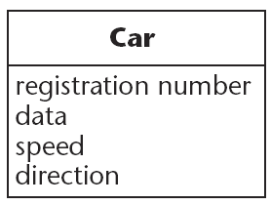
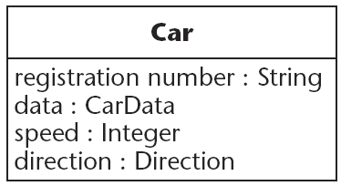
Class: Attributes
Classes have attributes that describe the characteristics of the objects.
The correct class attributes capture the information that describes and identifies a specific instance of the class.
Only the attributes that are interesting within the system being modeled should be included.
Attributes have values in object instances of the class.

Slide 11
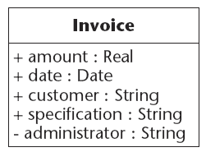
Class: Attributes Visibility
The attributes can have different visibility. Visibility describes whether the attribute can be referenced from classes other than the one in which they are defined.
If an attribute has the visibility of public, it can be used and viewed outside that class (use + sign)
If an attribute has the visibility of private, you cannot access it from other classes (use - sign)
If an attribute is protected it is private to the class, but visible to any subclasses through generalization and specialization (use # sign)
If no sign is displayed, this means that the visibility is undefined (there is no default visibility).

Slide 12
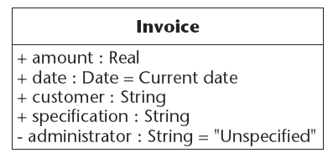
Class: Attributes Default Value
Figure below shows an attribute with a default value.
It’s assigned at the same time an object of the class is created.

Slide 13
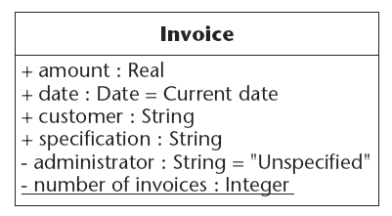
Class with a class-scope attribute
An attribute can also be defined as a class-scope attribute. This means that the attribute is shared between all objects of a certain class (sometimes called a class variable).
By convention, display the class-scope attribute with an underline.
UML tools might display class-scoped attributes in different ways, and the meaning of these will differ in models fitting a profile for a specific programming language. For example, in Java a class variable will mean a static variable.

Slide 14
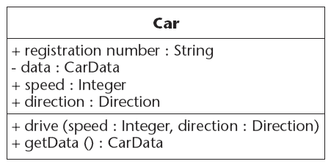
Class: Operations / Methods
Operations manipulate the attributes or perform other actions.
Operations are normally called functions, but they are inside a class and can be applied only to objects of that class.
An operation is described with
a return-type,
a name, and
zero or more parameters.

Slide 15
Relationships
Class diagrams consist of classes and the relationships among them.
The relationships that can be used are associations, generalizations, dependencies, and abstractions/realizations.
An association is a connection between classes, which means that it is also a connection between objects of those classes. In UML, an association is defined as a relationship that describes a set of links, where link is defined as a semantic connection among a tuple of objects.
A generalization is a relationship between a more general and a more specific element. The more specific element can contain only additional information. An instance (an object is an instance of a class) of the more specific element may be used wherever the more general element is allowed.
A dependency is a relationship between elements, one independent and one dependent. A change in the independent element will affect the dependent element.
An abstraction is a relationship between two descriptions of the same thing, but at different levels. A realization is a type of abstraction that shows a model element that realizes a more general element.

Slide 16
Sample (1)

Slide 17
Sample (2)
An insurance company has insurance contracts, which refer to one or more customers.
A customer has insurance contracts (zero or more), which refer to one insurance company.
An insurance contract is between an insurance company and one or more customers.
The insurance contract refers to both a customer (or customers) and an insurance company.
The insurance contract is expressed in an (zero or one) insurance policy (a written contract of insurance).
The insurance policy expresses an insurance contract.

Slide 18
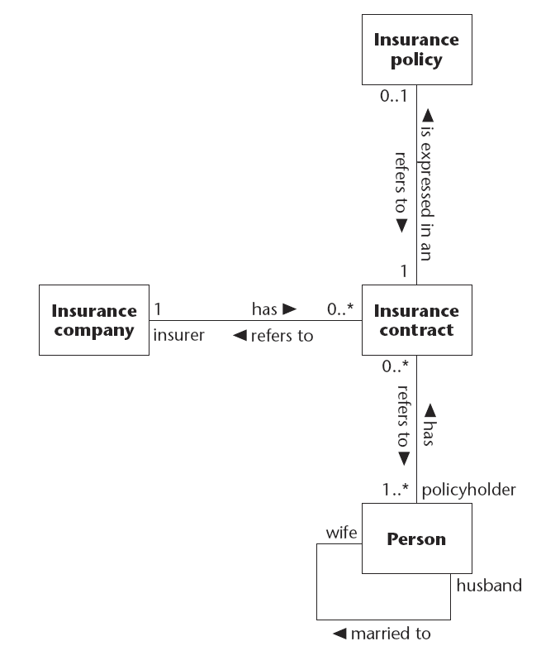
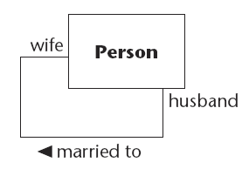
Recursive Association

Slide 19
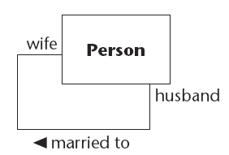
Role in Association (Qualified Association)

Slide 20
Ternary Association
More than two classes can be associated with each other; the ternary association associates three classes.
The model in Figure shows that a customer who plays the role of policyholder has many (zero-to-many) insurance contracts, and each insurance contract is associated with an insurance company that plays the role of insurer.
On the association between customer and insurance contract, there is an (zero or one) insurance policy.
The ternary association is shown as a large diamond.
Roles and multiplicity may be shown, but qualifiers and aggregation (see next section) are not allowed.
An association class may be connected to the ternary association by drawing a dashed line to one of the four points on the diamond.

Slide 21
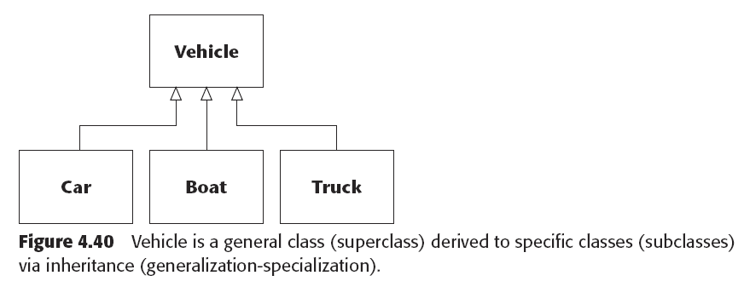
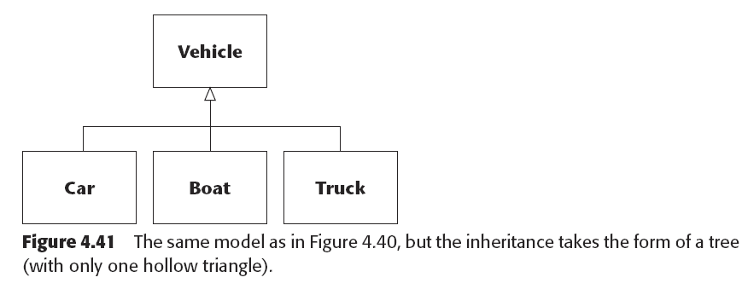
Generalization

Slide 22
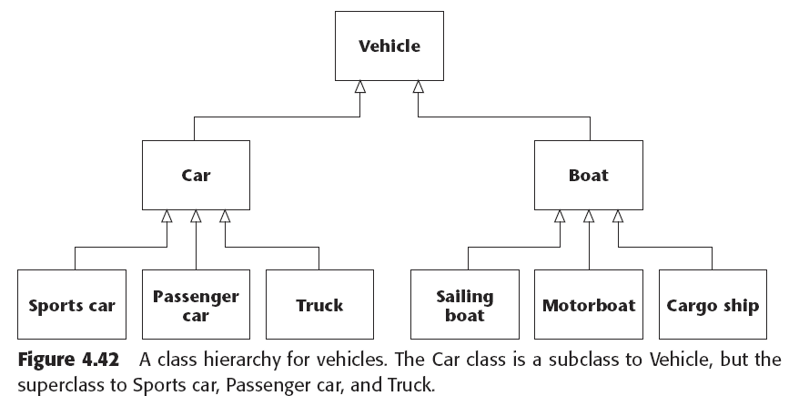
Generalization (2)

Slide 23
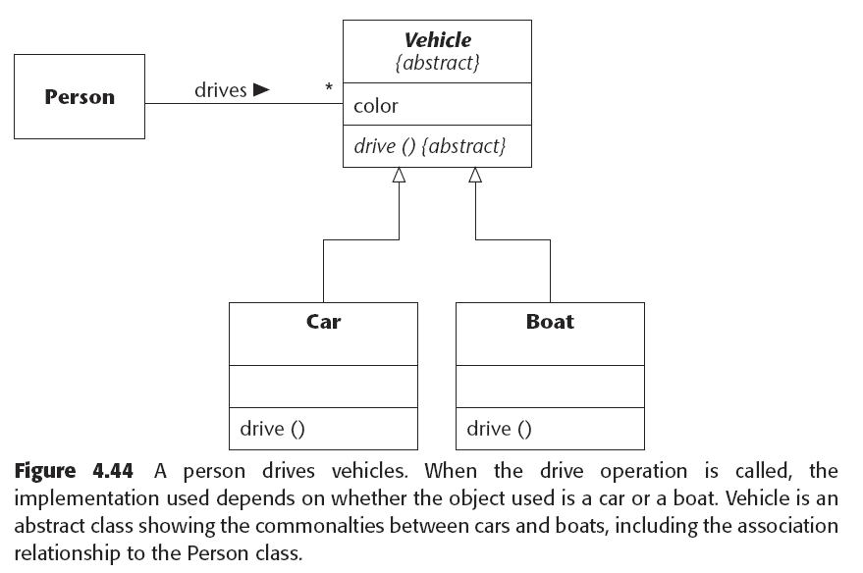
Generalization (3)

Slide 24
Thank you
THIS SLIDES CAN BE DOWNLOADED IN http://www.slideshare.net/kupalima
Arry, Farid, Armein
Jembatan Golden Gate, San-Francisco, 2001
Dalam rangka Comparative Study
Untuk Pengembangan Industri Software di Indonesia

