Slide 1
Sequence Diagram
Arry Akhmad Arman
School of Electrical Engineering and Informatics
Institut Teknologi Bandung, Indonesia
Email: arman@kupalima.com
Website: http://www.kupalima.com
Blog: http://kupalima.wordpress.com
Download Center: http://slideshare.net/kupalima
Course milist: arman_course_se@yahoogroups.com
Last update: March 30, 2010

Slide 2
Description
Sequence diagrams illustrate how objects interact with each other.
They focus on message sequences, that is, how messages are sent and received between a number of objects.
Sequence diagrams have two axes:
the vertical axis shows time and
the horizontal axis shows a set of objects.
A sequence diagram also reveals the interaction for a specific scenario — a specific interaction between the objects that happens at some point in time during the system’s execution (for example, when a specific function is used).

Slide 3
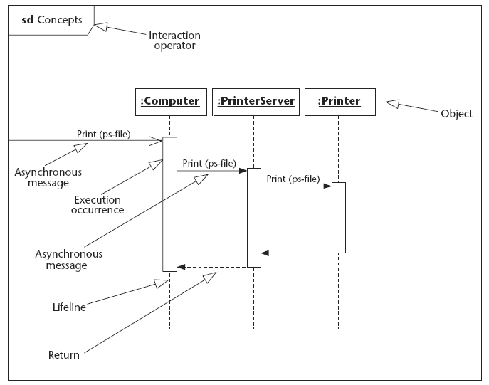
Concept of Sequence Diagram

Slide 4
Generic and Instance Form
Sequence diagrams can be used in two forms: the generic form and the instance form.
The instance form describes a specific scenario in detail; it documents one possible interaction. The instance form does not have any conditions, branches, or loops; it shows the interaction for just the chosen scenario.
Example: student choose a list of courses for specific condition, he want to finish his study faster than normal condition
The generic form describes all possible alternatives in a scenario; therefore branches, conditions, and loops may be included.
Example: student choose a list of courses for normal condition

Slide 5
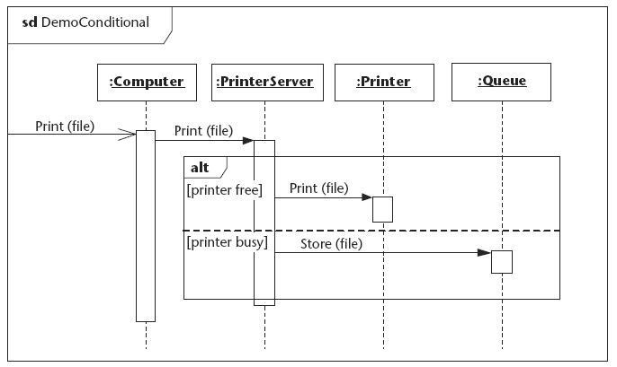
Conditional in Sequence Diagram

Slide 6
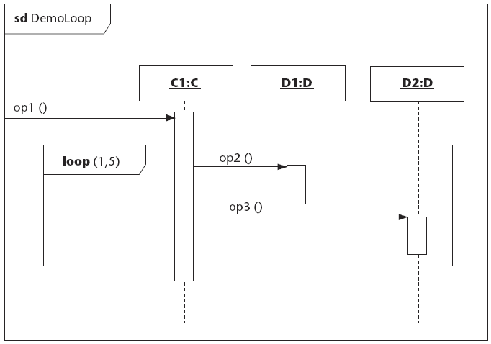
Loop in Sequence Diagram

Slide 7
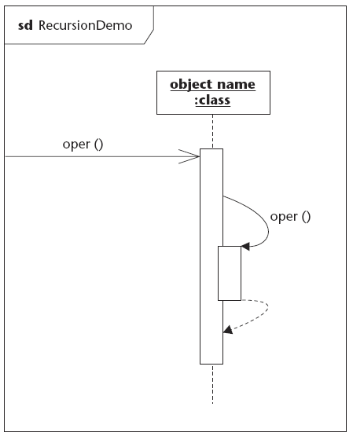
Recursion in Sequence Diagram

Slide 8
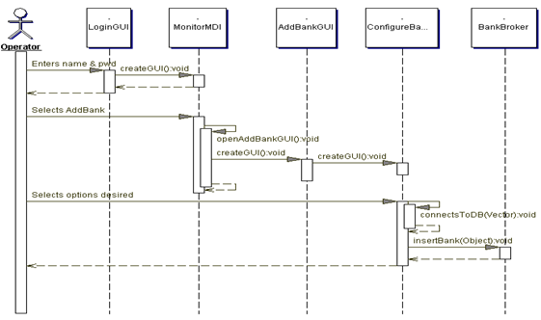
Sample (1)

Slide 9
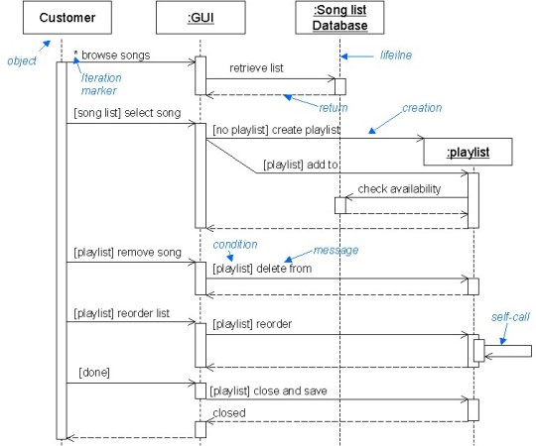
Sample (2)

Slide 10
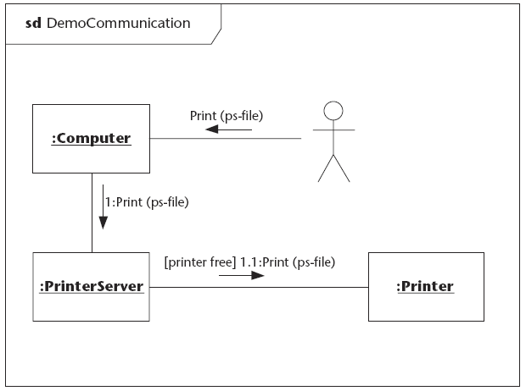

Slide 11
Thank you
THIS SLIDES CAN BE DOWNLOADED IN http://www.slideshare.net/kupalima
Arry, Farid, Armein
Jembatan Golden Gate, San-Francisco, 2001
Dalam rangka Comparative Study
Untuk Pengembangan Industri Software di Indonesia

