Slide 1
Chap VI : Problem in Stakeholder Management
Dr. Ir. Yeffry Handoko Putra, M.T
(yeffry@unikom.ac.id)
Magister Sistem Informasi Universitas Komputer Indonesia

Slide 2
Delegation

Slide 3
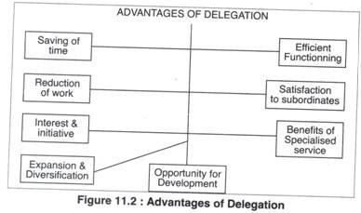

Slide 4
Delegation
It shares the workload of the project, particularly that of the leader.
It allows the leader to focus on what he or she is best at doing and enables the team member to learn new skills beyond normal team roles.
It shows that the leader trusts the team member to take on the challenge and “stretches” the team member, encouraging him or her to seek new stimulation through accepting challenges, thus building new skills that will benefit the individual as well as the team as a whole (Owen, 2012).

Slide 7
A leader should consider delegating tasks that
Can be done better by a subordinate,
Are urgent but not high priority,
Are relevant to a subordinate’s career
Are of appropriate difficulty,
Are both pleasant and unpleasant, and
Are not central to the manager’s role

Slide 9
Feedback

Slide 11
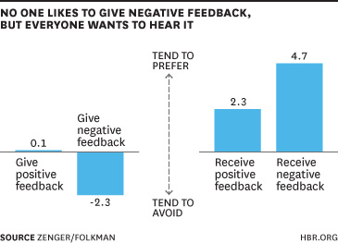

Slide 12
Feedback
Negative Feedback
Deny all wrongdoing: “That is not what happened.”
Spread the blame: “I was told to do this,” or “I thought someone else was doing this, but they let me down.”
Change the subject: “There are more important issues to focus on than this!”

Slide 13
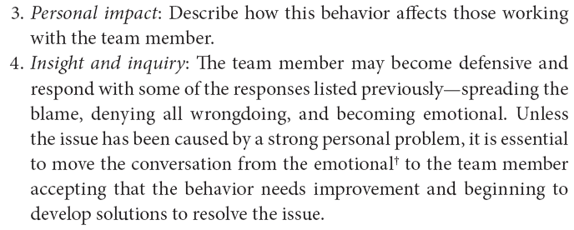
Feedback

Slide 14
Conflict

Slide 15
Thompson (2011) defined three major types of conflict
Relationship conflict
Task conflict
Process conflict:

Slide 18
Process to deal with conflict
Together agree on what the problem really is or if there actually is a problem.
Together agree on some optimal outcomes
Only then should the group identify potential solutions
Agree on the best course of action and develop an implementation plan
Set a date for the next meeting to report on progress

Slide 20
Blake and Mouton (1964) ‘s conflict resolution
Forcing or competing
Smoothing or accommodating
Compromise
Problem solving/confronting
Withdrawal or avoiding
Facilitated (binding or nonbinding)

Slide 23
Coaching
Counseling and coaching team members—dealing with the negative behaviors or performance issues of team members—are important leadership roles.

Slide 24
Coaching can be in the form of (Owen, 2012).
Helping solve problems through listening and asking questions to aid understanding and “unblock” thought processes;
Listening, summarizing, and encouraging reflection;
Guiding the individual to reach personal solutions;
Giving feedback (positive or negative); and
Encouraging action.

