Slide 1
Road to Knowledge Management System
By Amrit Tiwana

Slide 2
Integration of Knowledge Sources
what are the primary feeds to a knowledge management system?
Where does knowledge come into the system from?
it is clear that much of the knowledge can be explicated, put into systems, and reused.
However, some critical pieces of tacit knowledge are extremely difficult, if not impossible, to externalize in such a manner

Slide 3
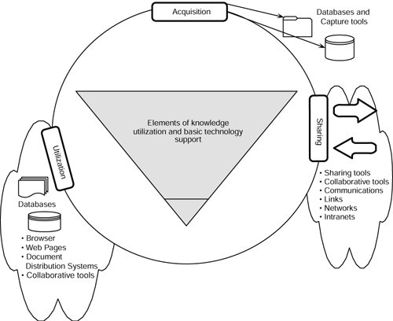
The Three Fundamental Steps
• Knowledge acquisition
• Knowledge sharing
• Knowledge utilization

Slide 4
Knowledge Acquisition
Knowledge acquisition is not to be confused with information acquisition. Knowledge acquisition is the process of development and creation of insights, skills, and relationships
For example, when an experienced stockbroker can see the trend line on a computer monitor and tell which way the market is headed—that is an example of intuition or acquired knowledge.
It is this type of knowledge in which information technology components
surrounding this process need to focus.
Data-capture tools with filtering abilities, intelligent databases, keyboard scanners, CrossPad type note-capture tools and electronic white boards are examples of information technology components that can support knowledge
acquisition.

Slide 5
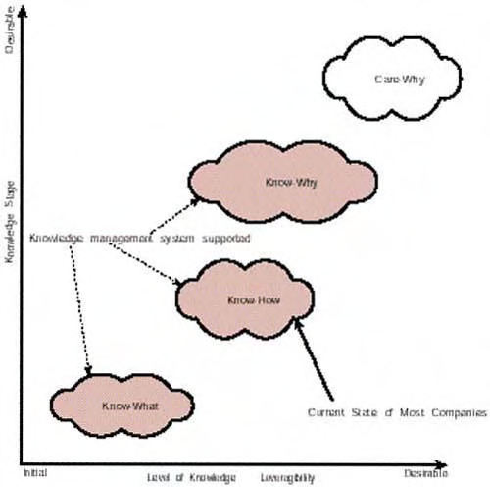
Knowledge Acquisition
Professional Intellect: Know-What to Care-Why
Care-why
Know-why
Know-how
Know-what

Slide 6
Knowledge Acquisition
Care-why
This happens to be the only level that cannot be supported by a knowledge management system.
Care-why explains why highly motivated, creative, and energetic groups and companies outperform larger corporations with more money and resources.
This level of knowledge exists in a company's culture, and after we have done all we can to provide technology support for the other three levels, we must give this one our best shot, since technology is of little or no help at this level.

Slide 7
Knowledge Acquisition
Know-why
A system's understanding represents the know-why aspect of knowledge.
It's the deep knowledge of the complex slush of cause-and-effect relationships that underlie an employee's range of responsibilities.
This knowledge enables individuals to move a step above know-how and create extraordinary leverage by using knowledge, bringing in the ability to deal with unknown interactions and unseen situations.
Examples include a stockbroker who intuitively knows just when to sell and buy, or a baseball player who knows the perfect moment to hit.

Slide 8
Knowledge Acquisition
Know-how
Know-how represents the ability to translate bookish knowledge into real-world results.
Marketing departments, for example, know that advertising during the Superbowl is expensive, but the payoffs are huge.
Professional know-how is developed most rapidly through repeated exposure to real- world, complex problems.
Any networking or knowledge support system that intends to move workers from this level to the know-why level must enable extensive exposure to problem solving

Slide 9
Knowledge Acquisition
Know-what
This represents cognitive knowledge.
This is an essential but insufficient basis for competing.
An analogy would be the kind of detailed knowledge a college graduate might have when he graduates with a degree in his discipline.
He might know what should be done but might not have ever done it in real life.

Slide 10
Knowledge Sharing
The Collaborative Nature of Knowledge
this stage comprises disseminating and making available what is already known. An expert system that helps a novice technical support person answer tech support calls at the help desks of Microsoft is a good example of knowledge that is being shared with that person.
One characteristic that distinguishes a firm's knowledge from its information assets is the foundation on which knowledge is primarily built.
Collaborative problem solving, conversations, and teamwork generate a significant proportion of the knowledge assets that exist within a firm.

Slide 11
Knowledge Utilization
Knowledge utilization comes into the picture when learning is integrated into the organization.
The Telephone as a Role Model for KM Systems Design
the first technology that comes to the minds of most managers is their intranet.
But what often is forgotten is a device as common as their coffeepot and arguably more useful than their PalmPilot: the telephone
The telephone represents the best set of characteristics that one
could wish for in a system that supports knowledge flow effectively. As you speak into the telephone, you can convey context, meaning, an attitude, and tone, along with information and data.
Notes:
The telephone, the fax, and the newspaper are successful devices not because they carry
information but because they are deeply embedded in the communities within a company.
For this reason, the telephone is perhaps the best role model for a knowledge management
system.

Slide 12
Knowledge Management Systems and Existing Technology

Slide 13
KM System
Differences Between a KM System and a Data Warehouse
Types of Information Managed
Context
Size
Content Focus
Performance
Networks
Because of the complex nature of retrieval and classification requests that a KM system must be able to handle, performance requirements and computing power needed for a knowledge management system are much higher than those of a data warehouse.
The content focus of a knowledge management system is on highly filtered information and on knowledge, whereas that of a data warehouse is on scrubbed, raw, clean, and organized data.
Since a data warehouse primarily focuses on clean, structured, and organized data, the size of a data warehouse is always large.
a knowledge management system might have storage system sizes ranging from very small to extremely large
A data warehouse focuses more on highly structured content, whereas a knowledge management system needs to support both informal and formal (highly unstructured as well as highly structured) content and everything in between.
A data warehouse does not need to be on a live network to function properly; however, this live network is imperative for a knowledge management system that is trying to draw from resources available throughout the entire enterprise and beyond it—from the Internet and collaborative, extended enterprise.
A data warehouse is arguably a resource of unquestionable value when you need to mine factual data. When such data is mined and interpreted, it provides value
A knowledge management system depends on much higher contextual focus than that typically provided by data warehouses

Slide 14
KM System
Differences Between a KM System, an Intranet, and an
Extranet
Intranets focus more on efficient information delivery and publishing. The focus is often
more on fast, low-cost delivery throughout the enterprise and the extended enterprise.
However, knowledge management systems focus more on actionable information, in other
words, knowledge.
Content Focus
Performance
Broader Base
Productizing Knowledge
Reciprocity

Slide 15
KM System
Differences Between a KM System, an Intranet, and an
Extranet
Performance demands on knowledge management systems are often higher than on basic
intranets, both in terms of network bandwidth requirements and processing power demands.
While processing power is rarely the problem, network bandwidth often is.
Content Focus
Performance
Broader Base
Productizing Knowledge
Reciprocity

Slide 16
KM System
Differences Between a KM System, an Intranet, and an
Extranet
A typical intranet often has a broader base and a more open face to the outside world such as the firm's major customers and partners. This is usually not the case with critical knowledge management systems a company uses to gain a competitive edge and to leverage business processes across an extended enterprise and the firm's value chain.
Content Focus
Performance
Broader Base
Productizing Knowledge
Reciprocity

Slide 17
KM System
Differences Between a KM System, an Intranet, and an
Extranet
Because intranets have a broader user base, they do not productize knowledge as much as knowledge management systems do. A typical knowledge management system, especially if it uses push delivery, has to do individual iteratively improved content customizations unlike
mass customization on which a typical intranet depends.
Content Focus
Performance
Broader Base
Productizing Knowledge
Reciprocity

Slide 18
KM System
Differences Between a KM System, an Intranet, and an
Extranet
Information technology, the Internet, and the Web are far reaching. However, the assumption that knowledge networks aided by these information networks will spread the same way is fundamentally flawed. A knowledge network is not limited by its reach and the extent to which it can be used to communicate but rather by the extent to which it supports reciprocity.
Content Focus
Performance
Broader Base
Productizing Knowledge
Reciprocity

Slide 19
KM System
Differences Between a KM System and GroupWare
Our focus on the differentiation between GroupWare and knowledge management systems is built around the following characteristics:
• Focus—function and content
• Archival versus generation functionality
• Internal versus external sources
• Relationship with knowledge generated from activities of the firm

Slide 20
KM System
Differences From Project Management Tools
Although project management tools allow for the capture of formal structured knowledge, a system needs to support some form of informal knowledge as well to "capture" at least some portion of tacit knowledge.
To transfer tacit knowledge from individuals to a repository, you need to support some form of community-based electronic discussion
A key feature that would differentiate a knowledge management support tool from a project management tool's organizational memory store which is the ability to capture and retrieve uncodified or tacit knowledge that can be slow and costly to transfer

Slide 21
Retrofitting Knowledge to Information Technology
Knowledge must be treated as a driver for technology choice, not vice versa.
technology can be fitted to knowledge, it is meant to support

Slide 22
The CKO title can be a misleading role definer. Many companies are structured in ways that do not allow a CKO, per se, to oversee knowledge management.
Numerous companies have scrapped the CKO title and assigned the role to equivalent high-level managerial workers such as competence managers and practice area specialists.

Slide 23
The Survival Imperative
The obvious question is why
In the knowledge-based economy, survival depends on the best possible response to a multitude of challenges.
Managing knowledge means more than just introducing powerful databases or intranets.
Managing it means adding or creating value by actively leveraging know-how, judgment, intuition, and experience resident within and outside the company with a focus on:
Generating new knowledge
Using accessible knowledge in making decisions
Embedding it in products, services, and processes
Facilitating knowledge growth
Transferring existing knowledge
Integrating competitive intelligence
Driving strategy

Slide 24
KMS
Difficulties and Coping Mechanisms for Knowledge
Management
Knowledge Management Is Expensive
Knowledge Markets, Not Hierarchies
Incompatible Combinations of Technology and People

Slide 25
Example Case
Texas Instruments (TI)
Texas Instruments (TI) was low on its customer satisfaction
rankings in 1992 because of the company's unusual failure to
deliver semiconductors on time. TI's worldwide wafer
fabrication team adopted and transferred best practices
internally across several locations, effectively creating
additional wafer fabrication capacity that would have needed a
$500 million investment in a new fabrication plant. Besides
saving half a billion dollars in additional investments, this
knowledge-sharing initiative pulled up the company from the
bottom to the top position on its industry's customer
satisfaction rankings.

Slide 26
KMS
The most important things
Knowledge access is only the beginning of knowledge management
Knowledge management is an infinite loop that never ends
Organizational politics come into play when knowledge exists, is used, and is exchanged.

Slide 27
Business and Knowledge
How Companies Learn to Learn
Knowledge-Friendly Companies
Knowledge-friendly companies are those that realize that their knowledge can be the only
asset from which they can hope to draw a long-term competitive advantage
Knowledge-Sharing Companies
Knowledge is one the few resources that demonstrates increasing returns to scale: The more you share it, the more it grows

Slide 28
Is Your Company Ready for Knowledge Management?
A number of facilitating factors are required for any knowledge management effort to succeed. You will notice that most successful adopters share many of these underlying facilitators that indicate their readiness for knowledge management:
Scanning imperative
Shared perception of performance gaps
Metrics
Corporate culture
Knowledge champions
Strategic alignment
Begin with what you know
seven characteristics that can help you decide if your company is ready for it

Slide 29
THANK’S FOR TODAY

