Slide 1
Phase 1
Infrastructure Evaluation

Slide 2
Link your company's existing networks, intranet, and extranets to your knowledge management strategy.
Comprehend the knowledge management technology framework and its components.
Analyze, leverage, and build upon data mining, data warehousing, project management, and DSS tools that might already be in place.
Deploy knowledge servers for enabling enterprise integration.
Integrate existing intranets, extranets, and GroupWare into your knowledge management system.
Perform a preliminary business needs analysis to evaluate relevant knowledge server choices.
Identify the limitations of implemented tools and identify existing gaps in your company's existing infrastructure.
Take definite steps to leverage and build upon existing infrastructural investments.

Slide 3
what can be leveraged?
From the machine to the mind
Collaborative synergy and support
Real knowledge, not artificial intelligence
Conversation as a medium for thought
Sources and originators, not just information
The golden rule
Decision support
Flexibility and scalability
Pragmatism, not perfection
The user is king
Ease of use

Slide 4
Leveraging the Internet
In the context of knowledge management, the Internet's global reach has five key implications:
A cost-effective global network backbone
Anyplace, anywhere
Distributed connectivity:
Robust global data path
Cheaper, faster, and directly usable global competitive intelligence

Slide 5
Platform Independence
Data in the enterprise is often available in a multitude of formats and platform-dependent forms.
Even if we ignore the platform compatibility issues that people might have with different versions of Windows alone, a typical company is still left with several, often incompatible platforms across which its data is spread out.
Knowledge management must begin by taking stock of what information and knowledge already exists

Slide 6
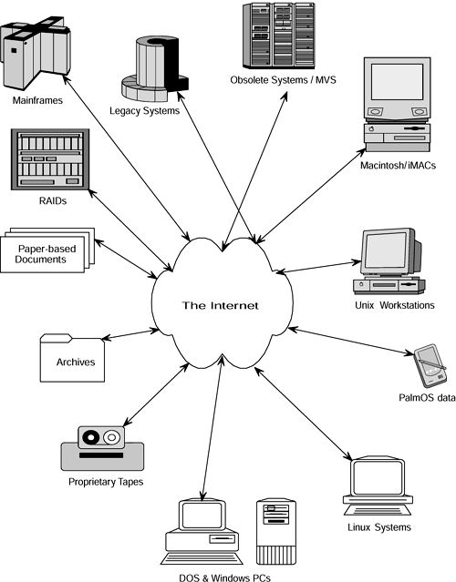
Paper documents are not a problem to begin

Slide 7
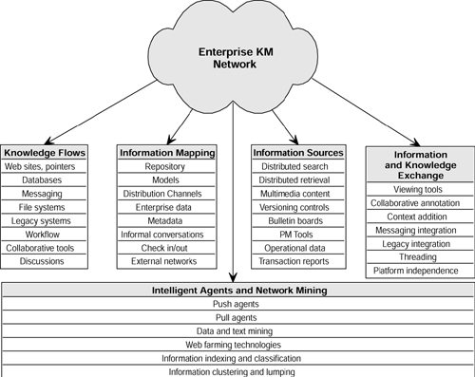
Enabling Technologies for the Knowledge Management Technology Framework
These link and map the flow of information that might
later be converted to knowledge across the enterprise.
Knowledge mining, linking, retrieval, and
intelligence tools facilitate finding knowledge using intelligent agents and pattern
mining tools.
These link and map the flow of information that might
later be converted to knowledge across the enterprise.
These components facilitate knowledge flow within the
knowledge management system
Tools and nontechnological facilitators
that enable exchange of information across tacit (such as people) and explicit (such
as databases, transaction processing repositories, and data warehouses) sources,
help create and share context (the process itself is called contextualization), and
facilitate sensemaking

Slide 8
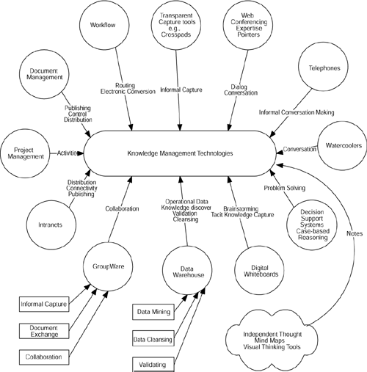
The framework of technologies required to support knowledge management and their functionality

Slide 9
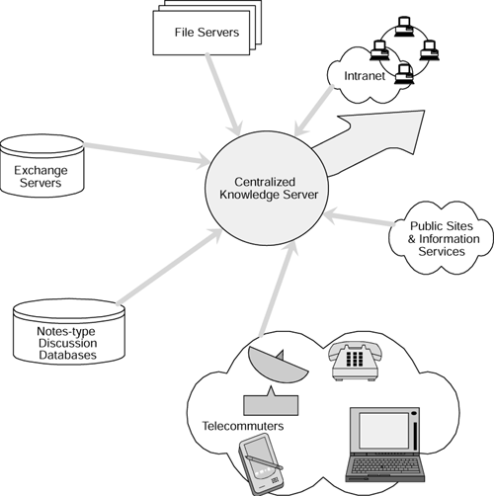
Integrating Technology
Knowledge Servers
A knowledge server, provides an extensible architecture for unifying and organizing access to disparate corporate repositories and Internet data sources as a first affirmative step toward building content for the knowledge management system. In a typical knowledge server, plug-in components or accessors periodically poll remote data sources for new content.

Slide 10
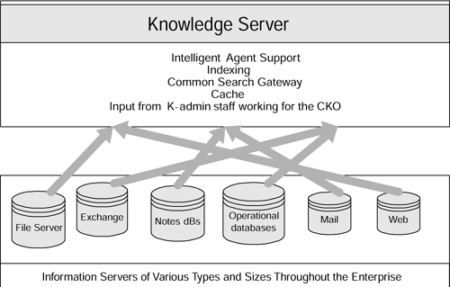
Knowledge Server
The strength of knowledge servers comes from their ability to integrate existing repositories without having to start from scratch

Slide 11
Aligning Knowledge Management and Business Strategy
Imagination is more important than knowledge
—Albert Einstein

Slide 12
If knowledge creation is to be successfully directed, there must be an indisputable link between your company's business strategy and its knowledge management strategy.
An effective knowledge management strategy is not simply a technology strategy but a well-balanced mix of technology, cultural change, new reward systems, and business focus that is perfectly in step with the company's business strategy
KNOWLEDGE STRATEGY | Product Innovation Knowledge Creation Intellectual Capital | Process Innovation Knowledge Sharing Developing Learning Culture | Product Innovation Customer Knowledge Integration Branding knowledge
BUSINESS STRATEGY | Product Sales Time to Market Distribution Network Pricing Strategy Patent & product leverage | Process streamlining SCM Accounting and Financing | Customer retention Customer product needs Revenue growth Partnering/alliance
 | GROWTH AND VALUE | OPERATIONAL EFFECTIVENESS | CUSTOMER INTIMACY

Slide 13
From Strategic Programming to Strategic Planning
Knowledge drives strategy. Strategy drives knowledge management
Strategic planning has not lived up to the irrational expectation of providing step-by-step instructions (i.e., strategic programming) for managers to execute strategies
Companies need to take a 180° turn and move from strategic programming to strategic thinking
Notes:
Henry Mintzberg, one
of the foremost management thinkers of our times, warns us that companies are too easily
driven by strategic plans, not strategic visions

Slide 14
Managers and businesses need to capture what they learn both from the soft insights and experiences and from hard market data, and then synthesize that learning into a vision of the direction that the business should pursue.
Effective knowledge management is to knowledge what the spreadsheet is to financial analysis: Both can be underused and abused, but when put into action properly, they provide the widest window into the future

Slide 15
Moving Beyond SWOT Analysis
knowledge management focuses specifically on your company and not your industry, Zack's model, not Porter's SWOT analysis framework, provides the key to aligning business strategy and knowledge management.

Slide 16
Codification or Personalization?
personalization
the personalization strategy is more focused on connecting knowledge workers through networks and is better suited to companies that face one-off and unique problems that depend more on tacit knowledge and expertise than on codified knowledge
codification
The codification strategy is more focused on technology that enables storage, indexing, retrieval, and reuse

Slide 17
Knowledge Maps to Link Knowledge to Strategy
The idea of knowledge maps as applied to KM comes from research by Michael Zack, who also describes this process as knowledge-based SWOT analysis.
To articulate the strategy-knowledge link, a company must explicate its strategic intent, identify knowledge required to actually execute that strategic choice, and reveal its strategic knowledge gaps by comparing these to its actual knowledge assets

Slide 18
The strategic choices that your company makes regarding technology, markets, products, services, and processes have a direct impact on the knowledge, skills, and competencies that it needs to compete in its intended markets

Slide 19
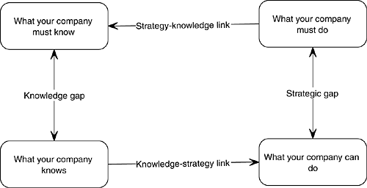
High-level Zack framework-based strategic knowledge gap analysis
Assessing your company's present knowledge position necessitates documenting its existing knowledge assets—the fourth step of the 10-step KM roadmap

Slide 20
For our initial high-level analysis, we can categorize knowledge into three classification:
Core knowledge:
Core knowledge is the basic level of knowledge required just to play the game.
Advanced knowledge:
Advanced knowledge is what makes your company competitively viable.
Innovative knowledge:
Innovative knowledge allows a company to lead its entire industry to an extent that clearly differentiates it from competition.

Slide 21
Core knowledge: Example
Let's take two examples: One from the consumer electronics (hard product) business and one from Internet programming (soft product). To enter the modem manufacturing market, a new company must have extensive knowledge of these aspects: a suitable circuit design, all electronic parts that go into a modem, fabricating surface mount (SMD) chip boards, how to write operating system drivers for modems, and familiarity with computer telephony standards. Similarly, a company developing Websites for, say, florists, needs server hosting capabilities, Internet programming skills, graphic design skills, clearly identified target markets, and necessary software. In either case, just about any competitor in those businesses is assumed to have this knowledge in order to compete in their respective markets; such essential knowledge therefore provides no advantage over other market players.

Slide 22
Advanced knowledge: Example
In the case of a company trying to compete in modem manufacturing markets, superior or user-friendly software or an additional capability in modems (such as warning online users of incoming telephone calls) represents such knowledge.
In case of a Website development firm, such knowledge might be about international flower markets and collaborative relationships in Dutch flower auctions that the company can use to improve Websites delivered to its customers.

Slide 23
Innovative knowledge: Example
Patented technology is an applicable example of changing the rules.
Innovative knowledge cannot always be protected by patents, as the lawsuit between Microsoft and Apple in the 1980s should serve to remind us.
Apple sued Microsoft for copying the look and feel of its graphical user interface (GUI). The Supreme Court ruled that things like look and feel cannot be patented; they can only be copyrighted. Microsoft won the case, since it copied the look and feel but used entirely different code to create it in the first place.

Slide 24
Creating a Knowledge Map
Knowledge is not static
What is innovative knowledge today will become the core knowledge of tomorrow
The key lies in staying consistently ahead of the competition
The knowledge map we'll create provides a snapshot of where your company is at any given time (such as today) relative to its competitors

Slide 25
Analyzing Knowledge Gaps
The gap between what your company is doing and what it should be doing represents its strategic gap.
your company's knowledge gap is represented by what your company should (and possibly can) know and what it does know in order to support the competitive position that it has adopted.
These two gaps must be aligned and must feed into each other to bridge existing gaps.

Slide 26
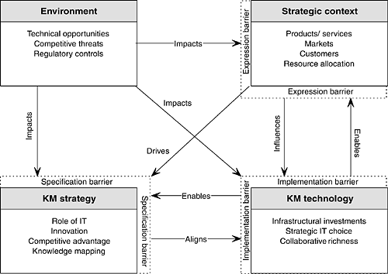
Aligning knowledge and business strategy

Slide 27
Thank’s for Today

