Slide 1
The Second Phase: KM System Analysis, Design, and Development
By Amrit Tiwana

Slide 2
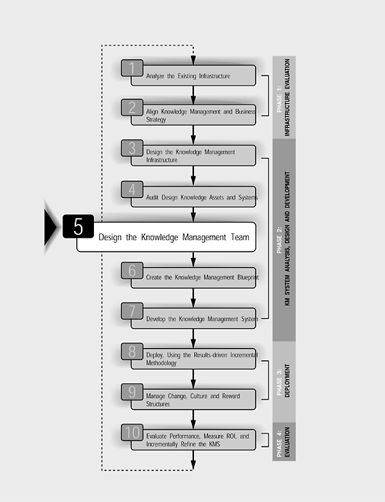
Designing the KM Team

Slide 3
A knowledge management system is built on expertise, knowledge, understanding, skills, and insights brought into the project by a variety of stakeholders who might have little in common from a functional standpoint
Identify sources of internal and external expertise needed, prioritize stakeholder needs, evaluate member selection criteria, and examine team life span and sizing issues.
Identify characteristics of the km project leader to determine mechanisms to streamline internal dynamics and maximize users' participation
Identify tasks for the KM team and fit them to the risk evaluation matrix to circumvent common points of failure

Slide 4
Sources of Expertise
Internal, centralized IT departments
Team-based local experts
External vendors, contractors, partners, and consultants
End users and front-line staff

Slide 5
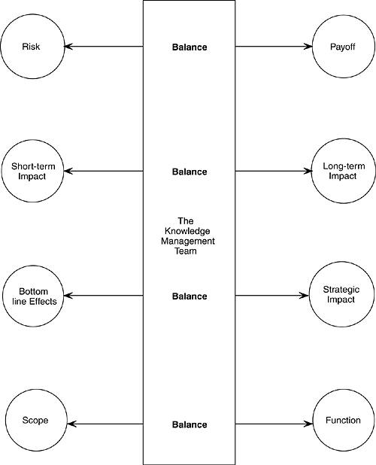
The KM team must strike the right balance
we cannot undermine the importance of IT staff who will actually build a system, the most important part of this team member set is the set of local team-based expert(s).
The burden of balancing counteracting requirements falls on the shoulders of the knowledge management team

Slide 6
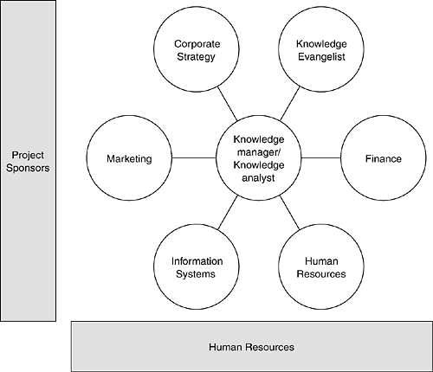
KM team structure.

Slide 7
Structuring the Knowledge Management Team
Teams
User teams
Technology
IT experts/information systems
Finance
Marketing
Other functional areas with which the knowledge management initiative is concerned
Internal IT staff
External consultants
Organizational
Senior management
Sponsors
Knowledge champion(s)
CKO

Slide 8
Focus: Teams
Role in the Knowledge Management Project
Provide functional expertise.
Characteristics Strongly Desired
Must understand work processes in their area.
Provide business expertise in their specific area.
Participate in the process design stage.
Help in the implementation stages of the system.
Must have good interpersonal and team skills.
Must have a certain degree of credibility within other participating groups.
Must be willing to see from other functional viewpoints.

Slide 9
Focus: Technology
Role in the Knowledge Management Project
Provide technology expertise.
Characteristics Strongly Desired
Must understand technology in depth.
Participate in the actual implementation and design.
Represent the internal and internally proficient technologists.
Actually write the code.
Bring in a perspective on functional capabilities and limitations of existing systems.
Must have good interpersonal skills.
Must have strong team skills.
Must be willing to understand the perspectives brought in by other team members and actually incorporate them into the design.
Must be willing to learn.
Must be credible.
Must have an expansive customer orientation.

Slide 10
Focus: Organizational
Role in the Knowledge Management Project
Support the legitimacy of the project.
Characteristics Strongly Desired
Understand the management and strategic processes.
Bring in vision that correlates with the overall companywide vision.
Serve on steering committees (if needed).
Commit the resources needed.
Must be credible.
Must have a strong leadership position that almost everyone on the team accepts.
Must have a clear idea of the bigger picture of where knowledge leveraging should take the company.
Must "eat their own dog food," that is, they must themselves believe what they say.
Need to be thoroughly convinced of the worth of the project.

Slide 11
Designing the Knowledge Management Project Team
Defining the knowledge management project leader's role
Defining the team composition and selection criteria for team members
Must be credible.
Must have a sufficient level of authority and resource capability.
Should not change; must be stable.
Must have specialized expertise.
Must have had sufficient experience within the company or working with the company as an external consultant.
Must have the required competencies that truly represent the concerns of the department or functional area that the team member represents.
Might work full time or part time on this project.
Must know how to facilitate, consult, and resolve conflicts.
Must take charge of the conventional project management, scheduling, and coordination duties.

Slide 12
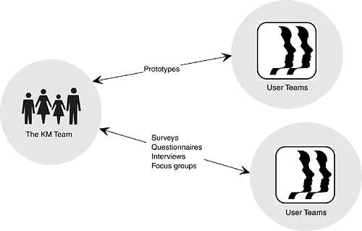
Prototyping and other methods of linking the user and the knowledge management project.

Slide 13
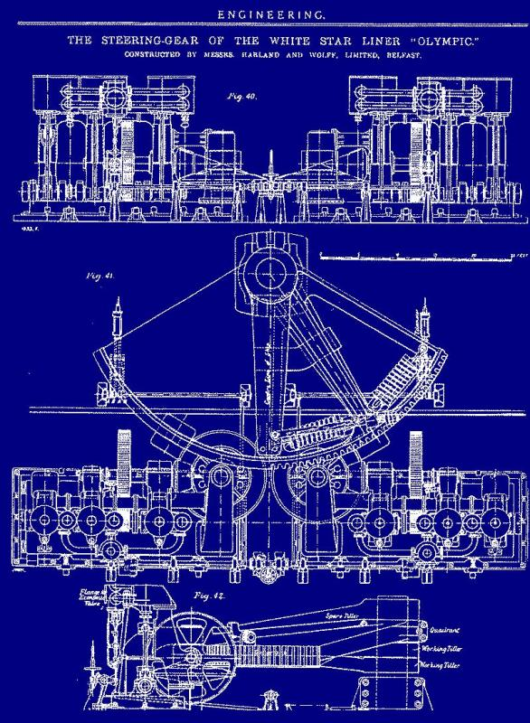
Creating the KM System Blueprint
Step 6

Slide 14
The Knowledge Management Architecture
Information technology is a great enabler for sharing, application, validation, and distribution of knowledge—primarily explicit knowledge.
The knowledge management architecture should be seen as an enabler for knowledge management and not a complete solution: a means and not an end in itself

Slide 15
Components of a Knowledge Management System
Repositories: Repositories hold explicated formal and informal knowledge and the rules associated with them for accumulation, refining, managing, validating, maintaining, annotating (adding context), and distributing content.
Collaborative platforms: Collaborative platforms support distributed work and incorporate pointers, skills databases, expert locators, and informal communications channels.
Networks: Networks support communications and conversation. These might include hard networks such as your company's leased lines, your intranet, your extranets, and soft networks such as shared spaces, industry-wide firm collaborations, trade nets, industry forums, and exchanges (both live and teleconferenced).
Culture: Cultural enablers to encourage sharing and use of the above.

Slide 16
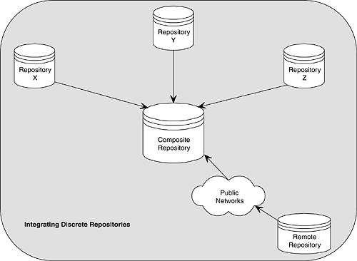
The Knowledge Repository
An information repository differs from a knowledge repository in the sense that the context of the knowledge object needs to be stored along with the content itself.

Slide 17
knowledge content
Declarative knowledge such as significant and meaningful concepts, categories,
definitions, and assumptions
Procedural knowledge such as processes, sequences of events and activities, and
actions
Causal knowledge such as rationale for decisions, rationale for rejected decisions or alternatives, eventual outcomes of activities, and associated informal pieces
Context of the decision circumstances, assumptions, results of those assumptions, and informal knowledge such as video clips, annotations, notes, and conversations

Slide 18
The Collaborative Platform
The collaborative platform, along with the communications network services and hardware, provides the pipeline to enable the flow of explicated knowledge, its context, and the medium for conversations.
the collaborative platform provides a surrogate channel for defining, storing, moving, and linking digital objects, such as conversation threads that correspond to knowledge units.

Slide 19
Collaborative Filtering
Active filtering: Users manually define filters and pointers to interesting content and share them across their work group.
Automated filtering: Statistical algorithms make recommendations based on correlations between the user's personal preferences and content ratings.
Content ratings can either be generated automatically (such as those produced by measuring the average time all readers spent on reading the item) or by manually assigning an average rating (aggregated across multiple readers).
Firefly, GroupLens, GrapeVine, and Tapestry are some better-known examples of such collaborative filtering tools.

Slide 20
The Interactive Application Component
The integrative components of a knowledge management system primarily support codified and explicitly captured knowledge.

Slide 21
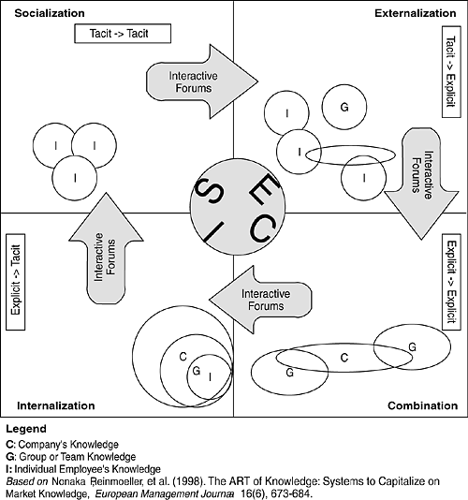
Rich media forums that run through high bandwidth networks often tend to be the most complex knowledge interaction applications, since they span the entire knowledge cycle.

Slide 22
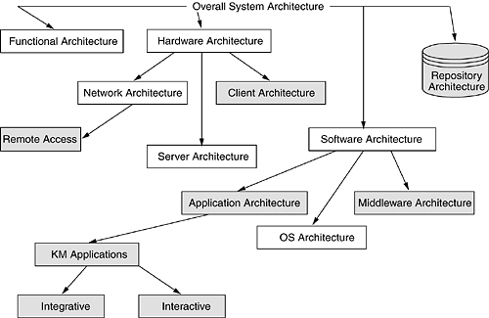
Architectural components (shown shaded) to be
modified or expanded to integrate the KM

Slide 23
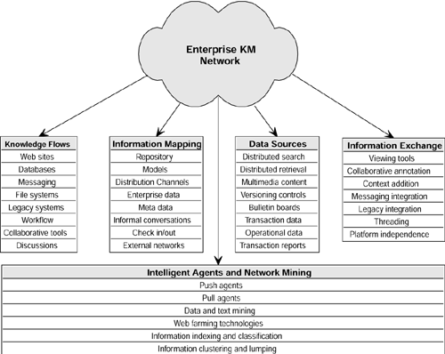
A Network View of the KM Architecture

Slide 24
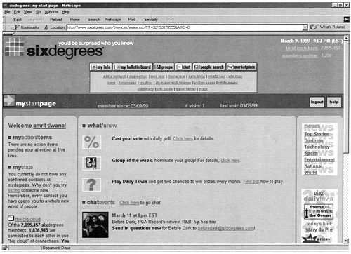
Six Degrees is a good example of a community built around relationships of collaborative filtering and members' recommendations

Slide 25
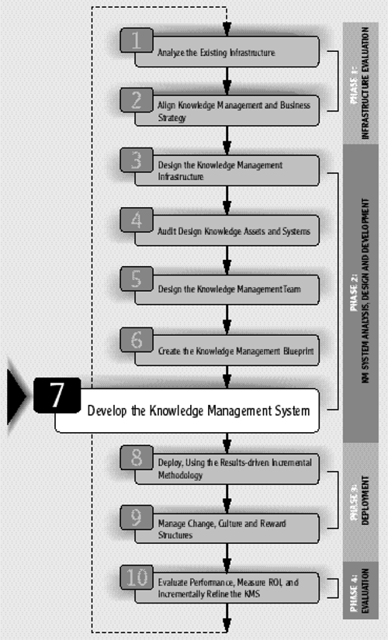
Developing the KM System
Step 7

Slide 26
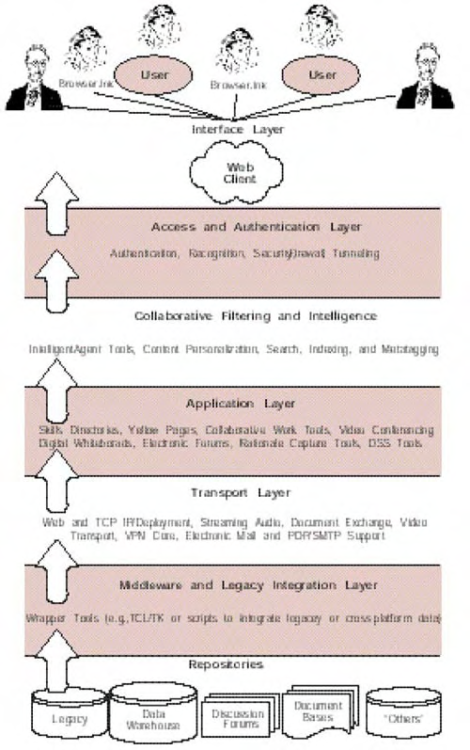
the next step, step 7, is that of actually putting together a working version of the system.
Development of the system begins by defining the seven layers of the knowledge management architecture.
Of the many possible interface choices, leveraging the existing intranet is the most feasible and effective approach.

Slide 27
Step 7 Point of View
Interface layer—incorporating platform independence, optimizing content, and enabling universal authorship
Access and authentication layer—providing a firewall for internal content
Collaboration layer—providing opportunity to build industry-standard document systems (and Web-friendly document standards such as DMA and Web DMA); shifting from client/server to agent/computing architecture
Application, transport, and repository layers—forming a nodding acquaintance with these three layers
Middleware and legacy integration layers—connecting the KM system to both true legacy data and recent legacy data repositories and databases

Slide 28
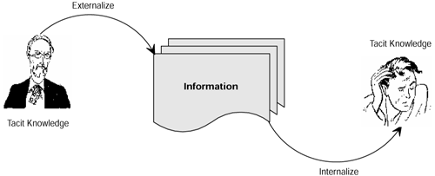
The Interface Layer : Channels for Tacit and Explicit Knowledge
Knowledge transfer involves information as an intermediate state

Slide 29
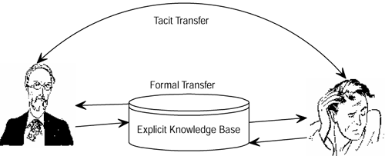
Transfer of knowledge can be through informal or formal channels.
tacit knowledge can be transferred by purely explicit mechanisms through possible explication, by purely informal mechanisms such as conversations, or by technological enablers such as such as CrossPads, electronic whiteboards. etc. that fall somewhere in between these two extremes.

Slide 30
The Application Layer
Applications such as skills directories, yellow pages, collaborative tools (often the back ends of Web-based collaborative tools), video conferencing software and hardware (and integration with the rest of the system), and conventional decision support tools are placed at this level.

Slide 31
The Transport Layer
components to support a knowledge management system:
TCP/IP connectivity throughout the organization.
An up-and-running Web server.
A POP3/ SMTP or MAIL server.
A virtual private network such as a PPTP-based VPN running on Windows 2000 (formerly Windows NT). This is also needed to support remote communications, access, and connectivity.
Support for streaming audio and video on the central server(s).

Slide 32
The Middleware and Legacy Integration Layer
The term legacy systems is often used in the context of mainframes, but for the purpose of building a knowledge management system we need a broader and more accurate definition incorporating both mainframe systems and other contemporary, retired, custom systems.
The legacy integration layer provides such connections between legacy data and existing and new systems.
The middleware layer, similarly, provides connectivity between old and new data formats, often through a Web front end

Slide 33
The Repositories Layer
This layer consists of operational databases, discussion databases, Web forum archives, legacy data, digital or digitized document archives, and object repositories.

Slide 34
Thank’s for today

