Slide 1
Enterprise Information technology
Dedeng Hirawan, S.Kom., M.Kom.

Slide 2
Enterprise
An organization supporting a defined business scope and mission.
An enterprise includes interdependent resources (PEOPLE, ORGANIZATIONS, TECHNOLOGY) who must coordinate their functions and share information in support of a common mission.

Slide 3
Enterprise Category
Profit oriented
Product
Service
Non-profit
Public service

Slide 4
Enterprise IT
Computer‐Based technologies to deliver information and functions to the organization for Business Purpose
Information System

Slide 5
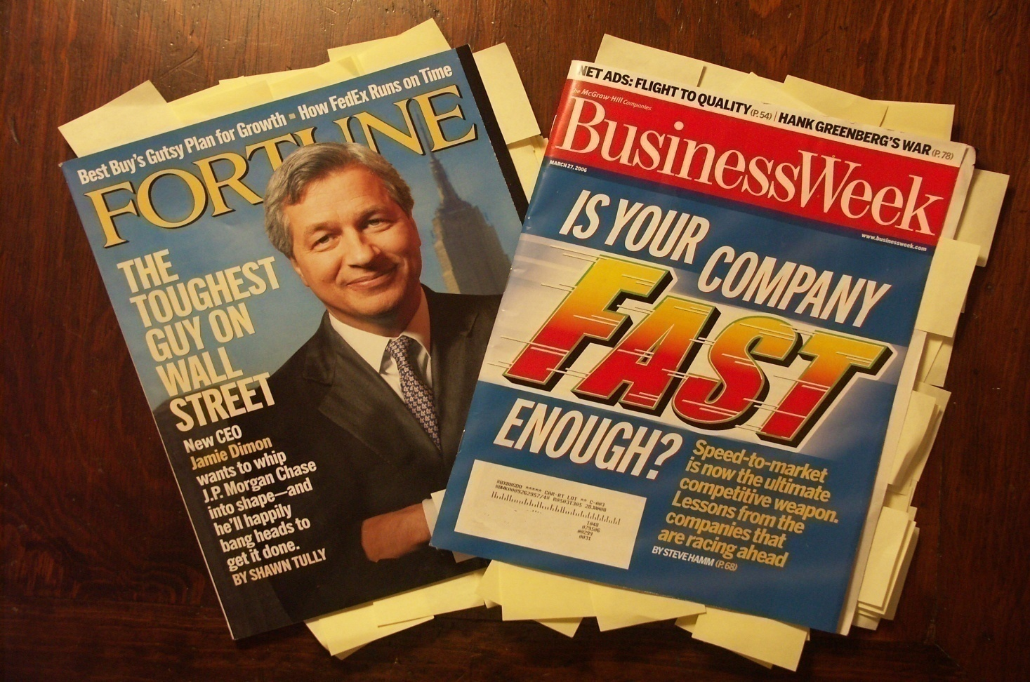
IT’s Role in Enterprise
IT is everywhere in Enterprise / Business

Slide 6
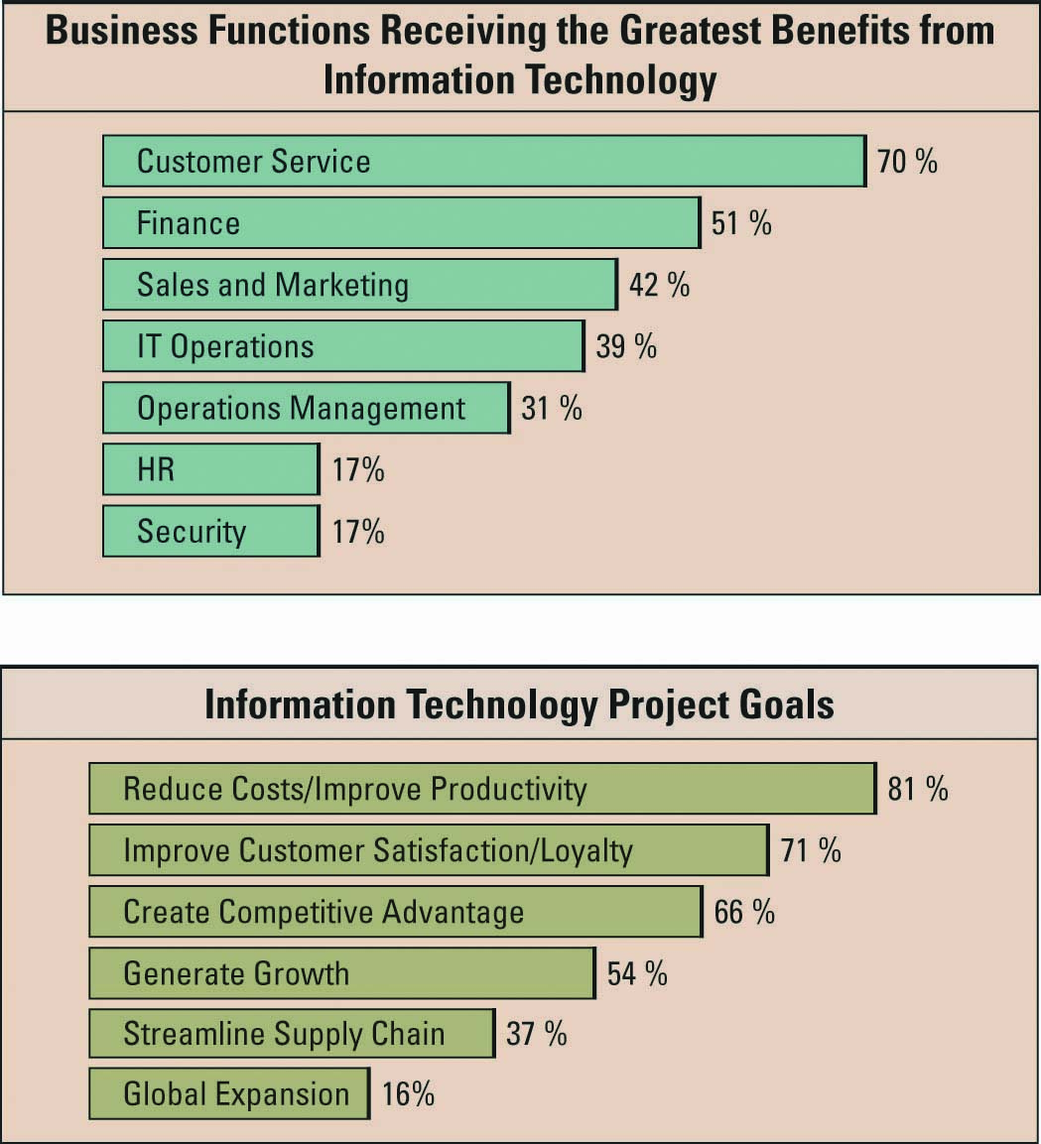
IT’s Impact on Business Operations

Slide 7
IT’s Impact on Business Operations

Slide 8
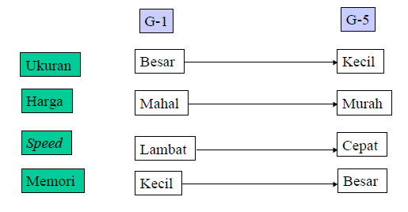
IT History

Slide 9
It basics

Slide 10
Information Technology (IT)
IT – a field concerned with the use of technology in managing and processing information
Information technology is an important enabler of business success and innovation

Slide 11
IT BASICS
Management information systems (MIS) – a general name for the business function and academic discipline covering the application of people, technologies, and procedures – collectively called information systems – to solve business problems
MIS is a business function, similar to Accounting, Finance, Operations, and Human Resources

Slide 12
IT BASICS
When beginning to learn about IT, it is important to understand the following:
Data, information, and business intelligence
IT resources
IT cultures

Slide 13
Data, Information, BI
Data - raw facts that describe the characteristic of an event
Information - data converted into a meaningful and useful context
Business Intelligence – applications and technologies that are used together, provide access, and analyze data and information to support decision-making efforts

Slide 14
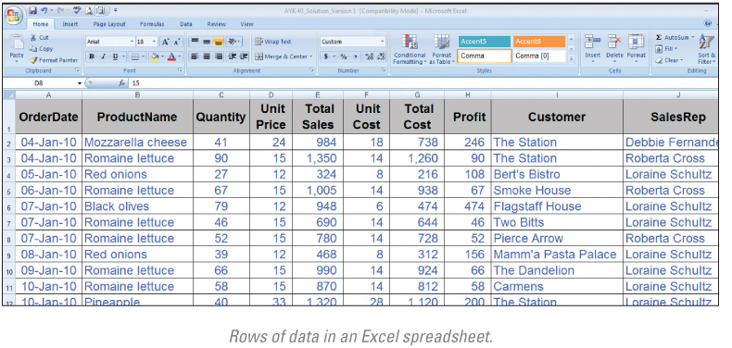
Data, Information, BI

Slide 15
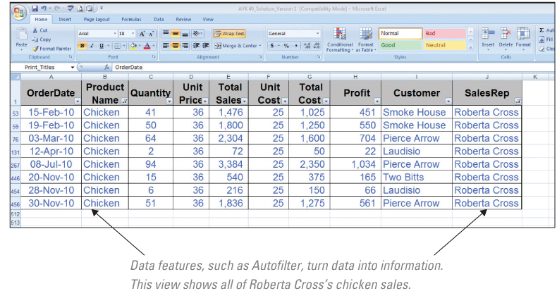
Data, Information, BI

Slide 16
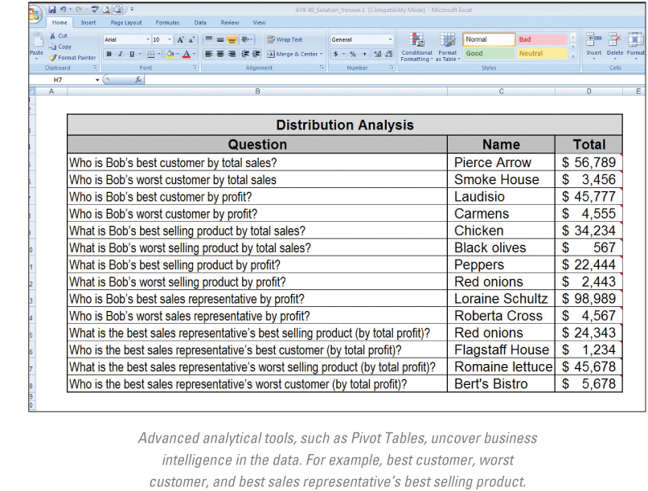
Data, Information, BI

Slide 17
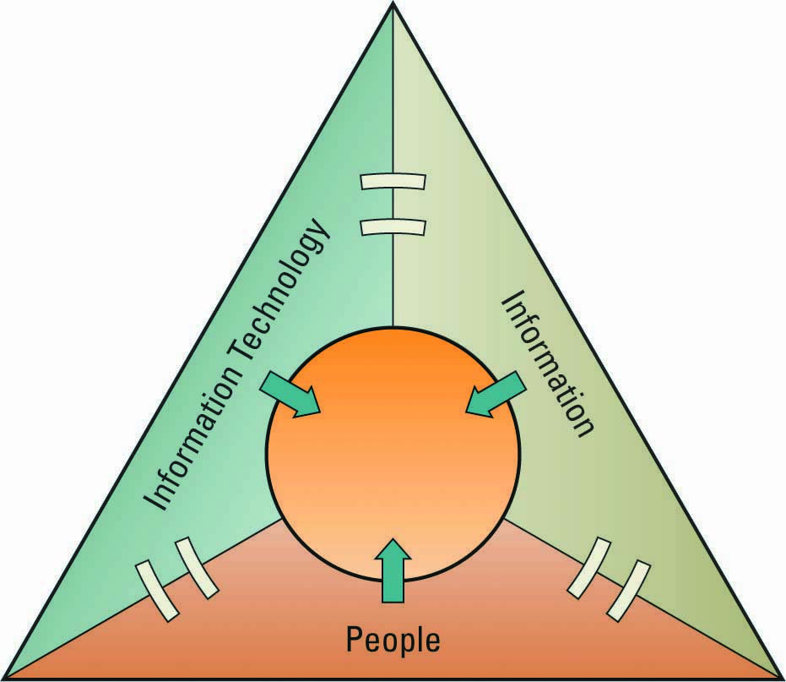
IT Resources
People use
Information technology to work with
Information

Slide 18
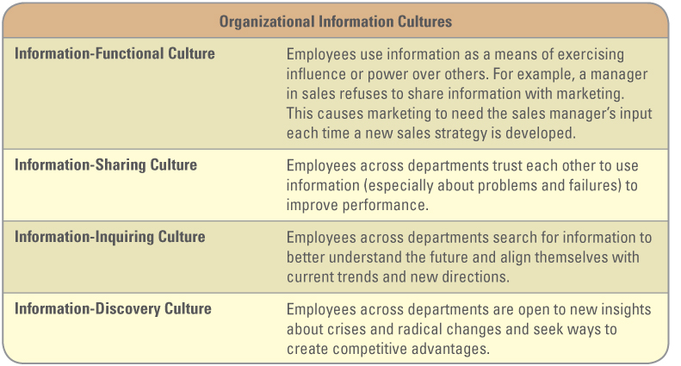
IT Cultures

Slide 19
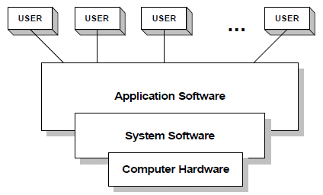
IT Components

Slide 20
IT Components
HARDWARE
Peralatan dari sistem komputer yang secara fisik terlihat dan terjamah
SOFTWARE
Program yang berisi perintah untuk melakukan pengolaahan data
BRAINWARE
Keterlibatan manusia dalam pengembangan dan pengoperasian sistem komputer

Slide 21
IT Components
INFOWARE
User manual, Cyber Law
FIRMWARE
Intruksi yang tersimpan secara permanen di ROM

Slide 22
Information quality

Slide 23
Organizational Information
Information is everywhere in an organization
Employees must be able to obtain and analyze the many different levels, formats, and granularities of organizational information to make decisions
Successfully collecting, compiling, sorting, and analyzing information can provide tremendous insight into how an organization is performing

Slide 24
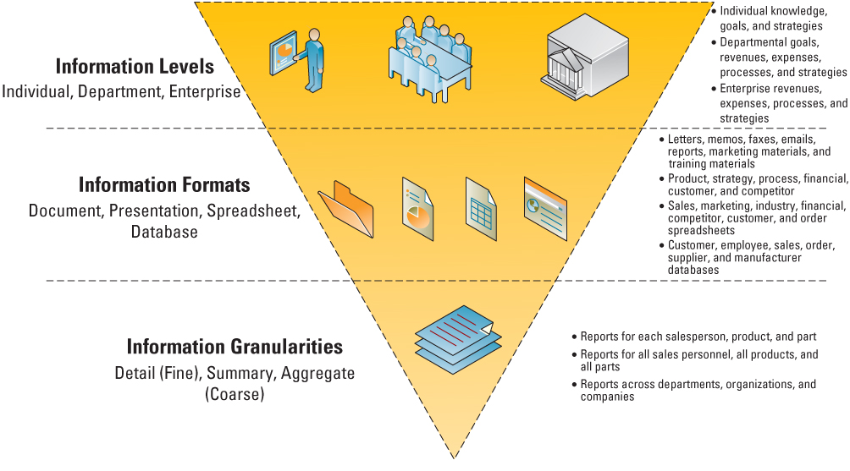
Organizational Information
Levels, formats, and granularities of organizational information

Slide 25
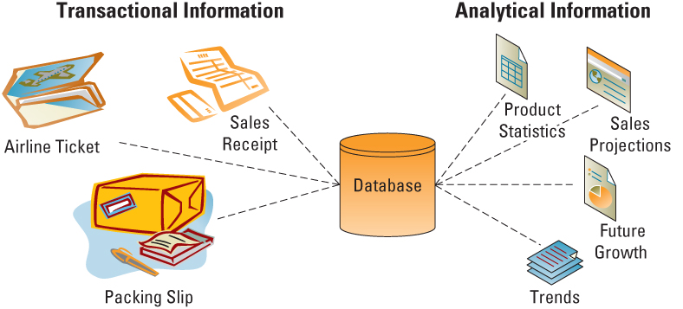
The Value of Transactional and Analytical Information
Transactional information verses analytical information

Slide 26
The Value of Timely Information
Timeliness is an aspect of information that depends on the situation
Real-time information – immediate, up-to-date information
Real-time system – provides real-time information in response to query requests

Slide 27
The Value of Quality Information
Business decisions are only as good as the quality of the information used to make the decisions
You never want to find yourself using technology to help you make a bad decision faster

Slide 28
The Value of Quality Information
Characteristics of high-quality information include:

Slide 29
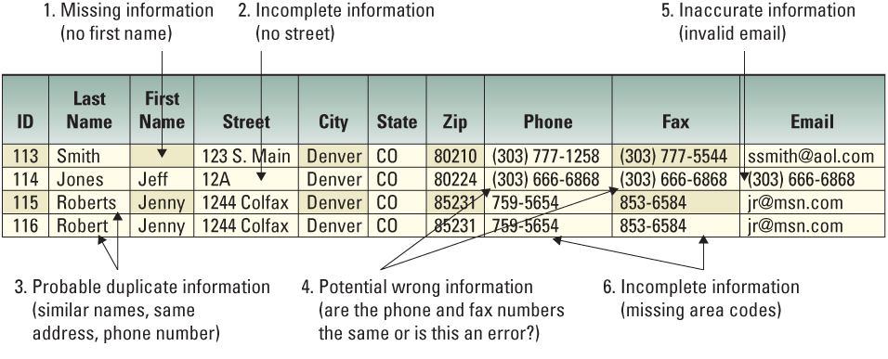
The Value of Quality Information
Low quality information example

Slide 30
Understanding the Costs of Poor Information
The four primary sources of low quality information include:
Online customers intentionally enter inaccurate information to protect their privacy
Information from different systems have different entry standards and formats
Call center operators enter abbreviated or erroneous information by accident or to save time
Third party and external information contains inconsistencies, inaccuracies, and errors

Slide 31
Understanding the Costs of Poor Information
Potential business effects resulting from low quality information include:
Inability to accurately track customers
Difficulty identifying valuable customers
Inability to identify selling opportunities
Marketing to nonexistent customers
Difficulty tracking revenue due to inaccurate invoices
Inability to build strong customer relationships

Slide 32
Understanding the Benefits of Good Information
High quality information can significantly improve the chances of making a good decision
Good decisions can directly impact an organization's bottom line

Slide 33
Terima Kasih

