Slide 1
BUSINESS PROCESS MODELING
Pertemuan ke-4
SISTEM INFORMASI ENTERPRISE
Program Studi Teknik Informatika
Universitas Komputer Indonesia

Slide 2
Standard BPM Stack
RNL - 2014

Slide 3
BPMN
Business Process Modeling Notation
Aims to appeal to wide range of users:
Business Analysts
Developers
Business People
1.0 specification released May 2004
Defines elements of BPD (Business Process Diagram)
RNL - 2014

Slide 4
Business Process Diagrams
Diagrams consist of four categories of diagramming elements:
Flow Objects
Connecting Objects
Swimlanes
Artifacts
RNL - 2014

Slide 5
Flow Objects
Diagrams consist of three core elements:
Event
Hollow to allow for markers
Activity
Generic “work” element
Gateway
Decision, forking, joining, merging
Start
Intermediate
End
Task
Sub-Process
RNL - 2014

Slide 6
Connecting Objects
Three ways to connect flow objects:
Sequence Flow
Indicates order of activities
Message Flow
Indicates flow of messages between Process Participants
Association
Associates data, text, or other Artifacts with flow objects
RNL - 2014

Slide 7
Swimlanes
Used to organize activities by responsibility or functional capability
Pool
Represents a Participant in a Process
Lane
A sub-partition within a Pool used to organize and categorize activities
RNL - 2014

Slide 8
Artifacts
Any number of Artifacts can be added to a diagram, with three types predefined:
Data Object
Show how data is required or produced by activities
Group
Used for documentation or analysis, but does not affect the sequence flow
Annotation
Allow for textual notes to be added
RNL - 2014

Slide 9
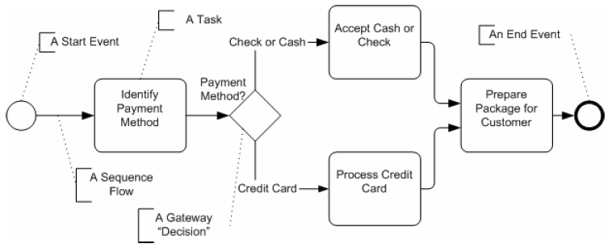
Simple Business Process
RNL - 2014

Slide 10
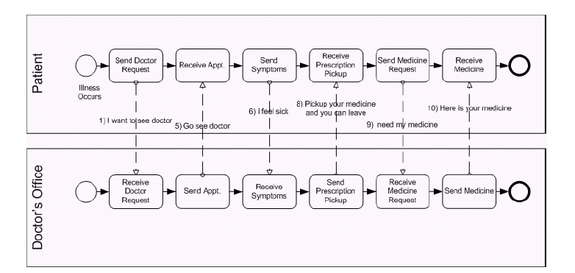
Example with Pool
RNL - 2014

Slide 11
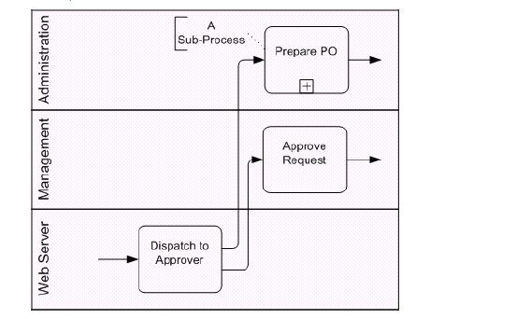
Example with Lane
RNL - 2014

Slide 12
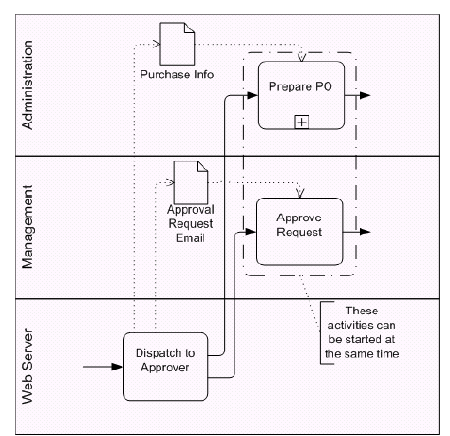
Example with Lane
RNL - 2014

Slide 13
Example High Level
RNL - 2014

Slide 14
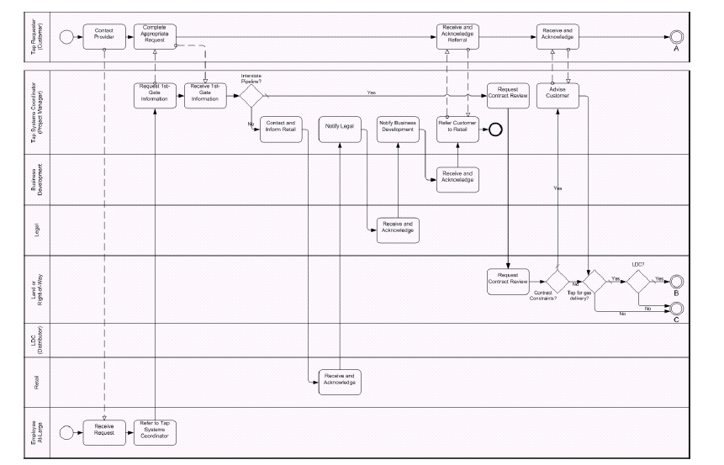
Example Lower Level
RNL - 2014

Slide 15
Example Lower Level
RNL - 2014

