Slide 1
Process Scheduling
Slide perkuliahan
SISTEM OPERASI
Sumber :
- Modern Operating System, Tanenbaum
Operating System, Internal and Design Principles, William Stallings
Ken Kinanti Purnamasari

Slide 2
SCHEDULING
Process Scheduling / Penjadwalan Proses
menentukan proses mana yang akan dieksekusi selanjutnya.

Slide 3
SCHEDULING
Kriteria Penjadwalan :
Efisiensi (Efficiency ) → memanfaatkan CPU secara optimal
Adil (Fairness ) → menjamin tiap proses dilayani dengan adil
Jumlah proses (Throughput ) → memaksimalkan jumlah proses yang dieksekusi dalam suatu waktu
Waktu proses (Turn Around Time ) → meminimalkan waktu tunggu proses, waktu eksekusi, dan waktu mengerjakan I/O.
Waktu Tunggu (Waiting Time ) → meminimalkan jeda antara waktu datang proses dan waktu dieksekusinya.

Slide 4
SCHEDULING
Berdasarkan waktu eksekusi, dibagi 2 :
Preemptive → ada batas waktu/ukuran
Non-preemptive → tidak ada batas waktu/ukuran

Slide 5
SCHEDULING
Berdasarkan karakteristik sistem, dibagi 3 :
Batch → kumpulan pekerjaan – eksekusi lama
Interactive → interaksi dengan user – eksekusi cepat
Real-time → misal: multimedia – eksekusi sangat cepat

Slide 6
B A T C H

Slide 7
BATCH
Algoritma :
FCFS / FIFO (First Come, First Serve)
SJF (Shortest Job First)

Slide 8
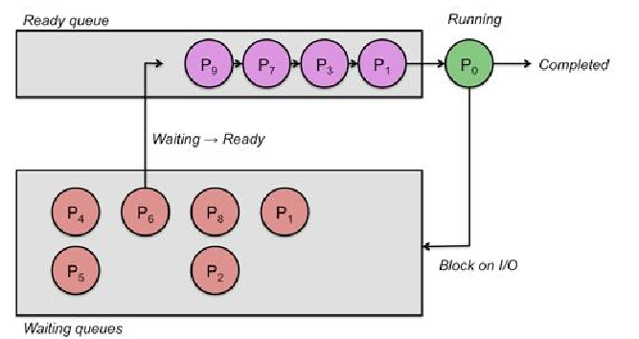
FCFS (First Come First Serve)
Urutan eksekusi sesuai WAKTU KEDATANGAN.
(Non-preemptive)

Slide 9
FCFS (First Come First Serve)
Keuntungan :
Sederhana
Kelemahan :
Tidak cocok untuk kondisi interaktif
Proses yang waktu eksekusinya lama, mempengaruhi antrian selanjutnya

Slide 10
FCFS (First Come First Serve)
PROSES | WAKTU DATANG | LAMA EKSEKUSI | MULAI EKSEKUSI
P0 | 0 | 5 | 0
P1 | 1 | 3 | 5
P2 | 2 | 8 | 8
P3 | 3 | 6 | 16
P0 | P1 | P2 | P3
0
5
8
16
22
Waktu Tunggu : P0 = 0, P1 = 5 - 1 = 4 , P2 = 8 – 2 = 6, P3 = 16 – 3 = 13
Rata2 (AWT) : ( 0 + 4 + 6 + 13 ) / 4 = 23 / 4 = 5.075

Slide 11
FCFS (First Come First Serve)
PROSES | WAKTU DATANG | LAMA EKSEKUSI | MULAI EKSEKUSI
A | 0 | 3
B | 2 | 6
C | 4 | 4
D | 6 | 5
E | 8 | 2
Waktu Tunggu :
Rata2 (AWT) :

Slide 12
SJF (Shortest Job First)
Urutan eksekusi sesuai WAKTU KEDATANGAN dan LAMA EKSEKUSI setiap proses.
(Non-preemptive)
Keuntungan :
Waktu eksekusi efisien
Kelemahan :
Sulit diterapkan
(umumnya, lama eksekusi tidak diketahui di awal)

Slide 13
SJF (Shortest Job First)
PROSES | WAKTU DATANG | LAMA EKSEKUSI | MULAI EKSEKUSI
P0 | 0 | 5 | 0
P1 | 1 | 3 | 5
P2 | 2 | 8 | 14
P3 | 3 | 6 | 8
P0 | P1 | P3 | P2
0
5
8
14
22
Waktu Tunggu : P0 = 0, P1 = 5 - 1 = 4 , P3 = 8 – 3 = 5, P4 = 14 – 2 = 12
Rata2 (AWT) : ( 0 + 4 + 5 + 12 ) / 4 = 21 / 4 = 5.025

Slide 14
SJF (Shortest Job First)
PROSES | WAKTU DATANG | LAMA EKSEKUSI | MULAI EKSEKUSI
A | 0 | 3
B | 2 | 6
C | 4 | 4
D | 6 | 5
E | 8 | 2
Waktu Tunggu :
Rata2 (AWT) :

Slide 15
I N T E R A C T I V E

Slide 16
INTERACTIVE
Algoritma :
Round Robin
Priority
Multiple Queues
- Shortest Process Next
Guaranteed Scheduling
Lottery Scheduling
Fair-share Scheduling

Slide 17
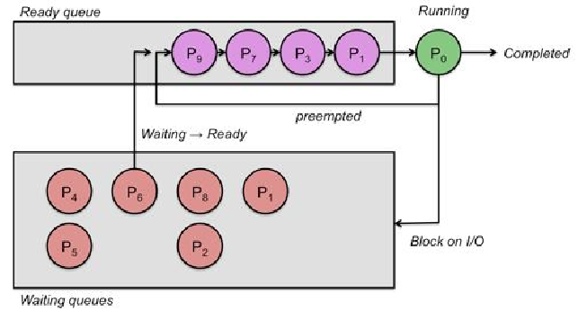
Round Robin
Proses yang melebihi batas, akan ditunda (harus antri lagi).
(Preemptive)

Slide 18
Round Robin
0
P0
PROSES | WAKTU DATANG | LAMA EKSEKUSI
P0 | 0 | 5 ms
P1 | 1 | 3 ms
P2 | 2 | 8 ms
P3 | 3 | 6 ms
1
P0
P1
2
P1
P2
P0
3
P1
P2
P0
P3
q = 2 ms
4
P2
P0
P3
P1
P0 | P1 | P2 | P0 | P3 | P1 | P2 | P0 | P3 | P2 | P3 | P2
0
2
4
6
8
10
11
13
14
16
18
20
22
p0 = 3
p1 = 1
p2 = 6
p0 = 1
p3 = 4
p1 = 0
p2 = 4
p0 = 0
p3 = 2
p2 = 2
p3 = 0
p2 = 0

Slide 19
Round Robin
Waktu Tunggu :
P0 = (6-2) + (13-8) = 4 + 5 = 9
P1 = (2-1) + (10-4) = 1 + 6 = 7
P2 = (4-2) + (11-6) + (16-13) + (20-18)
= 2 + 5 + 3 + 2 = 12
P3 = (8-3) + (14-10) + (18-16) = 5 + 4 + 2 = 11
Rata – rata Waktu Tunggu:
(9 + 7 + 12 + 11) / 4 = 39 / 4 = 9.75

Slide 20
Round Robin
PROSES | WAKTU DATANG | LAMA EKSEKUSI
A | 0 | 3
B | 2 | 6
C | 4 | 4
D | 6 | 5
E | 8 | 2
Waktu Tunggu :
Rata2 (AWT) :

Slide 21
Priority
Urutan proses berdasarkan NILAI PRIORITAS.
(Non-preemptive)

Slide 22
Priority
PROSES | WAKTU DATANG | LAMA EKSEKUSI | PRIORITAS | MULAI EKSEKUSI
P0 | 0 | 5 | 1 | 0
P1 | 1 | 3 | 2 | 11
P2 | 2 | 8 | 1 | 14
P3 | 3 | 6 | 3 | 5
P0 | P3 | P1 | P2
0
5
11
14
22
WT : P0 = 0, P1 = 11 - 1 = 10 , P2 = 14 – 2 = 12, P3 = 5 – 3 = 2
AWT : ( 0 + 10 + 12 + 2 ) / 4 = 24 / 4 = 6

Slide 23
Priority
PROSES | WAKTU DATANG | LAMA EKSEKUSI | PRIORITAS
A | 0 | 3 | 1
B | 2 | 6 | 2
C | 4 | 4 | 3
D | 6 | 5 | 4
E | 8 | 2 | 1
Waktu Tunggu :
Rata2 (AWT) :

Slide 24
Multiple-Queue
Menggabungkan beberapa metode penjadwalan.
(Preemptive)
Prioritas Tinggi
System Processes
Interactive Processes
Interactive Edit Processes
Batch Processes
Prioritas Rendah
User Processes

Slide 25
Multiple-Queue
PRIORITY SCHEDULING
ROUND ROBIN SCHEDULING
Prioritas Tinggi
CPU
Prioritas Rendah

Slide 26
R E A L - T I M E

Slide 27
REAL-TIME
Having the right answer but having it too late, is often just as bad as not having it at all.
Berdasarkan jenis kemunculan proses, dibagi 2 :
Periodic → waktu kemunculan teratur
(mengikuti interval tertentu)
Aperiodic → waktu kemunculan tidak dapat diprediksi

Slide 28
T H R E A D
S C H E D U L I N G

Slide 29
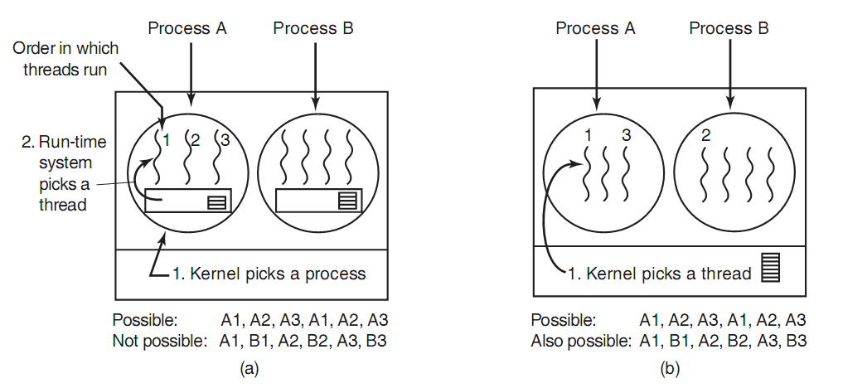
THREAD Scheduling

Slide 30
Ada Pertanyaan???

Slide 31
REFERENSI
MOS 4th, Andrew S. Tanenbaum & Herbert BOS
Operating System Scheduling Algorithms (www.tutorialspoint.com/operating_system)
Process Scheduling (https://www.cs.rutgers.edu/~pxk/416/notes/07-scheduling.html )

Slide 32
TUGAS PERORANGAN
Kerjakan Problems
di buku MOS [Tanenbaum, Bos]
halaman 174 – 180 !
(pilih 10 soal)

