Slide 1
MATERIAL REQUIREMENT PLANNING
Pertemuan ke-7
SISTEM INFORMASI ENTERPRISE
Program Studi Teknik Informatika
Universitas Komputer Indonesia

Slide 2
What is Materials Requirements Planning
A means for determining the number of parts, components, and materials needed to produce a product (end item).
A computer-based information system designed to handle ordering and scheduling of dependent-demand inventories (i.e. raw materials, component parts and subassemblies).
MRP provides time scheduling information specifying when each of the subassemblies, parts, and components should be ordered or produced
What, when, how many?
RNL - 2014

Slide 3
MRP as a Software System
MRP Inputs
MRP Processing
MRP Outputs
Changes
Oders
Forecast
Order releases
Master
schedule
Planned-order
schedules
Primary
reports
Design
Changes
Exception reports
Bill of
materials
Planning reports
MRP computer
programs
Secondary
reports
Performance-
control
reports
Receipts
Withdrawals
Inventory
records
Inventory
transaction

Slide 4
MRP Inputs
Master Production Schedule (MPS) – States which end items are to be produced, when they are needed, and in what quantities
Bill of Materials (BOM) – a listing of all of the raw materials, parts, and sub-assemblies needed to produce one unit of a product
Inventory Records – includes information on the status of an item during the planning horizon, eg. quantity, supplier, order lead time, lot size
RNL - 2014

Slide 5
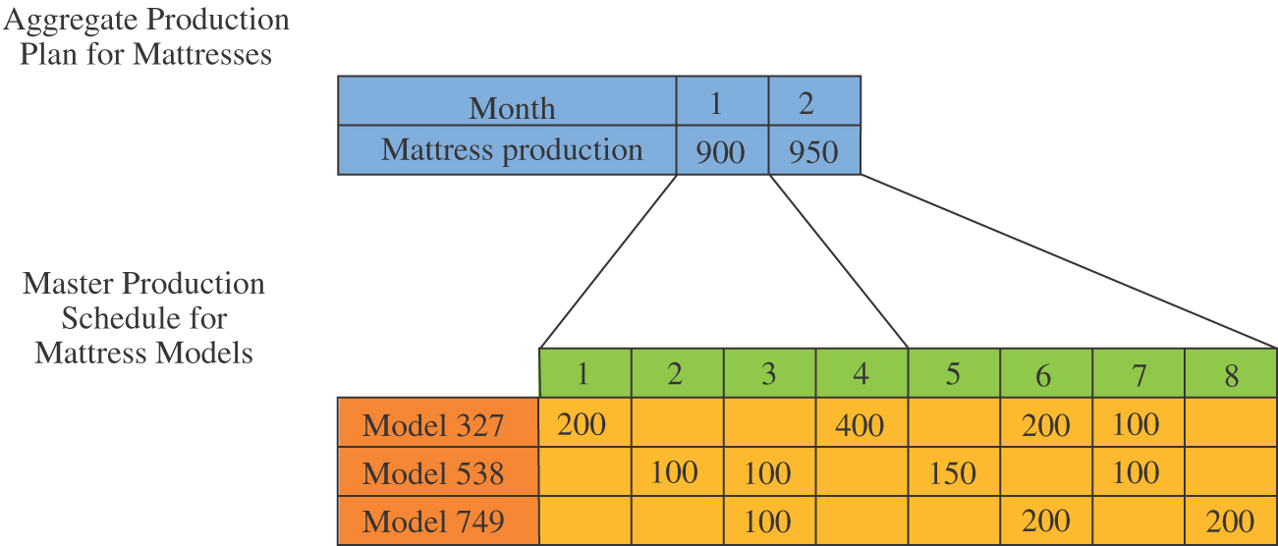
Master Production Schedule
Aggregate Plan
(Product Groups)
MPS
(Specific End Items)
Week
RNL - 2014

Slide 6
Bill of Materials
Level
0
Chair
1
Leg
Assembly
Back
Assembly
Seat
Cross
bar
Side
Rails (2)
Cross
bar
Back
Supports (3)
2
Legs (2)
RNL - 2014

Slide 7
Inventory Records
Stores information on the status of each item by time period. Includes:
1. Gross Requirements. The total expected demand for an item or raw material during each time period.
2. Scheduled Receipts. Open orders scheduled to arrive from vendors or elsewhere.
Projected on Hand. Expected amount of inventory that will be on hand at the beginning of each time period.
= scheduled receipts + available from last period.
4. Supplier. The name(s) and address(es) of the item’s supplier(s).
5. Lead Time. The average length of time, in days or weeks, between placing and receiving an order from the supplier.
6. Lot Size. Standard order size. This may be determined by techniques such as lot-for-lot ordering, EOQ, part period balancing, etc.
RNL - 2014

Slide 8
MRP Processing (1)
Processes the following for each time period:
Gross requirements
Schedule receipts
Projected on hand
Net requirements
Planned-order receipts
Planned-order releases
RNL - 2014

Slide 9
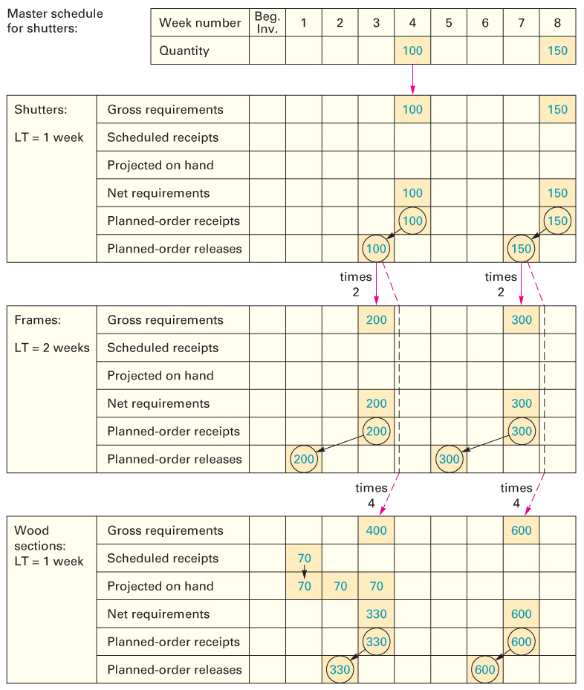
MRP Processing (2)

Slide 10
MRP Outputs
Primary Reports
Planned Orders – schedule indicating the amount and timing of future orders
Order Releases – Authorization for the execution of planned orders
Changes – revisions of due dates or order quantities, or cancellation of orders
Secondary Reports
Performance-control reports – Evaluation of system operation, including deviations from plans and cost information
Planning reports – Data useful for assessing future material requirements
Exception Reports – Data on major discrepancies encountered
RNL - 2014

