Slide 1
INTRODUCTION: INFORMATION SYSTEM MANAGEMENT
Dr. Yeffry Handoko Putra
UNIVERSITAS KOMPUTER INDONESIA

Slide 2
Using a handheld computer called a Delivery Information Acquisition Device (DIAD),
UPS drivers automatically capture customers’ signatures along with pickup, delivery, and time-card information.
UPS information systems use these data to track packages while they are being transported

Slide 3
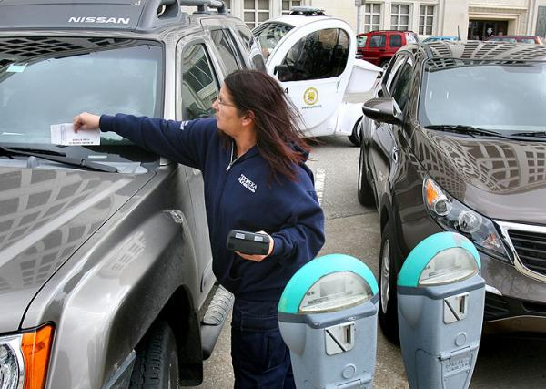
Police Parking Ticket
Memory with USB connector
Sometime have GSM Support
Real-time Processing
Printing Paper included

Slide 4
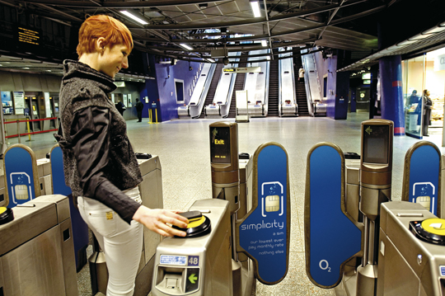
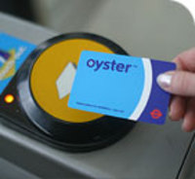
Transaction with Oyster Travelled card
Top up, pay as you go
the cheapest way to pay for single journeys on bus, Tube, tram, DLR, London overground and most National Rail services in London.
You will need to pay £5 deposit when you get a new Oyster card.

Slide 5
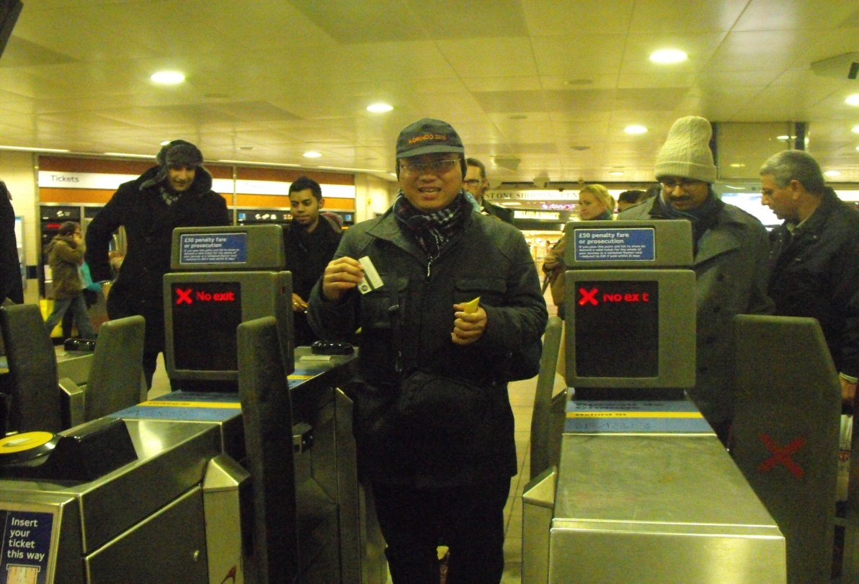
Transaction with Oyster Travelled card
Top up, pay as you go
the cheapest way to pay for single journeys on bus, Tube, tram, DLR, London overground and most National Rail services in London.
You will need to pay £5 deposit when you get a new Oyster card.

Slide 6
Buku Acuan
[Shim] Jae K. Shim, (2000), Information System and Technology for the Non Information System Executive, St. Lucie Press, USA
[Curry, et. all] Adrienne Curry, Peter Flett dan Ivan Hollingsworth, (2006), Managing Information and System, Routledge, London
[Straub, et. all] Detmar W. Straub, Seymour Goodman, Richard L. Baskerville, 2008, Information Security: Policies, Process and Practices, ME Sharpe, London
[Laudon] Kenneth Laudon, 2004, Management Information Systems: Managing the digital Form, 9th Edition, Prentice Hall
[Powell] Galvin Powell, 2006, Beginning Databse Design, Wiley Publishing

Slide 7
Rencana Perkuliahan
Overview IS dan ISM
[Shim] chap 1 + chap 2
[Curry, et all] chap 5
Database Management System
[Shim] chap 6
[Powell] chap 8, 12
Introduction to Organisation and Information
[Curry, et.all] chap 1, 6, 7
[Laudon] sec 3.1, 3,2
Management, Information and Decision Making
[Curry, et.all] chap 3
[Laudon] sec 3.3, chap 13
IT Infrastructure
[Laudon] chap 6, 7

Slide 8
Rencana Perkuliahan (lanjutan)
Information System and Organisation Security
[STRAUB] Chap 2, 3
[Laudon] chap 10
Ethic and Social Issue
[Laudon] chap 5
Enteprise Application and Business Process Integration
[Laudon] chap 11

Slide 9
Penilaian
Tugas Kecil : 20%
UTS/Tugas Pengganti UTS: 40%
UAS/Tugas Pengganti UAS: 40%
Absensi : syarat UTS/UAS %

Slide 10
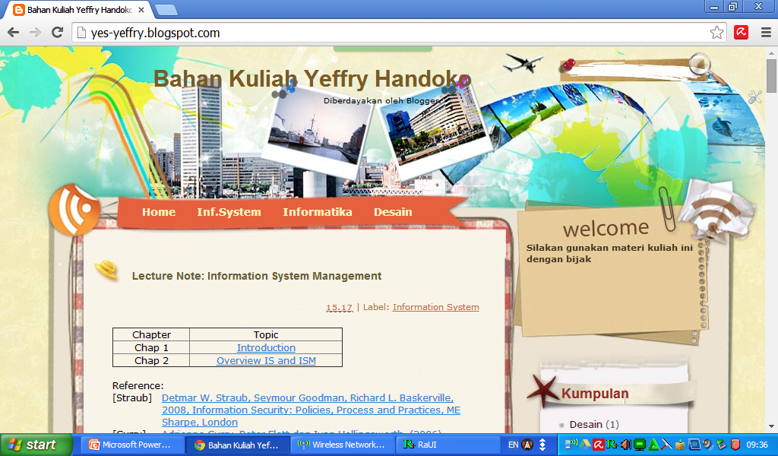
Lecture note at http://yes-yeffry.blogspot.com

Slide 11
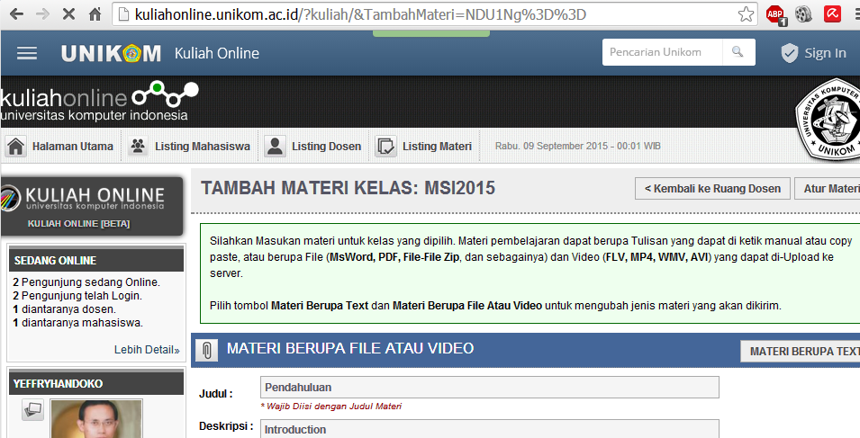
Kuliahonline.unikom.ac.id

Slide 12
IS for Level of Management
Decision support for Executive Board
Organizer/report for manager
Transaction Process
Notes:
Informasi jangan salah orang, salah tempat dan salah waktu

Slide 13
Terminology
Management of Information System (MIS)
Management Information System (MIS)
Information System Management (ISM)

Slide 14
INFORMATION TECHNOLOGY BASICS
Information technology (IT) – any computer-based tool that people use to work with information and support the information and information-processing needs of an organization
Information technology is an important enabler (or disabler) of business success and innovation
Notes:
IT does not equal or represent business success and innovation, it is simply an enabler of business success and innovation
Will spending large amounts of money on IT guarantee automatic success?
Spending large amounts of money on IT will not guarantee an organization automatic success
Organizations need to allocate resources on the right types of IT that correctly support their business operations to be successful

Slide 15
INFORMATION TECHNOLOGY BASICS
Management information systems (MIS) – the function that plans for, develops, implements, and maintains IT hardware, software, and applications that people use to support the goals of an organization
MIS is a business function, similar to Accounting, Finance, Operations, and Human Resources
Notes:
Most organizations have an IT department that is responsible for performing the MIS function
This is similar to an organization having an Accounting department that is responsible for performing the accounts payable and accounts receivable functions

Slide 16
MANAGEMENT OF INFORMATION SYSTEM (Information System Management)
the study of information systems in business and management.
specific category of information systems serving management level functions by plans, develops, implements, and maintains IT hardware, software, and applications that people use to support the goals of an organization
providing managers with reports and often online access to the organization’s current performance and historical records.

Slide 17
Management of Information System case: DaimlerChrysler’s Agile Supply Chain

Slide 18
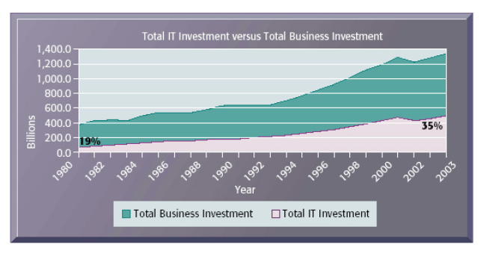
Why Information Systems Matter
Information technology capital investment

Slide 19
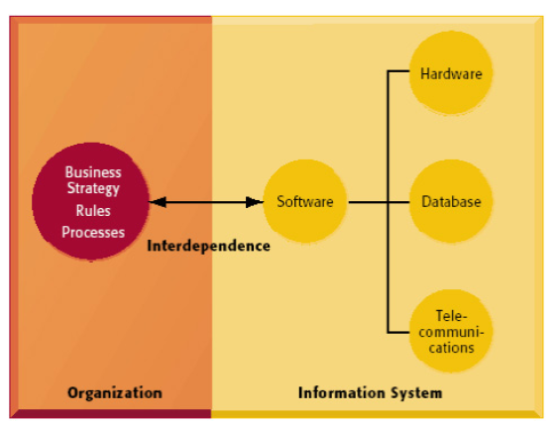
Why Information Systems Matter
The interdependence between organizations and information systems

Slide 20
MIS DOMAIN

Slide 21
CONTEMPORARY IS Management

Slide 22
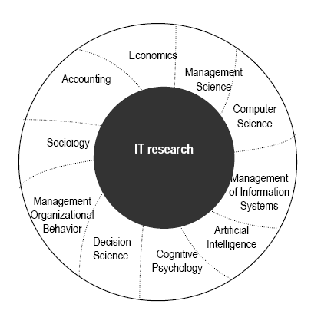
Interdisciplinary nature of IT research
Notes:
[Flodström] page 57

Slide 23
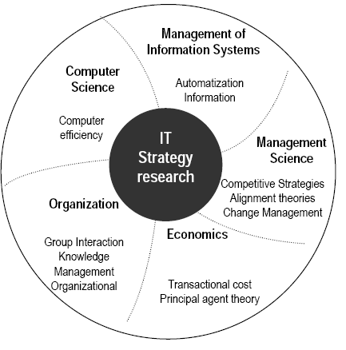
Interdisciplinary nature of IT Strategy Research
Notes:
[Flodström] page 59

Slide 24
Information Technology’s Impact on Business Operations
five factors to consider when assessing the growing impact of IT in business
Internet growth and technology convergence
Transformation of the business enterprise
Growth of a globally connected economy
Growth of knowledge and information-based economies
Emergence of the digital firm
Notes:
Businesses can be divided into separate departments by function. Not all companies are structured this way.
The manager of each department is responsible for that department’s performance. “Functional Silos” is jargon you should know.

Slide 25
Information Technology’s Impact on Business Operations
Notes:
Businesses can be divided into separate departments by function. Not all companies are structured this way.
The manager of each department is responsible for that department’s performance. “Functional Silos” is jargon you should know.

Slide 26
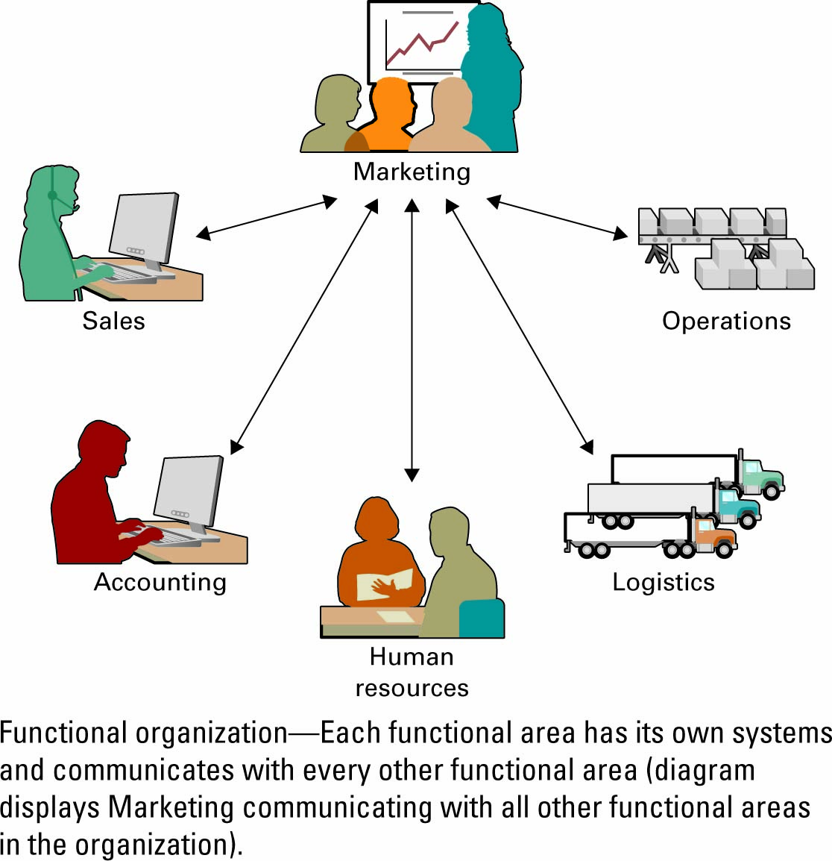
Information Technology’s Impact on Business Operations
Organizations typically operate by functional areas or functional silos
Functional areas are interdependent
Notes:
It is important for your students to understand that functional areas are anything but independent, in fact, they are interdependent
Why are functional areas interdependent?
Departments cannot operate in isolation, they require information from around the organization to operate
Why must sales and marketing work with operations?
To know what is available for sale including overstocked items and understocked items
More importantly, why do they fail to cooperate? Office politics plays a big role. Managers are responsible for their department’s success, not for the success of the organization.

Slide 27
SYSTEMS FROM A FUNCTIONAL PERSPECTIVE

Slide 28
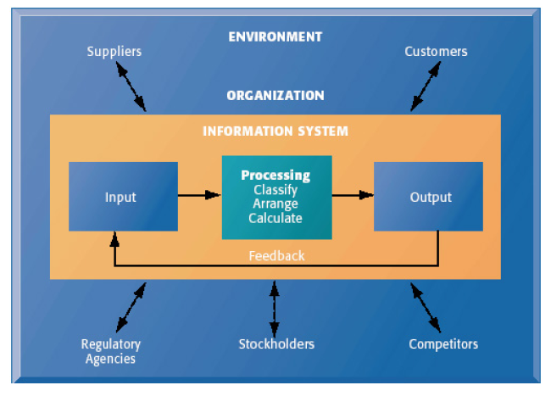
FUNCTION OF INFORMATION SYSTEM

Slide 29
Information System Quality Characteristic
Complete Data
Accurate Data
Precise Data
Understandable Output
Timely Output
Relevant Output
Meaningful Output
User friendly Operation
Error Resistant Operation
Authorize Use
Protected System and Operation
Ref: Gordon B. Davis

Slide 30
Business Perspective on Information Systems

Slide 31
Scope of Information System
Data : raw facts that describe the characteristic of an event
Information : data converted into a meaningful and useful context
Business Intelligent. E.g. Customer Relationship Management
Knowledge . E.g. Knowledge Management System

Slide 32
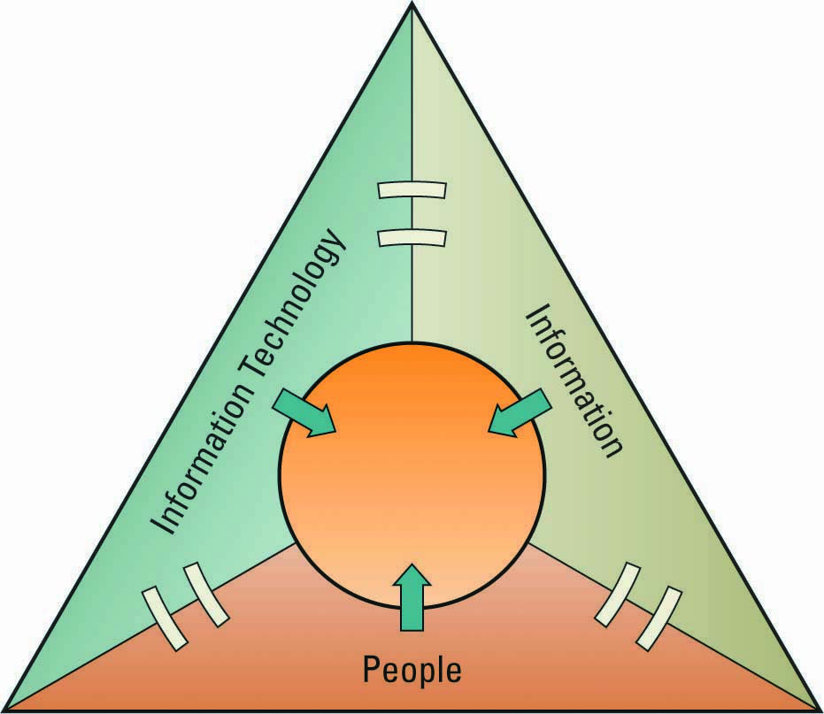
IT Resources
People use
Information technology to work with
Information
Notes:
What is useful about this slide? Not much.
You need people who are trained to use the hardware and software
You need hardware and software
You need raw data and information to be processed. Is this always true?

Slide 33
ROLES AND RESPONSIBILITIES IN IT
Chief Information Officer (CIO) – oversees all uses of IT and ensures the strategic alignment of IT with business goals and objectives
Broad CIO functions include:
Manager – ensuring the delivery of all IT projects, on time and within budget
Leader – ensuring the strategic vision of IT is in line with the strategic vision of the organization
Communicator – building and maintaining strong executive relationships
Notes:
The CIO typically reports directly to the Chief Executive Officer (CEO)
CIOs must possess a solid and detailed understanding of every aspect of an organization coupled with tremendous insight into the capability of IT
CIOs must have strong business skills and strong IT skills
Can you name any famous CEOs?
Jack Welch, General Electric (retired)
Jeff Bezos, Amazon.com
Bill Gates, Microsoft
Michael Dell, Dell computers
Can you name any famous CIOs?
Most students will be familiar with many famous CEOs but not CIOs, CPOs, CSOs, CKOs, or CTOs

Slide 34
ROLES AND RESPONSIBILITIES IN IT
Chief Technology Officer (CTO) – responsible for ensuring the throughput, speed, accuracy, availability, and reliability of IT
Chief Security Officer (CSO) – responsible for ensuring the security of IT systems
Chief Privacy Officer (CPO) – responsible for ensuring the ethical and legal use of information
Chief Knowledge Office (CKO) - responsible for collecting, maintaining, and distributing the organization’s knowledge
Notes:
Definitions for the quiz

Slide 35
ROLES AND RESPONSIBILITIES IN IT Brief Summary
(CInformationO) Ensure strategic alignment
(CTechnologyO) Proper equipment/software
(CSecurityO) Protect from viruses & hackers
(CPrivacyO) restrict access to private info
(CKnowledgeO) databases and AI systems
Notes:
The important thing is to note that there are five basic functions

Slide 36
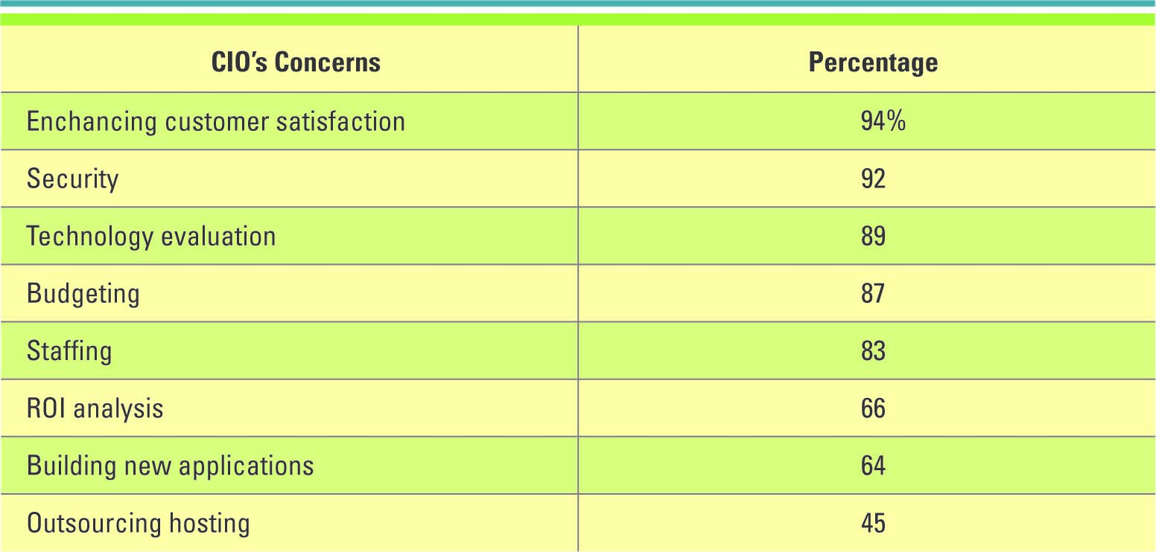
ROLES AND RESPONSIBILITIES IN IT
What concerns CIOs the most
Notes:
Enhancing customer satisfaction is the number one concern for many CIOs
This will be surprising to most students since they expect the CIO to be primarily concerned with technology
Why are CIOs concerned with customer satisfaction?
Any surprises here?
What is the source of these numbers?

Slide 37
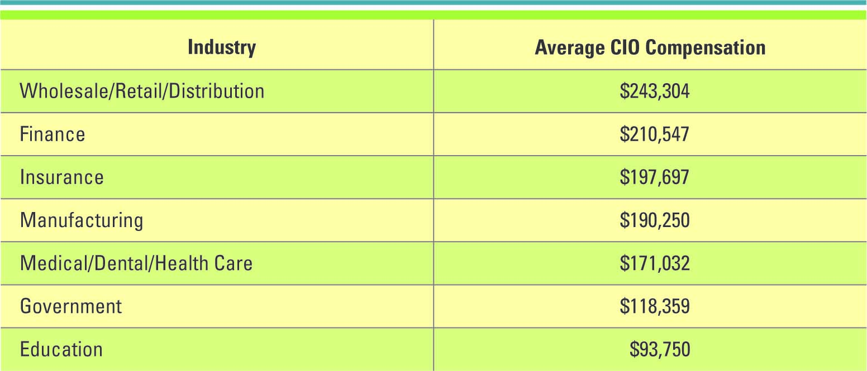
ROLES AND RESPONSIBILITIES IN IT
Average CIO compensation by industry
Notes:
Is this more or less than you thought a CIO would make?
Do you think these salaries will increase or decrease in the future?
Why are there such large differences? What causes them?

Slide 38
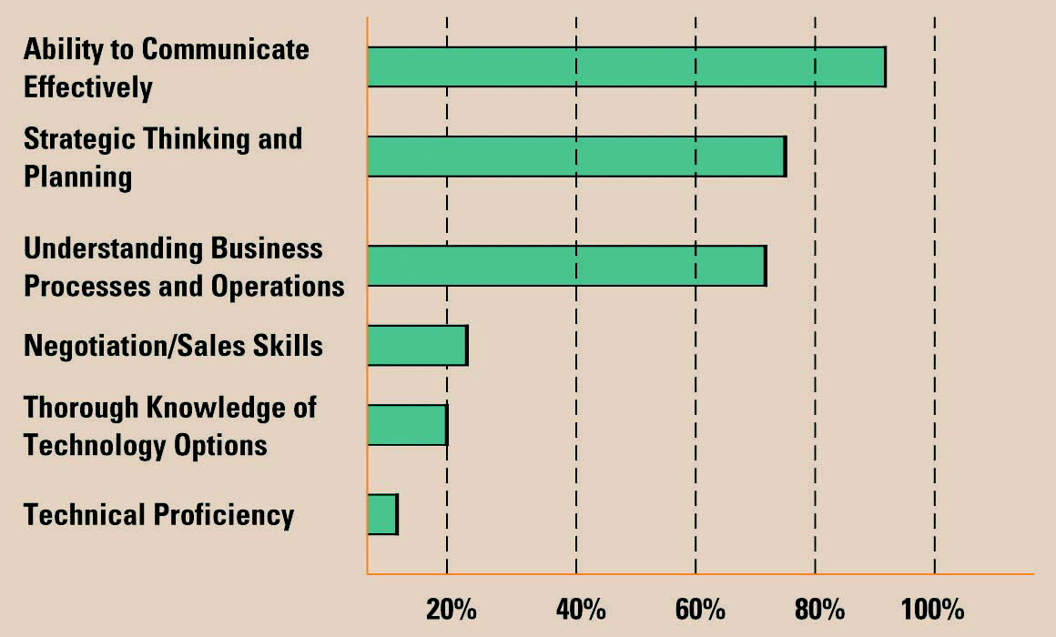
ROLES AND RESPONSIBILITIES IN IT
Skills pivotal for success in executive IT roles
Notes:
Presentation skills are vital in management. IT is no exception.
Look how low technical proficiency is valued.
I wonder what is the source of this “information”. Can this kind of thing even be measured?

Slide 39
Why we need MIS majors
Business personnel possess expertise in functional areas such as marketing, accounting, and sales
IT personnel have the technological expertise
This typically causes a communications gap between the business personnel and IT personnel
MIS Majors bridge the gap.
Notes:
IT personnel have their own vocabularies consisting of acronyms and technical terms
Business personnel have their own vocabularies based on their experience and expertise
To have effective communications, the business personnel must understand IT, and the IT personnel must understand business.
The authors likes to use the word “must”

Slide 40
Improving Communications
Business personnel must seek to increase their understanding of IT –Why?
IT personnel must seek to increase their understanding of the business – Why?
It is the responsibility of the CIO to ensure effective communication between business personnel and IT personnel
Notes:
The book makes a lot of blanket assertions like this. Do you agree or disagree?

