Slide 1
Chap 11 : Protecting Information Assets
Dr. Ir. Yeffry Handoko Putra, M.T
Magister Sistem Informasi
Universitas Komputer Indonesia

Slide 2
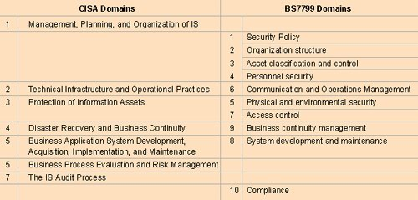

Slide 3
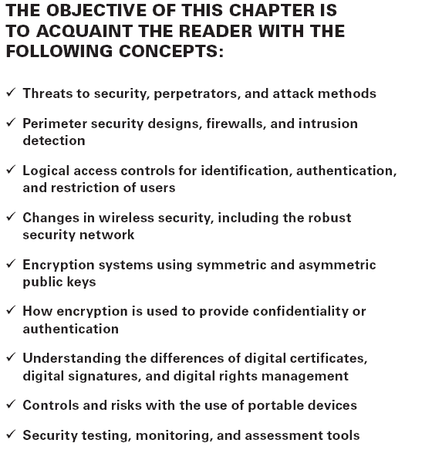

Slide 4
Recognizing Types of Threats and Computer Crimes
Theft
Fraud
Sabotage
Industrial Espionage
Unauthorized Disclosure
Loss of Credibility
Loss of Proprietary Information
Legal Repercussions
Notes:
Theft The theft of information, designs, plans, and customer lists could be catastrophic to
an organization. Consider the controls in place to prevent theft of money or embezzlement.
Have equivalent controls in place to prevent the theft of valuable intellectual property.
Fraud Misrepresentation to gain an advantage is the definition of fraud. Electronic records
may be subject to remote manipulation for the purpose of deceit, suppression, or unfair profit.
Fraud may occur with or without the computer. Variations of fraud include using false pretenses,
also known as pretexting, for any purpose of deceit or misrepresentation.
Sabotage Sabotage is defined as willful and malicious destruction of an employer’s property,
often during a labor dispute or to cause malicious interference with normal operations.
Blackmail Blackmail is the unlawful demand of money or property under threat to do
harm. Examples are to injure property, make an accusation of a crime, or to expose disgraceful
defects. This is commonly referred to as extortion.
Industrial Espionage The world is full of competitors and spies. Espionage is a crime of spying
by individuals and governments with the intent to gather, transmit, or release information
to the advantage of any foreign organization. It’s not uncommon for governments to eavesdrop
on the communications of foreign companies. The purpose is to uncover business secrets to
share with companies in their country. The intention is to steal any perceived advancements
in position or technology. Telecommunications traveling through each country are subject to
legal eavesdropping by governments. Additional care must be taken to keep secrets out of the
hands of a competitor.
Unauthorized Disclosure Unauthorized disclosure is the release of information without
permission. The purpose may be fraud or sabotage. For example, unauthorized disclosure
of trade secrets or product defects may cause substantial damage that is irreversible. The
unauthorized disclosure of client records would cause a violation of privacy laws, not to
mention details that would be valuable for a competitor.
Loss of Credibility Loss of credibility is the damage to an organization’s image, brand,
or executive management. This can severely impact revenue and the organization’s ability
to continue. Fraud, sabotage, blackmail, and unauthorized disclosure may be used to
destroy credibility.
Loss of Proprietary Information The mishandling of information can result in the loss of
trade secrets. Valuable information concerning system designs, future marketing plans, and
corporate formulas could be released without any method of recovering the data. Once a
secret is out, there is no way to make the information secret again.
Legal Repercussions The breach of control or loss of an asset can create a situation of
undesirable attention. Privacy concerns have created new requirements for public disclosure
following a breach. Without a doubt, the last thing an organization needs is increased interest
from a government regulator. Stockholders and customers may have grounds for subsequent
legal action in alleging negligence or misconduct, depending on the situation.

Slide 5
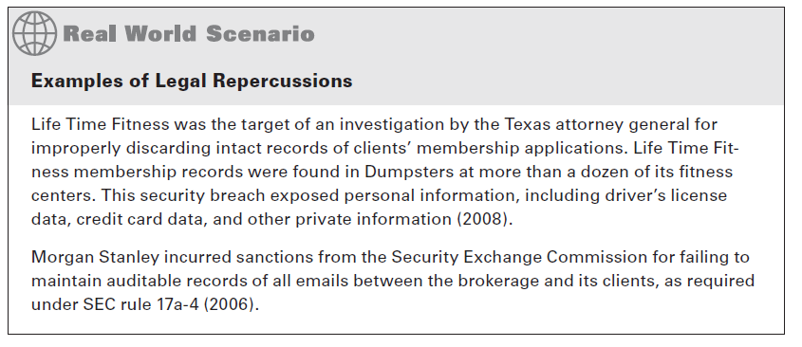

Slide 6
Identifying the Perpetrators
Hackers
Crackers
Script Kiddies
Employee Betrayal
Ethical Hacker Gone Bad
Notes:
Hackers
The term hacker has a double meaning. The honorable interpretation of hacker refers to a
computer programmer who is able to create usable computer programs where none previously
existed. In this Study Guide, we refer to the dishonorable interpretation of a hacker—an undesirable
criminal.
The criminal hacker focuses on a desire to break in, take over, and damage or discredit
legitimate computer processing. The first goal of hacking is to exceed the authorized level
of system privileges. This is why it is necessary to monitor systems and take swift action
against any individual who attempts to gain a higher level of access. Hackers may be internal
or external to the organization. Attempts to gain unauthorized access within the organization
should be dealt with by using the highest level of severity, including immediate
termination of employment.
Crackers
The term cracker is a variation of hacker, with the analogy equal to a safe cracker. Some
individuals use the term cracker in an attempt to differentiate from the honorable computer
programmer definition of hacker. The criminal cracker and criminal hacker terms are used
interchangeably. Crackers attempt to illegally or unethically break into a system without
authorization.
Script Kiddies
A number of specialized programs exist for the purpose of bypassing security controls. Many
hacker tools began as well-intentioned tools for system administration. The argument would
be the same if we were discussing a carpenter’s hammer. A carpenter’s hammer used for the
right purpose is a constructive tool. The same tool is a weapon if used for a nefarious purpose.
A script kiddy is an individual who executes computer scripts and programs written by
others. The script kiddy’s motive is to hack a computer by using someone else’s software.
Examples include password decryption programs and automated access utilities. Several
years ago, a login utility was created for Microsoft users to get push-button access into
a Novell server. This nifty utility was released worldwide before it was recognized that
the utility bypassed Novell security. The utility was nicknamed Red Button and became
immensely popular with script kiddies. Internal controls must be put in place to restrict
the possession or use of administration utilities. Violations should be considered severe
and dealt with in the same manner as hacker violations.
Employee Betrayal
There is a reason why the FBI report cited the high volume of internal crimes. A person within
the organization has more access and opportunity than anyone else. Few persons would have
a better understanding of the security posture and weaknesses. In fact, an employee may be in
a position of influence to socially engineer coworkers into ignoring safeguards and alert conditions.
This is why it is important to recheck (recertify) employees’ backgrounds annually for
changes in their financial or criminal history and also to monitor internal employee satisfaction.
The great medieval fortresses fell by the betrayal of trusted allies.
Ethical Hacker Gone Bad
An ethical hacker or white hat is one who is authorized to test computer hacks and attacks
with the goal of identifying an organization’s weakness. Some individuals participate in
special training to learn about penetrating computer defenses. This will usually result in
one of two outcomes.

Slide 7
Understanding Attack Methods
Passive Attacks
network analysis
traffic analysis
Eavesdropping
Active Attacks
Social Engineering
Phishing
Spear Phishing
Dumpster Diving
Notes:
Passive Attacks
Passive attacks are characterized by techniques of observation. The intention of a passive
attack is to gain additional information before launching an active attack. Three examples
of passive attacks are network analysis, traffic analysis, and eavesdropping:
Network Analysis The computer traffic across a network can be analyzed to create a map
of the hosts and routers. Common tools such as IBM Tivoli, Cisco Works, HP Openview,
Network Instruments Observer or open source equivalents like OpenNMS and OpsView
are useful for creating live network maps. The objective of network analysis is to create a complete profile of the network infrastructure prior to launching an active attack. Computers
transmit large numbers of requests that other computers on the network will observe. Simple
maps can be created with no more than the observed traffic or responses from a series of ping
commands. The network ping command provides a simple communications test between two
devices by sending a single request, also known as a ping. The concept of creating maps by
using network analysis is commonly referred to as painting or footprinting.
Host Traffic Analysis Traffic analysis is used to identify systems of particular interest.
The communication between host computers can be monitored by the activity level and
number of service requests. Host traffic analysis is an easy method used to identify servers
on the network.
Passive attacks tend to be relatively invisible, whereas active attacks are easier to detect. The
attacker will proceed to execute an active attack after obtaining sufficient background information.
The active attack is designed to execute an act of theft or to cause a disruption in
normal computer processing. Following is a list of active attacks:
Social Engineering Criminals can trick an individual into cooperating by using a technique
known as social engineering. The social engineer will fraudulently present themselves as a person of authority or someone in need of assistance. The social engineer’s story will be woven
with tiny bits of truth. All social engineers are opportunists who gain access by asking for it.
For example, the social engineer may pretend to be a contractor or employee sent to work on a
problem. The social engineer will play upon the victim’s natural desire to help.
Phishing A social engineering technique called phishing (pronounced fishing) utilizes fake
emails sent to unsuspecting victims, which contain a link to the criminal’s counterfeit website.
Anyone can copy the images and format of a legitimate website by using their Internet
browser. A phishing criminal copies legitimate web pages into a fake email or to a fake website.
The message tells the unsuspecting victim that it is necessary to enter personal details such
as U.S. social security number, credit card number, bank account information, or online user
ID and password. Phishing attacks can also be used to implement spyware on unprotected
computers. Many phishing attacks can be avoided through user education
Spear Phishing One of the most effective attack techniques is known as spear-phishing. This
attack targets a specific server, user, database, or network device. Spear-phishing is easier than
it sounds. Target systems can be identified through traffic analysis, remnant metadata found
in exported files, or simply by browsing a web page and right-clicking View Source. Dynamic
pages, including user-submitted forms with HTML or Post HyperText Protocol (PHP) usually
contain a POST or GET command that contains the exact address of your server, your database
name, valid login ID of the program, and real password. These specific parameters must be
disclosed (required) for programming the web page to get data out of your database, for web
surfers to view content, or for users to save data submitted through online forms.
Dumpster Diving Attackers will frequently resort to rummaging through the trash for
discarded information. The practice is also known as Dumpster diving. Dumpster diving is perfectly legal under the condition that the individuals are not trespassing. This is the
primary reason why proper destruction is mandatory. Most paper records and optical disks
are destroyed by shredding

Slide 9
Persistent Electronic Threats
Malware
Trojan Horse
Virus
Internet Worm
Logic Bomb
Time Bomb
Trapdoor
Root Kit
Brute Force Attack
Denial of Service (DoS)
Distributed Denial of Service (DDoS)
IP Fragmentation Attack
Crash-Restart
Maintenance Accounts
Robot Networks
Programming Vulnerability
Cross-Site Scripting (XSS)
Middleware Attack
Zero-Day Attack
Remote Access Attack
Notes:
It’s rare for modern hackers to physically enter building premises because they may be
caught or apprehended. Physical facility controls have a limited purpose in information
security, to simply provide a local barrier for physical intrusion. These localized barriers
protect against common crimes by persons entering and leaving the facility. With the
advent of the Internet, a smaller percentage of criminals will chance the risks of committing
a physical crime. The new persistent threat is through electronic attacks. A hacker can
commit the crime at a safe distance without fear of being physically caught. Attacks may
originate from anywhere in the world or even be sponsored by a foreign government to
gather intelligence data.
Technical controls to protect against electronic attacks are usually spotty and inconsistent
because of a lack of awareness for specific threats or lopsided implementations. It is very easy
for the technical staff to inadvertently focus on only a few areas, thereby neglecting serious
threats that still exist in others. Technical threats against software are usually difficult for
lay-persons to visualize in the physical world. The adage out of sight, out of mind also means
outside of budget. Let’s take a moment to understand how the electronic threat will manifest
in our clients’ environment.
Malware This title refers to every malicious software program ever created, whether it
exploits a known vulnerability or creates its own. There are so many different ones, it’s easier
to just call the entire group by the title of malware. The king of the malware threat is known
as the Trojan horse.
Trojan Horse A revised concept of the historical Trojan horse has been adapted to
attack computers. In a tale from the Trojan war, soldiers hid inside a bogus gift known
as the Trojan horse. The unassuming recipients accepted the horse and brought it inside
their fortress, only to be attacked by enemy soldiers hiding within. Malicious programs
frequently use the Trojan horse concept to deliver viruses, worms, logic bombs, and other
root kits through downloaded files.
Virus You may recall we mentioned the virus in a previous chapter. The goal of a virus
is to disrupt operations. Users inadvertently download a program built like a Trojan horse
containing the virus. The attacker’s goal is usually to damage your programs or data files.
Viruses append themselves to the end-of-file (EOF) marker on computerized files.
Internet Worm An Internet worm operates in a similar manner to the Trojan or virus,
with one major exception: Worm programs can freely travel between computers because they
exploit unprotected data transfer ports (software programming sockets) to access other systems.
Internet worms started by trying to access the automatic update (file transfer) function
through software ports with poor authentication or no authentication mechanism. As mentioned
previously in Chapter 5, “Information Systems Life Cycle,” it is the responsibility of the IS programmer to implement security of the ports and protocols. IT technicians for hardware
and operating system support cannot fix poor programming implementations. For IT technicians,
the only choice is to disable software ports, but that won’t happen if the programmer
requires the port left open for the user’s application program to operate.
Logic Bomb The concept of the logic bomb is designed around dormant program code that
is waiting for a trigger event to cause detonation. Unlike a virus or worm, logic bombs do not
travel. The logic bomb remains in one location, awaiting detonation. Logic bombs are difficult
to detect. Some logic bombs are intentional, and others are the unintentional result of poor
programming. Intentional logic bombs can be set to detonate after the perpetrator is gone.
Time Bomb Programmers can install time bombs in their program to disable the software
upon a predetermined date. Time bombs might be used to kill programs on symbolic dates
such as April Fools’ Day or the anniversary of a historic event. Free trial evaluation versions
of software use the time bomb mechanism to disable their program after 30–60 days with
the intention of forcing the user to purchase a license. Time bombs can be installed by the
vendor to eliminate perpetual customer support issues by forcing upgrades after a few years.
The software installation utility will no longer run or install, because the programmer’s time
bomb setting disabled the program. Now when trying to run the software, a message directs
user to contact customer support to purchase an upgrade. Hackers use the same technique to
disrupt operations.
Trapdoor Computer programmers frequently install a shortcut, also known as a trapdoor,
for use during software testing. The trapdoor is a hidden access point within the computer
software. A competent programmer will remove the majority of trapdoors before releasing
a production version of the program. However, several vendors routinely leave a trapdoor
in a computer program to facilitate user support. Commercial encryption software began to
change in 1996 with the addition of “key recovery” features. This is basically a trap door
feature to recover lost encryption keys and to allow the government to read encrypted files,
if necessary.
Root Kit One of the most threatening attacks is the secret compromise of the operating
system kernel. Attackers embed a root kit into downloadable software. This malicious software
will subvert security settings by linking itself directly into the kernel processes, system
memory, address registers, and swap space. Root kits operate in stealth to hide their presence.
Hackers designed root kits to never display their execution as running applications. The system
resource monitor does not show any activity related to the presence of the root kit. After
the root kit is installed, the hacker has control over the system. The computer is completely
compromised. Automatic update features use the same techniques as malicious root kits to
allow the software vendor to bypass your security settings. Vendors know that using the term
root kit may alarm users. Software agent is just another name for a root kit.
Brute Force Attack Brute force is the use of extreme effort to overcome an obstacle. For
example, an amateur could discover the combination to a safe by dialing all of the 63,000
possible combinations. There is a mathematical likelihood that the actual combination will be
determined after trying less than one-third of the possible combinations. Brute force attacks
are frequently used against user logon IDs and passwords. In one particular attack, all of the

Slide 10
DDoS attack method

Slide 11
Bot-net concept of remote-control attacks

Slide 12
Using reCAPTCHA for input validation to reduce automated submission

Slide 13
Typical implementation of middleware in computer programming

Slide 14
Cross-network connectivity

Slide 15
Other attack
Source Routing
Salami Technique
Packet Replay
Message Modification
Email Spamming and Spoofing

Slide 16
Implementing Administrative Protection
Formal organizational reporting structure with accurate job descriptions (maintained by HR for all personnel including contractors)
Physical and environmental protection of IT assets
Classification of data in the organization’s possession (by value, type, or risk threshold)
Records management policy (based on ISO 15489 with IT backup/restore functions)
Access control policy (all data, all departmental functions across the organization)
Personnel security policy (maintained by HR)
Identification and authentication policy (authorized users, devices, program access)
Security planning policy with capital budgeting (created by the steering committee with input from IT and Finance)
Risk assessment policy focused on the likelihood of occurrence or consequence of loss
System and services acquisition policy (by Procurement)
System protection policy (by Legal, CFO, and IT for all computing devices)

Slide 17
Implementing Administrative Protection
Communications protection policy (governing all connected networks, IT, ISP, and telcom provider)
Configuration management policy (by Quality, mandatory change control)
Acceptable use policy (maintained by HR)
Computing/communications maintenance policy (for systems and devices)
Media protection policy (print, electronic, CD, HDD, tape, portable drives, and so forth)
Telecommuting policy (for remote workers)
Network connection and data sharing with business partners (Legal, IT, internal audit)
Contingency planning policy (driven by program office, business unit subcomponents)
Incident response policy (HR, Legal, law enforcement, Facility, and IT components)
Audit and accountability policy (executive audit committee, internal audit)
Security assessment mandating use of specific technical certification procedures (prerequisite to management accreditation) policy (governing all connected networks, IT, ISP, and

Slide 18
Proper Data Classification
Classified
Unclassified
For example, credit card data requires special security with partial records destruction of account number segments and account authenticators in accordance with payment card industry (PCI) standards. To violate the PCI standards could bring forfeiture of merchant privileges plus civil and criminal liability
Notes:
Classified means that the data is ranked somewhere in a protection scheme (aka
protection plan).
Unclassified is synonymous with public records or unprotected data. This type of
design has been used for hundreds, if not thousands, of years in government, military,
and commerce.

Slide 19
Records management classification process

Slide 20
Technical Control Classification
using a combination of mandatory controls or discretionary controls.
Mandatory Access Controls
Discretionary Access Controls
Role-Based Access Controls
Task-Based Access Controls
Attribute-Based Access Controls

Slide 21
Application Software Controls
Database views for security
Restricted User Interface
Security Labels

Slide 22
Database views for security

Slide 23
Authentication Methods

Slide 24
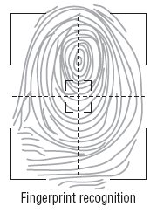
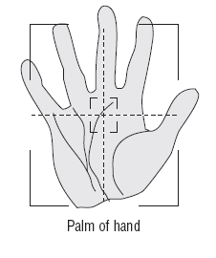
Authentication Methods
login ID and password
PIN.
Using Biometrics
Fingerprint - Palm Print - Retina scanning
Face Scan

Slide 25
Network Access Protection
Kerberos Single Sign-On
Network Firewalls

Slide 26
Kerberos single sign-on

Slide 27
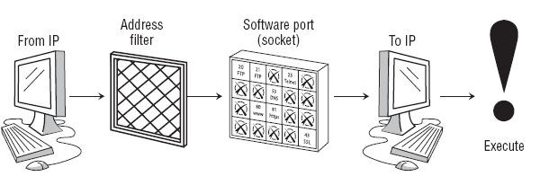
firewall technology
First Generation: Packet Filter
The first generation was a packet filter. Filtering is based on the sending and receiving address combined with the service port (a packet). The advantage of this design is its low cost.

Slide 28
firewall technology
Second Generation: Application Proxy Filter
A firewall application program was added to the first-generation design of packet filtering. The second generation uses an application proxy to relay requests through the firewall. The proxy checks the inbound request to ensure that it complies with safe computing in both format and type of request. Application proxies perform user requests without granting direct access to the target software

Slide 29
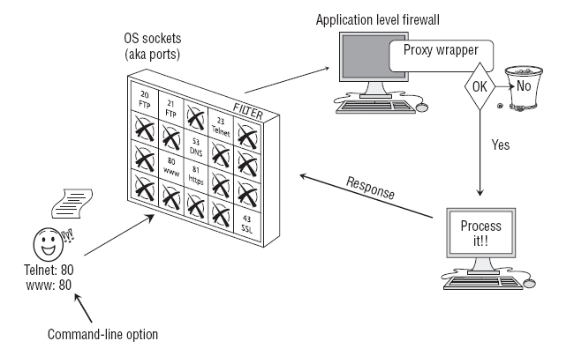
firewall technology
Second Generation: Application Proxy Filter

Slide 30
Third Generation: Stateful Inspection
Fourth Generation: Adaptive Response
Fifth Generation: Kernel Process

Slide 31
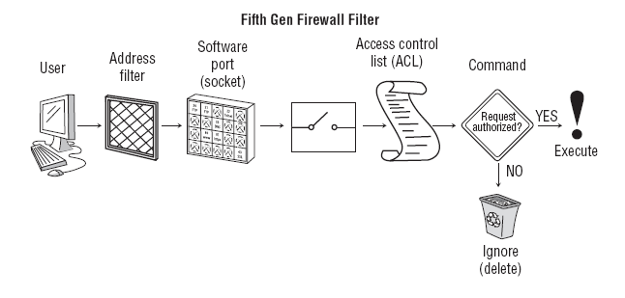
Fifth Generation: Kernel Process

Slide 32
Three common types of VPNs

Slide 33
four types of VPN technology
Point-to-Point Tunneling P NN rotocol, or PPTP
Layer 2 Tunneling Protocol, or L2TP (OSI layer 2, Data-Link)
Secure Sockets Layer, or SSL (OSI layer 5, Session)
Internet Protocol Security, or IPsec (OSI layer 3, Networking

