Slide 1
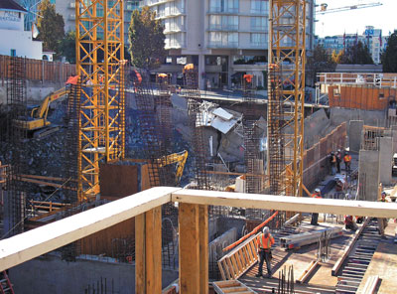
Project crashing
Project Management
Magister Management
Universitas Komputer Indonesia
Source:
Larson, e.w., Gray C.F., Project management – the managerial process, 011, 5tH ed.;
Pinto, j.k.project management – achieving competitive advantage, 2010, 2ND. ED.

Slide 2
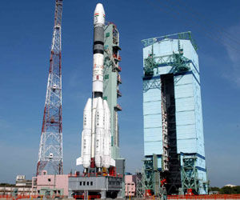
Project crashing
At times it is necessary to expedite the project, to accelerate development to reach an earlier completion date. The process of accelerating a project is referred to as crashing. Crashing a project directly relates to resource commitment. The more resources we are willing to expend, the faster we can push the project to its finish.

Slide 3

Reasons to Crash a Project
The initial schedule may be to optimistic.
Market needs change and the project is in demand earlier than anticipated.
The project has slipped considerably behind schedule.
The contractual situation provides even more incentive to avoid schedule slippage.

Slide 4

Options for Accelerating Activities
Improving the productivity of existing project resources.
Changing the working method employed for the activity, usually by altering the technology and types of resources employed.
Increasing the quantity of project resources, including personnel, plant, and equipment.

Slide 5
Time-Cost Trade-Offs for Crashing Activities
Crashed Point
Crashed
Cost
Normal Point
Normal
Crashed
Normal
Time

Slide 6

COST OF CRASHING
        Crash Cost – Normal Cost
Slope = ------------------------
        Normal Time – Crash Time

Slide 7
EXAMPLE
Calculate the cost of crashing project activities, suppose the normal activity duration of activity X is 5 weeks and is budgeted cost $12,000. The crash time for this activity is 3 weeks and is expected to cost $32,000.

Slide 8
Crashing a Project (Example)
Suppose we had a project with only eight activities, as ilustrated in the next table. The table also shows our calculated normal activity durations and costs and crashed durations and their costs. We wish to determine which activities are the optimal candidates for crashing. Assume the project cost listed include both fixed and variable costs for each activity.

Slide 9
Crashing a Project (Example)
Activity | Normal Duration Cost |  | Crash Duration Cost
A | 5 days | $ 1,000 | 3 days | $ 1,500
B | 7 days | 700 | 6 days | 1,000
C | 3 days | 2,500 | 2 days | 4,000
D | 5 days | 1,500 | 5 days | 1,500
E | 9 days | 3,750 | 6 days | 9,000
F | 4 days | 1,600 | 3 days | 2,500
G | 6 days | 2,400 | 4 days | 3,000
H | 8 days | 9,000 | 5 days | 15,000
TOTAL COST= |  | 22,450 |  | $ 37,500

Slide 10
Cost of Crashing Each Activity
Activity | Crashing Cost (per day)
A | $ 250
B | 300
C | 1,500
D | 0
E | 1,750
F | 900
G | 300
H | 2,000

Slide 11
Normal Activity Network
B
7
F
4
A
5
C
3
E
9
H
8
D
5
G
6

Slide 12
Fully Crashed Activity Network
B
6
F
3
A
3
C
2
E
6
H
5
D
5
G
4

Slide 13
EXERCISE -1
You are considering the decission of whether or not to crash your project. After asking your operation manager to conduct an analysis, you have determined the crash activity duration and costs, shown in the table below (assume all activities are on the critical path):
Activity | Normal Duration Cost |  | Crashed Duration Cost
A | 6 days | $ 1,000 | 4 days | $ 2,000
B | 5 days | $ 2,500 | 5 days | $ 2,500
C | 3 days | $ 800 | 2 days | $ 1,200
D | 7 days | $ 3,500 | 3 days | $ 7,000
E | 2 days | $ 500 | 1 day | $ 5,000
F | 5 days | $ 2,000 | 4 days | $ 3,000
G | 10 days | $ 5,000 | 6 days | $ 6,300
a. Calculate the per day cost for crashing each activity
b. Which are the most attractives candidates for crashing? Why?

Slide 14
EXERCISE -2
Given the data and information that follow, compute the total direct cost for each duration. If the indirect costs for each project duration are $90 (15 time units), $70 (14), $50 (13), $40 (12), and $30 (11), compute the total project cost for each duration. What is the optimum cost-time schedule for the project? What is this cost?
Act. | Crash cost (slope) | Maximum crash time | Normal time | Normal cost
A | 20 | 1 | 5 | 50
B | 60 | 2 | 3 | 60
C | 0 | 0 | 4 | 70
D | 10 | 1 | 2 | 50
E | 60 | 3 | 5 | 100
F | 100 | 1 | 2 | 90
G | 30 | 1 | 5 | 50
H | 40 | 0 | 2 | 60
I | 200 | 1 | 3 | 200

Slide 15
Exercise 2 - Network Model
C
F
A
5
D
G
I
B
E
H

Slide 16
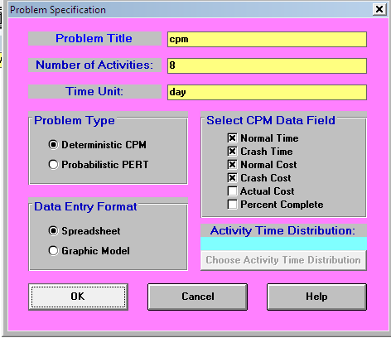
Solving Example using Win QS - Example
File – New Problem
Fill: Problem Title, Number of Activities, & Time Unit
Klik: Deterministik CPM
Klik: Normal Time, Crash Time, Normal Cost, Crash Cost
OK

Slide 17
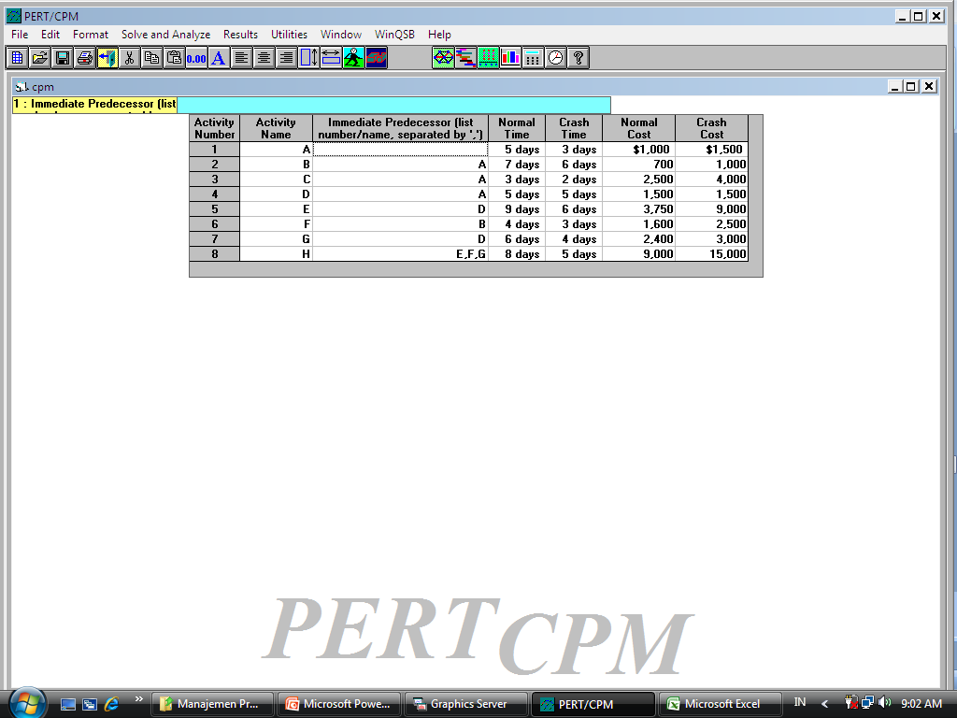
Solving Exercise using Win QS - Example
Input data

Slide 18
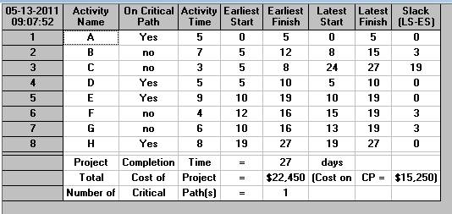
Solve and Analyze – Solve Critical Path Using Normal Time

Slide 19
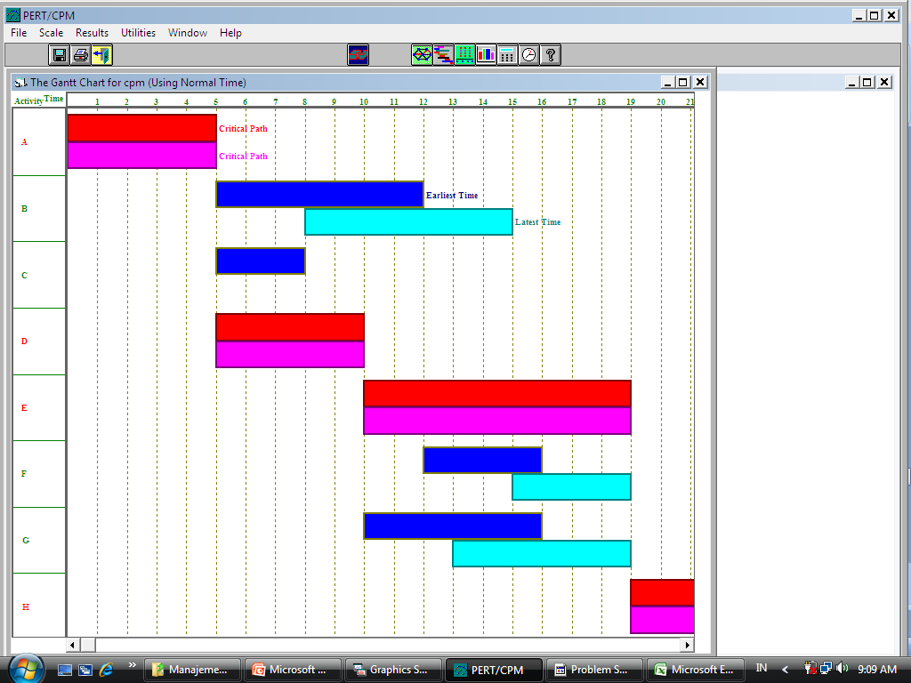
Results – Gantt Chart

Slide 20
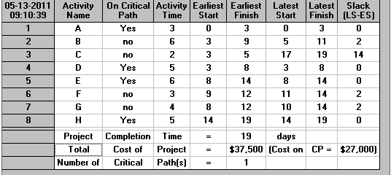
Solve and Analyze – Solve Critical Path Using Crash Time

Slide 21
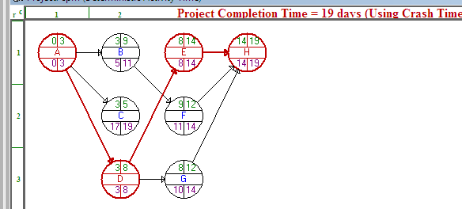
Results – Graphic Activity Analysis

Slide 22

TERIMA KASIH
TERIMA KASIH

