Slide 1
SCOPE MANAGEMENT
Project Management
Magister Sistem Informasi
Universitas Komputer Indonesia
Source:
Larson & gray, 2014
Pinto, j.k. 2010, 2ND. ED.

Slide 2
Project scope
is everything about a project – work content as well as expected outcomes. Project scope consist of naming all activities to be performed, the resources consumed, and the end product that result, including quality standard. Scope includes a project goals, constraints, limitations.

Slide 3
SCOPE MANAGEMENT
is the function of controlling a project in terms of its goals and objectives through the processes of conceptual development, full definition, execution, and termination.
It’s a dream until you write it down. Then it’s goal
We can control only what we have planned

Slide 4
Defining the project
Defining the project scope
1. Project objective
2. Deliverables
3. Milestones
4. Technical requirements
5. Limits & Exclusions
6. Reviews with customer
Establishing project priorities
Creating the breakdown structure
Integrating the WBS with the Organization
Coding the WBS

Slide 5
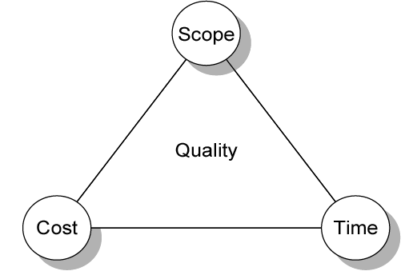
Establishing project priorities

Slide 6
Establishing project priorities
Cost
Profit Potential
Time To Market
Development Risk
Others

Slide 7
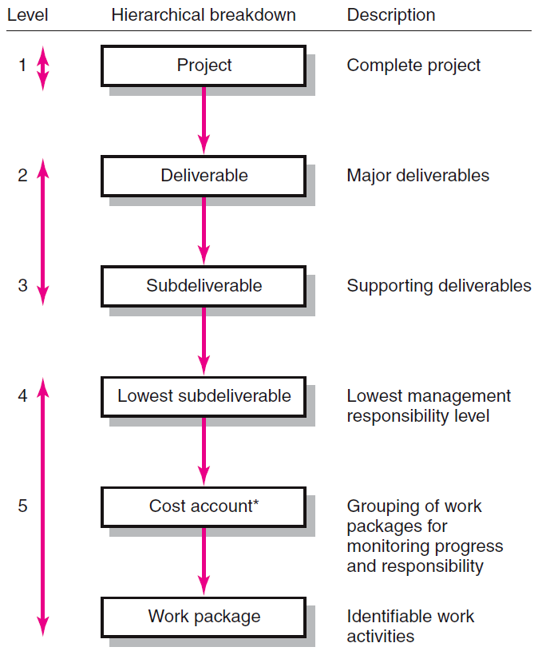
Hierarchical breakdown of the wbs

Slide 8
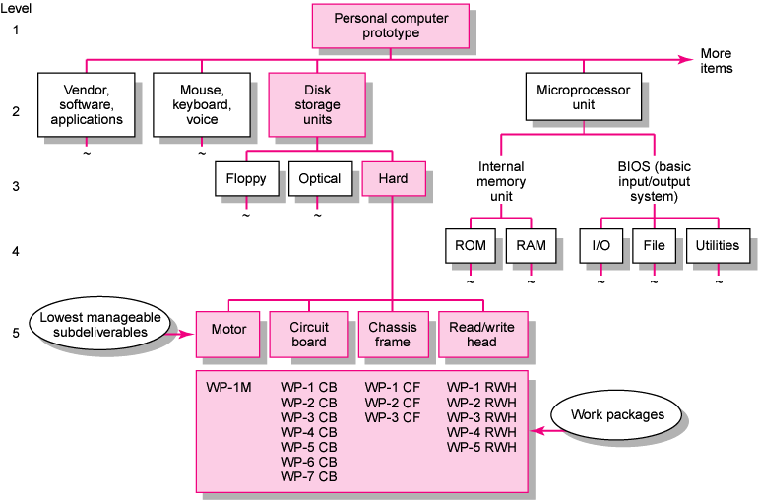
Work breakdown structure (Example)

Slide 9
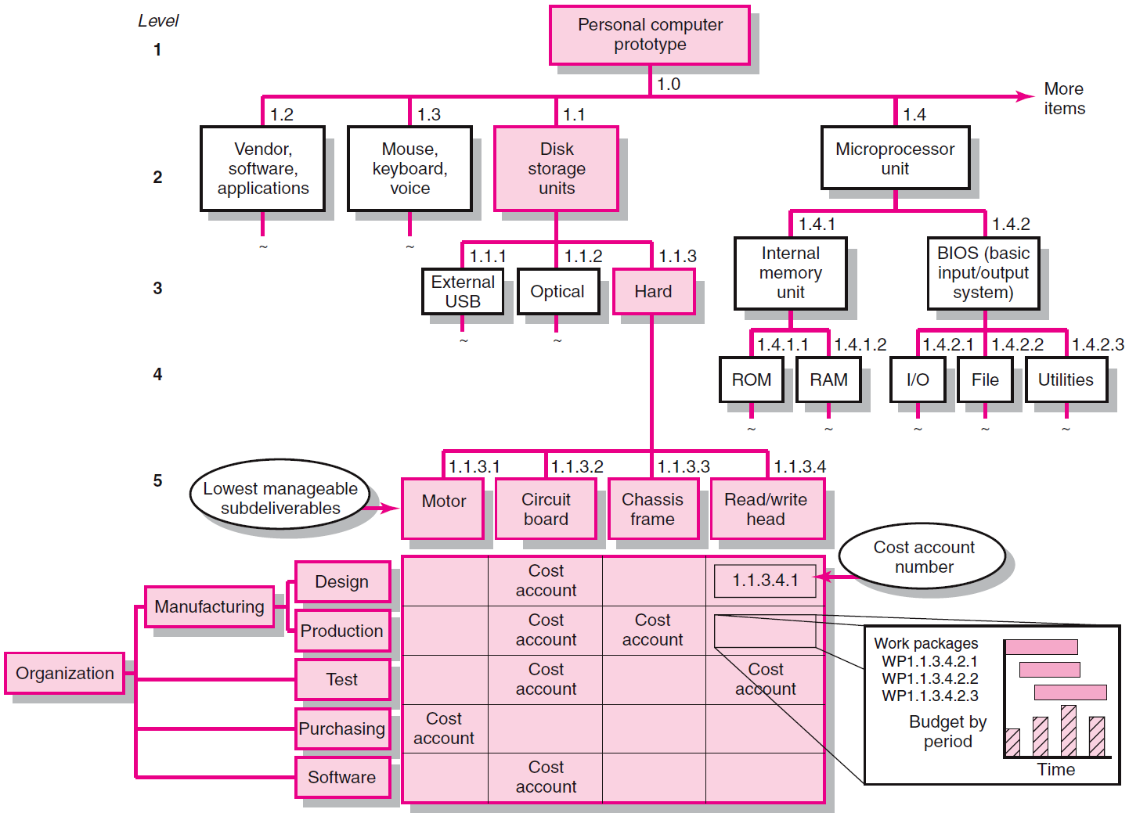
Integrating wbs & obs (Example)

Slide 10
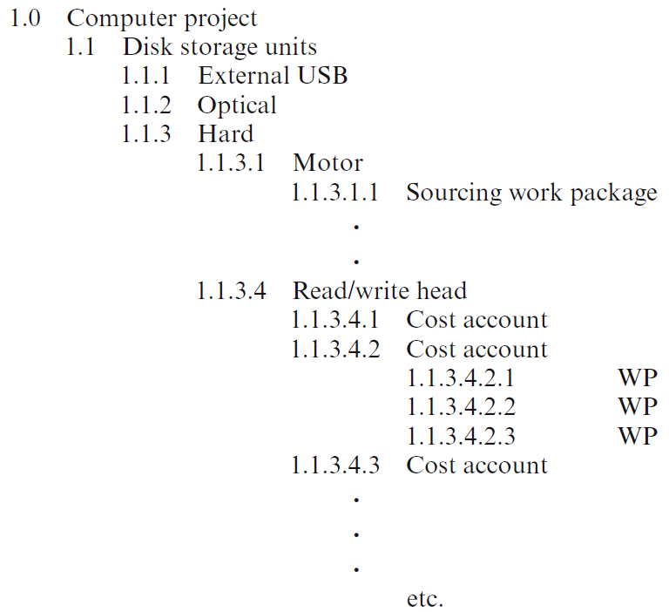
Coding the wbs for information (EXAMPLE)

Slide 11
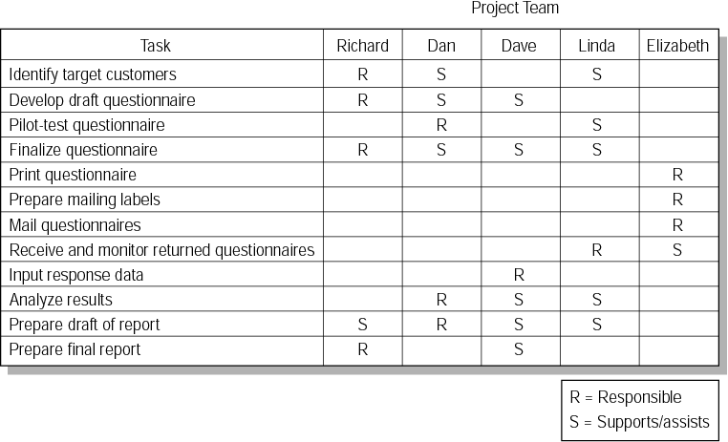
Responsibility matrix for market research project (EXAMPLE)

