Slide 1
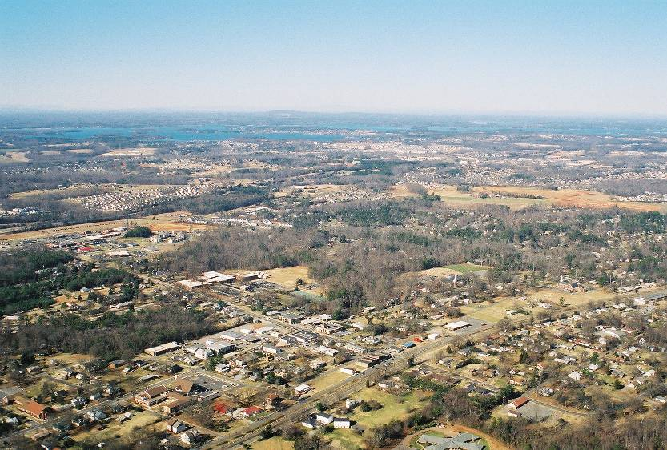
Guna lahan perkotaan

Slide 2
Tiga model
Concentric Zone Model
Sector Model
Multiple Nuclei

Slide 3
Concentric Zone Model
Burgess
Model jalur terpusat
Model Burgess

Slide 4
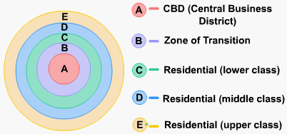
Concentric Zone Model

Slide 6
Concentric Zone Model
Model
Chicago, 1920s
Single Family Dwellings
Second Immigrant
Settlement
Little
Sicily
Ghetto
LOOP
Two Plan
Area
Apartment Houses
Black Belt
Residential District
Bungalow
Section
I - Loop (downtown)
IV - Working class zone
II - Factory zone
V - Residential zone
III - Zone of transition
VI - Commuter zone

Slide 7
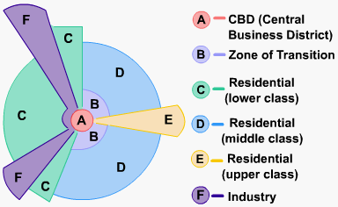
Sector Model (Hoyt)

Slide 8
Multiple Nuclei
Model Inti Ganda
Harris & Ullman (1945) → artikel “The nature of cities”

Slide 9
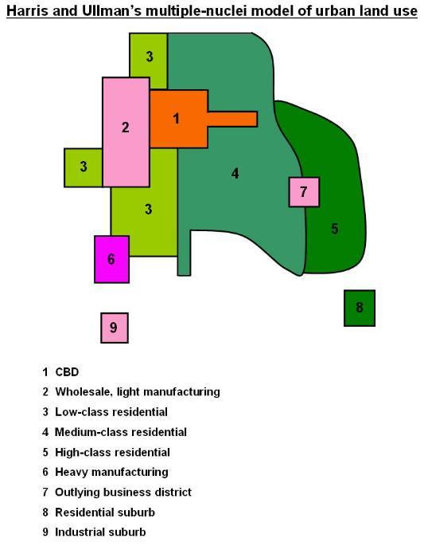

Slide 10
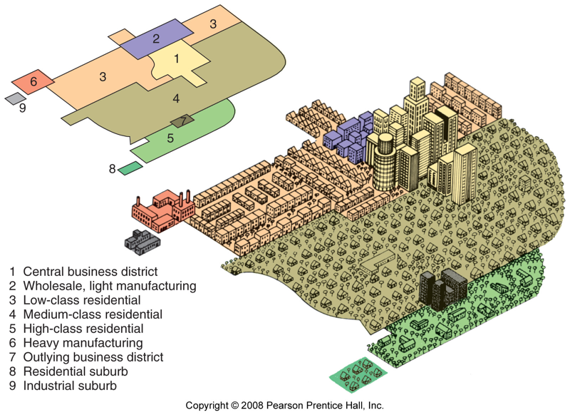

Slide 11
Teori Sektor (Hoyt) & Multiple Nuclei
Sector
Nuclei
2
3
3
4
2
1
3
3
4
5
3
1
3
3
7
5
3
6
2
3
4
9
8
1 CBD (central Business District)
2 Perdagangan dan industri ringan
3 Perumahan kelas menengah ke bawah
4 Perumahan menengah ke atas
5 Perumahan kelas atas
6 Industri berat
7 Sub business district
8 Perumahan suburban
9 Industri suburban

Slide 12
Red light area
Red light district (kawasan lampu merah)
Daerah konsentrasi prostitusi di kawasan bisnis (central business district = CBD)
Disebut dengan kawasan lampu merah, menurut mitos, karena jaman dulu pegawai KA membawa lampu warna merah bila mengunjungi lokasi prostitusi tersebut.

Slide 13
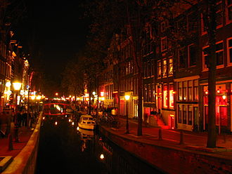
AMSTERDAM

Slide 14
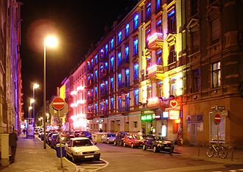
FRANKFURT

Slide 15
frankfurt

Slide 16
Struktur Kota Jakarta (Ford, 1993)

