Slide 1

WEEK 2
Project Management
Magister DESAIN
Universitas Komputer Indonesia

Slide 2

THE ORGANIZATIONAL CONTEXT
STRATEGY, STRUCTURE, and CULTURE

Slide 3

STRATEGY

Slide 4
STRATEGIC MANAGEMENT
Strategic management is the science of formulating, implementing, and evaluating cross functional decission thats enabling the organization achieving its objective

Slide 5
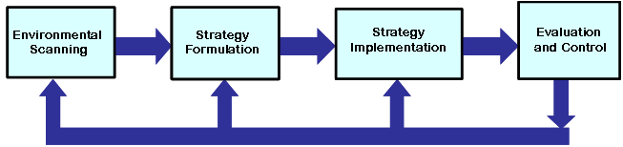
BASIC MODEL OF
STRATEGIC MANAGEMENT

Slide 6
PROJECTS REFLECT STRATEGY
STRATEGY
PROJECT
Technical or evaluating initiatives (such as decentralized plant operation)
Redevelopment of product for greater market acceptance
Changes in strategic direction or product portofolio reconfiguration
Construction of new plants or modernization of facilities
Reengineering projects
New product lines

Slide 7
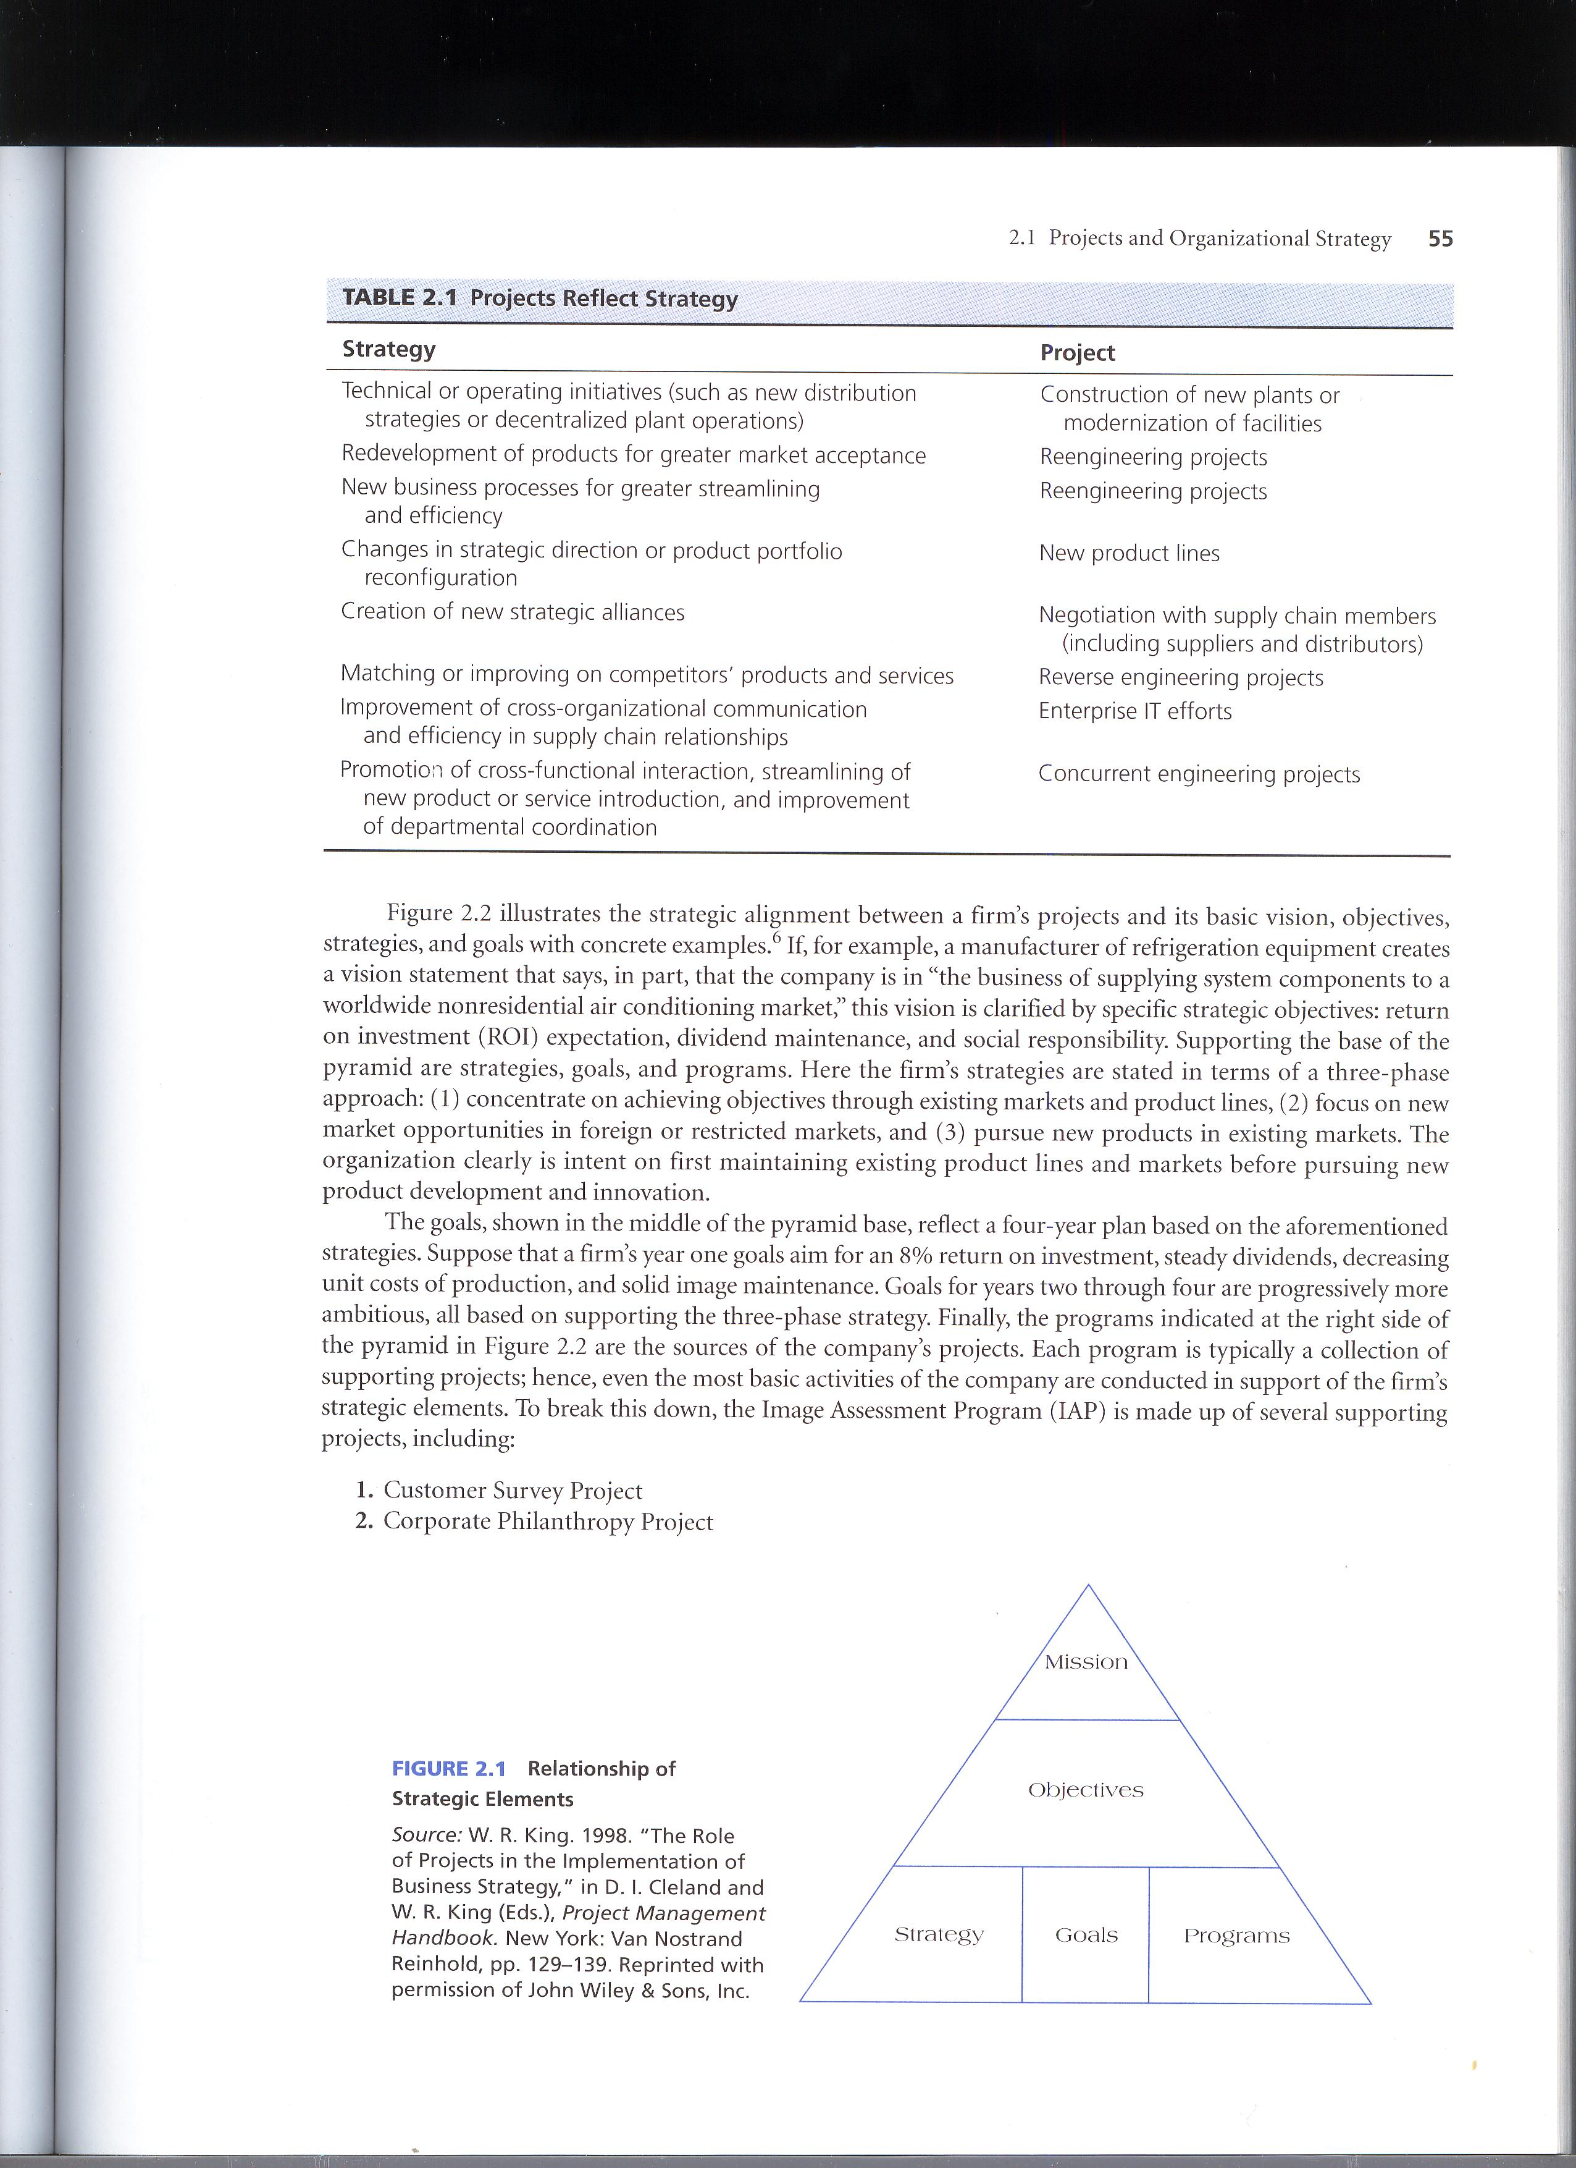
RELATIONSHIP OF STRATEGIC ELEMENTS

Slide 8
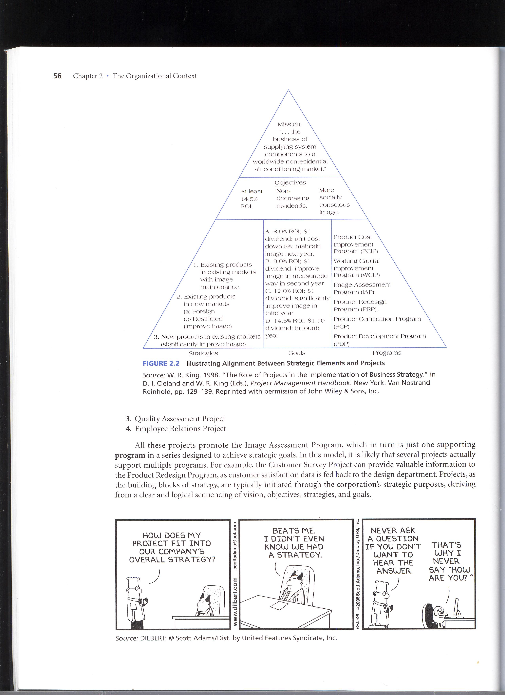
ILLUSTRATING ALIGNMENT BETWEEN STRATEGIC ELEMENTS AND PROJECTS

Slide 9

STAKEHOLDER

Slide 10
PROJECT STAKEHOLDER
All individuals or groups who have an active stake in the project and can potentially impact, either positively or negatively, its development.

Slide 11
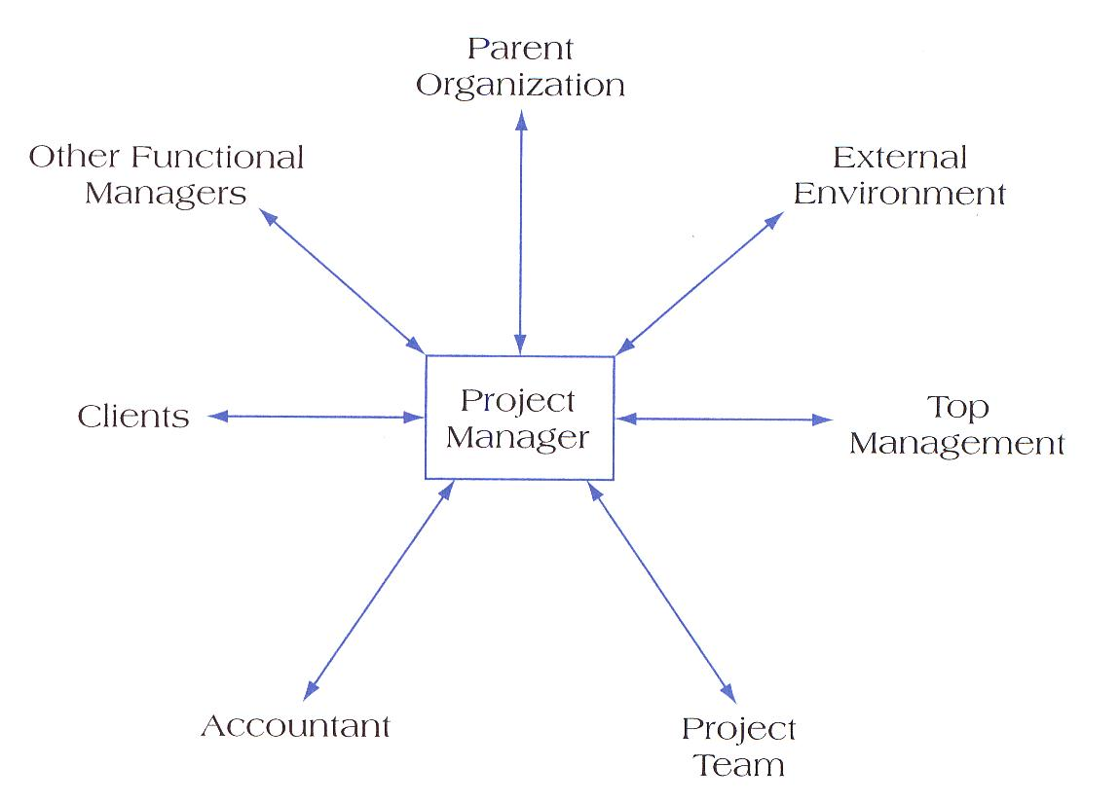
PROJECT STAKEHOLDER RELATIONSHIP

Slide 12
MANAGING STAKEHOLDER
Assess the environment
Identify the goals of the principal actors
Assess your own capabilities
Define the problems
Develop solutions
Test and refine the solutions

Slide 13
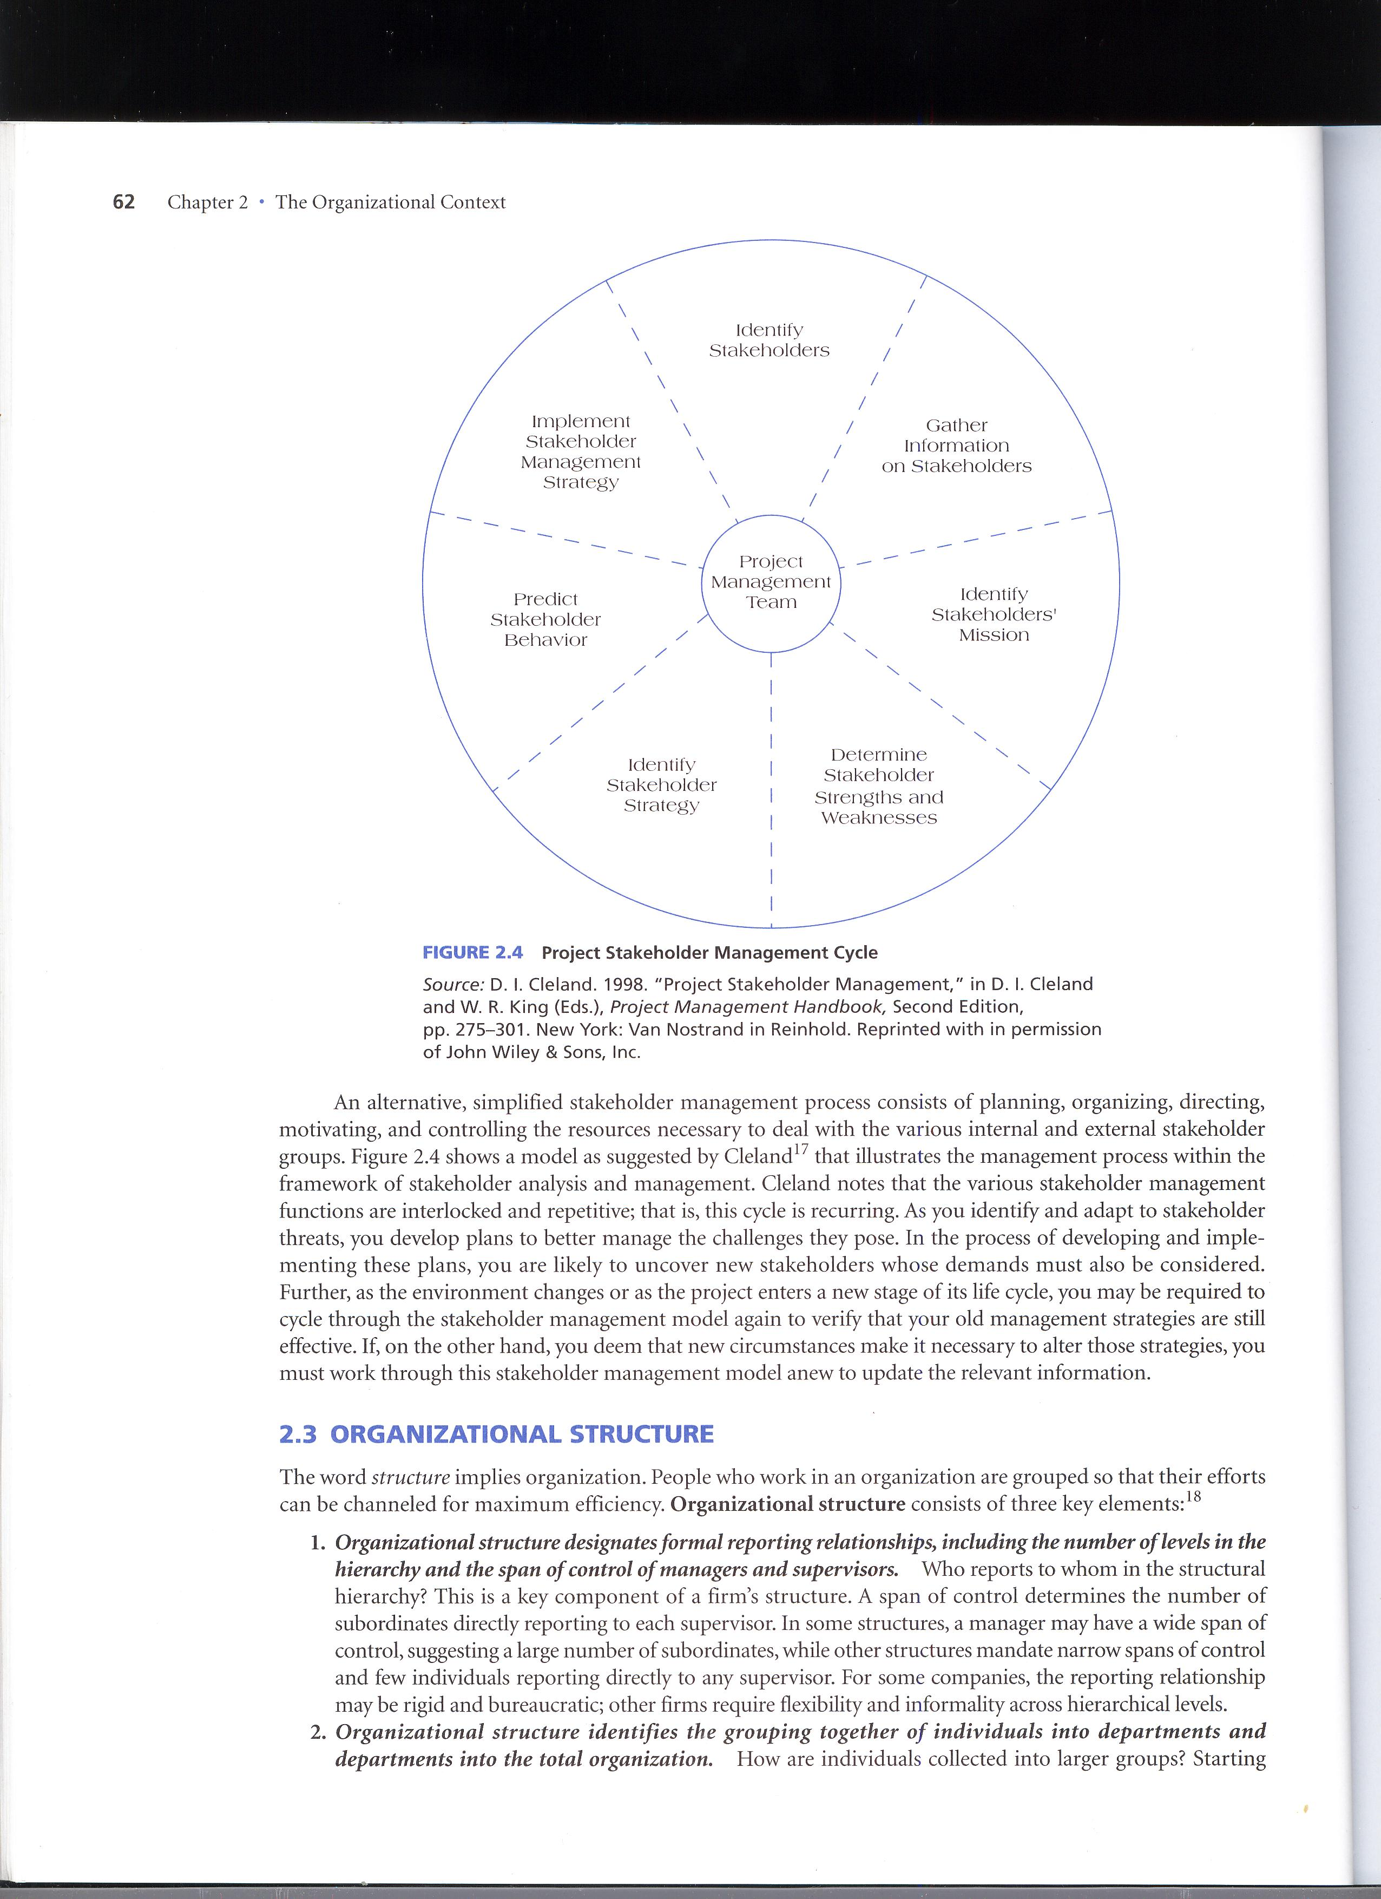
PROJECT STAKEHOLDER MANAGEMENT CYCLE

Slide 14

ORGANIZATIONAL
STRUCTURE

Slide 15
FORMS OF ORGANIZATIONAL STRUCTURE

Slide 16
FORMS OF ORGANIZATIONAL STRUCTURE
FUNCTIONAL ORGANIZATIONS – Companies are structured by grouping people performing similar activities into departments.
PROJECT ORGANIZATIONS – Companies are structured by grouping people into project teams on temporary assignment.
MATRIX ORGANIZATIONS - Companies are structured by creating a dual hirarchy in which functions and projects have equal prominence.

Slide 17
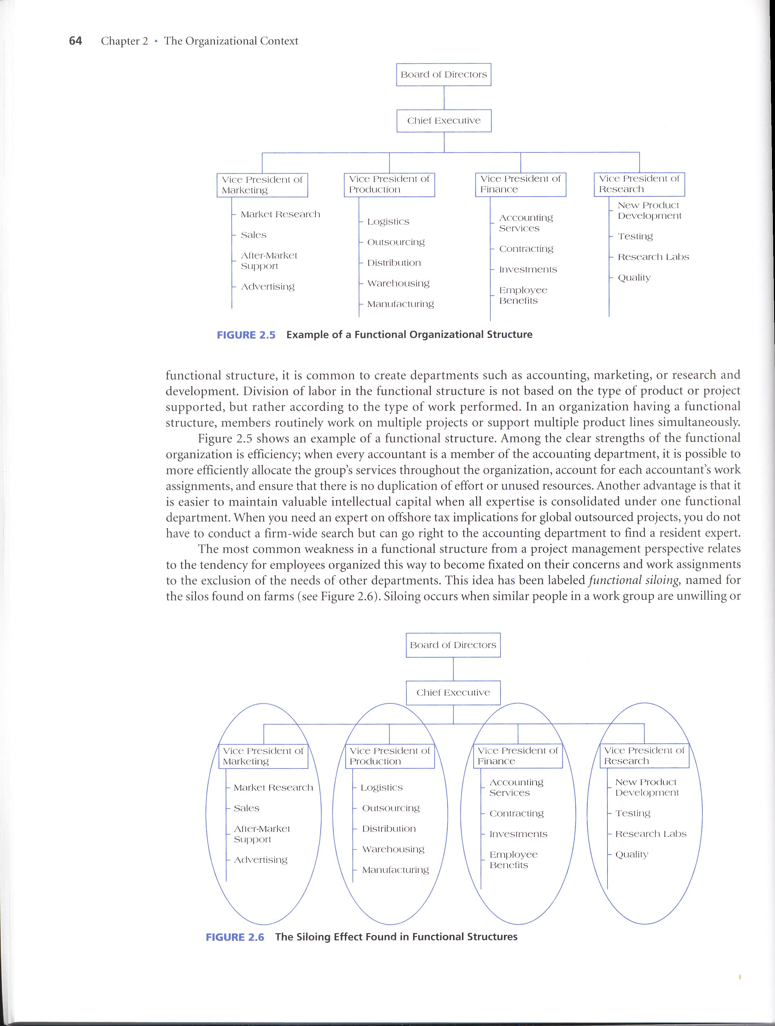
Example of Functional Organization

Slide 18
Functional Organization Advantages
No change
Flexibility
In-Depth Expertise
Easy Post-Project Transition

Slide 19
Functional Organization Disadvantages
Lack of Focus
Poor Integration
Slow
Lack of Ownership

Slide 20
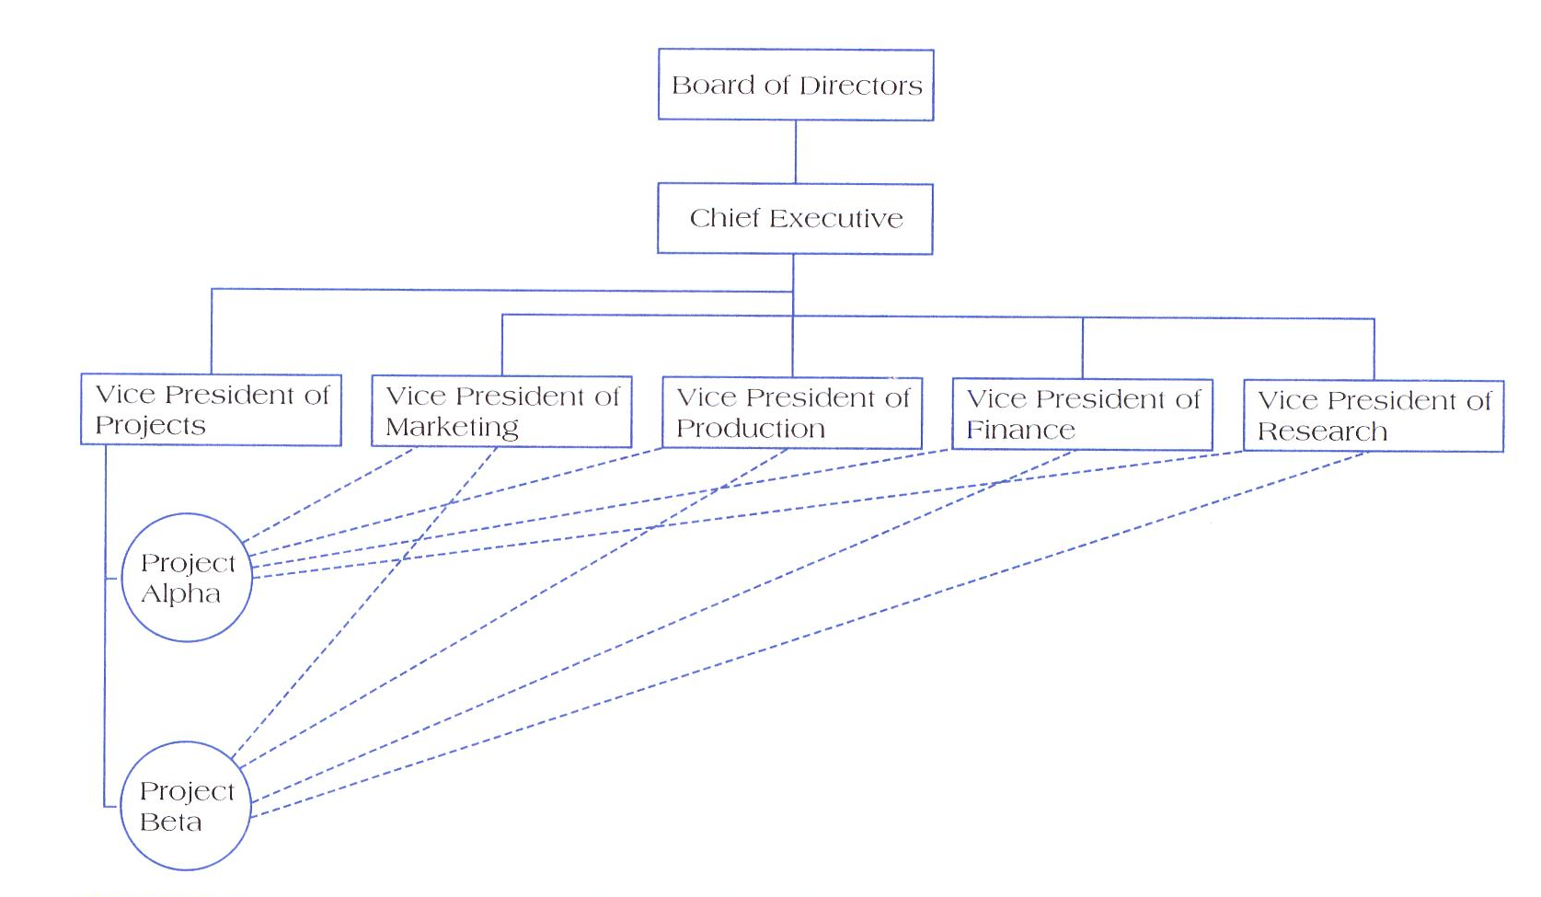
Projectized Organization Structure

Slide 21
Projectized Organization Structure - Advantage
Simple
Fast
Cohesive
Cross-Functional Integration

Slide 22
Projectized Organization Structure - Disadvantage
Expensive
Internal Strife
Limited Technological Expertise
Difficult Post-Project Transition.

Slide 23
MATRIX STRUCTURE
Matrix management works, but it sure is difficult at time. All matrix managers must keep up their health and take Stress-Tabs.
A PROJECT MANAGER

Slide 24
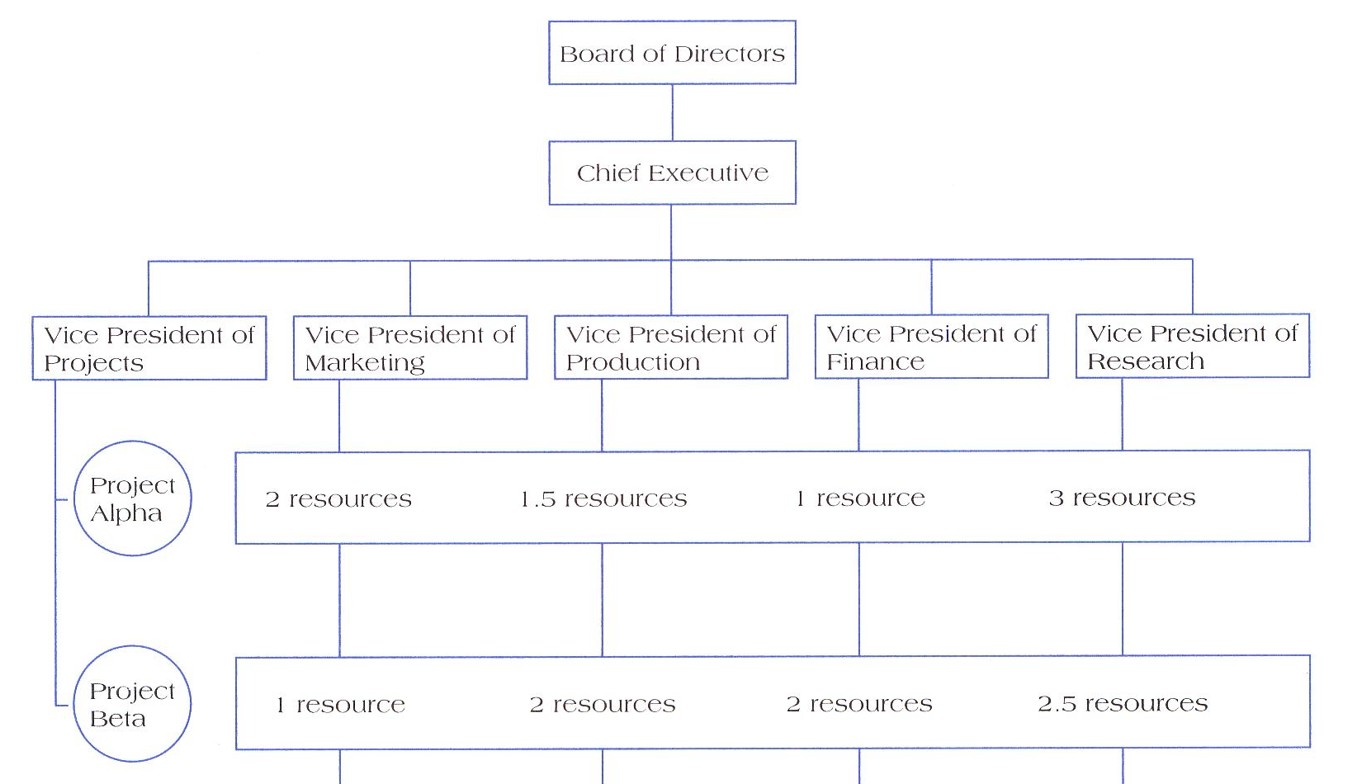
Example of Matrix Organizations

Slide 25
Matrix Structure Advantage
Efficient
Strong Project Focus
Easier Post-Project Transition
Flexible

Slide 26
Matrix Structure Disadvantage
Dysfunctional Conflict
Infighting
Stressfull
Slow

Slide 27
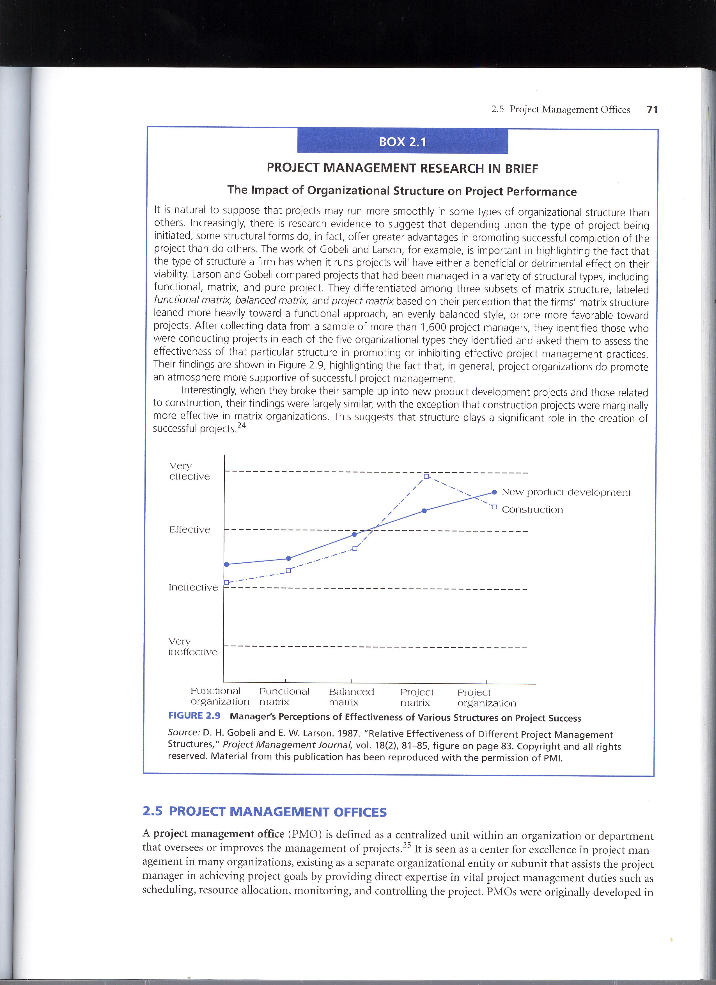
The Impact of Organizational Structure on Project Performance

Slide 28

ORGANIZATIONAL CULTURE

Slide 29
Culture
Refer to unwritten rules of behaviour, or norms that are used to shape and guide behaviour, that are shared by some subset of organizational members, and are taught to all new members of the company.

Slide 30
Key Factors that Affect the Development of Culture
Technology
Environment
Geographical location
Reward Systems
Rules and Procedures
Key Organizational Members
Critical Incidents

Slide 31


