Slide 1
ENGLISH SEMANTICS
Some Fundamental Concepts for Semantics
Dr. Retno Purwani Sari, M.Hum.

Slide 2
The Definition of Semantics
“Semantics is the study of meaning in human language.”
(Allan, 2001:1)
Characteristics of meaning:
Compositional
Significantly underspecified

Slide 3
Human Language and Linguistic Brances

Slide 4
Phonetics
The physical side of linguistic utterances—the articulation and perception of speech sounds (articulatory, acoustic and auditory)—is the domain of phonetics. It is not a trivial task to study the physical properties of articulatory movements and the physical properties of acoustic phenomena related to spoken language. Thanks to the progress in sciences like acoustics, we have a body of significant findings.

Slide 5
Phonology
What are the smallest
meaning distinguishing units (=phonemes) in a given language?
cat
sat
bat
mat
Speech sounds as physical entities may be infinitely varied, but when they function as elements in a language, as phonological units, they are highly constrained. Native speakers of any language intuitively know which sequences of speech sounds are words or could be words in their language.

Slide 6
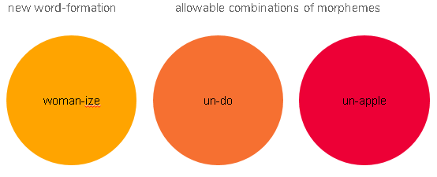
Morphology
Morphology: the structure of words and the smallest meaning-bearing units and how they combine into words:

Slide 7
Syntax
Syntax: the formation of sentences, how words are combined to larger units than words, to phrases and sentences
1. *portrait Rembrandt painted that a
2. A portrait that Rembrand painted

Slide 8
SEMANTICS
the study of MEANING in LANGUAGE.

Slide 9
Pragmatics
Pragmatics is about the interaction of semantic knowledge with our knowledge of the world, taking into account context of use.

Slide 10
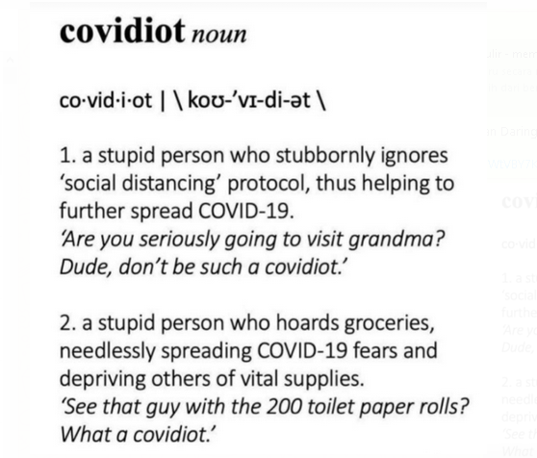
Latest Case

Slide 11
How does compositional work
Killed, crocodile, hunter, the, the
The hunter killed the crocodile
The crocodile killed the hunter
Horseback, polo, played, is, on
Horseback is played on polo.*
Polo is played on horseback

Slide 12
Meaning is significantly underspecified
Last night the king of France fell of her bike while playing polo.
The sentence may describes falsity in truth condition. It is nonsense. The value depends on knowledge (both linguistic and non-linguistic) or experience and intuitions of the analyst. It is known that:
[i] There is no longer a King of France;
[ii] Polo is played on horseback not bikes;
[iii] Her cannot normally refer to a king.
Covidmoron

Slide 13
References
Allan, Keith. (2001). Natural Language Semantics. USA: Wiley-Blackwell.
Griffiths, P. (2006). An Introduction to English Semantics and Pragmatics. Edinburgh University Press Ltd.

