Slide 1
PENGENALAN TEKNIK TELEKOMUNIKASI
Modul : 01 Perkembangan Teknologi Telekomunikasi
Teknik Elektro
UNIKOM

Slide 2
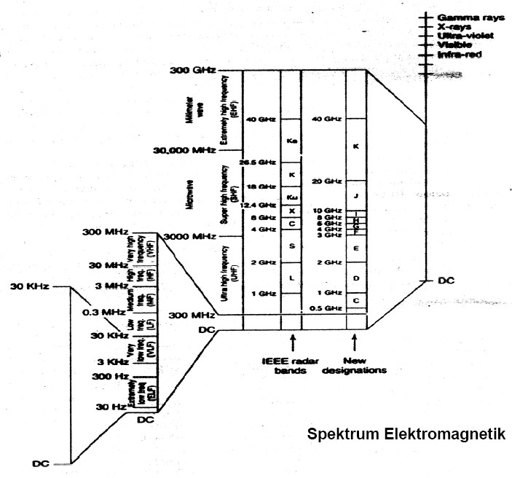
Spektrum Elektromagnetik

Slide 3
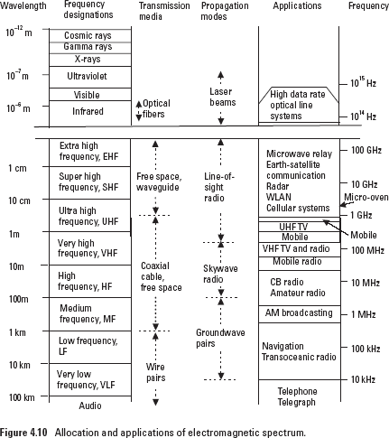

Slide 4
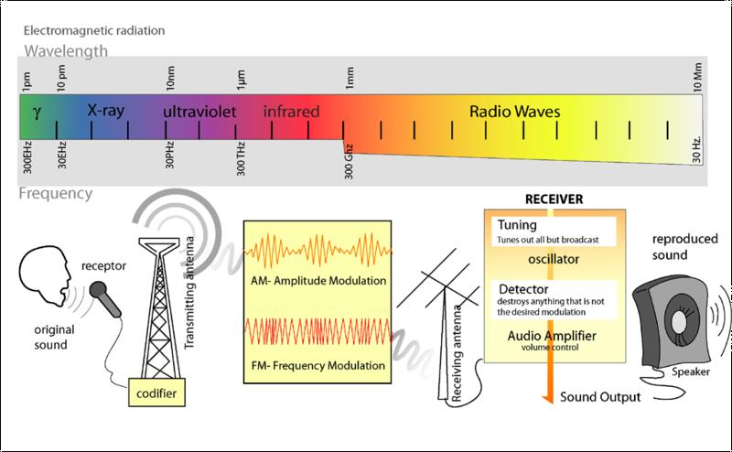
Radio Transmisi

Slide 5

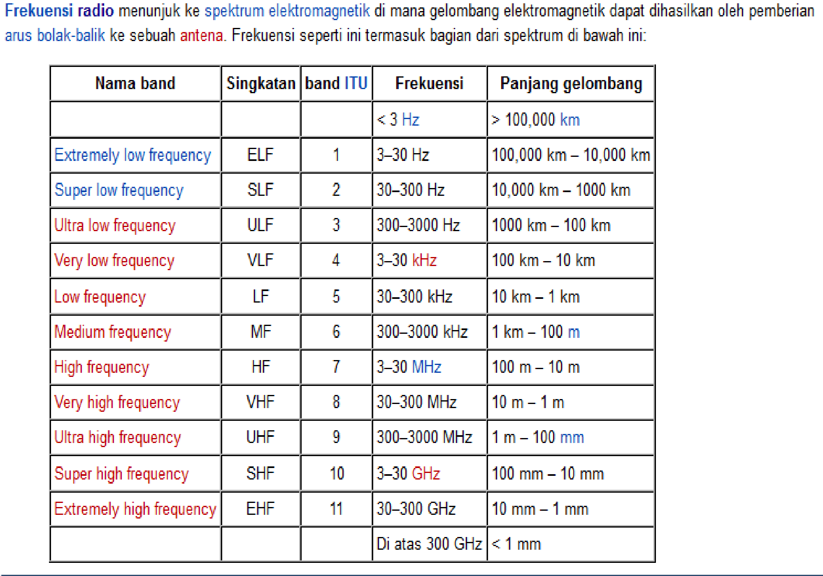

Slide 6
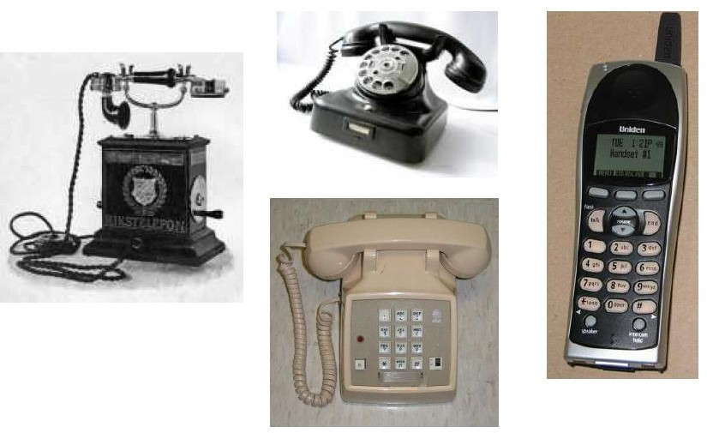
PESAWAT TELEPON

Slide 7
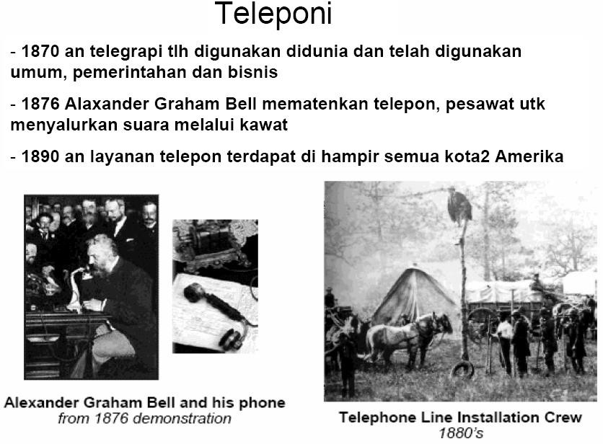

Slide 8
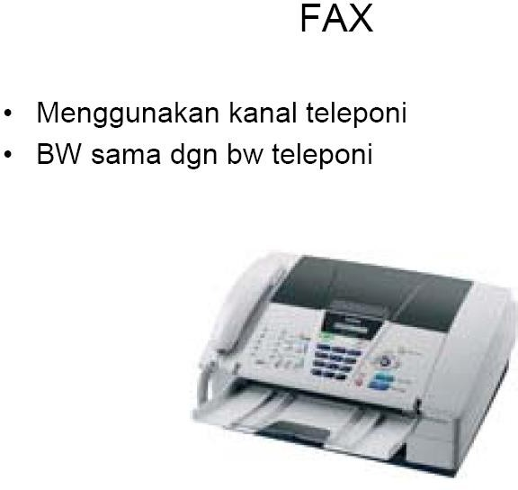

Slide 9
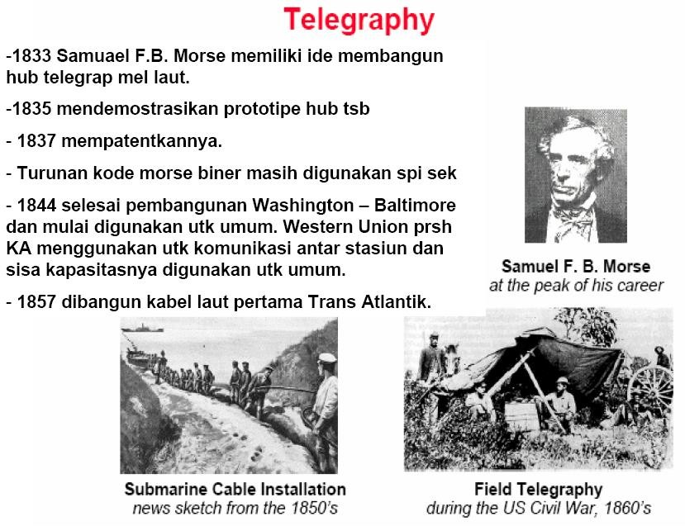

Slide 10
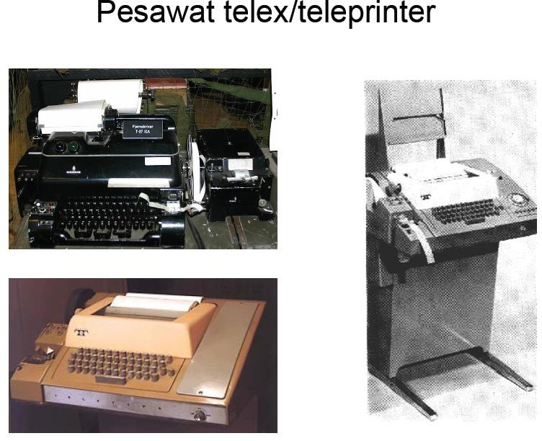

Slide 11
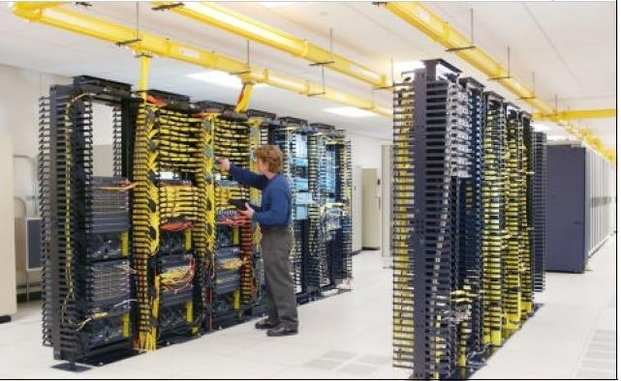
Sentral Telephone

Slide 12
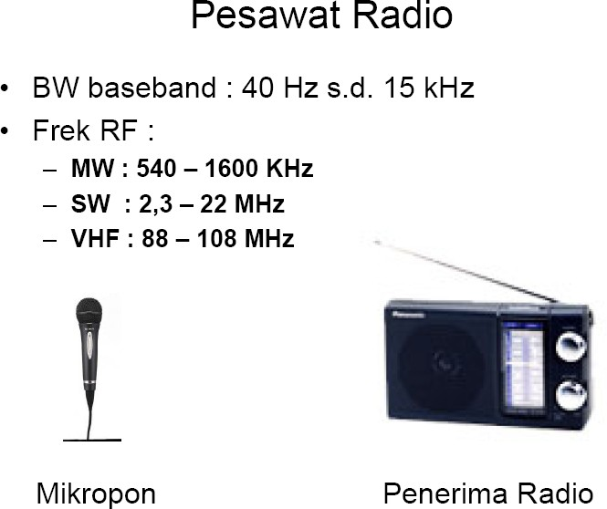
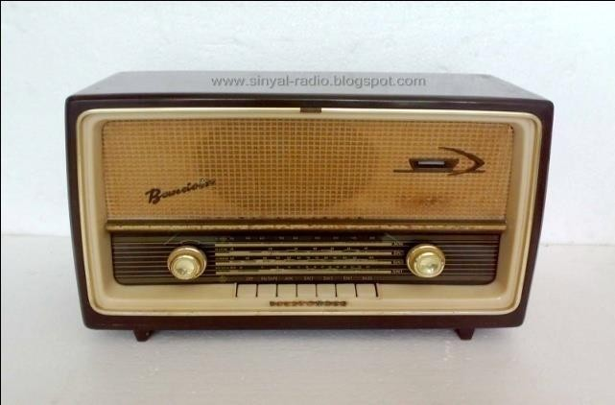

Slide 13
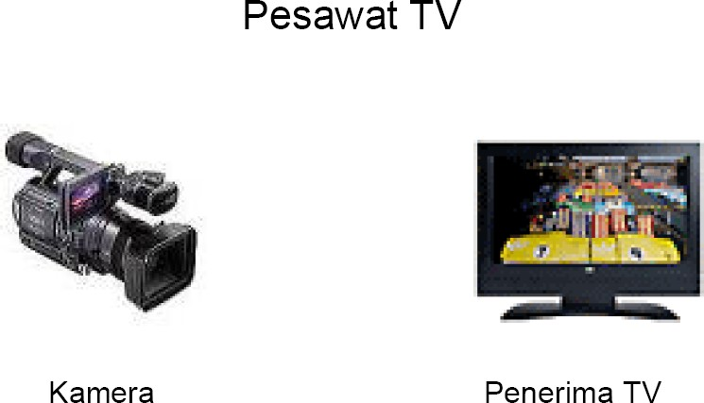

Slide 14
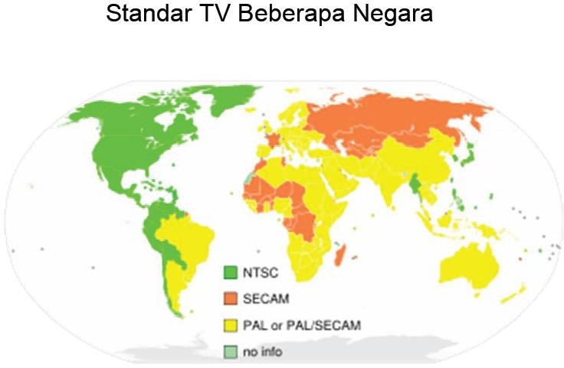

Slide 15
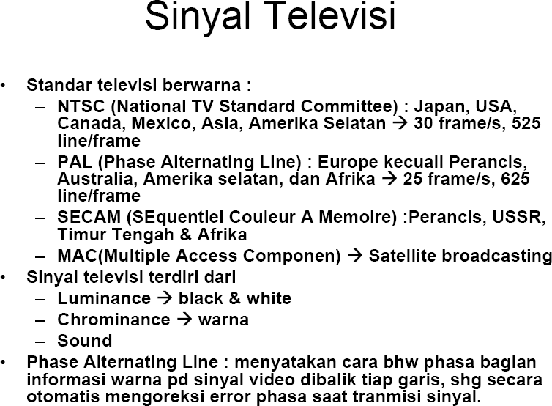

Slide 16
Apa ItuVoIP ?
Voice-over-IP = Internet telephony
–“Internet telephony refers to communications services—voice, facsimile, and/or voice-messaging applications—that are transported via the Internet, rather than the public switched telephone network (PSTN).
- The basic steps involved in originating an Internet telephone call are conversion of the analog voice signal to digital format and compression/translation of the signal into Internet protocol (IP) packets for transmission over the Internet; the process is reversed at the receiving end.”(IEC)
Bukan single technology, melainkan kombinasi beberapa teknologi Internet
Saat ini hanya suara, tetapi dapat dikembangkan dengan mudah ke video

Slide 17
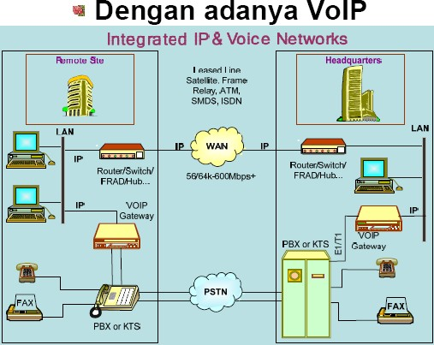

Slide 18
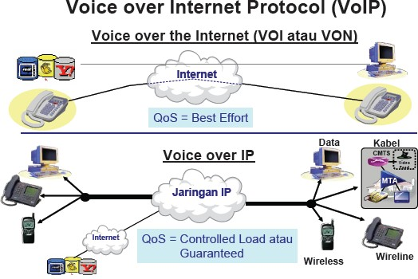

Slide 19
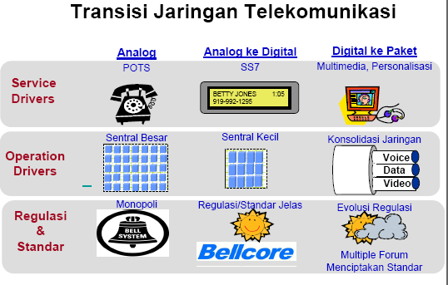

Slide 20
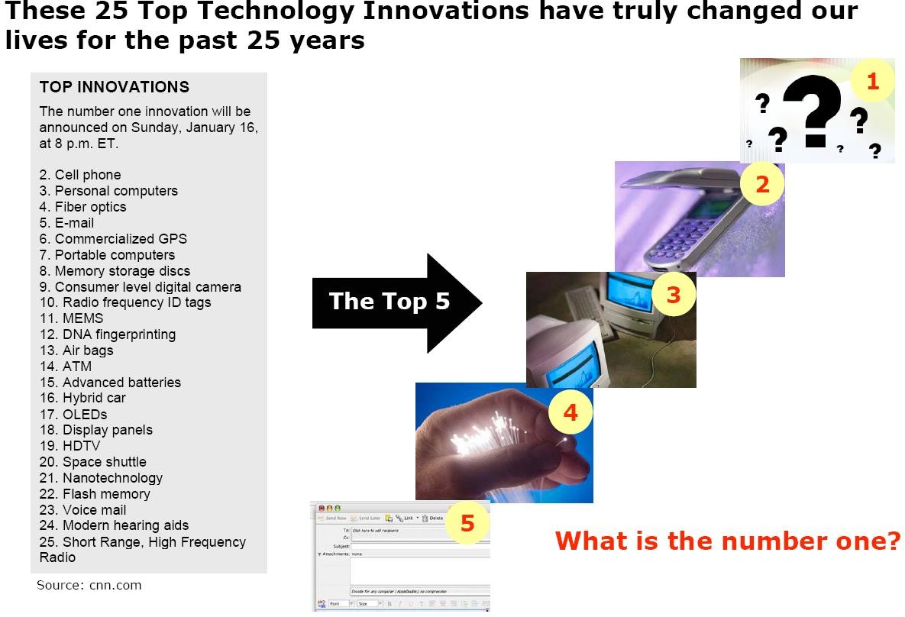

Slide 21
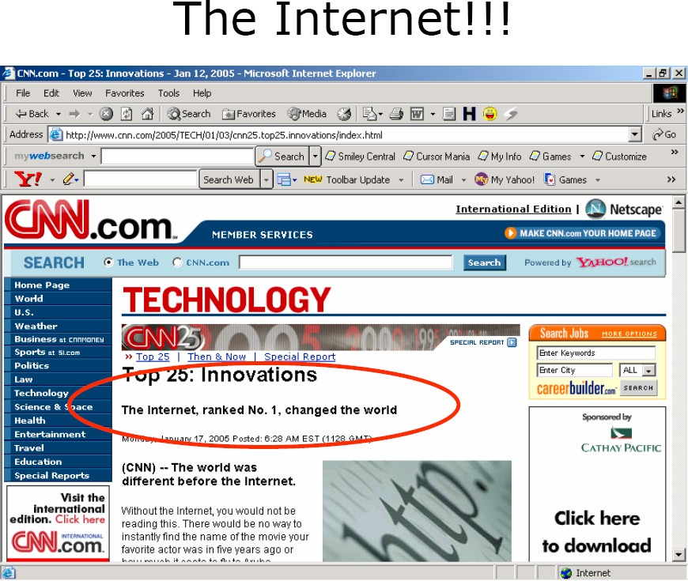

Slide 22
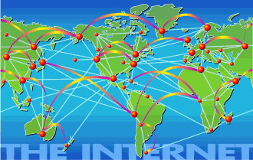

Slide 23
Identitas dalam Internet
IP Address
202.xxx.xx.xx
Domain Name
  generic (misal: www.detik.com)
  Cc-TLD (www.unikom.ac.id,

Slide 24
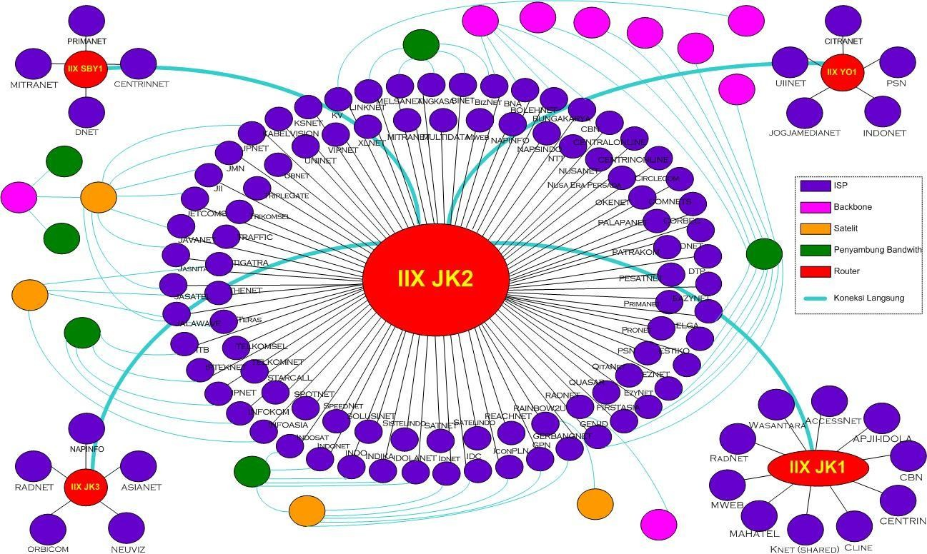

Slide 25
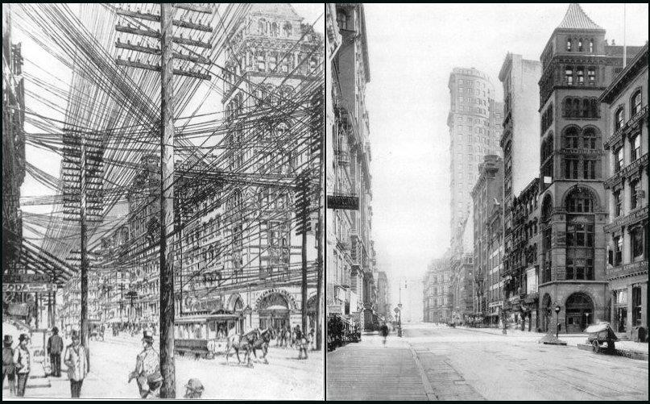
WIRELESS

Slide 26
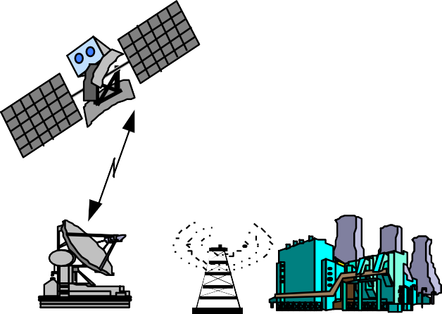



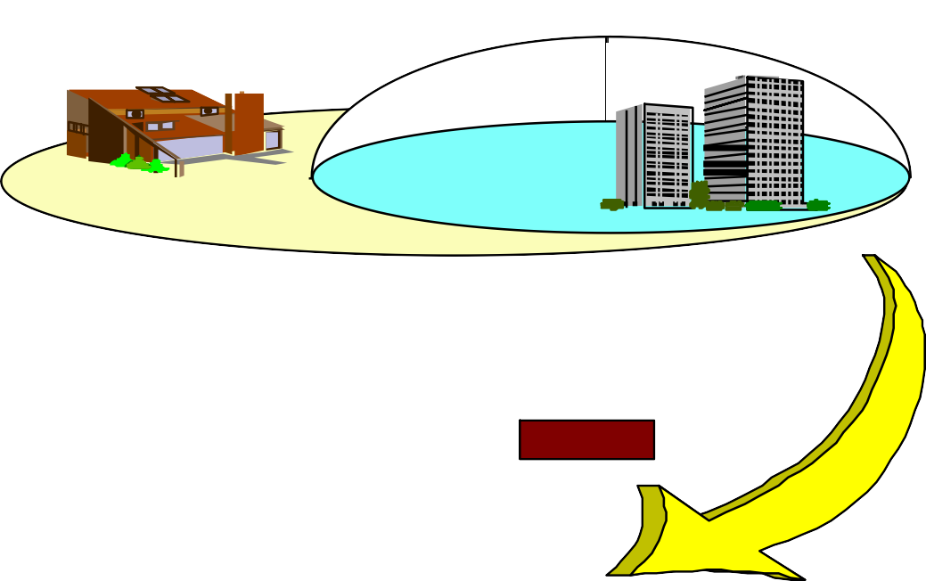



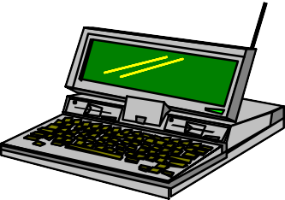
IMT-2000 Vision Includes LAN, WAN and Satellite Services
Global
Satellite
Suburban
Urban
In-Building
Microcell
Picocell
Macrocell
Basic Terminal PDA Terminal
Audio/Visual Terminal

Slide 27
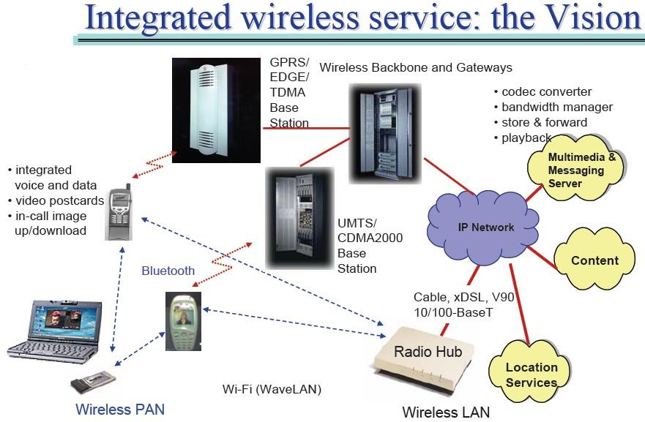

Slide 28
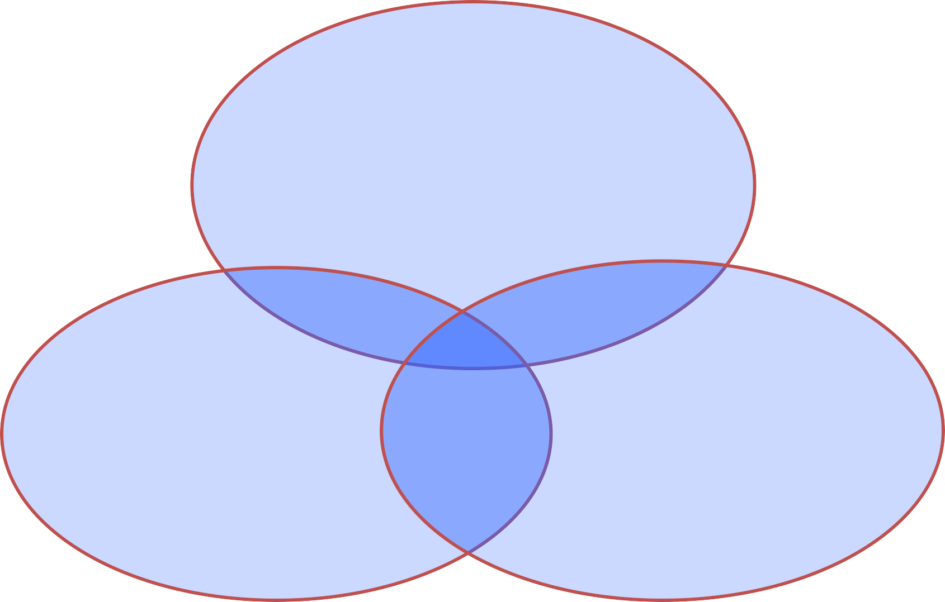




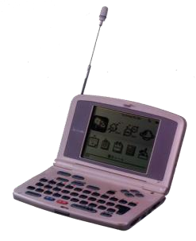
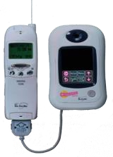









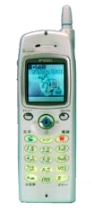



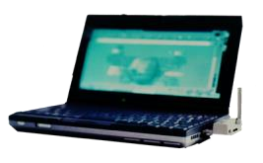

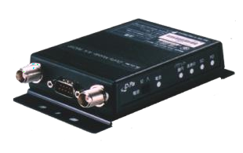










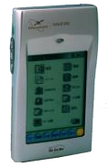













Sifat yg ada dimana-mana
Person-to-Person
MM mail
e-mail
Mobile Multimedia
Voice
Mobile Network
Tele-metering Remote Operation
Net browsing
i-mode
GPS
MMD
Machine-to-
^{ITS} Person-to- machine
Automatic Control
machine

Slide 29

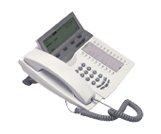
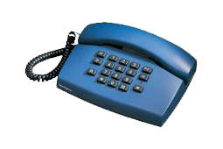


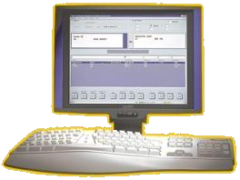
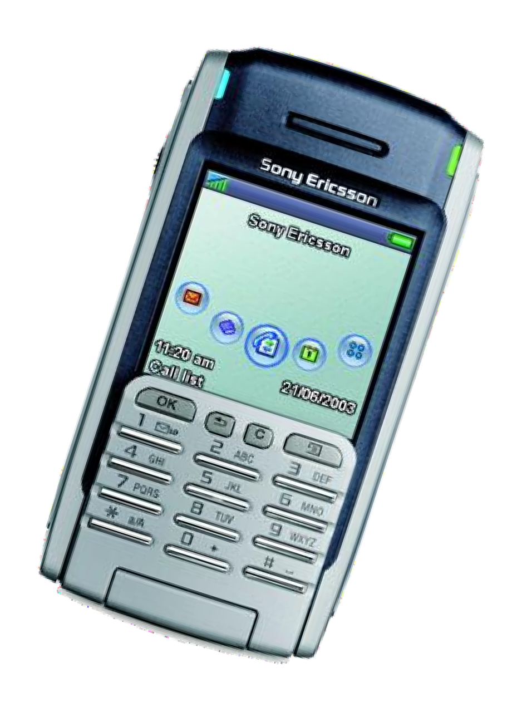
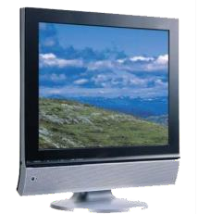
Mobile Triple Play
Telephony, Data and Video/TV delivered by BWA networks
Mobile
Telephony
Data
WWW/@
Broadcast
Triple Play + Mobility = Quadruple^{Pen}P^{gT}l^{e}a^{kT}y^{el-Modul:01}

Slide 30
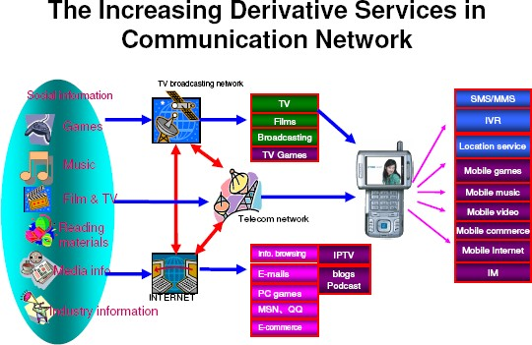

Slide 31
