Slide 3
Creativity is the ability to generate new ideas and new connections between ideas, and ways to solve problems in any field or realm of our lives

Slide 9
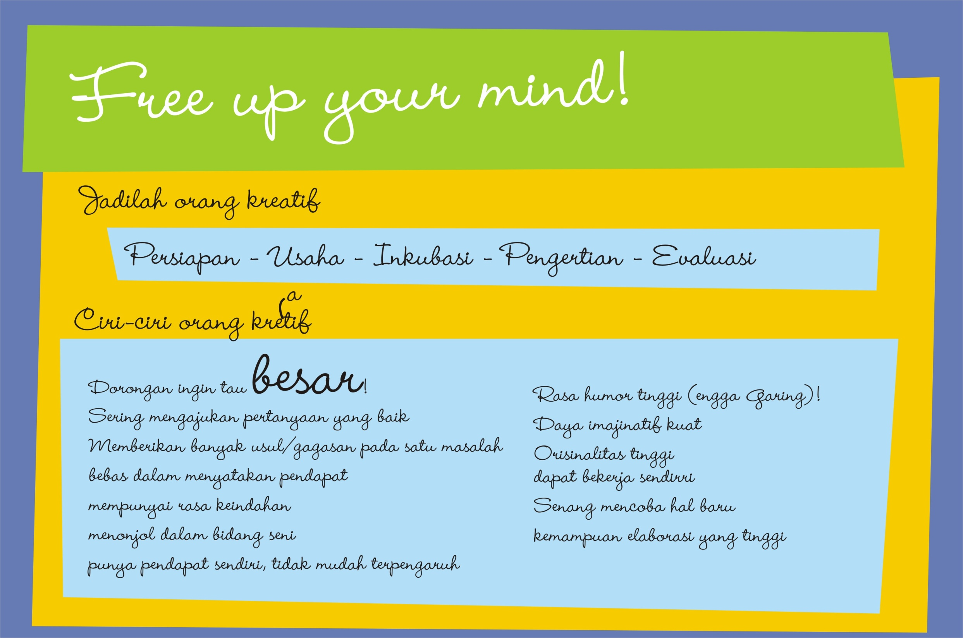

Slide 14
“Curiosity about life in all of its aspects, I think, is still the secret of great creative people.”
– Leo Burnett

Slide 15
“Creative people are curious, flexible, persistent, and independent with a tremendous spirit of adventure and a love of play.”
Henri Matisse

