Slide 1
Keterampilan BerbahasA: Bahasa & periklanan
DR. K

Slide 2
RULES
- Absen 3x
- Kehadiran bernilai 5
- Sakit/izin dengan surat yang jelas
- Tugas, UTS dan UAS tidak terlambat
- Keterlambatan konsekuensi -10/ pertemuan
- Be Creative and Enjoy!

Slide 3
Bahasa periklanan adalah copywriting & narasi iklan
Copywriting is the art and science of writing to promote a product, a business, a person or an idea.
And carefully selecting, editing, weaving and constructing those words in a way that they’ll persuade the reader into taking a specific and measurable action.

Slide 4
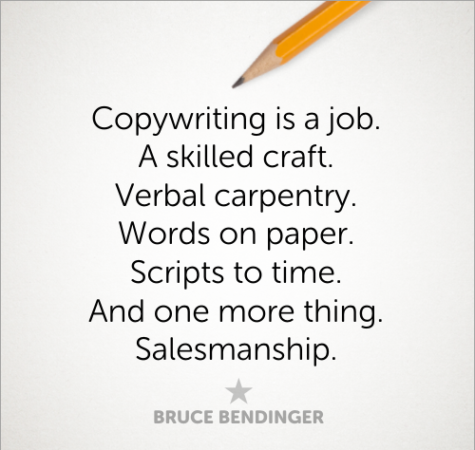

Slide 5
Just do it!

Slide 6
Think Different

Slide 7
Connecting People

Slide 8
Karena Anda Begitu Berharga

Slide 9
Pria Punya Selera

Slide 10
Cintailah
Produk-produk Indonesia

Slide 11
Ashhhhiyaaaapp!

Slide 12
Apaan Tuh!

Slide 13
Jatuh bangun aku...

Slide 14
Tinky Winky
Dipsy
Lala
…

Slide 15
Who live in a pineapple under the sea?
………………………..

Slide 16
Kekuatan Copywriting
Seduktif
Mengiang-ngiang
Masuk Alam Bawah Sadar
Provokatif, Merasuk
Dibenci Sekaligus Disukai

Slide 17
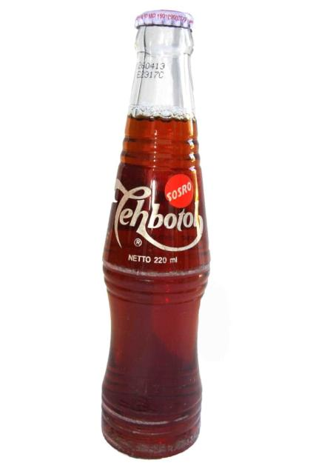

Slide 18
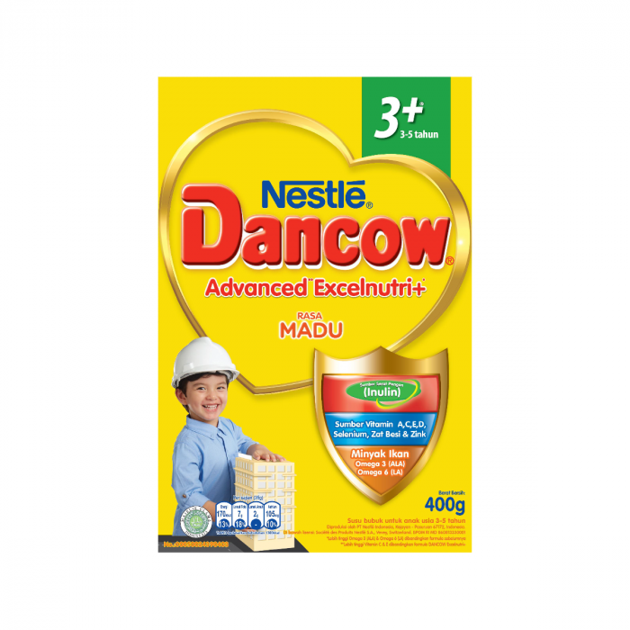

Slide 19
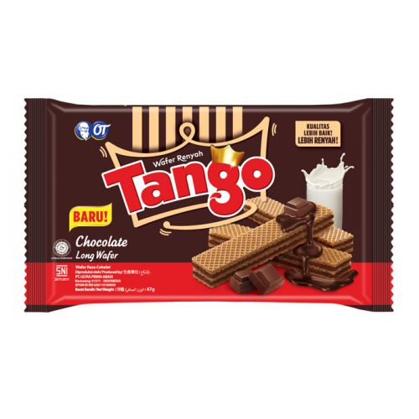

Slide 21
copy writing can work magically or logically

Slide 22
Terimakasih

