Slide 1
FRANKENSTEIN
Figurative language
Simile
Metaphor
Symbol
Allusion
Motif
Fabian Firmansyah Faran 63718008
Karin Maharani 63718015
Muhammad Rifan Fadliansyah 63718016
Rahmelia Prastamawati 63718022

Slide 2
FIGURATIVE LANGUAGE
Figurative language is a conspicuous departure from what competent users of a language apprehend as the standard meaning of words, or else the standard order of words, in order to achieve some special meaning or effect.
(M. H. Abrams)

Slide 3
Simile Metaphor Symbol Allusion Motif
In a simile, a comparison between two distinctly different things is explicitly indicated by the word “like” or “as.” (M. H. Abrams)
Simile is an overt act of comparison, it relies heavily on comparative forms such as like or as (neither one of the two forms is actually privileged above the other in usage, even though standard examples of simile cited by researchers much more commonly use like). (Barbara Dancygier and Eve Sweetser)

Slide 4
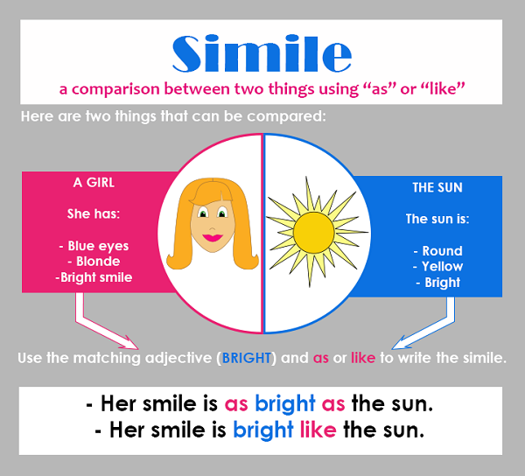
Similes find, or perhaps create, similarities in typically different things. In fact, there may be no real similarity between the things compared, such a woman and the sun.

Slide 5
Simile Example in Frankenstein
"The saintly soul of Elizabeth shone like a shrine dedicated lamp in our peaceful home"
(Chapter 2, Page 33)
Frankenstein compares the compassion and moral goodness of Elizabeth to a holy light against the darkness.

Slide 6
Simile Metaphor Symbol Allusion Motif
In a metaphor, a word or expression that in literal usage denotes one kind of thing is applied to a distinctly different kind of thing, without asserting a comparison. (M. H. Abrams)

Slide 7
Both similes and metaphors compare two different types of things. Unlike simile, though, metaphor makes a direct comparison without using “like” or “as.”
Metaphor
He’s a wolf.
In this metaphor, the comparison made is that a person is equal to a wolf, not like a wolf. Since this cannot be literal, we know that it must mean that he is like a wolf in some way, probably that he is predatory, wild, or hungry. In order to express the same idea, simile is slightly different:
Simile
He’s like a wolf.
He’s as hungry as a wolf.
As you can see, both metaphors and similes make the same kinds of vivid comparisons, just in different words. Which one you use may just depend on what kind of wording sounds or feels best in context.

Slide 8
Metaphor Example in Frankenstein
“Her hair was the brightest living gold”
(Chapter 1, Page 28)
The color of her hair like gold means glory that symbolizes a great achievement and associated with something luxurious

Slide 9
Simile Metaphor Symbol Allusion Motif
In the broadest sense a symbol is anything which signifies something else; in this sense all words are symbols. (M. H. Abrams)
A symbol is literary device that contains several layers of meaning, often concealed at first sight, and is representative of several other aspects, concepts or traits than those that are visible in the literal translation alone.

Slide 10
A symbol (pronounced SIM-bull) is any image or thing that stands for something else. It could be as simple as a letter, which is a symbol for a given sound (or set of sounds). Similarly, every word is a symbol for the idea it represents. Flags are symbols for nations. And of course, we have all sorts of visual symbols that we use every day: $ @ & =
Symbols are objects, characters, figures, and colors used to represent abstract ideas or concepts

Slide 11
Simile Metaphor Symbol Allusion Motif
Allusion is a passing reference, without explicit identification, to a literary or historical person, place, or event, or to another literary work or passage. (M. H. Abrams)

Slide 12
Allusion Example in Frankenstein
”Life and death appeared to me ideal bounds, which I should first break through, and pour a torrent of light into our dark world..."
(Chapter IV, Page 54)
The meaning of the sentence is, that life is light and death is likened to darkness, so this is why Victor very curious how humans can be created

Slide 13
Simile Metaphor Symbol Allusion Motif
A motif is a conspicuous element, such as a type of event, device, reference, or formula, which occurs frequently in works of literature. (M. H. Abrams)
A discrete thing, image, or phrase that is repeated in a narrative. (H. Porter Abott)

Slide 14
Motif Example in Frankenstein
The motif of nature.
Nature is one of the force that affects Victor in many aspects of his life. He begins to see himself as "God" when he creates the monster, and now he sees nature as something he can control. When he is in a positive mental state, Victor sees nature as calming and beautiful. When he is in a negative mental state, nature is monstrous and terrifying. And we think nature helps to set the mood of the story.

Slide 15
References
Abrams, M. H., & Harpham, G. (2011). A glossary of literary terms. Cengage Learning.
Dancygier, B., & Sweetser, E. (2014). Figurative language. Cambridge University Press.
Abbott, H. P. (2008). The Cambridge introduction to narrative. Cambridge University Press.
Simile. (n.d.). Retrieved from Literary Terms: https://literaryterms.net/simile/

