Slide 1
Propositions
A category in logic
Dr. Retno Purwani Sari, M.Hum

Slide 2
Overview
Semantic Class

Slide 3
Semantic Perspectives
Meaning covers representation of the meaning of every constituent and expression in language, and also of the meaning relationships between them. (Wierzbicka, 1988:1)
The basic building block for language is a form paired with its meaning (Allan, 2001:6) ⇒ lexical item; “bundle” of semantic properties (Carstairs, 2002:13; Larson, 1998:59)
situation/state of affairs expressed in a sentence

Slide 4
Semantic Class Sharing semantic properties
Case 1
[+PARENT]
Mother ⇒ Entity ⇒ [+FEMALE]
[+ADULT]
[+HUMAN]
THING
[+PARENT] (all animate beings, natural or supernatural
Father ⇒ Entity ⇒ [+MALE] and all inanimate entities; boy, angel, [+ADULT] ghost, stone, galaxy, idea, blood etc)
[+HUMAN]
Nouns

Slide 5
Semantic Class Sharing semantic properties
Case 2
[+ RELATING TO PEOPLE]
Imprudent ⇒ Quality ⇒ [- GOOD MANNER]
[+ASCRIBE TO THING]
[+ RELATING TO INSTITUTION]
Impertinent ⇒ Quality ⇒ [- GOOD MANNER]
[+ ASCRIBE TO THING]
ATTRIBUTE Modifiers
(all those attributes of quality or quantity ascribe to any (Adjectives, Adverbs)
THING or EVENT: long, thick, soft, rough, slowly,
suddenly, few, all)

Slide 6
Semantic Class Sharing semantic properties
Case 3
[+ GO THROUGH THE AIR]
Fly ⇒ Process ⇒ [+ POSITIONAL CHANGE]
[+CHANGE OF STATE]
[+ MOTION]
[+ GO ON FOOT]
Walk ⇒ Process ⇒ [+ POSITIONAL CHAGE]
[+ CHANGE OF STATE]
[+ MOTION]
EVENT Verbs
(all action, change of state, and experiences:
eat, run, think, stretch, melt, smile)

Slide 7
Semantic Class Sharing semantic properties
Case 4
[+ ADDITION]
And ⇒ Relation ⇒
[+RELATION POSITED BETWEEN TWO]
[+ OPPOSITE]
But ⇒ Relation ⇒ [+ RELATION POSITED BETWEEN TOW]
RELATIONS Preposition or Conjunction
(all those relations posited between
any two of the other semantic units:
with, by, because, since, before, therefore, or)

Slide 8
Summary
The relationship between semantic class and grammatical class
THINGS ………………… nouns, pronouns
EVENTS ………………… verbs
ATTRIBUTES ………………… adjectives, adverbs
RELATIONS ……………….... conjunctions, prepositions

Slide 9
EXERCISES
Define semantic class of each following lexical item
crawl
balloon
cheeky
for
lousy
devil
often
wisdom
always
already

Slide 10
Propositions
Some state of affairs

Slide 11
Utterances, sentences and propositions
Examples
1a. Jim picked up the children
1b. Jim picked the children up
2a. Mary started her lecture late
2b. Mary started her lecture late
3a. Went to the toilet James
3b. Mary the put on hat

Slide 12
Utterances, sentences and propositions
1a. Jim picked up the children
1b. Jim picked the children up
They are different sentences
2a. Mary started her lecture late
2b. Mary started her lecture late
They are same sentence.
3a. Went to the toilet James
3b. Mary the put on hat
They are not English Sentence. However, there are languages, such as Spanish, where word
order is less important.
4a. Mary started her lecture late
4b. Mary started her lecture late
Pronounced by two different persons are different utterances.

Slide 13
summarize
“…utterances are real pieces of speech, and by filtering out certain types
of (especially phonetic) information we can abstract grammatical elements,
that is sentences. Then, filtering out again certain types of grammatical
information we can get to propositions (Rambaud, 2012)

Slide 14
Definition
Another possible definition of proposition (Hurford & Heasley, 1983) is
“that part of the meaning of the utterance of a declarative sentence
which describes some state of affairs.”
the concept of argument structure

Slide 15
The concept of argument structure
Proposition
some state of affairs
denotes a situation that is stated
by the sentence
(1) the argument structure relates a relation
(2) function with a number of arguments
entity
or relation among entities
The concept of argument

Slide 16
Proposition Structure
“In propositions, logicians identify verbs as functions with subjects and objects as arguments of the function” (Rambaud, 2012:25)
Formula ⇒ Fx (a,b)

Slide 17
Fx (a,b)
Proposition:
tell (Lucas, lie, Nicholas)
arguments Subject or verb
verb function

Slide 18
“Propositions capture part of the meaning shared with other sentences.”
(Rambaud, 2012:25)
Sentence Realizations:
Lucas told Nicholas a lie
Did Lucas tell Nicholas a lie?
Lucas, tell Nicholas a lie!
the statement, the question and the command might be seen to share a propositional element:
LUCAS TELL NICHOLAS LIE

Slide 19
Sentence (1), (2). And (3) make the speaker do different things and result in different action of listeners.
with proposition:
LUCAS TELL NICHOLAS LIE
the sentence may function as
assert it as a past event
question it
request someone to perform it
As a result, we see that propositions capture only part of the meaning of a sentence.

Slide 20
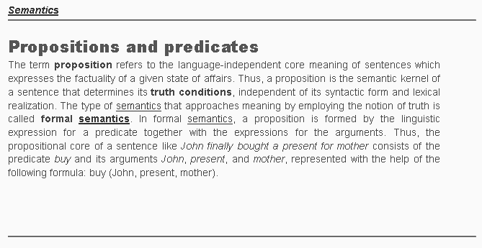

Slide 21
Exercises Represent formulas for propositions in the following sentences
War ended.
Mathew broke the glass.
Peter was hit by John.
John, close your eyes!
John rejected me.
The city was destructed by someone.
Can you give me a hand?
John, jumping over the fence, ran, and dove into the lake.

Slide 22
Summary
Propositions thus are descriptions of states of affairs which some writers see
as a basic element of sentence meaning.
This has to do with the logical structure of sentences, which capture the
more abstract component of information transmission.
The skeleton of information is function and arguments.
Function = predicates
Arguments take specific roles in proposition structure.

