Slide 1
QUIS IF-5/S1/II

Slide 2
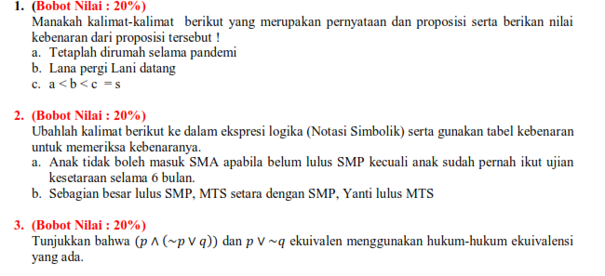

Slide 3
