Slide 1
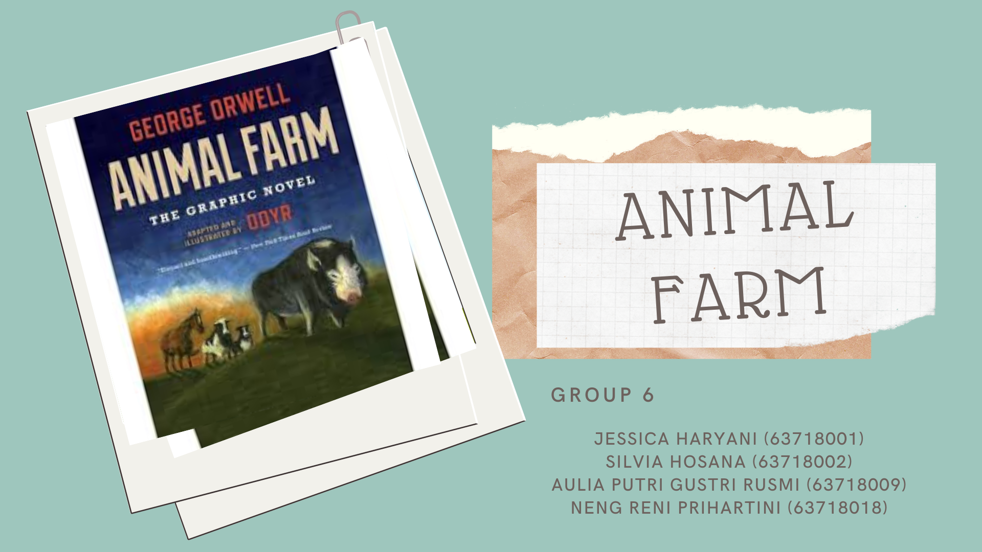

Slide 2
Plot summary:
-Chapter 1: The dream of an Old Major (old pig) about Rebellion.
-Chapter2: Old Major died, the animals took over the farm, and the new making of seven Commandments.
-Chapter3: The animal started learn to read and writting
-Chapter 4: The revenge of Mr. Jones
-Chapter 5: The making of windmill, and the expulsion of Snowball, Napoleon took the command of the farm.

Slide 3
-Chapter 6: The animals forced to work harder, Napoleon started a business with human
-Chapter 7: The animals started to kill each other, Napoleon slain some animal who accused as the follower of Snowball
-Chapter 8: The windmill war happen
-Chapter 9: The death of Boxer
-Chapter 10: The pigs were ruled whole of the farm, and make them equal as the manor of the farm

Slide 4
All narrative is necessarily diegesis (telling), in that it can attain no more than an illusion of mimesis (showing) by making the story real and alive. Thus, every narrative implies a narrator.
-Gerrard Genette
All narrative is necessarily diegesis (telling), in that it can attain no more than an illusion of mimesis (showing) by making the story real and alive. Thus, every narrative implies a narrator. -Gerrard Genette

Slide 5
1. Narratized speech
The character's words and actions are integrated into the narration, and are treated like any other event (+ + distant).
Example
He confided in his friend, telling him about his mother's death.
Example in Animal Farm
(By the late summer the news of what had happened on Animal Farm had spread across half the county. Every day Snowball and Napoleon sent out flights of pigeons whose instructions were to mingle with the animals on neighbouring farms, tell them the story of the Rebellion, and teach them the tune of ‘Beasts of England’.)-Chapter 4, p.21

Slide 6
2. Transposed speech,indirect style
The character's words or actions are reported by the narrator, who presents them with his interpretation (+ distant).
Example
He confided to his friend that his mother had passed away.
Example in Animal Farm
(For example, Squealer told them that the pigs had to expend enormous labours every day upon mysterious things called “files,” “reports,” “minutes,” and “memoranda”.)–Chapter 10, p. 72

Slide 7
Understanding of the relations between the narrator and the story in a given narrative.-Gerrard Genette

Slide 8
Example in Animal Farm
He is dead,” said Boxer sorrowfully. “I had no intention of doing that. I forgot that I was wearing iron shoes. Who will believe that I did not do this on purpose?”“No sentimentality, comrade!” cried Snowball from whose wounds the blood was still dripping. “War is war. The only good human being is a dead one.”
(Chapter 4, p. 24)

Slide 9
Within the main plot, the author can insert other short embedded narratives, told by other narrators from other narrative perspectives. -Gerrard Genette

Slide 10
Example (fictitious)
Today I saw a teacher come up to a group of children at play. After a few minutes, she spoke: "Listen, children, I'm going to tell you an amazing story of courage that happened a few hundred years ago. This is the story of Marguerite Bourgeois..."
Example in Animal Farm
Here we assumed that, the narrators of the Animal Farm is Extradiegetic. Because it is not take the part in the story, but only as the narrator.
So maybe for the simple, according to our group, the Narrative level is some kind of “Point Of View. Where maybe the relations between the narrator in the story distinguish into two parts, there are; Narrator TAKES PART in the story (intradiegetic narrator), and Narrator DOES NOT TAKE PART in the story (Extradiegetic narrator).

Slide 11
The relation between the sequencing of events in the story and their arrangement in the narrative.
In Narrative Time, there`s known a term which called Anachrony. Anachrony is used to designate the non-chronoloigical order in narrative.

Slide 12
Example in Animal Farm
(It was the time were Squealer hynotized the Animals in the farm that Snowball had already destroyed the windmill, but then one of them known as Boxer was believed that Snowball will never did such a thing like that.)-Chapter 7, p. 45
(Another example of that is used in the book is when Squealer talks about remembering what it was like when Jones was their "master" and how they wouldn't want that to happen again. So there for the pigs should get the milk and apples)-Chapter 3, p. 19-20
Analepsis
The narrator recounts after the fact an event that took place earlier than the present point in the main story.
Example (fictitious)
I woke up in a good mood this morning. In my mind were memories of my childhood, with Mum singing every morning, her voice ringing out.

Slide 13
Example in Animal Farm
“Comrades, you have heard already about the strange dream that I had last night. But I will come to the dream later. I have something else to say first. I do not think, comrades, that I shall be with you for many months longer, and before I die, I feel it my duty to pass on to you such wisdom as I have acquired.”- Chapter 1, p. 2
Prolepsis
The narrator anticipates events that will occur after the main story ends.
Example (fictitious)
How will my adventure in Europe affect me? I will never be able to look at my family and friends in the same way; surely I will become contentious and distant.

Slide 14
Refferences
Lucie Guillemette and Cynthia Lévesque (2016), « Narratology », in Louis Hébert (dir.), Signo [online], Rimouski (Quebec), http://www.signosemio.com/genette/narratology.asp.
An updated and extended version of this chapter can be found in Louis Hébert, An Introduction to Applied Semiotics: Tools for Text and Image Analysis (Routledge, 2019, www.routledge.com/9780367351120).
Genette, G. (1983). Narrative Discourse: An Essay in Method. Cornell University Press.

Slide 15
Thank You

