Slide 1
Persuasive; advertising oleh: Dr. K

Slide 2
Arti Persuasi
Ajakan kepada seseorang dengan cara memberikan alasan dan prospek baik yang meyakinkannya; bujukan halus: mereka percaya dapat meyakinkan orang lain dengan -- saja; imbauan; 2 karangan yang bertujuan membuktikan pendapat; (KBBI; 2020)
Pesuade: to make someone do or believe something by giving them a good reason to do it or by talking to that person and making them believe it: (Cambridge Dictionary; 2020

Slide 3
Tujuan persuasi
Persuasi berkaitan dengan perkara mempengaruhi orang lain melalui bahasa.
Pengaruh dalam berupa pemikiran, paradigm, mindset bahkan prilaku dan kebiasaan
Bahasa perangkatnya adalah teks
2 Jenis Teks Verbal & Visual

Slide 4
Jenis Persuasi (Putri 2019)
Persuasi politik dipakai oleh orang-orang yang berkecimpung di bidang politik dan kenegaraan.
Persuasi Pendidikan. Persuasi pendidikan dipakai oleh orang-orang yang berkecimpung di bidang pendidikan dan digunakan untuk mencapai tujuan-tujuan pendidikan.

Slide 5
Persuasi advertensi atau iklan. Persuasi ini dimanfaatkan terutama dalam dunia usaha untuk memperkenalkan suatu barang atau bentuk jasa tertentu. Lewat persuasi iklan ini, diharapkan pembaca atau pendengar menjadi kenal, senang, ingin memiliki barang atau memakai jasa yang ditawarkan.
Persuasi Propaganda. Objek yang disampaikan dalam persuasi propaganda adalah informasi. Tujuannya tidak hanya penyebaran informasi saja. Lebih dari itu, dengan informasi diharapkan pembaca atau pendengar mau dan sadar untuk berbuat sesuatu.

Slide 6
Persuasi dalam Periklanan
The persuasive strategies used by advertisers can be divided into three categories:
Pathos: an appeal to emotion. An advertisement using pathos will attempt to evoke an emotional response in the consumer. Sometimes, it is a positive emotion such as happiness: an image of people enjoying themselves while drinking Pepsi. Other times, advertisers will use negative emotions such as pain: a person having back problems after buying the “wrong” mattress. Pathos can also include emotions such as fear and guilt: images of a starving child persuade you to send money.

Slide 7
Persuasi dalam Periklanan
Logos: an appeal to logic or reason. An advertisement using logos will give you the evidence and statistics you need to fully understand what the product does. The logos of an advertisement will be the "straight facts"
Ethos: an appeal to credibility or character. An advertisement using ethos will try to convince you that the company is more reliable, honest, and credible; therefore, you should buy its product. Ethos often involves statistics from reliable experts. Often, a celebrity endorses a product to lend it more credibility

Slide 11
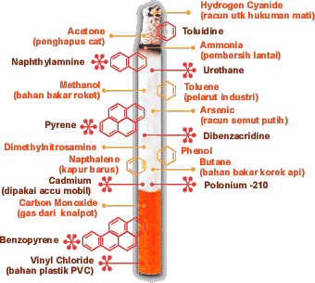

Slide 13
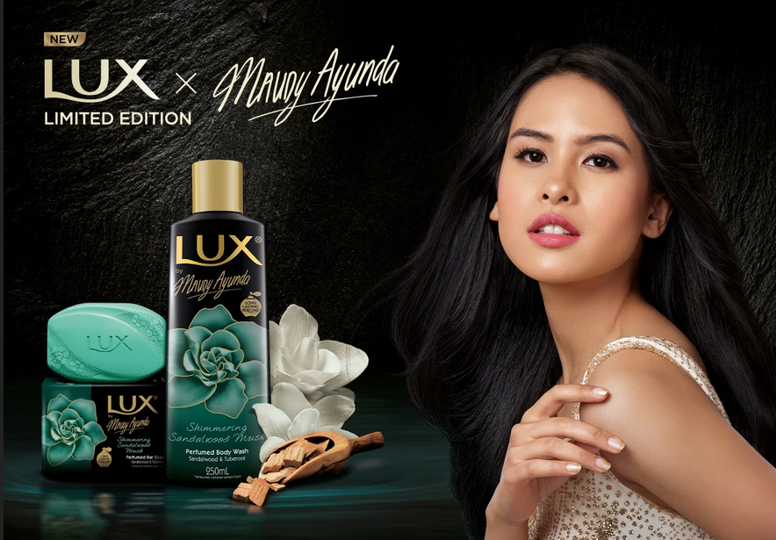

Slide 15
Specific Strategies in Persuasive Advertising
Avante Garde The suggestion that using this product puts the user ahead of the times. A toy manufacturer encourages kids to be the first on their block to have a new toy.
Weasel Words “Weasel words” are used to suggest a positive meaning without actually really making any guarantee. A scientist says that a diet product might help you to lose weight the way it helped him to lose weight.
Magic Ingredients The suggestion that some almost miraculous discovery makes the product exceptionally effective. A pharmaceutical manufacturer describes a special coating that makes their pain reliever less irritating to the stomach than a competitor’s.

Slide 16
Patriotism; The suggestion that purchasing this product shows your love of your country
Transfer Positive; Words, images, and ideas are used to suggest that the product being sold is also positive. A textile manufacturer wanting people to wear their product to stay cool during the summer shows people wearing fashions made from their cloth at a sunny seaside setting where there is a cool breeze
Plain Folks; The suggestion that the product is a practical product of good value for ordinary people. A cereal manufacturer show san ordinary family sitting down to breakfast and enjoying their product.

Slide 17
Snob Appeal The suggestion that the use of the product makes the customer part of an elite group with a luxurious and glamorous lifestyle.
Bribery; Bribery offers you something “extra.” Buy a burger; get free fries.
Bandwagon; The suggestion that you should join the crowd or be on the winning side by using a product—you don’t want to be the only person without it

