Slide 1
Propositions
Methodological Perspectives

Slide 2
Concept of Argument Structure
Proposition
Argument
Subject
Complement
Relation/Function
Verb

Slide 3
A Description of States of Affairs (A Basic Element of Sentence Meaning)
Lucas _{argument} ….. told _{relation/function} ….. Nicholas _{argument} ….. a lie _{argument}
Fx (a,b) ⇒ tell (Lucas, a lie, Nicholas)*
Such formulae often delete verb endings, articles and other grammatical elements (Saeed, 2009:14)
Fx (a,b) ⇒ tell (Lucas, lie, Nicholas)
Speaker’s attitude determines Grammatical Representation
Lucas told Nicholas a lie. (declarative – stating information)
Did Lucas tell Nicholas a lie? (interrogative – asking for information)
Tell Nicholas a lie! (imperative – command)

Slide 4
Types of Proposition (based on characteristics of relation of verb)
Proposition
Event
Action
Experience
State
State
Process

Slide 5
There are two main types of prepositions – event proposition and state proposition.
The event proposition has EVENT as the central concept: action (run, hit, eat, and swim), experience (smell, see, hear, think, and covet), or process (freeze, boil, melt).
The event proposition consists of at least a central EVENT concept and and additional THING concept, eg. The boys ran.
The state proposition will have a THING or ATTRIBUTE as s central concept.
The state proposition consists of THING and ATTRIBUTE which are related the one to the other by state relation.
The state proposition has two main parts: the topic (the CONCEPT being talked about), and the comment (the THING or ATTRIBUTE being used to describe or identify the topic plus the state relation)

Slide 6
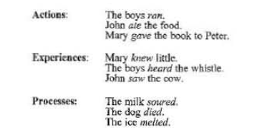
Event Proposition
(Adapted from Larson, 1984:213)

Slide 7
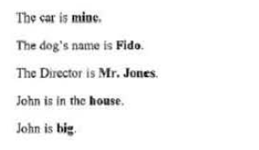
State Proposition
(Adapted from Larson, 1984:213)

Slide 8
Proposition
most often takes the form of a clause or simple sentences in the grammatical structure but not always. It may be encoded in a variety of forms (Larson, 1984:207)

Slide 9
Exercises 1
Give 5 (five) clauses or simple sentences for each type of proposition.

Slide 10
State Proposition
The topic (the CONCEPT being talked about)
The comment (the THING or ATTRIBUTE being used to describe or identify the topic plus the state relation)
For example:
The book is Peter’s
The topic: the book
The comment/the central concept: Peter by the relation of ownership
Meaning of the book is Peter’s: The book is owned by Peter or The book belongs to Peter.

Slide 11
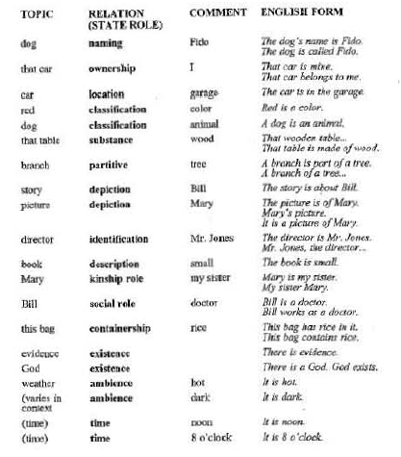
The various kinds of relation in State Proposition

Slide 12
Exercises 2
Give 5 (five) clauses or simple sentences portray state proposition.
Analyze each based on the topic and central concept to see the relation.
Determine the meaning of each.

Slide 13
Event Proposition
EVENT
(the Central concept)
Additional THING
For example:
John smiles
EVENT: smile
The additional THING: John
Meaning of John smiled: John experienced the phenomenon of smiling (presenting the look regarding amusement or ridicule)

Slide 14
Verbs and Thematic Role Grids
Verbs have particular requirements for their thematic roles (Saeed, 2009: 160)
eg.
Gina raised the car with a jack.
This sentence identifies three entities: (1) Gina; (2) the car; and (3) a jack.
These entities are related by the action, raise.
The sentence portrays these entities in specific roles:
(a) Gina is the entity responsible for initiating and carrying out the action,
(b) the car is acted upon and has its position changed by the action,and
(c) a jack is the means by which Gina is able to cause the action.
Such roles have a number of labels in semantics, including: participant roles (Allan 1986), deep semantic cases (Fillmore 1968), semantic roles (Givón 1990), thematic relations (Gruber 1976, Jackendoff 1972) and thematic roles (Dowty 1986, 1989, 1991, Jackendoff 1990).
Given its wide usage in recent work, we will use the last term here: thematic roles.

Slide 15
A List of Thematic Roles
Thematic Roles (Saeed, 2009:153-154)
Agent
Patient
Theme
Experiencer
Beneficiary
Instrument
Location
Goal
Source
Stimulus

Slide 16
Agent: the initiator of some action, capable of acting with volition, eg. David cooked the rashers.
Patient: the entity undergoing the effect of some action, often undergoing some change in state, e.g. Enda cut back these bushes.
Theme: the entity which is moved by an action, or whose location is described, e.g. Roberto passed the ball wide.
Experiencer: the entity which is aware of the action or state described by the predicate but which is not in control of the action or state, e.g. Kevin felt ill.
Beneficiary: the entity for whose benefit the action was performed, e.g. Robert filled in the form for his grandmother.
Instrument: the means by which an action is performed or something comes about, e.g. She cleaned the wound with an antiseptic wipe.
Location: the place in which something is situated or takes place, e.g. The monster was hiding under the bed.
Goal: the entity towards which something moves, either literally or metaphorically e.g. Sheila handed her license to the policeman or Pat told the joke to his friends.
Source: the entity from which something moves, either literally or metaphorically e.g. The plane came back from Kinshasa or We got the idea from a French magazine.
Stimulus: the entity causing an effect (usually psychological) in the experiencer, e.g. John didn’t like the cool breeze.

Slide 17
Exercises 3
Give 5 (five) clauses or simple sentences portray event proposition.
Analyze each based on event as a central concept and additional THING.
Identify the thematic role for each additional THING constructing the propositions.
Determine the meaning.

Slide 18
Proposition
most often takes the form of a clause or simple sentences in the grammatical structure but not always. It may be encoded in a variety of forms (Larson, 1984:207)

