Slide 1
Kepemilikan Media Massa Nasional & Global

Slide 2
Media Mogul
Definisi:
… a person/company who owns large numbers of entities of various mass media such as television, radio, publishing, movies, and the Internet.
… it is also referred to as media institutions and media groups.
Nasional:
Tanoe bersaudara (MNC)
Sariaatmadja bersaudara (Emtek Group)
Chaerul Tanjung (Para Group/TransCorp)
Anindya Bakrie (Bakrie)
Global:
Rupert Murdoch (News Corp)
Ted Turner (Time Warner)
Michael Bloomberg (Bloomberg)
Richard Branson (Virgin Media)

Slide 3
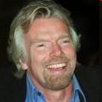
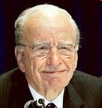
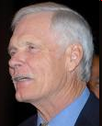
Media Mogul = Pemilik Modal Besar
mereka adalah pemilik mainstream media dengan kapital/uang besar dan pengaruh besar

Slide 4
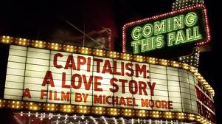
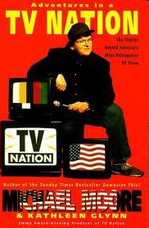
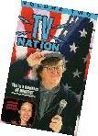
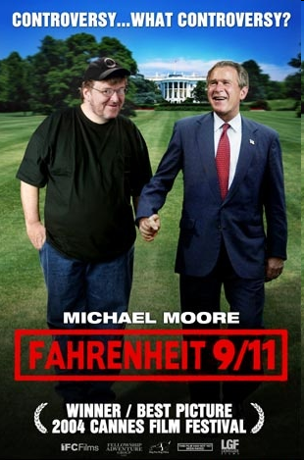
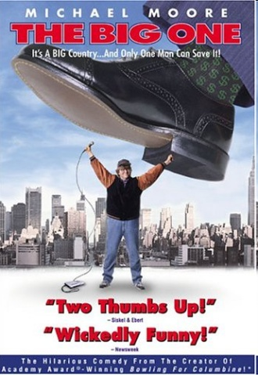
http://www.youtube.com/watch?v=IhydyxRjujU
TRAILER: Michael Moore's 'Capitalism: A Love Story' - On DVD March 9th, 2010
mmflint channel @ Youtube

Slide 5
MEDIA CONGLOMERATION, HORIZONTAL & VERTICAL INTEGRATION

Slide 6
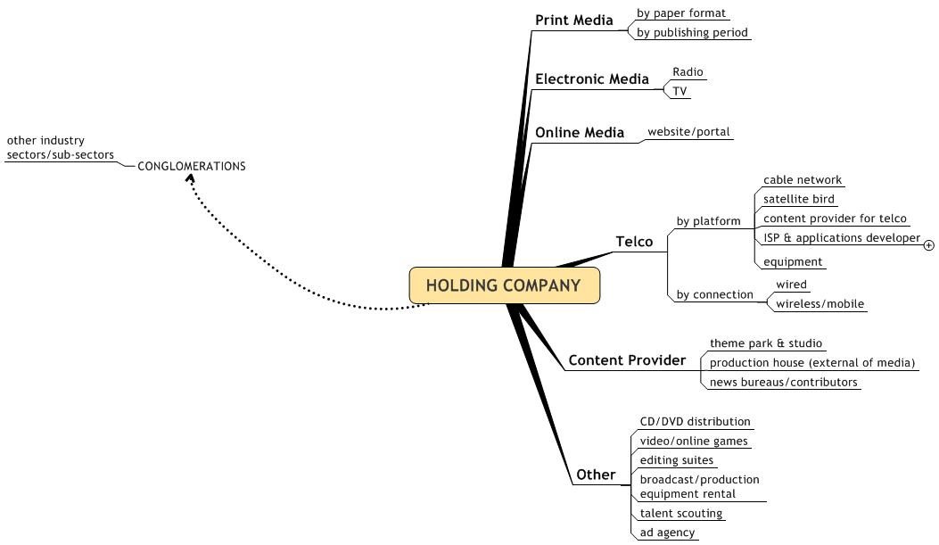
VERTICAL INTEGRATION
CONGLOMERATION
PROPERTY
BANKING
AGROBIZ
MINING, ETC.
HORIZONTAL INTEGRATION

Slide 7
Media Mogul: NASIONAL

Slide 8
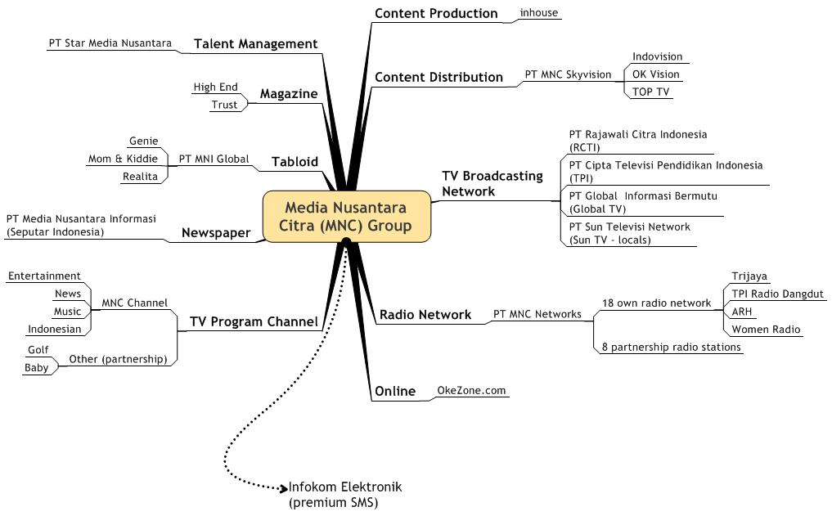
VERTICAL INTEGRATION
large scale

Slide 9
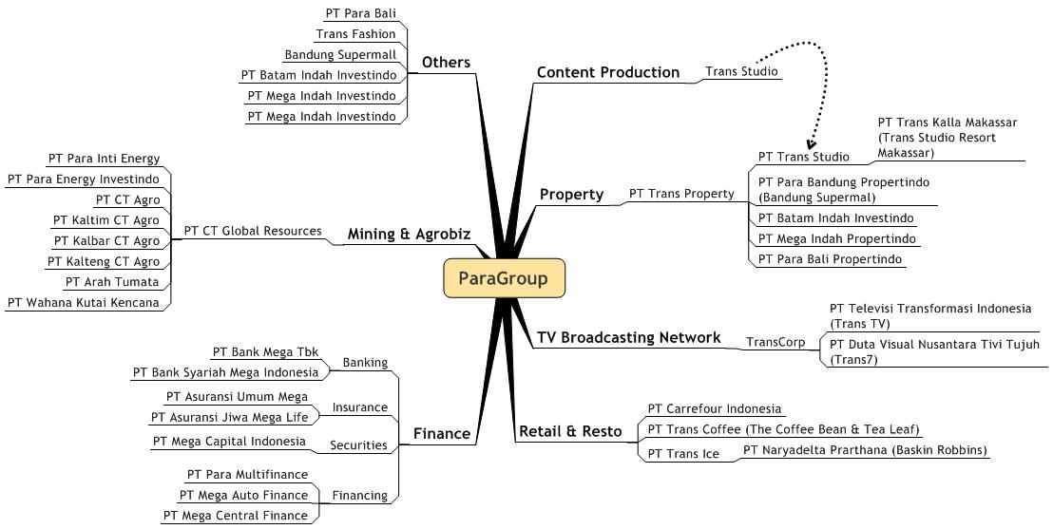
CONGLOMERATION
large scale

Slide 10
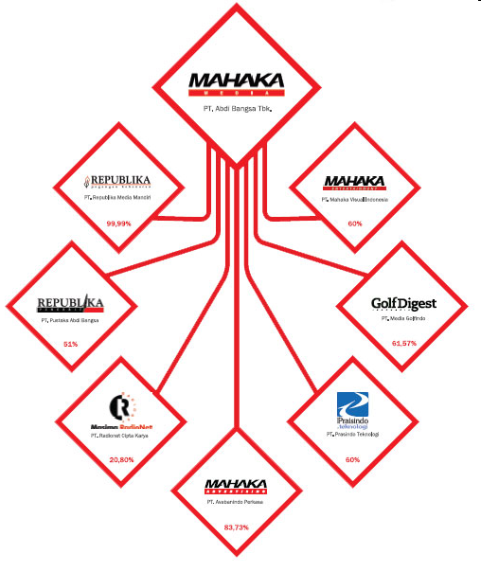

Slide 11
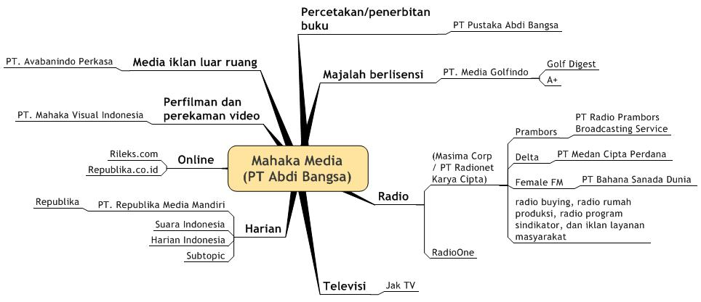
VERTICAL INTEGRATION
small scale

Slide 12
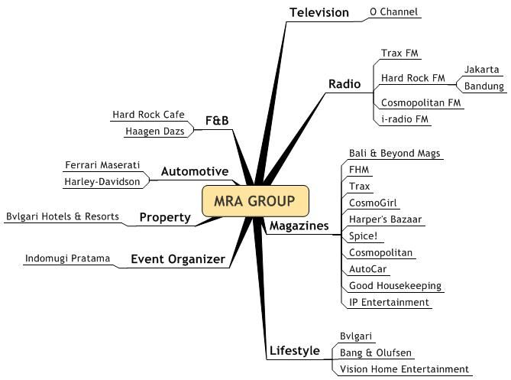
CONGLOMERATION
small scale

Slide 13
NOW, LET’S GO GLOBAL

Slide 14
MEDIA CORP: 5 GLOBAL GIANTS (a Canadian studens’ version)
Gunnarolla Canada Channel @ Youtube

Slide 15
At the end of the 1990s, there were 9 corporations (mainly US) that dominated the media world:
* AOL-Time Warner
* Disney
* Bertelsmann
* Viacom
* News Corporation
* TCI
* General Electric (owner of NBC)
* Sony (owner of Columbia and TriStar Pictures and major recording interests), and
* Seagram (owner of Universal film and music interests).
sumber: www.globalissues.org

Slide 16
Mother Jones magazine reports that by the end of 2006, there are only 8 giant media companies dominating the US media, from which most people get their news and information:
* Disney (market value: $72.8 billion)
* AOL-Time Warner (market value: $90.7 billion)
* Viacom (market value: $53.9 billion)
* General Electric (owner of NBC, market value: $390.6 billion)
* News Corporation (market value: $56.7 billion)
* Yahoo! (market value: $40.1 billion)
* Microsoft (market value: $306.8 billion)
* Google (market value: $154.6 billion)
sumber: www.globalissues.org

Slide 17
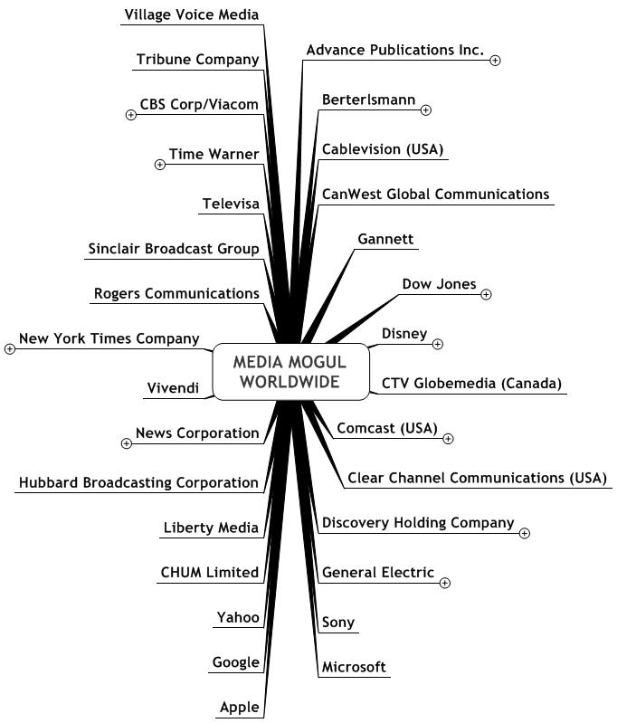

Slide 18
1. GENERAL ELECTRIC

Slide 19
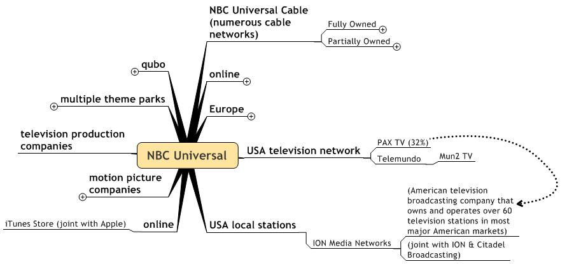
GENERAL ELECTRIC
1. NBC

Slide 20
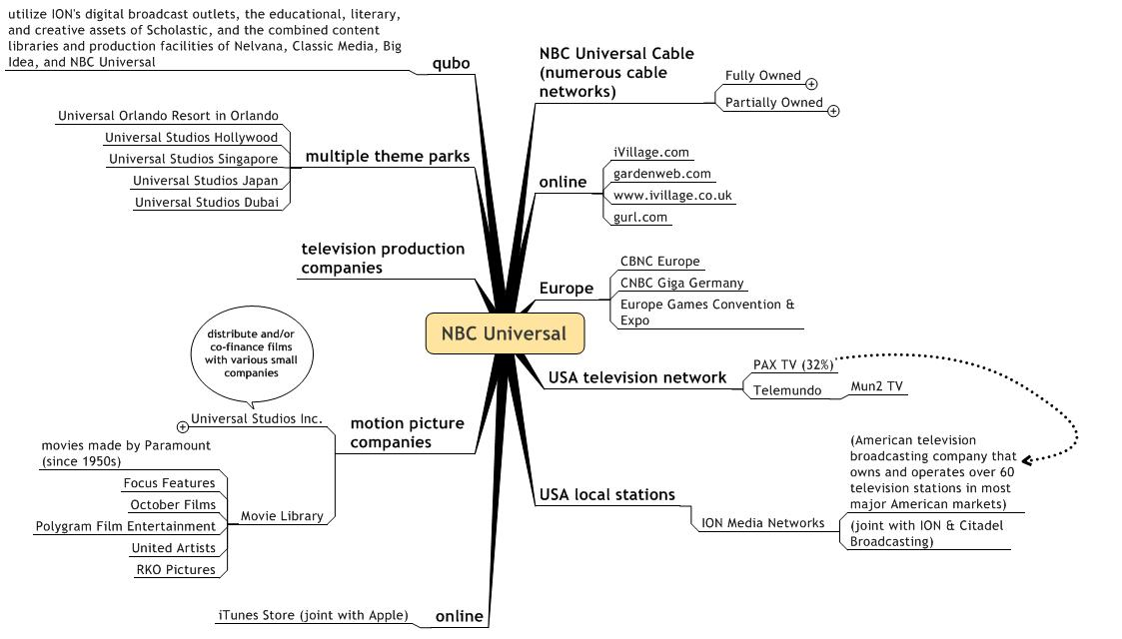
GENERAL ELECTRIC
1. NBC (details)

Slide 21
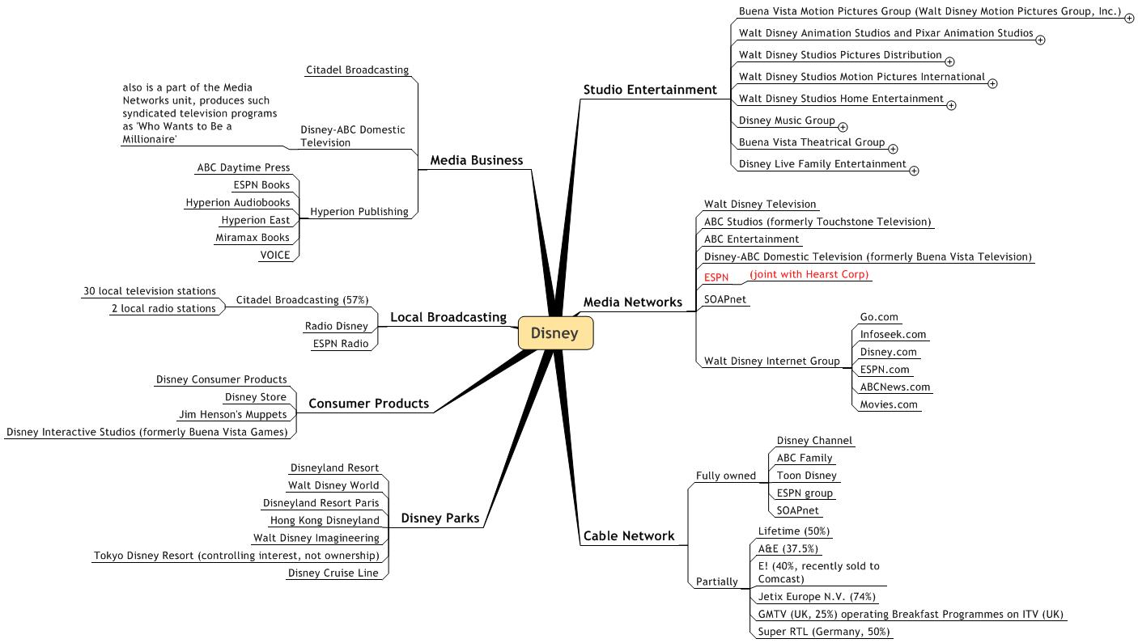
2. DISNEY

Slide 22
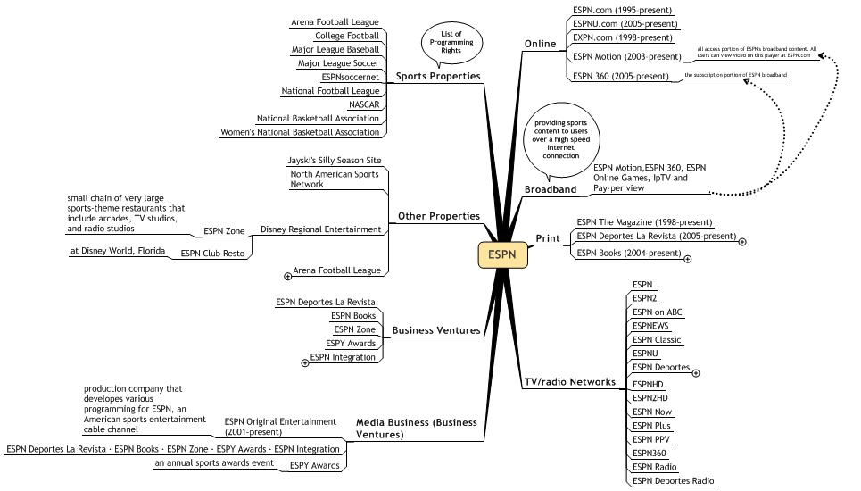
2. DISNEY
2. 1. ESPN

Slide 23
THINK MONOPOLY THINK VERTICAL & HORIZONTAL

Slide 24
Vertical expansion is also known as a vertical acquisition. Vertical expansion or acquisitions can also be used to increase scales and to gain market power. The acquisition of DirectTV by News Corporation is an example of forward vertical expansion or acquisition. DirectTV is a satellite TV company through which News Corporation can distribute more of its media content: news, movies, and television shows.
The pending acquisition of NBC by Comcast Cable (as of January 16, 2010) is an example of backward vertical integration.
sumber: wikipedia

Slide 26
RICH MEDIA POOR DEMOCRACY
Challenging Media Channel @ Youtube

Slide 27
CORPORATE MEDIA
Robert L Vogel Channel @ Youtube

Slide 29
MEDIA CORPORATE & POLITICS
Challenging Media Channel @ Youtube

