Slide 1
Adventures of Huckleberry Finn: Local Color and The 18th Century American Slavery & Economy
Raiswati Untsa Mega 63718014
Natasha Puspa Dewi 63718017
Rizki Trializa 63718019
Andy Jefferson Sabur 63718025

Slide 2
Adventures of Huckleberry Finn

Slide 3
Antebellum Era (Pre Civil War)
Missouri
Mississippi River
Arkansas
etc
Huckleberry Finn
Jim
Tom Sawyer
Miss Watson
The Widow
Judge Thatcher
The “Duke”
The “Dauphin”
etc
Setting &
Character

Slide 4
Plot Summary
Chapter 1-11: Character introduction. Pap abuses Huck, Jim runs away from the farm, and together they eventually took a raft down the Mississippi River to escape the town.
Chapter 12-31: Adventures of Huck and Jim on the raft, avoiding capture. The wanted to go to Cairo, Illinois(a free state) for Jim, but failed. Then they meet two con men. Eventually the con men betrayed them and sold Jim back to slavery. Huck resolves to save Jim.
Chapter 32-43: Hucks meets up with Tom, and they try to release Jim. They fail, with Tom being shot and Jim staying behind to keep him alive, going back into slavery for it. Eventually Jim is freed by the will of his owner.

Slide 5
Local Color

Slide 6
Theory
1
Detailed representation of a setting in fiction based on real world locale
Abrams: described in the dialect, customs, beliefs, even the geography of the area
Cuddon: used to add a feel of authenticity and add interest to the specific feel of the characters
2
3

Slide 7
Analysis
1
Location: It starts from Missouri. Jackson Island based on Glasscock Island. Existence of Memphis, Cairo, and Illinois as real world landmarks
2
Dialect: Three dialects(Missouri slave speak, Southwestern, Pike County and the modifications)
3
Belief: Superstitious belief of witches and the link between body hair and future wealth as well as the character’s perspective towards white people
4
5

Slide 8
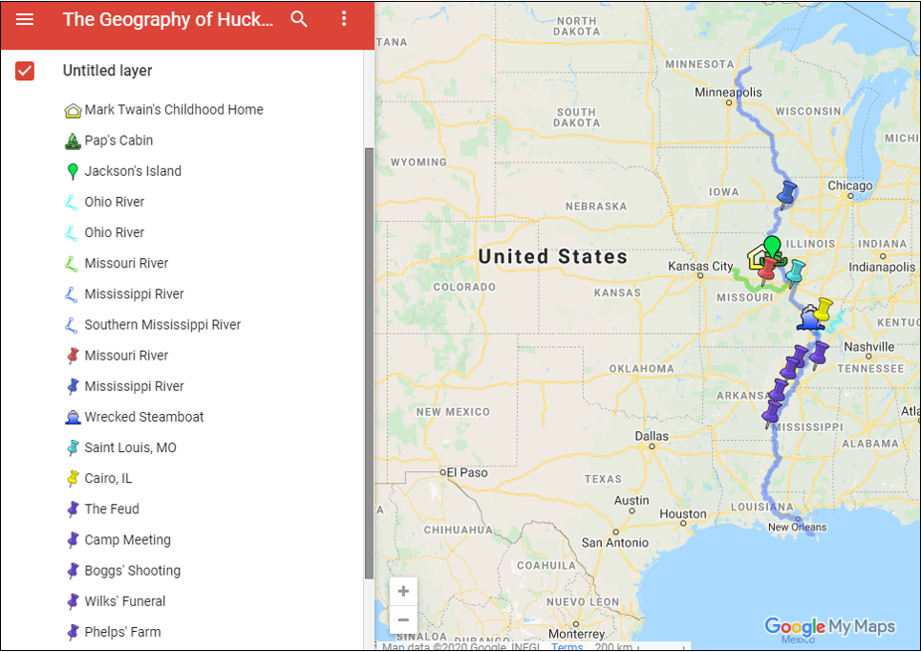
Figure 1. Google Map points of where the story would have taken place

Slide 9
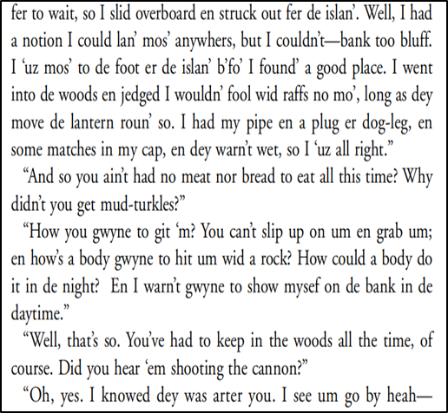
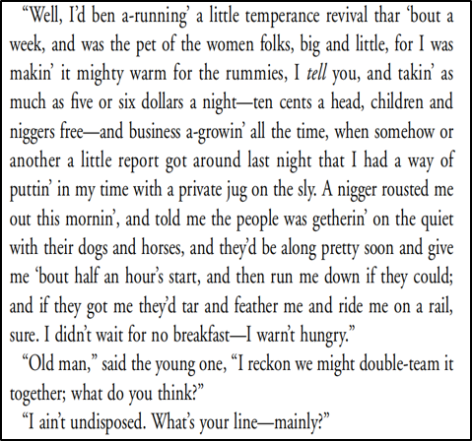
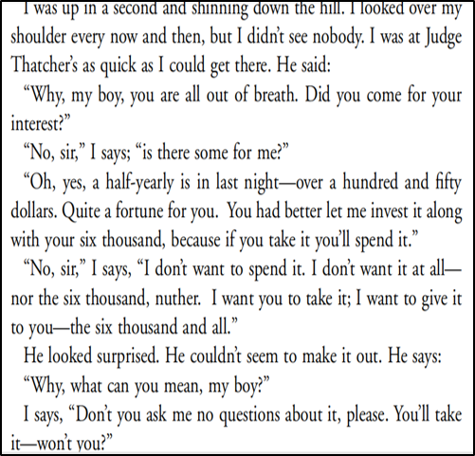

Slide 10
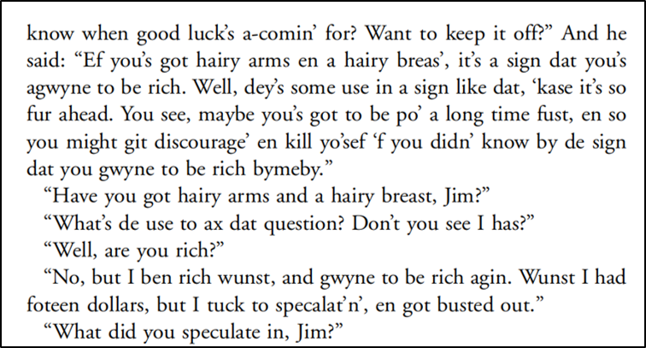
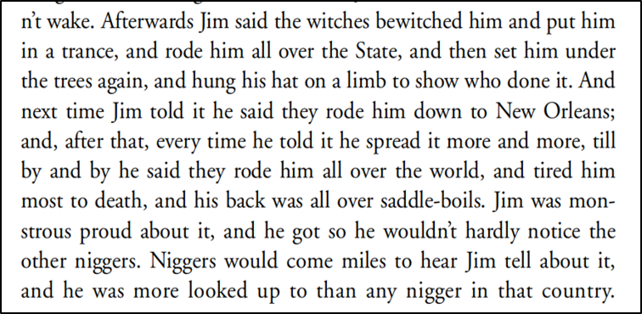

Slide 11
18th Century American Slavery & Economy

Slide 12
Theory
1
2
Rothman: Slaves as part of the economy
3
Martin: Slaves as property and commodity
Slaves not seen as person unless emancipated by owner

Slide 13
Analysis (Part 1)
Slave work in plantation and cotton
Not counted as a casualty in an accident
Jim being sold

Slide 14
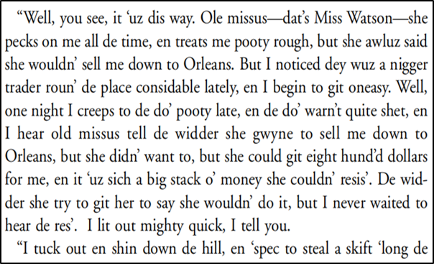
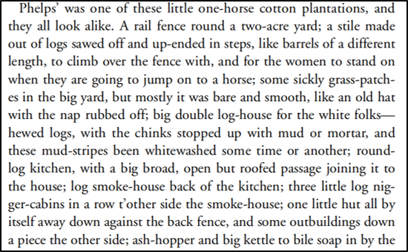
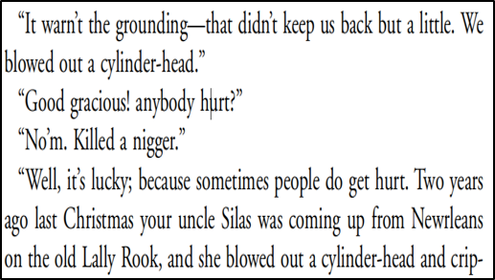

Slide 15
Analysis (part 2)
Government regulation of slave trade/rights
The desire to lynch slaves attempting to escape

Slide 16
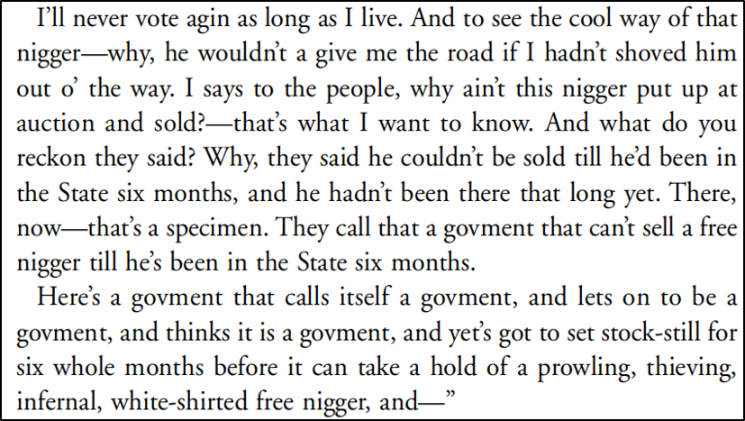

Slide 17
Reference
Abrams, M. (1999). A Glossary of Literary Terms. Boston: Heinle & Heinle.
Carkeet, D. (1979). The Dialects in Huckleberry Finn. American Literature, 315-332.
Cuddon, J. (1998). The Penguin Dictionary of Literary Terms and Literary Theory. London: Penguin Books.
Martin, B. (2016). Neighbor-to-Neighbor Capitalism: Local Credit Networks and the Mortgaging of Slaves. In S. Beckert, & S. Rockman, Slavery's Capitalism: A New History of American Economic Development (pp. 107-121). Philadelphia: University of Pennsylvania Press.
Pederson, L. A. (1965). Negro Speech in the Adventures of Huckleberry Finn. Mark Twain Journal, 1-4.
Rothman, J. D. (2016). The Contours of Cotton Capitalism: Speculation,Slavery, and Economic Panic in Mississippi, 1832-1841. In S. Beckert, & S. Rockman, Slavery's Capitalism: A New History of American Economic Development (pp. 122-145). Philadelphia: University of Pennsylvania Press.
Twain, M. (1996). Adventures of Huckleberry Finn. New York: Random House.
Wells, D. M. (1973, November). More on the Geography of "Huckleberry Finn". South Atlantic Bulletin, pp. 82-86.
Baynton, D. C. (2013). Disability and the justification of inequality in American history. The disability studies reader, 17(33), 57-5.Costa, T. Runaway Slaves and Servants in Colonial Virginia. (2013, January 29).
In Encyclopedia Virginia. Retrieved from http://www.EncyclopediaVirginia.org/Runaway_Slaves_and_Servants_in_Colonial_Virginia.

