Slide 1
Grammatical Semantics
The study of meaning conveyed by grammatical devices
By Dr. Retno Purwani Sari, S.S., M.Hum.

Slide 2
A sentence may represent one or more propositions.
A sentence, as a grammatical construction, captures grammatical semantics: semantics of syntax and semantics of morphology. (Wierzbicka, 1988:3).

Slide 3
Identify Propositions using four steps of the analysis There was once a small brown mouse who lived in a little nest at the edge of a field, deep in the countryside. Life in the countryside was not easy and he had to work hard to find food, but he was perfectly content. He had many good friends, his nest was cozy and comfortable and after a hard day’s work, he always slept well and woke refreshed, to the sounds of nature.

Slide 4
There was once a small brown mouse who lived in a little nest at the edge of a field, deep in the countryside.
[which was]
[which was]

Slide 5
There was once a small brown mouse
(2) (who) lived in a little nest at the edge of a field
(3) [which was] deep in the countryside
(4) [which was] at the edge of a field

Slide 6
a small brown mouse
A mouse was small
A mouse was brown
a little nest
(3) A nest was little
the edge of a field
(4) The edge is part of a field

Slide 7
There was once a small brown mouse who lived in a little nest at the edge of a field, deep in the countryside.
(1) There was once a small brown mouse
(2) A mouse was small
(3) A mouse was brown
(4) [the mouse] lived in (a specific place)
(5) A nest was little
(6) [the nest was] at the edge of a field
(7) The edge was a part of a field
(8) [the field was] deep in the countryside

Slide 8
(2) Life in the countryside was not easy and he had to work hard to find food,
but he was perfectly content.
(1) life in the countryside was not easy
(2) life was in the countryside
(3) (and) he had to work hard (on something)
(4) he found food
(5) (but) he was perfectly content
Back
[which was]

Slide 9
(3) He had many good friends, his nest was cozy and comfortable and after
a hard day’s work, he always slept well and woke refreshed, to the sounds
of nature.
(1) He [the mouse] had friends
(2) His nest was cozy
(3) [his nest] was comfortable
(4) (and after) a hard day’s work, he always slept well
(5) [he always] woke refreshed
(6) [he always] woke to the sound of nature
(7) The friends are many (in numbers)
(8) The friends are good
(9) Nest belongs to [the mouse]
(10) work represented for a the whole day
Back
[and]

Slide 10
Abstract Noun Semantics of Morphology
The abstract nouns, life and work represent what is semantically an EVENT.
Life in the country side ⇒ [the mouse] lived (in the countryside)
a hard day’s work ⇒ [the mouse] worked hard for a day

Slide 11
More Cases
(4) John rejected Peter’s offer.
John rejected
Peter offered
(5) Disobedience brings much suffering.
[someone] disobeys
[someone] suffers
(6) The destruction of the city was planned well
[someone] destroyed the city
[someone] planned well

Slide 12
These propositions create a semantic relation, introducing logic in semantic analysis (Rambaud, 2012:65).
A proposition can be encoded in a wide variety of grammatical structures (Larson, 1984:190).
Back

Slide 13
Three Semantic Categories
Three Semantic Categories
Participants
Process
Circumstances

Slide 14
Circumstances
Time (temporal)
Place
Manners
Cause
Accompaniment
Matter
Role
Means
Quality
Comparison
Reason
Purpose
Behalf

Slide 15
Extended Analysis: 1. Type of propositions 2. Semantic category: thematic roles, types of process, and type of circumstances
There was once a small brown mouse who lived in a little nest at the edge of a field, deep in the countryside. Life in the countryside was not easy and he had to work hard to find food, but he was perfectly content. He had many good friends, his nest was cozy and comfortable and after a hard day’s work, he always slept well and woke refreshed, to the sounds of nature.

Slide 16
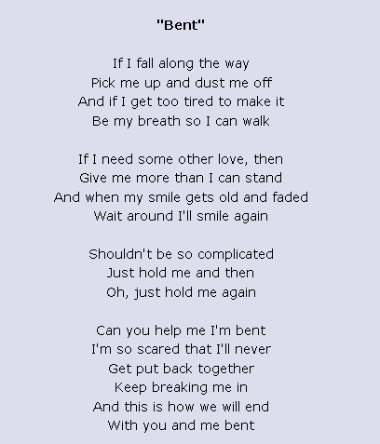
More Exercise

Slide 17
Thank you

