Slide 1
Huckleberry Finn
Race, Gender, Class in a story.
63718004 M. Luthfi
63718007 Rima Mardiani
63718010 Melva Pangestu
63718020 Dinan Fuzianti

Slide 2
Summary
Huckleberry Finn is a story writen by Mark Twain. The story is about an adventure of the boy named Huck and his friend Jim. Huck is a boy who is abused by his parents and there are Jim a slave who runaway. They begin their adventure in a Missipipi River and learn the story about the people and experiences many things.

Slide 3
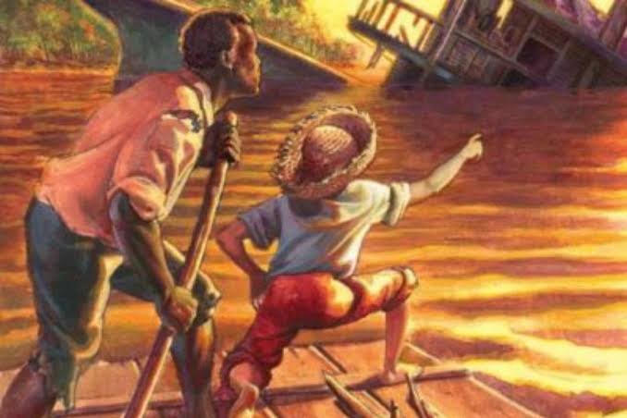
Race
01.
1. A race is a social grouping of people who have similiar physical or social characteristics that are generally considered by society as forming a distinct group. – Schaefer
2. Race is a discursive formation, which delimits social relations on the basis of alleged of physical differences. - Smith

Slide 4
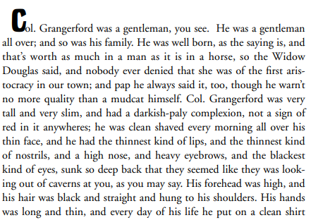
Race Analysis
Beside the story of the adventure of huckleberry finn we can conclude there are two race in this story
The white people or Caucasian race, like the passage that
mentioned in page 222.
.
The white people or Caucasian race in this novel described as an aristocratic people and have slave like in this passage that mentioned in page 108.

Slide 5
Race Analysis
2. Black race or Negroid people. In this novel the black race or Negroid. In this novel the black people tagged by “nigger” word. It reference to the black people who become a slave. Like in this passage that mentioned in page 5.

Slide 6
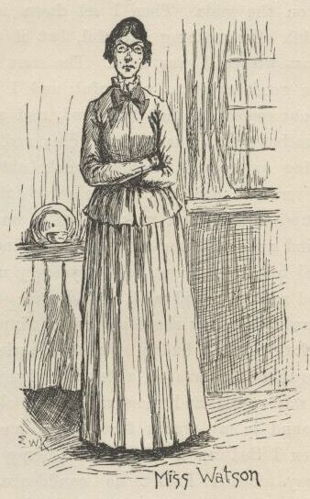
Gender
02.
1. Gender is the relationship between biological sex and behaviour. -Udry
2. Gender is socially constructed and implications of a culture's dominant models of femininity and masculinity. – Kimmel & Kaler

Slide 7
This passage from Miss Judith Lotus that tell about the difference between boys and girls. (page 63-64)
2. In this passage, Twain shows the role of the men. Men were always be the leader or the head of authority. Twain describing himself as a strict yet kind and an overall leader. (page 108-109)

Slide 8
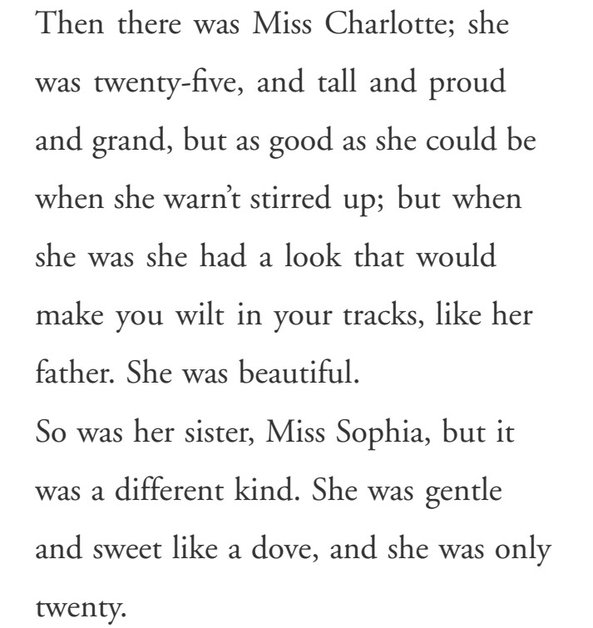
Gender Analysis
3. This passage is describing about the different between Miss Charlotte and her sister, Miss Sophia’s personality. Miss Charlotte has a glorious personality, and Miss Sophia has gentle and sweet personality. (page 109)

Slide 9
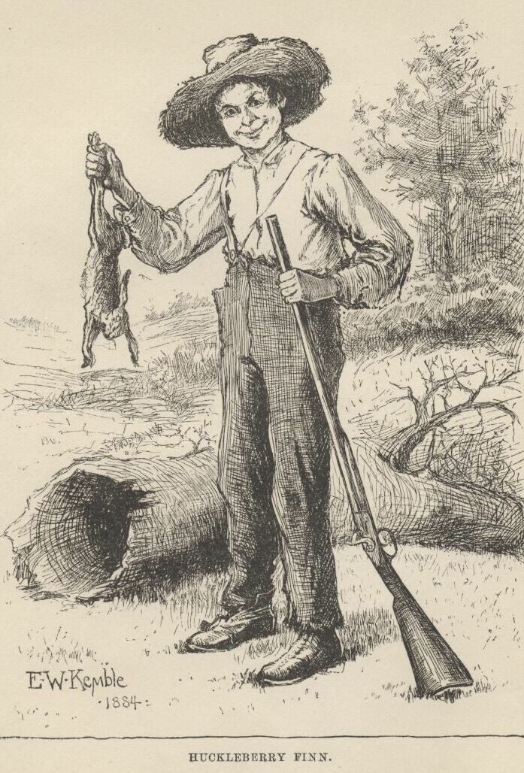
Class
03.
1. A class is a group with intrinsic tendencies and interests that differ from those of other groups within society, the basis of a fundamental antagonism between such groups - Parkin
2. A class is those who share common economic interests, are conscious of those interests, and engage in collective action which advances those interests - Andrew

Slide 10
Class Analysis
Based on the whole story we can conclude :
There are four class issue in this book
● First is the aristocrat class the wealthiest class represent by Grangerfords in page 110 and 112

Slide 11
● Second is class that can own their slave which is represent by white people
● Third is the normal class which is represent by Huck which doesn’t have slave.
● Fourth is the lowest class, the black people which is working as slave like Jim.

Slide 12
Thank You!

Slide 13
References
Schaefer, R. T. (2008). Encyclopedia of race, ethnicity, and society (Vol. 1). Sage.
Smith, D. L. (1984). Huck, Jim, and American Racial Discourse. Mark Twain Journal, 22(2), 4-12
Udry, J. R. (1994). The nature of gender. Demography, 31(4), 561-573.
Kimmel, M. S., Aronson, A., & Kaler, A. (Eds.). (2008). The gendered society reader. New York, NY: Oxford University Press.
Parkin, F. Marx’s Theory of History: A Bourgeois Critique. New York: Columbia University Press, 1979.
Andrew, E. (1983). Class in itself and class against capital: Karl Marx and his classifiers. Canadian Journal of Political Science/Revue canadienne de science politique, 577-584.

