Slide 1
Error Detection and Correction
Komunikasi Data

Slide 2
Objective
Mahasiswa mampu mengenali eror yang terjadi pada transmisi asinkron, dan mendeteksinya dengan menggunakan bit parity.
Mahasiswa mampu mengenali eror yang terjadi pada transmisi sinkron, dan eror dikoreksi dengan menggunakan LRC dan VRC.
Mahasiswa dapat menjelaskan bagaimana mendeteksi eror pada transmisi sinkron dan dengan menggunakan checksum dan CRC
Mahasiswa dapat menjelaskan bagaimana eror pada transmisi sinkron dapat dikoreksi dengan menggunakan kode Hamming
Mahasiswa mampu menjelaskan bagaimana eror dapat dikoreksi menggunakan ARQ (Automatic Repeat Request).

Slide 3
Error Detection and Correction
1 Types of Errors
2 Detection
3 Error Correction

Slide 4
Error Detection and Correction
Data can be corrupted during transmission. For reliable communication, error must be detected and corrected
are implemented either at the data link layer or the transport layer of the OSI model

Slide 5
1. Type of Errors

Slide 6
Type of Errors(cont’d)
Single-Bit Error
~ is when only one bit in the data unit has changed (ex : ASCII STX - ASCII LF)

Slide 7
Type of Errors(cont’d)
Multiple-Bit Error
~ is when two or more nonconsecutive bits in the data unit have changed(ex : ASCII B - ASCII LF)

Slide 8
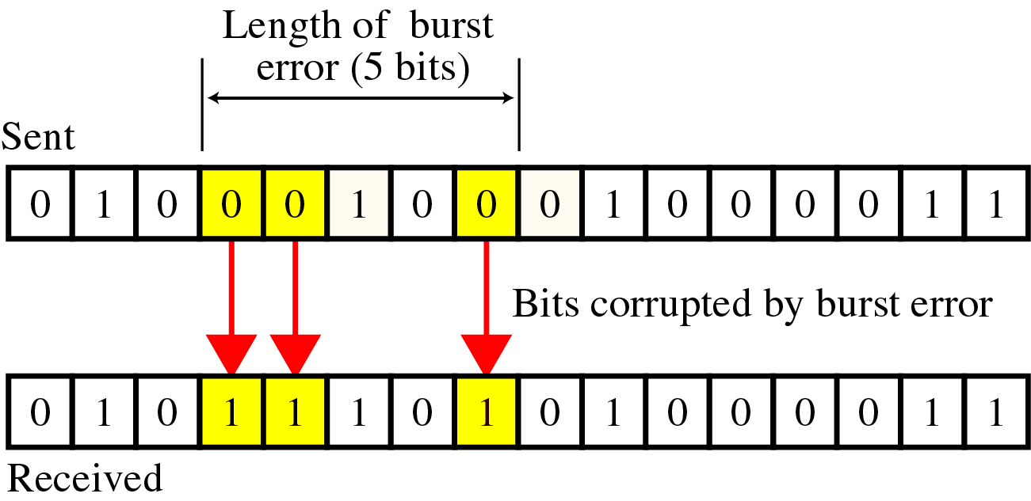
Type of Errors(cont’d)
Burst Error
~ means that two or more consecutive bits in the data unit have changed

Slide 9
2. Detection
Error detection uses the concept of redundancy, which means adding extra bits for detecting errors at the destination

Slide 10
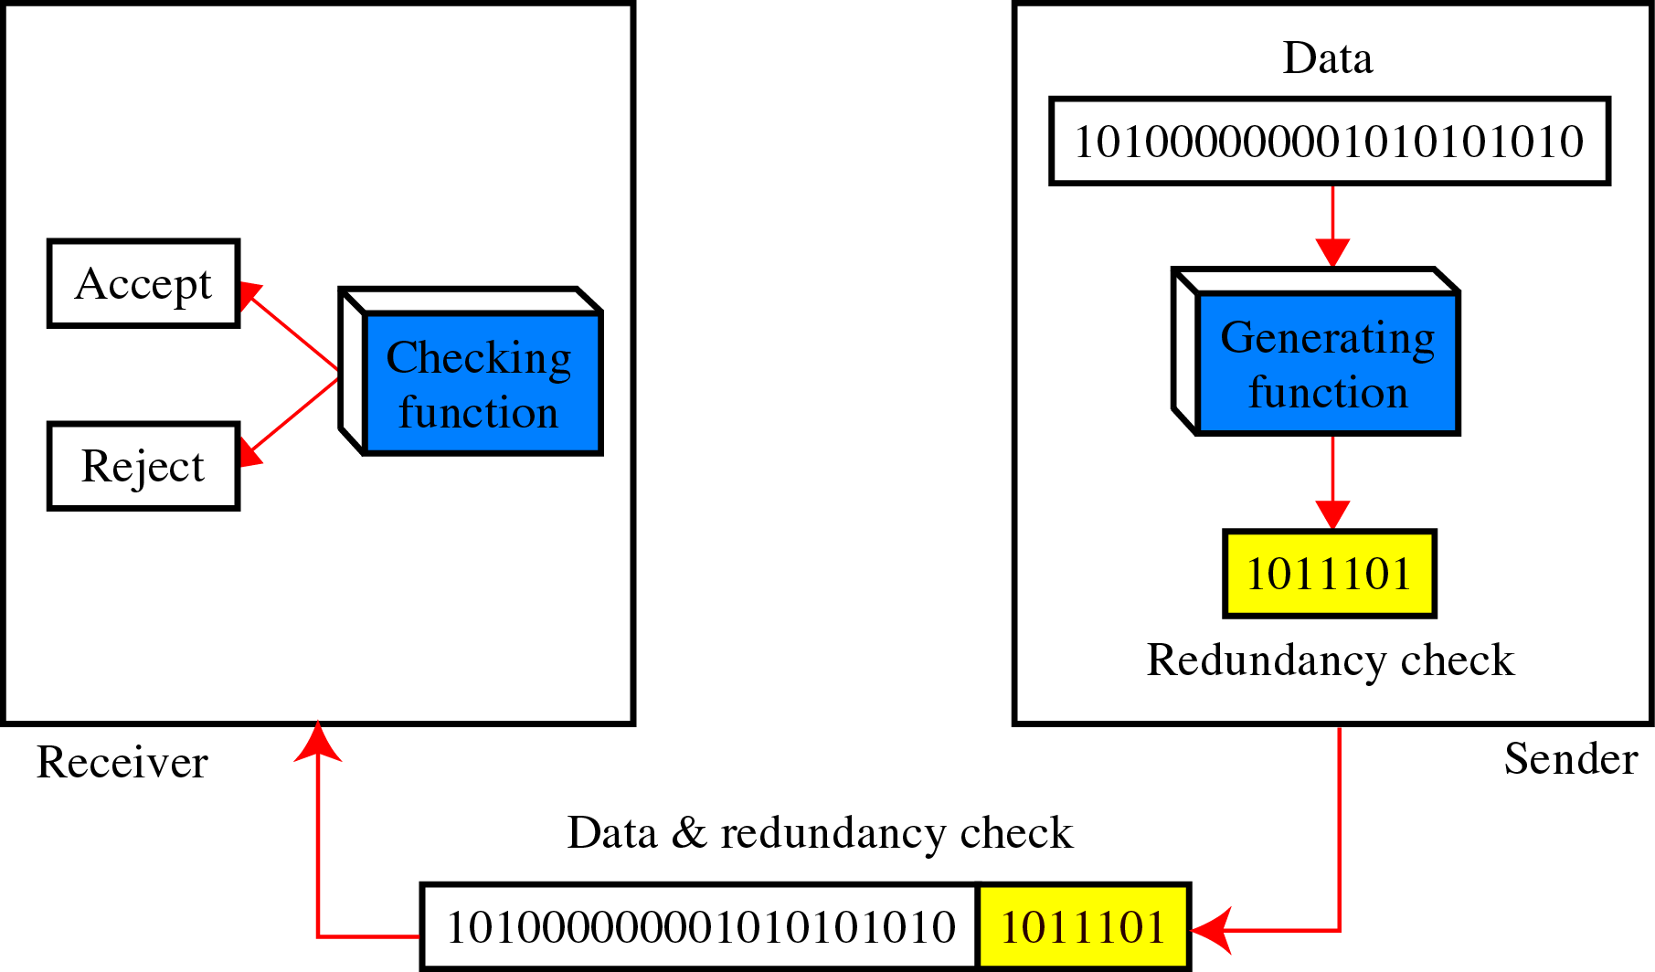
Detection(cont’d)
Redundancy

Slide 11
Detection(cont’d)
Detection methods
VRC (Vertical Redundancy Check)
LRC (Longitudinal Redundancy)
CRC (Cyclical redundancy Check)
Checksum

Slide 12
Detection(cont’d)
VRC(Vertical Redundancy Check)
A parity bit is added to every data unit so that the total number of 1s(including the parity bit) becomes even for even-parity check or odd for odd-parity check
VRC can detect all single-bit errors. It can detect multiple-bit or burst errors only the total number of errors is odd.

Slide 13
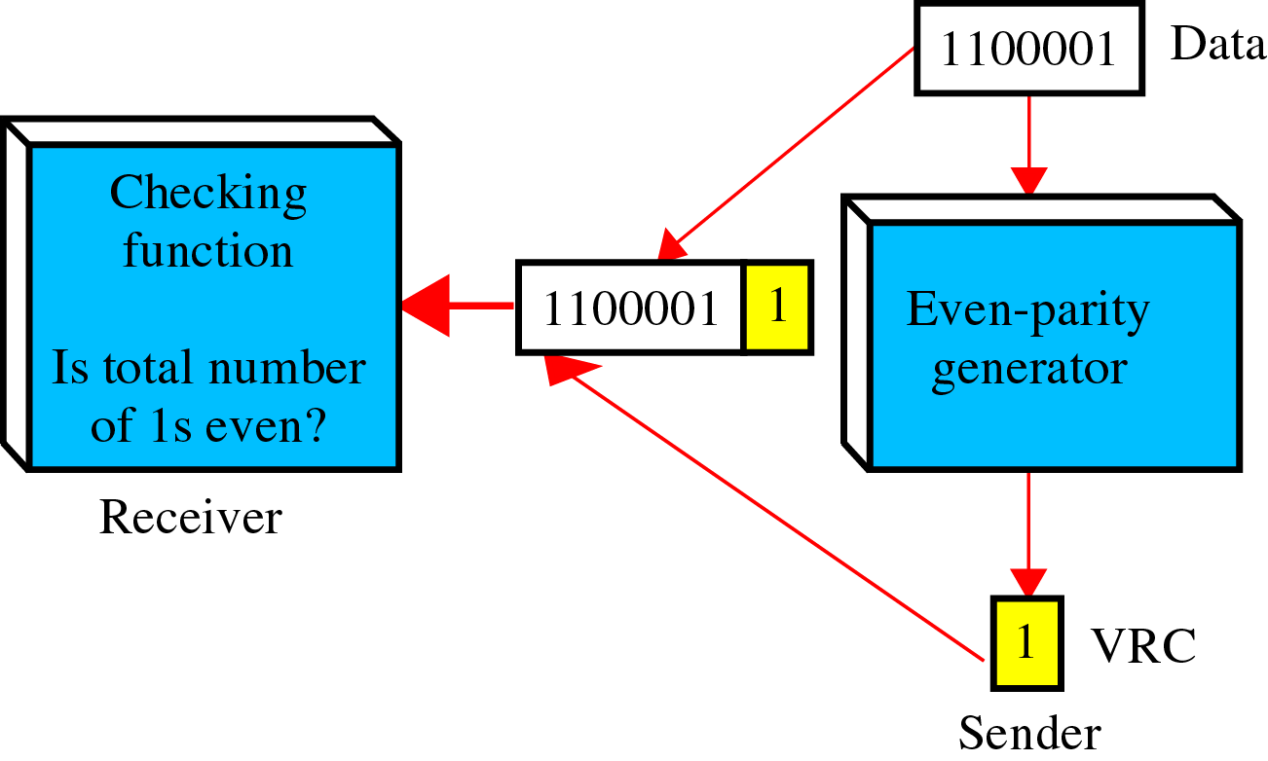
Detection(cont’d)
Even parity VRC concept

Slide 14
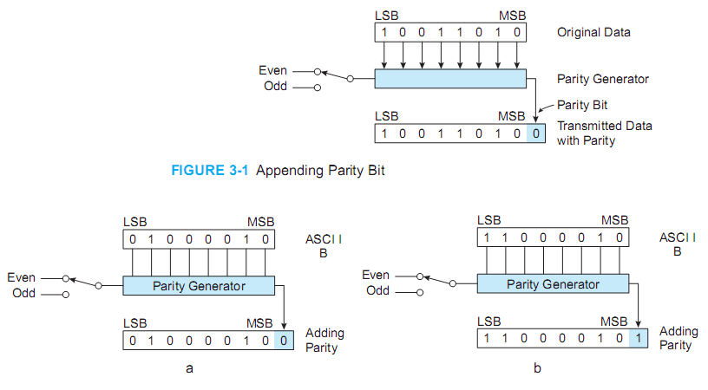

Slide 15
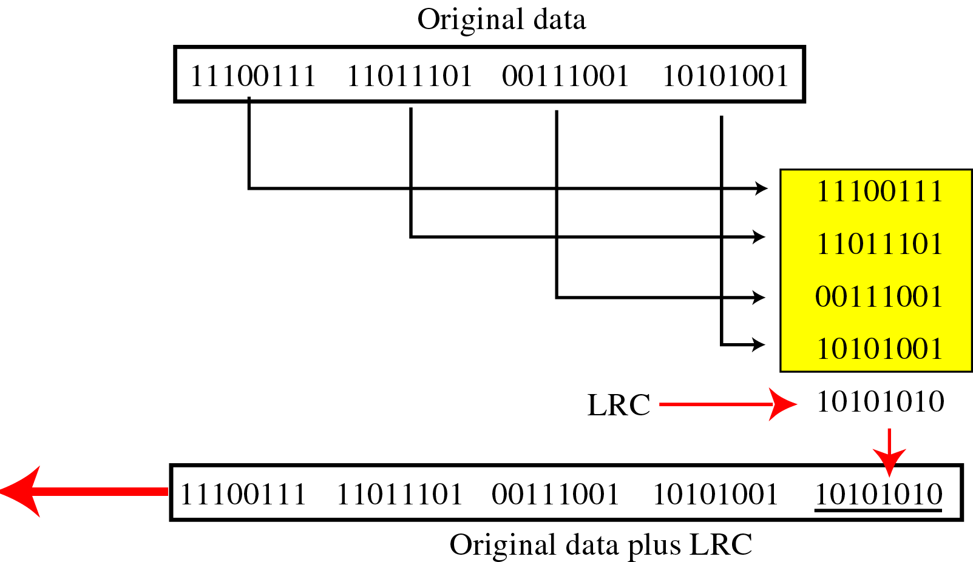
Detection(cont’d)
LRC(Longitudinal Redundancy Check)
Parity bits of all the positions are assembled into a new data unit, which is added to the end of the data block

Slide 16
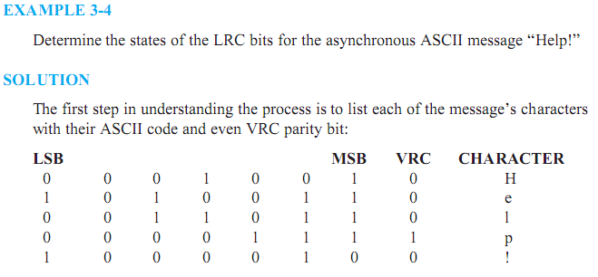

Slide 17
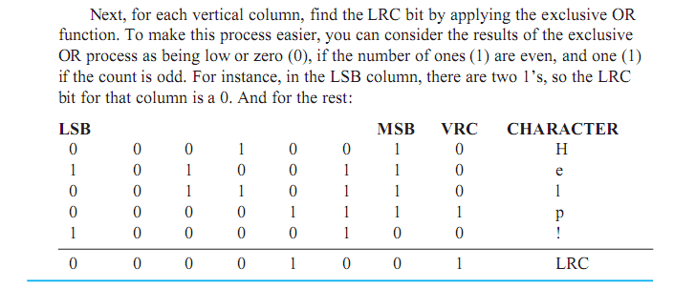

Slide 18
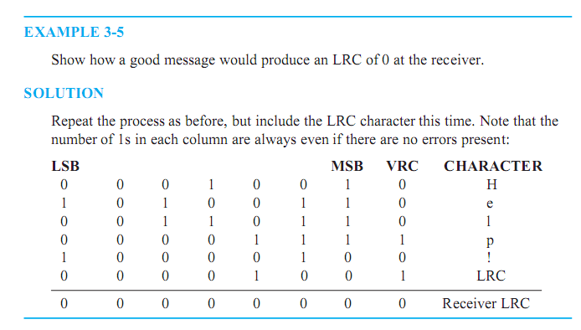

Slide 19
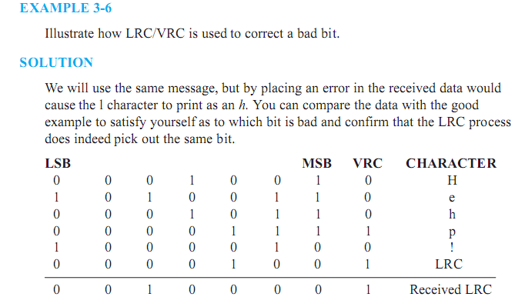

Slide 20
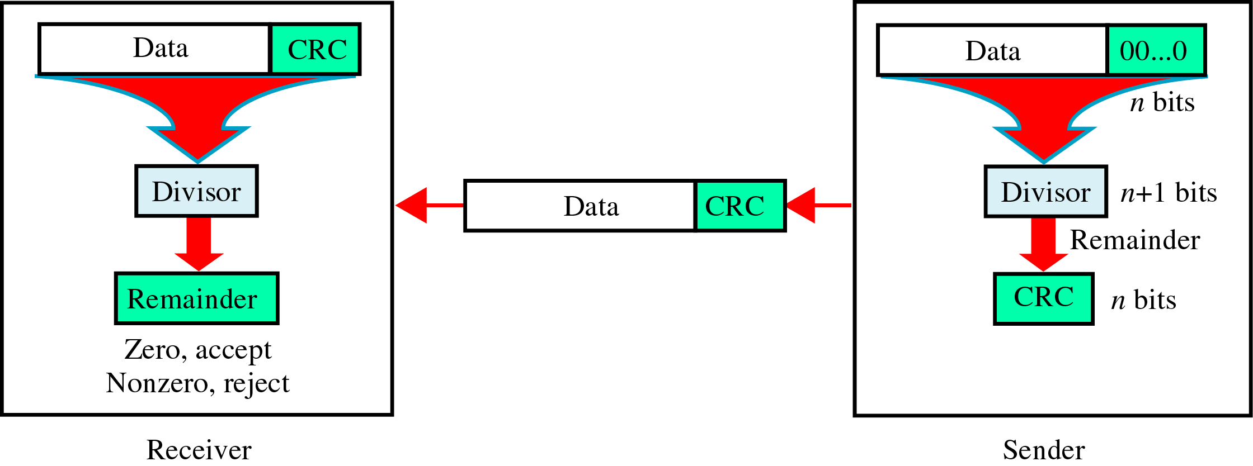
Detection(cont’d)
CRC(Cyclic Redundancy Check)
~ is based on binary division.

Slide 21
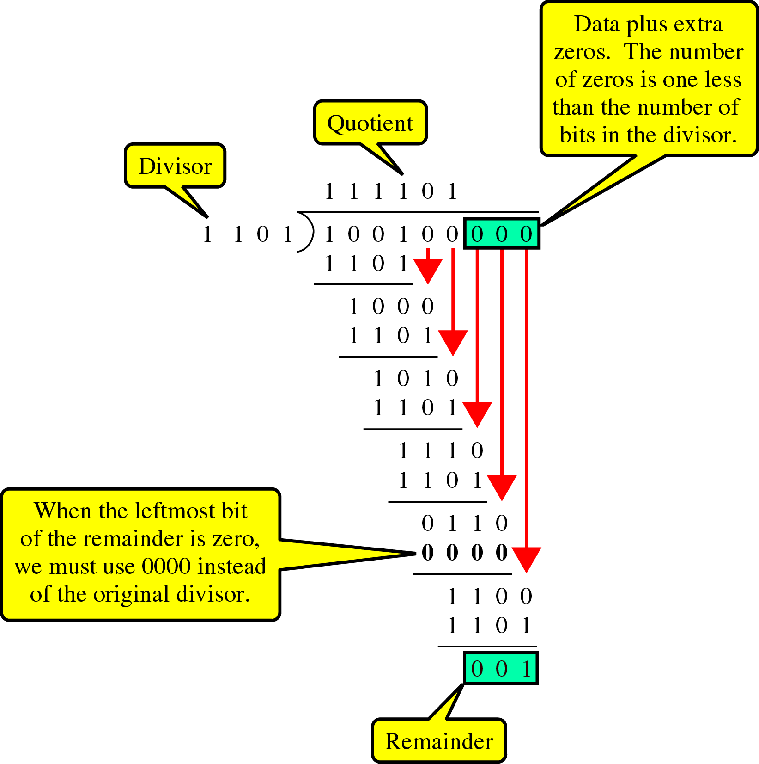
Detection(cont’d)
CRC generator
~ uses modular-2 division.
Binary Division
in a
CRC Generator

Slide 22
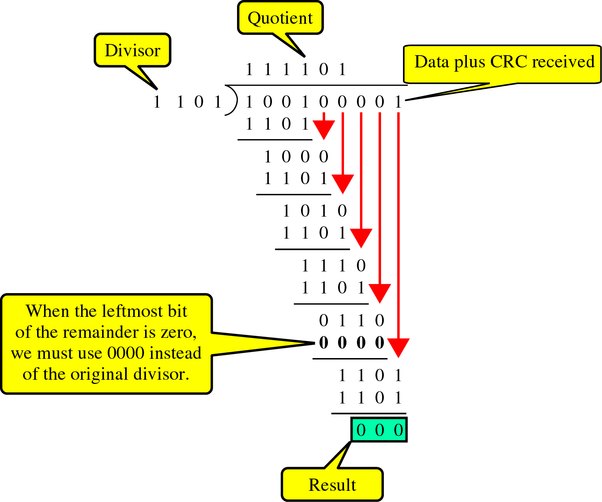
Detection(cont’d)
Binary Division
in a
CRC Checker

Slide 23
Detection(cont’d)
Polynomials
CRC generator(divisor) is most often represented not as a string of 1s and 0s, but as an algebraic polynomial.

Slide 24
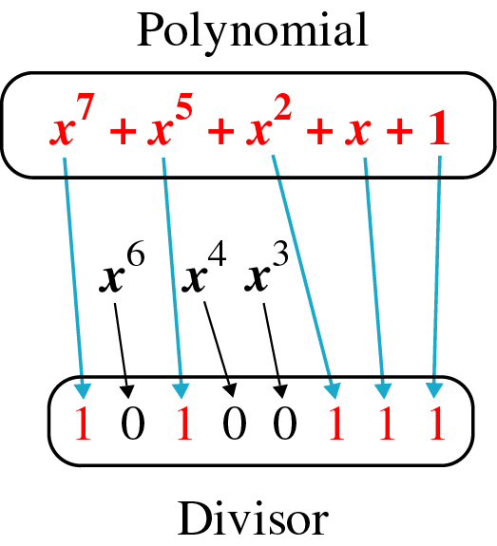
Detection(cont’d)
A polynomial representing a divisor

Slide 25
Detection(cont’d)
Standard polynomials

Slide 26
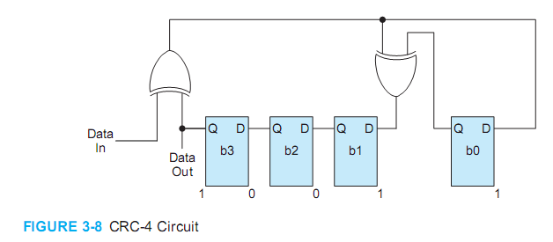

Slide 27
Detection(cont’d)
Checksum
~ used by the higher layer protocols
~ is based on the concept of redundancy(VRC, LRC, CRC ….)

Slide 28
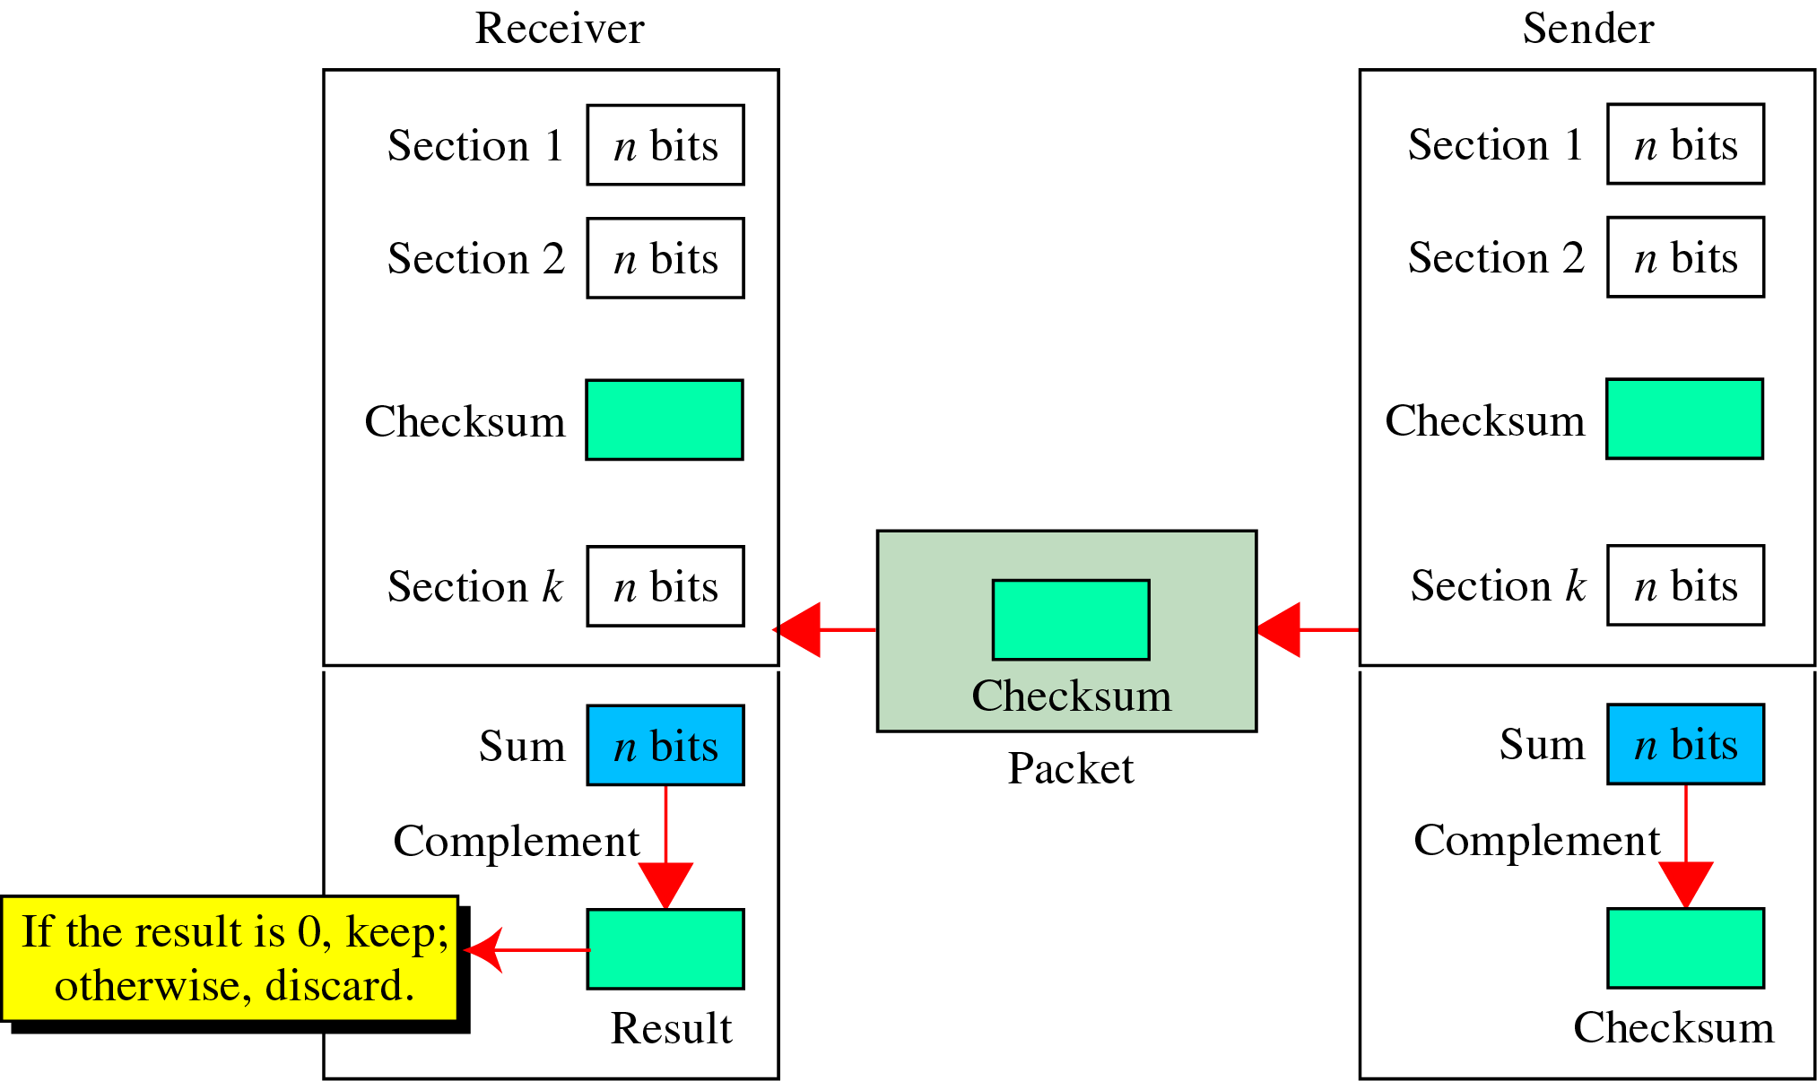
Detection(cont’d)
Checksum Generator

Slide 29
Detection(cont’d)
To create the checksum the sender does the following:
The unit is divided into K sections, each of n bits.
Section 1 and 2 are added together using one’s complement.
Section 3 is added to the result of the previous step.
Section 4 is added to the result of the previous step.
The process repeats until section k is added to the result of the previous step.
The final result is complemented to make the checksum.

Slide 30
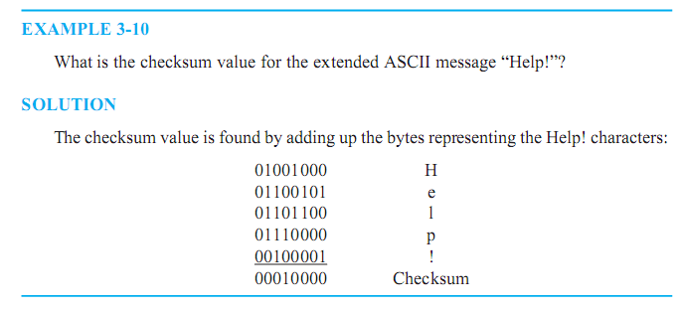

Slide 31
Detection(cont’d)
data unit and checksum

Slide 32
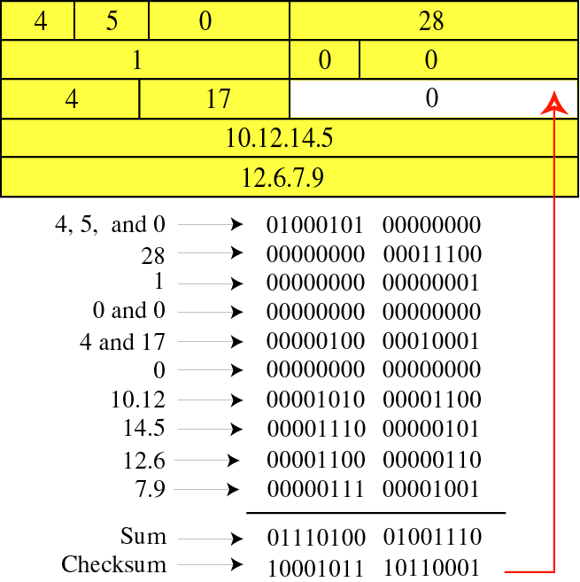
Detection(cont’d)

Slide 33
3. Error Correction
~ can be handled in two ways
✶ when an error is discovered, the receiver can have the sender retransmit the entire data unit.
✴ a receiver can use an error-correcting code, which automatically corrects certain errors.

