Slide 1
Critical Thinking
Nungki Heriyati, S.S., M.A

Slide 2
First Impressions
What is the first thing you notice about the passage?
What is the second thing?
Do the two things you noticed complement each other? Or contradict each other?
What mood does the passage create in you? Why?

Slide 3
Context
Does it depart from conventions? Or does it perfect or expand existing conventions? How and why?
What historical trends, social norms, or political events are behind the actions of or thoughts of the characters?
Are they embedded in the themes?

Slide 4
Point of View
Who speaks in the passage? The narrator, the protagonist, the antagonist, or a new or minor character?
To whom does he or she speak?
Does the narrator have a limited or partial point of view? Or does the narrator appear to be omniscient, and he knows things the characters couldn't possibly know? (For example, omniscient narrators might mention future historical events, events taking place "off stage," the thoughts and feelings of multiple characters, and so on).

Slide 5
Characters
How does the passage make us react or think about any characters or events within the narrative?
Does the passage reveal something new about the motivations of a character?
What is the character’s tone in the text? How is the tone developed? Why do they assume that tone?
Does the selected text mark a departure from a particular character usual attitudes and actions about something?

Slide 6
Vocabulary and Diction
Which words do you notice first? Why?
What is noteworthy about this diction?
How do the important words relate to one another? Do any words seem oddly used to you? Why?
Analyzing the literal and figurative meaning of the characters’ (or author’s) choice of words can help you determine the tone and underlying theme the passage addresses.

Slide 7
Vocabulary and Diction
Look up the definitions of words that stand out to you. Do any words have double meanings? Do they have extra connotations? Look up any unfamiliar words. For a pre-20th century text, look in the Oxford English Dictionary for possible outdated meanings.
If so how does it enrich or expand your understanding of the themes and characters of the work?
What is the effect of the connotative meanings on the tone?

Slide 8
Symbolism
Does the scene grab your attention because of the reappearance or repetition of a specific word, object, or action?
Does it symbolize a character, a theme, or an idea?
How might objects represent something else?
Do any of the objects, colors, animals, or plants appearing in the passage have traditional connotations or meaning?
What about religious or biblical significance?
Why would the author choose to repeat that particular word or object?
Is the symbolism used to build an allegory?

Slide 9
Conflict
What is the point of tension in the passage? Does the conflict in your particular passage relate directly or indirectly to a larger conflict in the text?
Is the conflict internal in which a character struggles with a psychological, philosophical, or moral issues within the psyche? Or is it an external conflict in which a character battles against nature, society, or another character outside the psyche?
How does the conflict reinforce and build themes in the novel as a whole?

Slide 10
Creating your argument
Your thesis must make an arguable statement about the novel. In other words, make sure your thesis does not just summarize or paraphrase your observations about the passage, but instead makes a statement that can be challenged by another person’s analysis.
Use your text as evidence to back up your claim. You will find that a single sentence can have multiple layers that will take you toward the core themes of the work.
Focus on details. This will not only help you narrow the scope of your argument but will also create a thesis that is unique to your reading of the work.
Question everything. After each observation, ask yourself why and how it reveals the larger meaning of the novel. Your observations should lead you to a conclusion about the meaning and value of the novel.

Slide 11
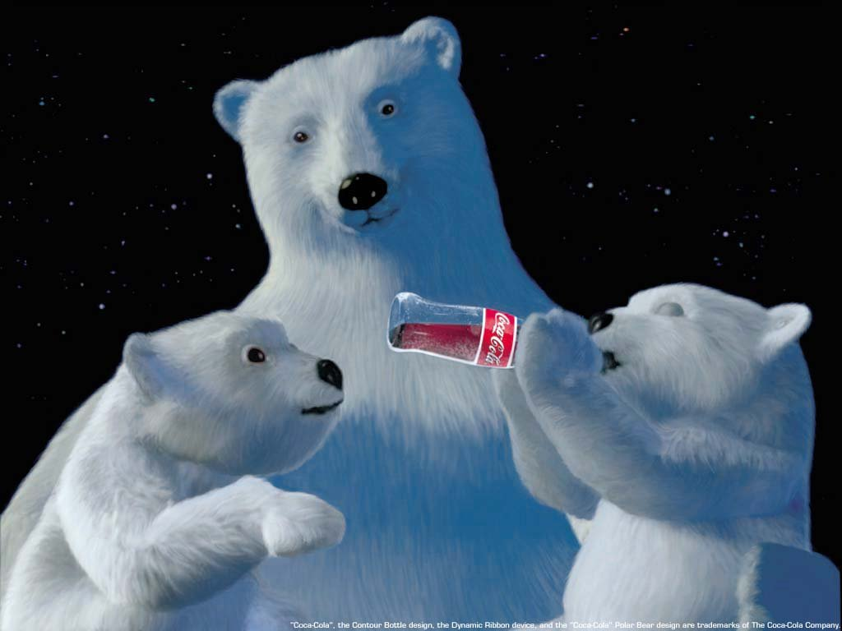
Thank You

